Slide 2
Two photos
Notes:
Here, the facilitator can explain that you will show the players two photos and you want them to tell you what kinds of land uses might be represented on the map.

Slide 3
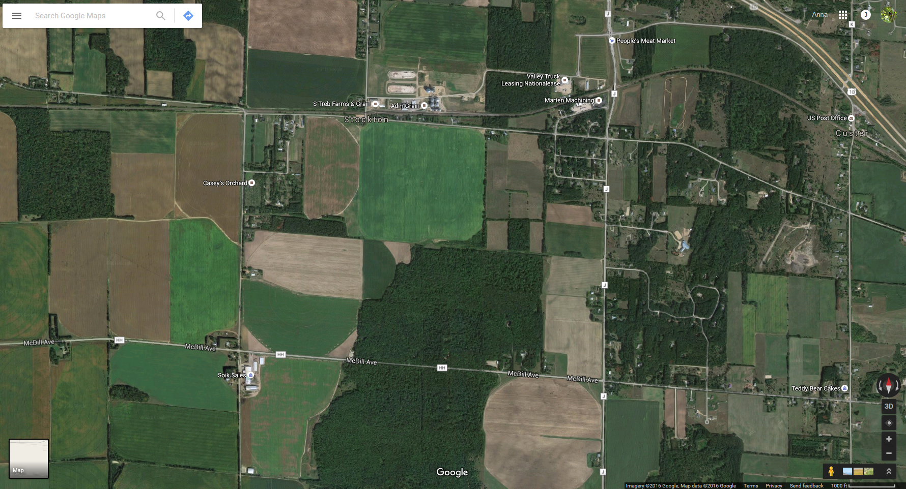
Notes:
We recommend replacing this aerial photo from Google with one from your own region.

Slide 4
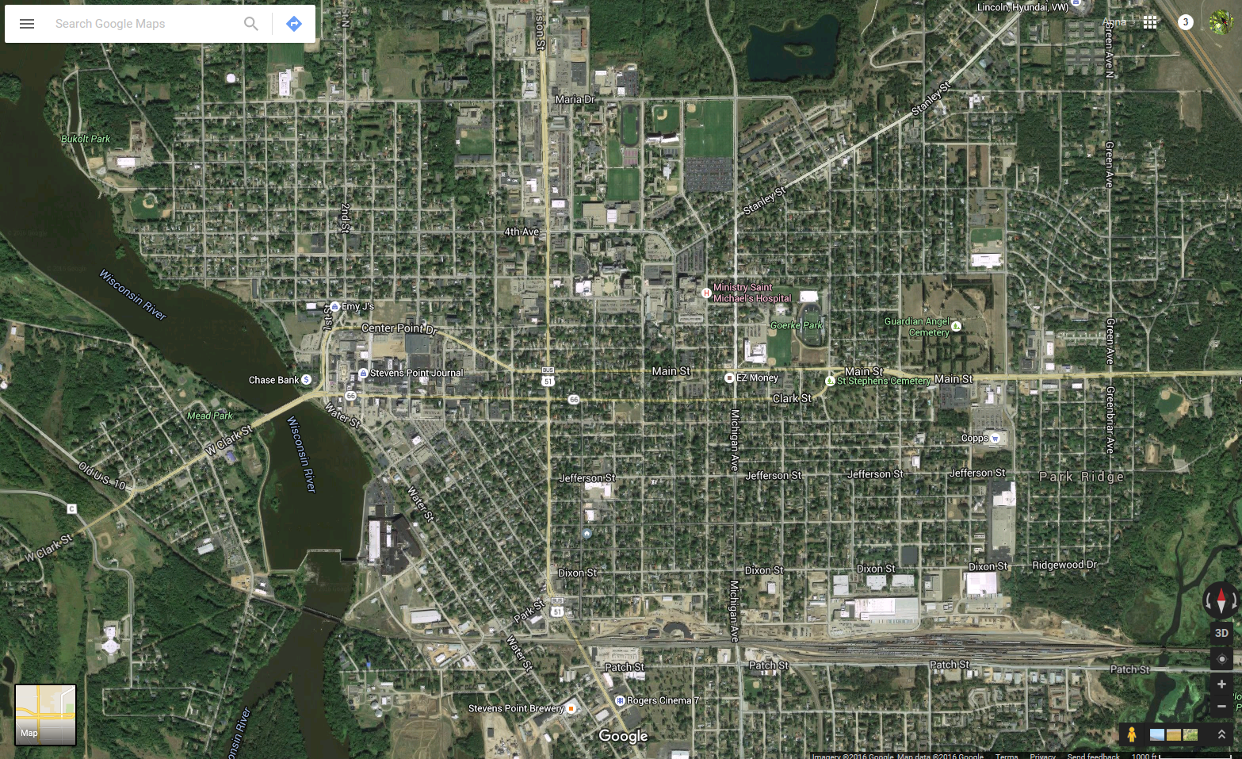
Notes:
We recommend replacing this aerial photo from Google with one from your own region.

Slide 5

Let’s play!
First, some instructions

Slide 6
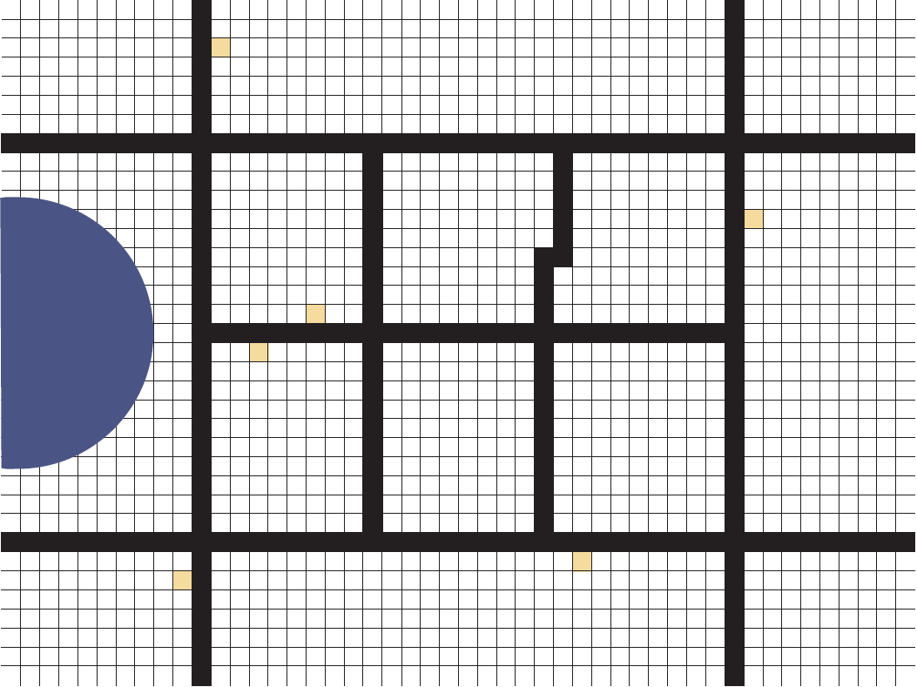
The
Game
Board
Notes:
The facilitator can talk about the game board here and explain that the black roads are equivalent to main roads in an area. As the group lays down cards, other roads are created but we don’t see them. In addition, the yellow and green squares can be built on and represent farm houses or some other rural buildings.

Slide 7


The cards
Packet of Cards
  Many land uses
  Mixed Use
    A development that allows multiple compatible uses to be in close proximity to one another Such as retail space with Residential
  Retail Cards
    Neighborhood business uses such as:
      Gift stores and antique stores
      Restaurants not over 3,000 square feet
      Dry cleaning or laundromats not over 3,000 sq.
      Second-hand or resale stores
      Bars and Taverns
Notes:
Here the facilitator can explain that everyone will receive a packet of cards that they will need to place on the game board. The facilitator can explain the types of cards that they will find in their packets, although not everyone will receive all of the same types of cards. It’s useful to explain the definition of mixed use and that retail cards encompass a broad range of retail uses.

Slide 8

Land Use Game Rules
You must put all your cards on the board
Once placed, you cannot move your cards
You will have one card to designate a land use you think is missing by writing the use on it
Inside the large red roads, you should assume there are smaller roads
Each minute is one decade, I will tell you the passing minutes/decades

Slide 9

Discussion Questions
Take a look at both maps
  Do you notice any differences between the maps? What are a few examples?
  Would you want to live in this community?
    Why or why not?
  Where might there be conflicts?
Notes:
The facilitator can ask these questions in both rounds.

Slide 10
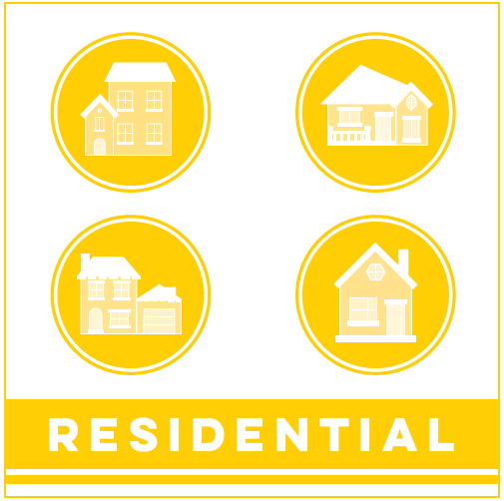
And now for Round 2

Slide 11
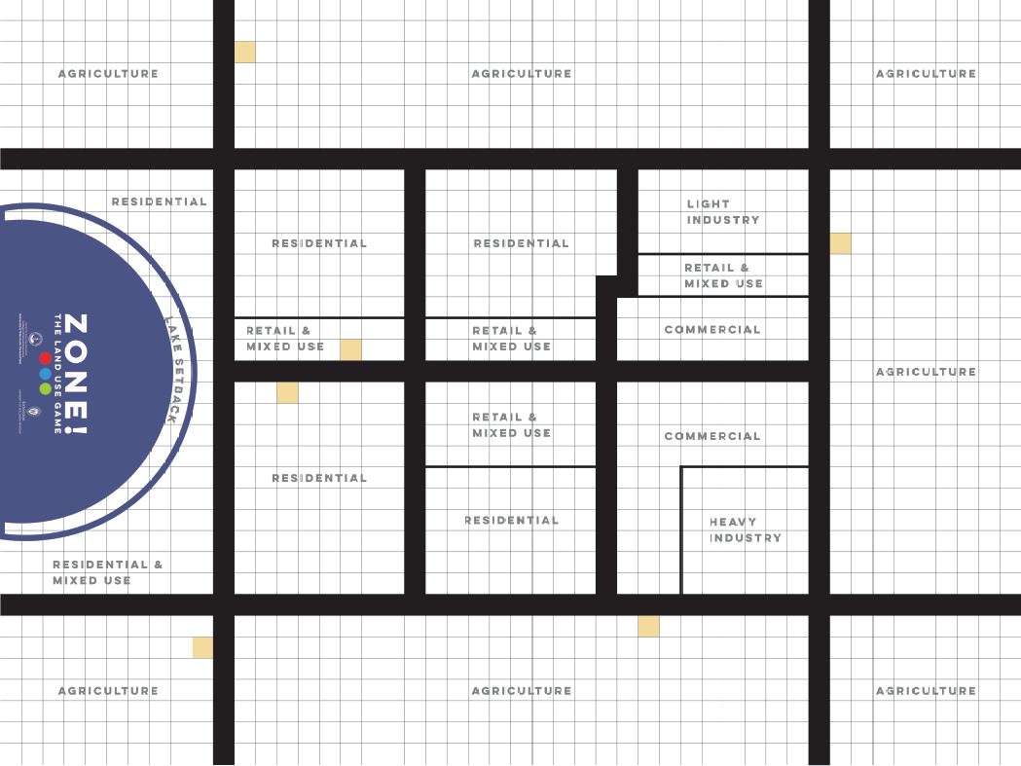

Slide 12

Land Use Game Rules
You must put all your cards on the board
Once placed, you cannot move your cards
You will have one card to designate a land use you think is missing by writing the use on it
Inside the large red roads, you should assume there are smaller roads
Each minute is one decade, I will tell you the passing minutes/decades
You cannot build into the agriculture areas unless you ask me for a growth card
Notes:
The facilitator should remind them of the rules and that there is one additional rule.

Slide 13
Discussion Questions
Take a look at both maps
  Do you notice any differences between the maps? What are a few examples?
  Would you want to live in this community?
    Why or why not?
  Where might there be conflicts?
  Who are the parties that would be in conflict? What would their point of view be?
  Were there any cards you did not want to place on the map? Why?
  What useful function could the card you didn’t want to place serve in a community?
Notes:
The facilitator can ask these questions in both rounds.

Slide 14

Discussion Questions
  Which of these land uses do you think use lots of services (water, sewer, Fire, police, other)?
Which resources do you think various uses require and what are the consequences?

Slide 15

Tools Local governments use to manage change and growth (sometimes decline)
Plans
Zoning
Subdivision
Annexation
Eminent Domain
Tax Incremental Finance
Intergovernmental agreements

Slide 16

What can you do?
Provide your opinion at public hearings
Participate in Public input sessions
Join Plan Commission
Ask to join the Zoning Board
Run for Elected Office

Slide 17

Final Thoughts?
Thank you!
Contact information
Notes:
The facilitator can add in their contact information

