Slide 1
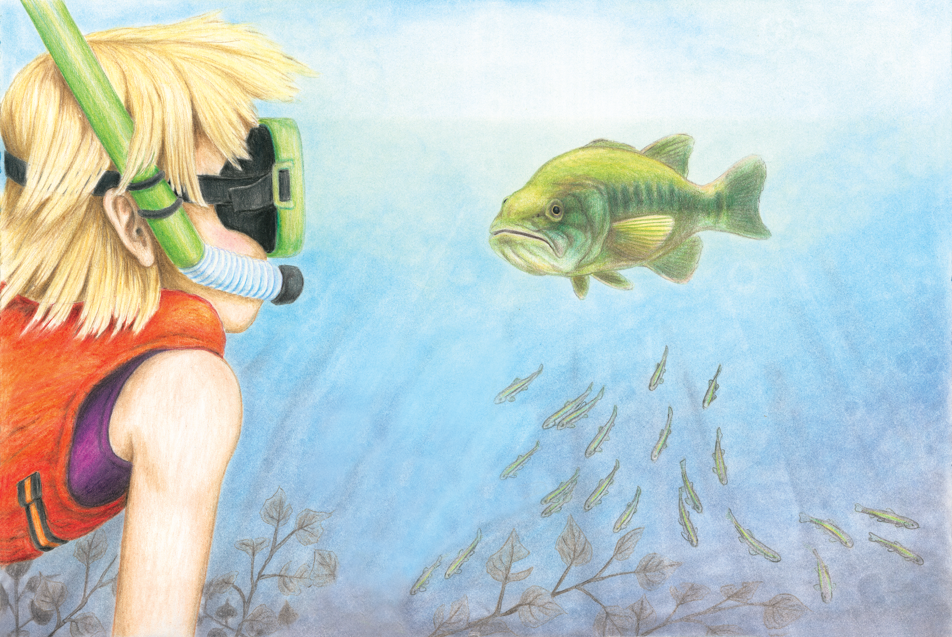

Shorelines
Activity to go with Fish Hotel

Slide 2
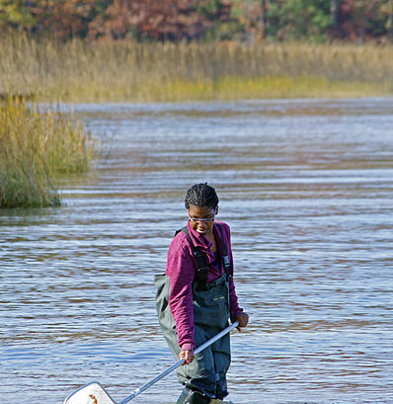
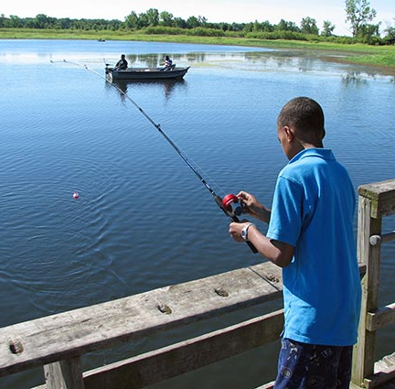
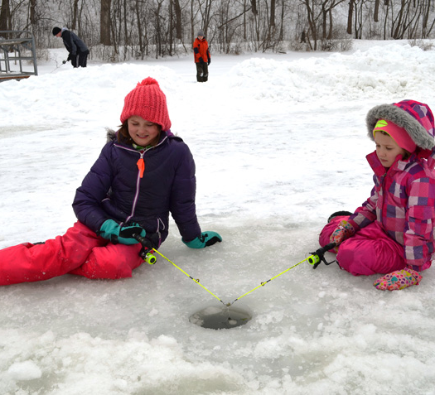
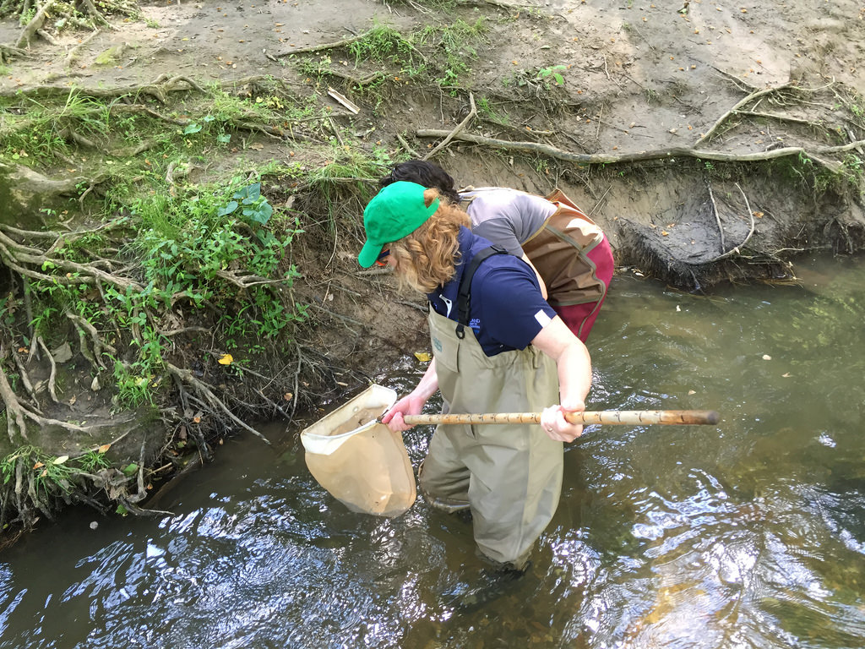
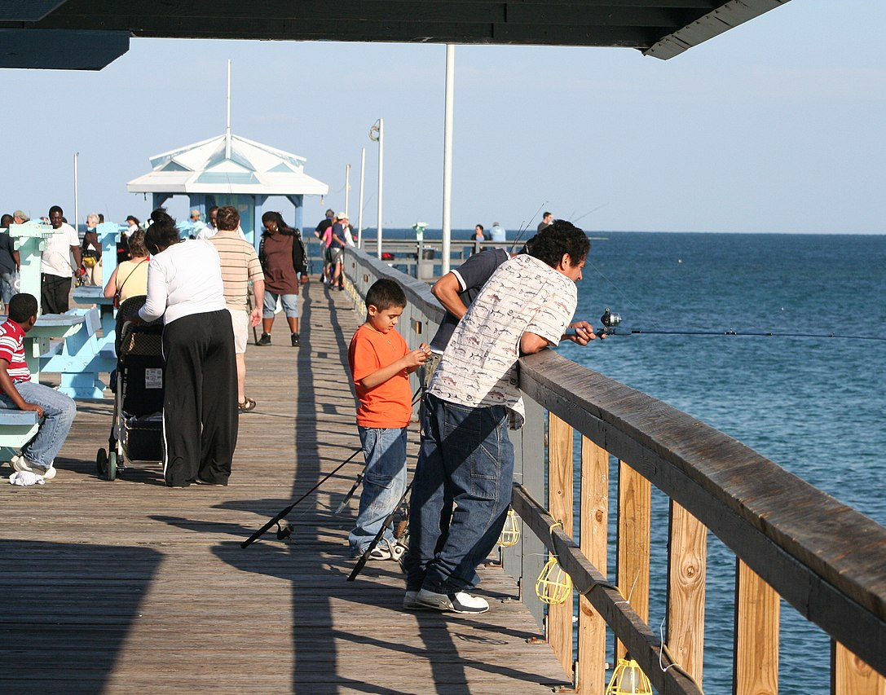
Looking for fish
Notes:
You can see fish many ways. Walking into shallow water, looking off a pier, or using a net. When you walk into the water you often scare the fish away. If you stand still for a minute or two they usually come back.

Slide 3

How big do you think a fish is when it hatches from its egg?
Notes:
How big do you think fish in Wisconsin are when they hatch from their egg?
The answer is less than an inch long, even for muskies and walleye that get very large as adults. Most fish are about the size of a green pea when they hatch.
If you’re a fish that just hatched from its egg, what do you need to survive until tomorrow when you’re in a lake with big fish?
This leads to shelter – a place to hide from the big fish. Fallen trees are an important part of shelter for fish, so are water plants. It’s like hide-and-seek; little fish need good places to hide.
What do fish need?
Food: plants, water insects, smaller fish
Water: provides oxygen. Cold water has more oxygen than warm water. Fish need clear water so that they can see their prey, or so they can see the predator coming after them. Fish need water free of pollutants like gasoline, oil, manure, fertilizers, pesticides, etc.
Shelter: fallen trees, water plants like lily pads (often called ‘seaweed’, but actually seaweed lives in the sea). Rocks and crevices between rocks and gravel are also shelter. Some small fish also dive into the sand or muck on the lake bottom for protection when predators come after them.

Slide 4
Do you think fish will survive along these shorelines?
Why or why not?

Slide 5
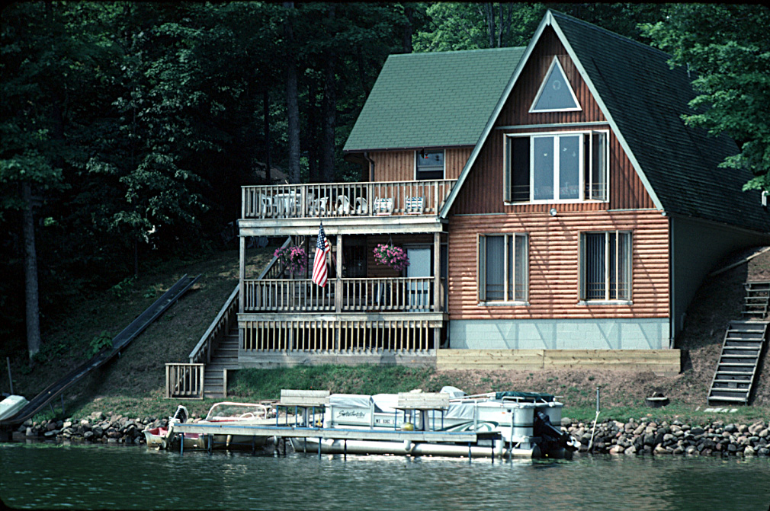
When houses are built close to the water trees are removed, leading to fewer fish hotels
Could you survive as a fish here?
Notes:
When houses are built close to the water trees are removed, leading to fewer fish hotels. Soil/sediment getting washed into the water cover fish spawning beds resulting in some fish eggs never hatching. No deep-rooted trees/shrubs/native plants along the shoreline to hold soil in place and slow down runoff.

Slide 6
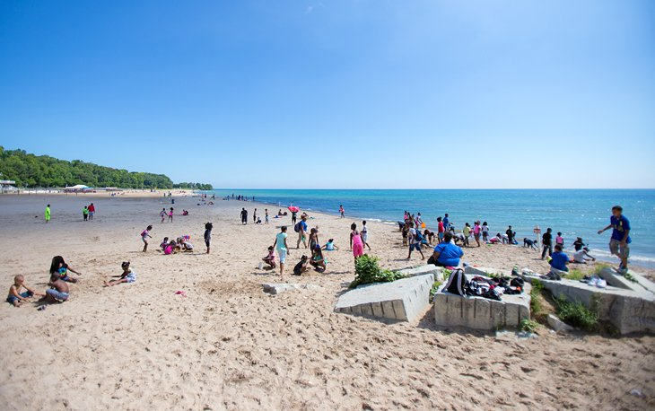
Could you survive as a fish here?
Notes:
No trees or fish hotels along the beach.
Summer at Bradford Beach, Milwaukee. https://www.planetware.com/wisconsin/best-beaches-in-wisconsin-us-wi-90.htm

Slide 7
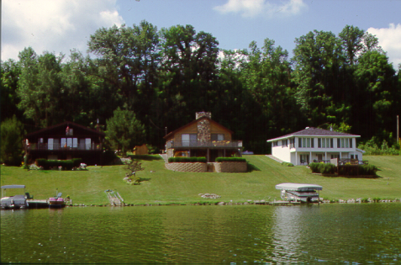
75 foot wide lots
Could you survive as a fish here?
Notes:
Small lot sizes result in houses close together and often tree removal. No trees near the water or fish hotels. Limited wildlife habitat along shoreline. Habitat gone for frogs, kingfishers, loons and other shoreline animals. Grass attracts Canada geese and deer.
Lake Redstone, Sauk County. Approximately 75 foot lots. State standards are 65’ wide for sewered lots and 100’ for unsewered lots.
Photo from Carmen Wagner

Slide 8
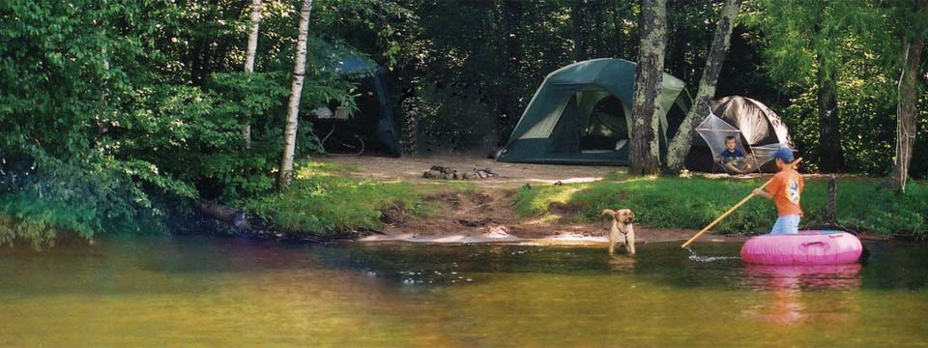
Could you survive as a fish here?
Notes:
Some trees and shrubs along the shoreline to shade water and become future fish hotels. Soil eroding where trees are removed.
Lake Chippewa Campground https://www.lakechip.com/campsites.htm

Slide 9
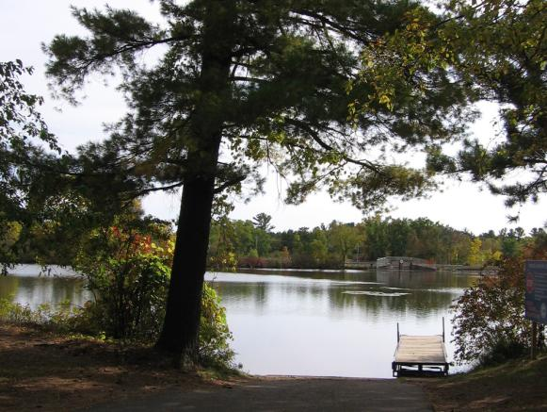
Could you survive as a fish here?
Notes:
Some trees and shrubs along the shoreline to shade water and become future fish hotels. Soil eroding where trees are removed.
Jordan County Park https://www.stevenspointarea.com/listing/jordan-county-park/1012/

Slide 10
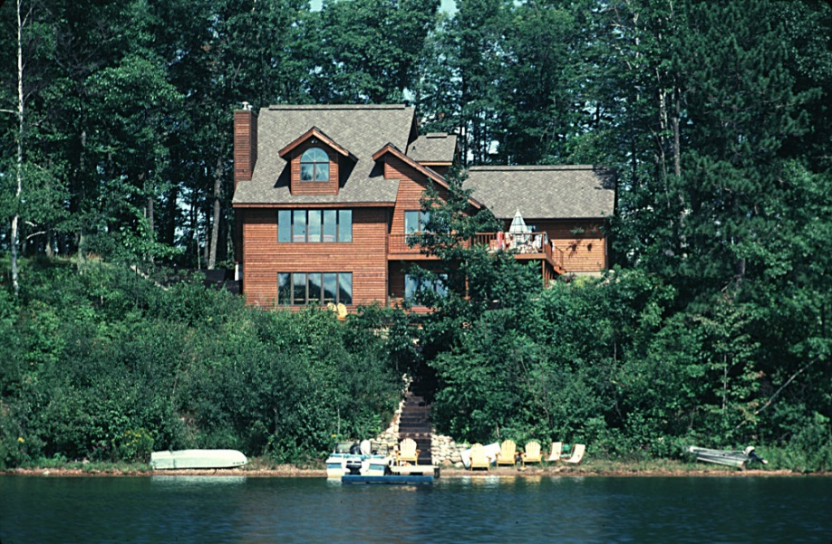
Could you survive as a fish here?
Notes:
Many trees and shrubs with deep roots that hold soil in place and allow water and nutrients to soak in so they don’t cause algae blooms or low oxygen. Trees and shrubs also provide some shade for the ground and the water, keeping the water cooler. Trees and shrubs will eventually die and some will fall into the lake becoming fish hotels.

Slide 11
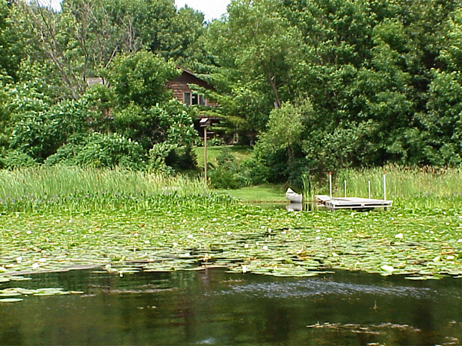
Notes:
It’s a great sign for fish when plants on land and in the water make it difficult to tell where the land ends and the water begins, as shown in this photo. Trees on land shade the water and will become future fish hotels. Water plants like lily pads shade the water, like walking through a cool woods in the summer. The lily pads and other aquatic plants also provide food for fish, and food for the aquatic insects that fish eat.

Slide 12
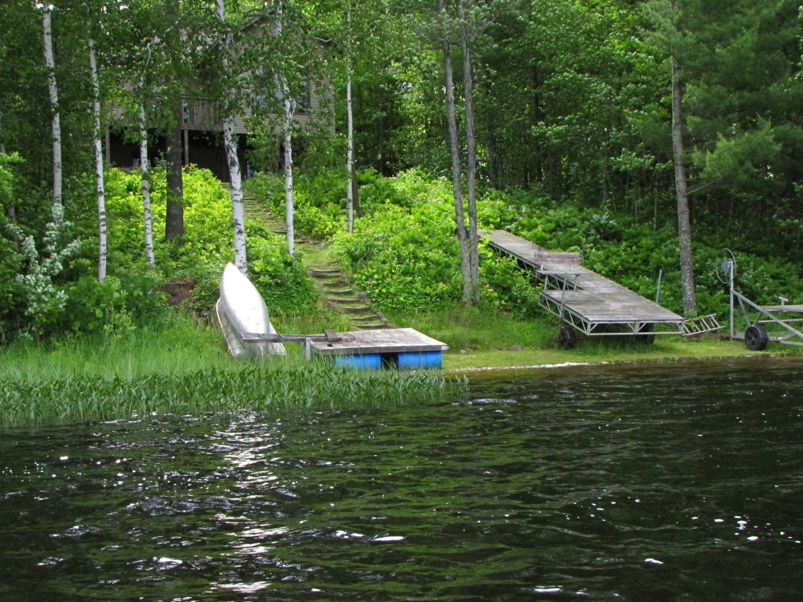
Notes:
The house is set back from the shoreline with many trees and shrubs along the shoreline, and in the water. All of these things are good for fish. Some fish eat water plants. Most small fish eat insects that live on the water plants.

Slide 13
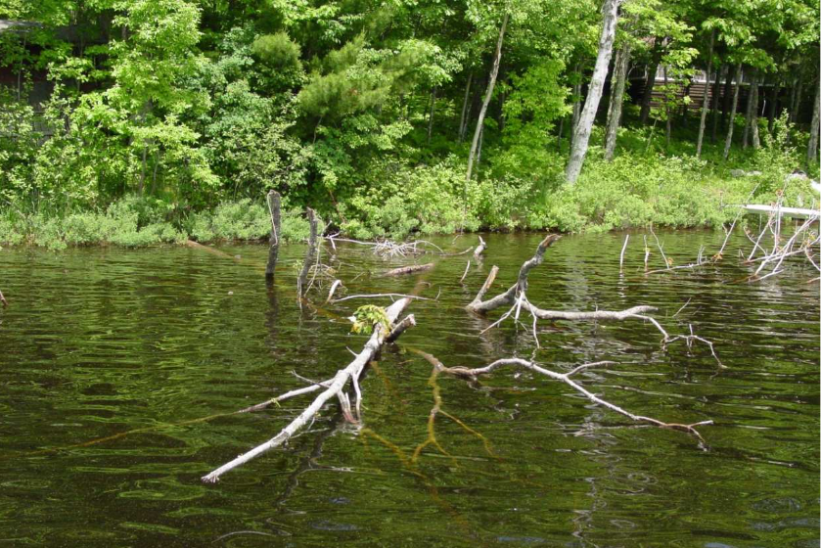
Park shoreline
Notes:
Wooded shoreline and fish hotel!

Slide 14
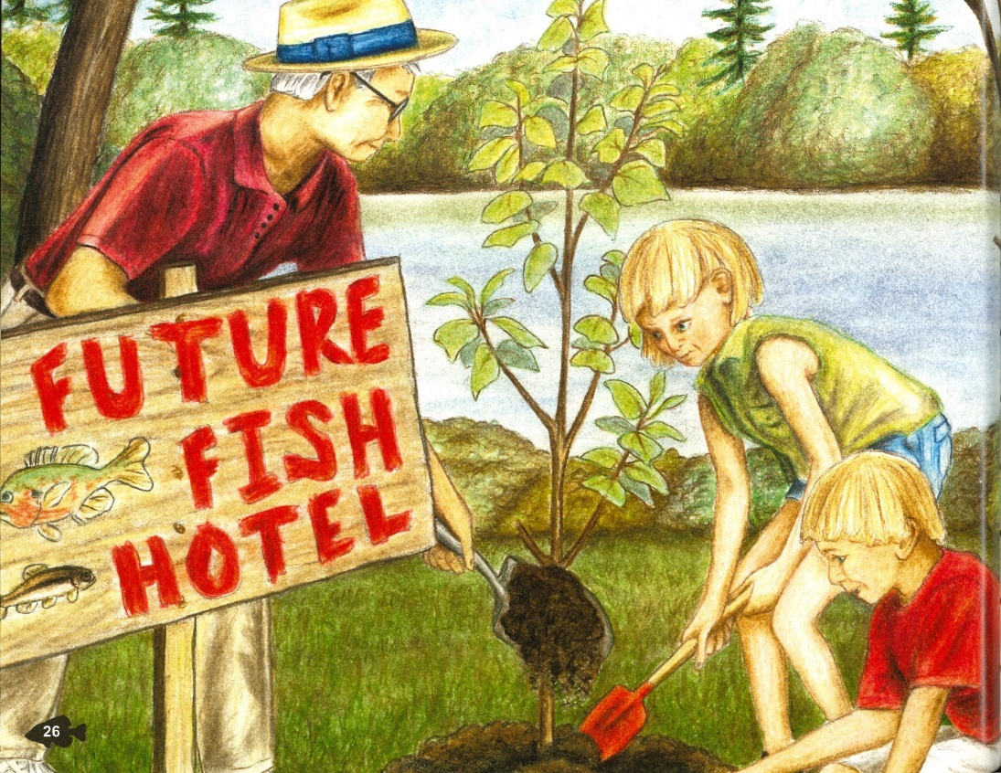
Ways to help fish
Leave trees, branches and water plants in the water.
If a fallen tree is in the way, move it over.
Leave trees along the shoreline. If there aren’t many trees, plant some.
Enjoy the fish and other animals! Tell your friends about them.

Slide 15
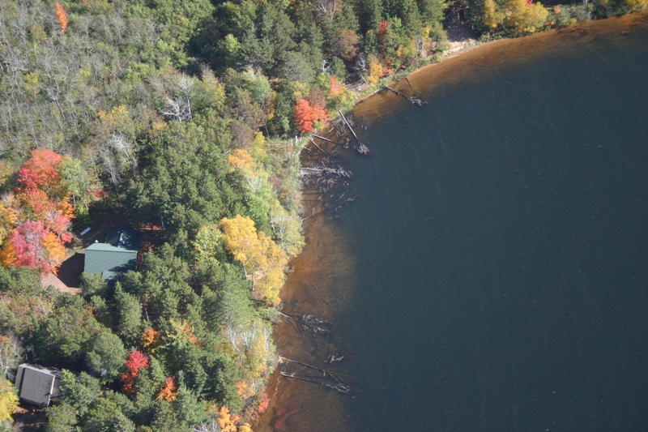
Study results from northern Wisconsin
Where houses have been built along lakes, people have removed almost 9 out of 10 trees from the water
We have many trees to replace in the water by planting trees along shorelines and letting fallen trees be
Notes:
Background: This study found we have lost many fish hotels in northern Wisconsin. Looking at shorelines in southern Wisconsin, the same seems to be true.
The softcover publication Fish Hotels, which is part of the Fish Hotel Kit, includes this information and other facts about fish hotels.
Christensen, D.L., B.R. Herwig, D.E. Schindler, and S.R. Carpenter. 1996. Impacts of lakeshore residential development on coarse woody debris in north temperate lakes. Ecological Applications 6: 1143-1149.

