Slide 1
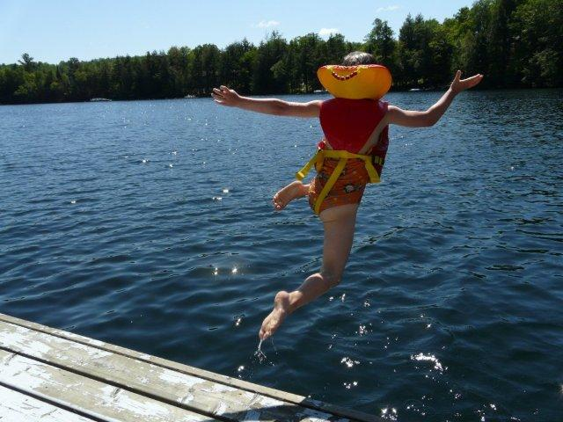
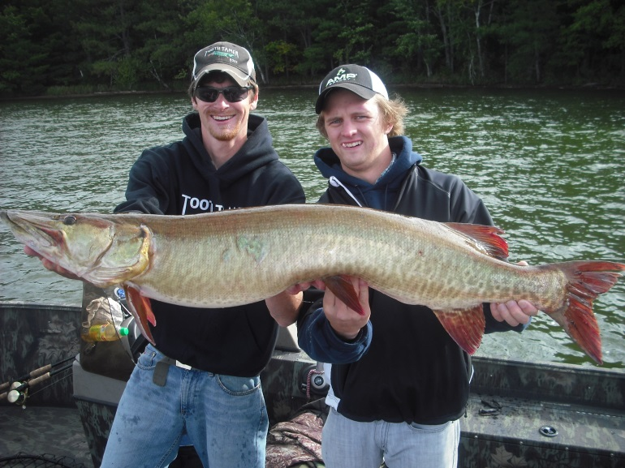
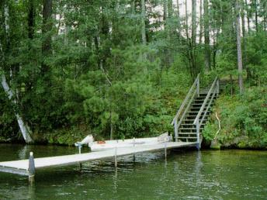
We have shoreland zoning rules in WI to…
Protect lakes and streams
Prevent and control water pollution
Protect spawning grounds, fish and aquatic life
Reserve shore cover and natural beauty
Notes:
Variance transfers with property
Because a property rather than its owner may qualify for a variance (unique property limitations test), a variance transfers with the property to subsequent owners.[i]
[i] Goldberg v. City of Milwaukee Bd. of Zoning App., 115 Wis. 2d 517, 523-24, 340 N.W. 2d 458 (Ct. App. 1983)
-------------------------------------------------------------------------------------------------------
Nonconformity: To be nonconforming a structure must be legally constructed and predate the standard with which it does not comply. Nonconforming structure provisions should not be applied to structures granted variances (e.g. 50% rule and variations).
Transfer: A variance transfers with a property to subsequent owners because, under the unique property limitations test, a property rather than its owner may qualify for a variance.

Slide 2
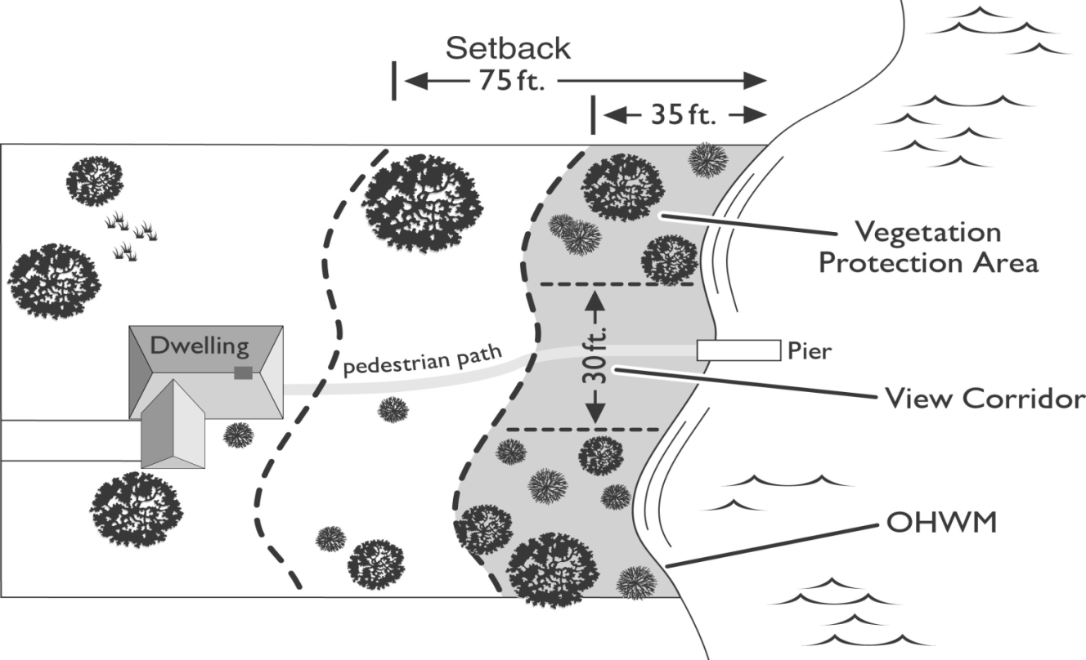
Shoreland rules to protect water & fish
Minimum lot sizes so houses aren’t packed along shorelines
Set buildings back from the water to give runoff a chance to soak in rather than run into lake
Vegetation protection area to hold soil in place and filter some pollutants from runoff
Limit impervious surfaces
Notes:
To get counties with no standards higher than state standards, I combined maps.
For counties that had no standards stricter than the state minimums, I counted 17 counties=24%. The counties were:
Polk
Dunn
Pepin
Buffalo
Taylor
Clark
Wood
Adams
Green Lake
Columbia
Fond du Lac
Washington
Green
Vernon
Crawford
Richland
Grant

Slide 3
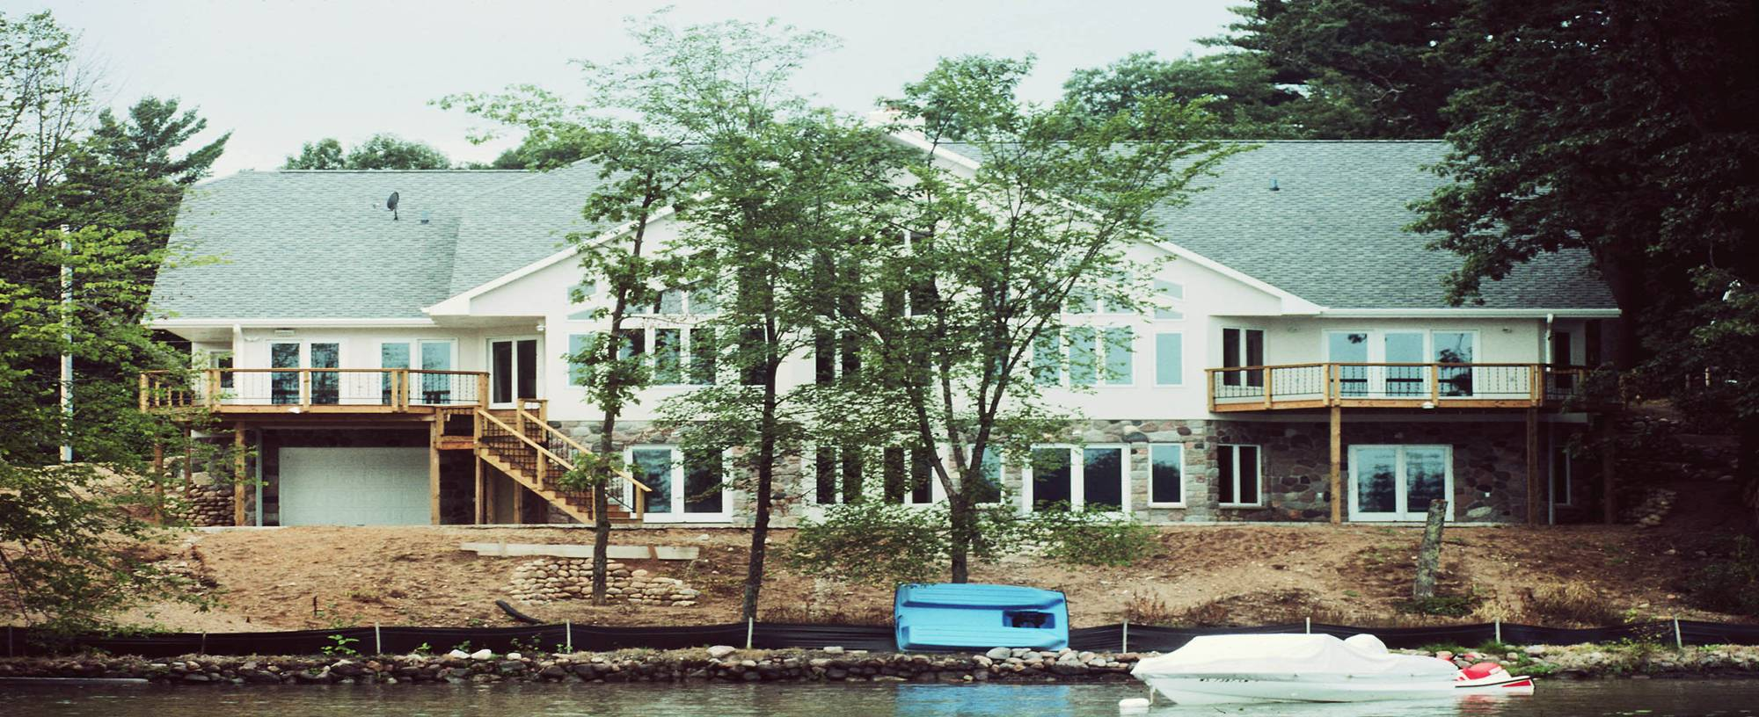
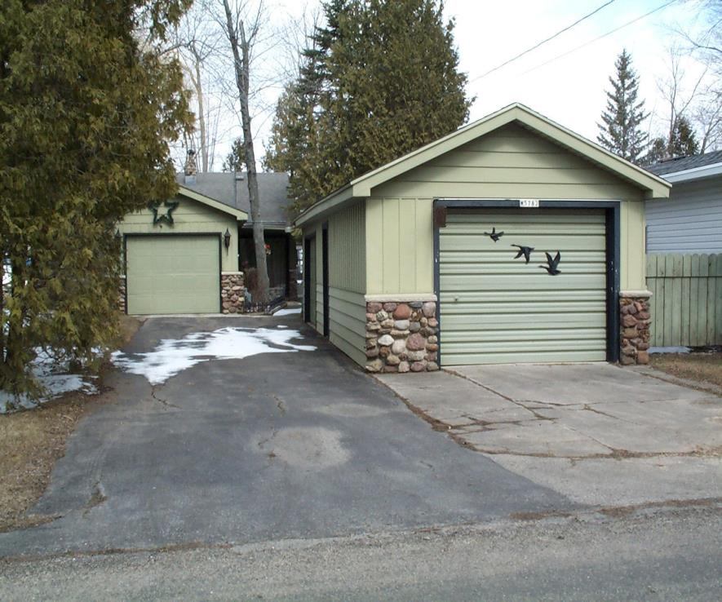
Impervious surfaces
Notes:
Impervious surfaces are hard, manmade surfaces such as rooftops, driveways, roads, parking areas and patios.
With hard surfaces, rain and melting snow can no longer soak into the ground, which increases the amount water that runs off the land carrying pollutants to lakes and streams. Impervious surfaces also decrease the amount of rain and snow that becomes groundwater, which reduces the cool water entering lakes and streams during dry periods.

Slide 4
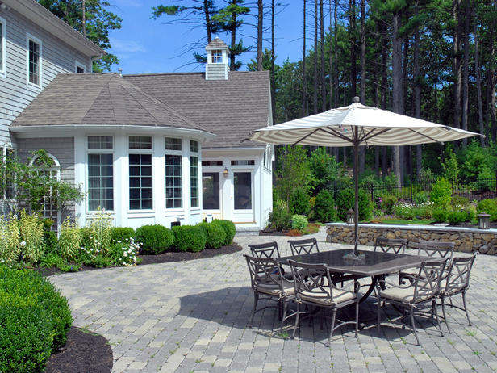
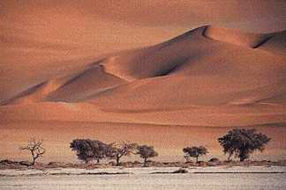
Impervious surfaces can be thought of as biological deserts
With no plants, animals cannot find food or shelter, making them easy prey, and making them more likely to die

Slide 5
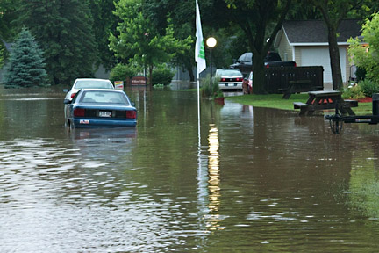
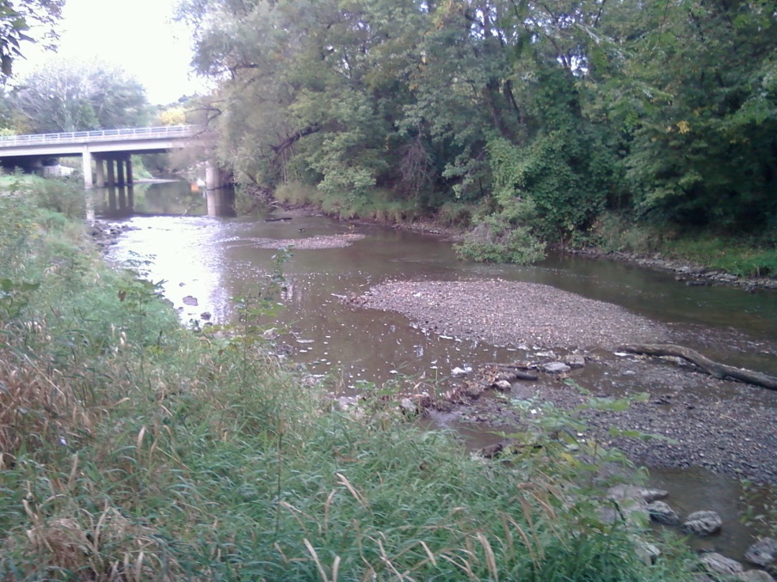
More impervious surface causes
Larger and more frequent floods
More Impervious Surface = Less Fish
Less groundwater leads to lower stream flows & warmer water temperatures during dry periods
Notes:
Now let’s talk about why more impervious surface results in fewer fish.
Impervious surfaces cause rain and snow to run off rather than soak into the ground and become our groundwater. Greater runoff from impervious surfaces lead to larger and more frequent floods during wet periods. The flip side is because the water runs off during storms, it doesn’t soak into the ground. This leads to lower stream flows and warmer water temperatures during dry periods, which is hard on fish.
Notes: Left photo from Boscobel, WI, June 2013.. Right photo from Root River, WI

Slide 6
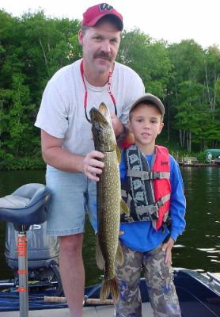
More Impervious Surface = Less Fish
More runoff from hot pavement and shingles makes the water hotter
More nutrients from soil and fertilizers result in less oxygen in the water, which fish need to survive
Trout are gone above 11% impervious
Northern pike are gone above 12% impervious
Notes:
As you know, a paved parking lot can get pretty hot on a summer day. When water runs off hot pavement or shingles it makes the water in lakes and streams hotter for the fish
Runoff from impervious surfaces carries more nutrients from soil and fertilizers into our waters. This results in less oxygen in the water, which fish need to survive.

Slide 7
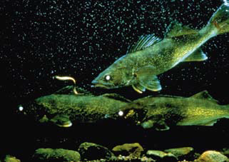
More Impervious Surface = Less Fish
More sediments and algae growth make it difficult for some predator species that hunt by sight to find their food
More sediments cover spawning beds of fish such as walleye and smallmouth bass, depriving eggs of oxygen
Notes:
Note: Smallmouth bass are centrarchids and do maintain their nests, so are less affected by sedimentation.

Slide 8
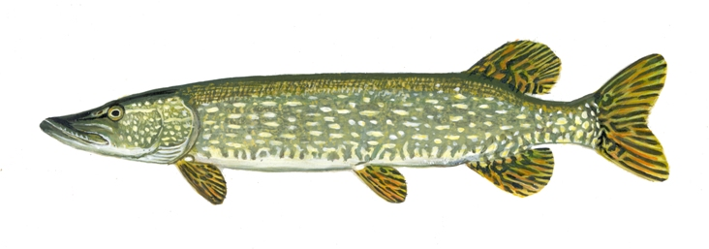
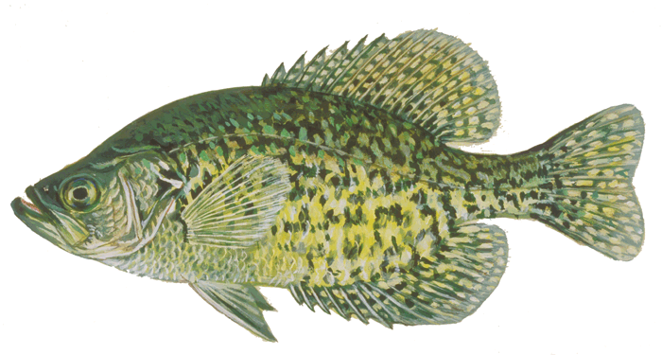
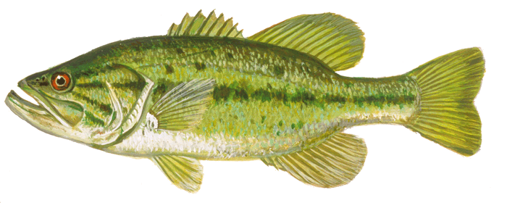
20,000 square foot waterfront lot
about a half-acre
Hand out fish cards

Slide 9
20,000 square foot waterfront lot
about a half-acre

Slide 10
7% of 20,000 sq. ft. lot impervious
1000 sq. ft. house footprint
400 sq. ft. driveway
1400 sq. ft. total
All fish survived with this level of waterfront development.
We can have waterfront development and healthy fisheries, but with half-acre lots it requires a small footprint.
One-acre lots could have 2X as much impervious surface without eliminating fish.

Slide 11
10% of 20,000 sq. ft. lot impervious
1200 sq. ft. house footprint
800 sq. ft. driveway
2000 sq. ft. total
Gone
Iowa darter
Black crappie
Channel catfish
Yellow perch
Rock Bass
Hornyhead chub
Sand shiner
Southern redbelly dace
Brook trout

Slide 12
15% of 20,000 sq. ft. lot impervious
1500 sq. ft. house footprint
740 sq. ft. garage
660 sq. ft. driveway
100 sq. ft. sidewalk
3000 sq. ft. total
More species gone
Golden shiner
Northern pike
Largemouth bass
Bluntnose minnow
Johnny darter
Common shiner

Slide 13
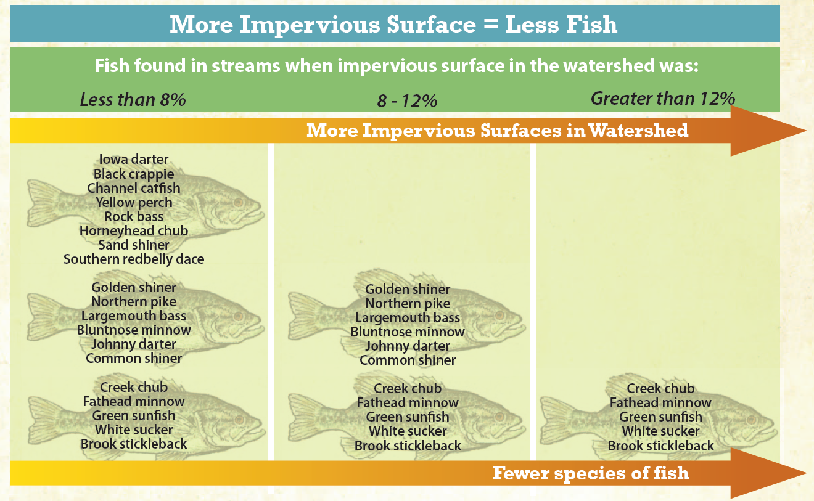
Current shoreland rules allow:
15% impervious on residential lots
40% on commercial & industrial lots
Insufficient to keep most fish species
2008 study of 164 WI lakes found the same trend
2008 study of 164 WI lakes found the same trend
Wang et al., JAWRA, 36:5, 1173-1189, 2000
Notes:
On this slide, you see the results of a study of 47 warm water streams in Wisconsin.
When the watershed, the area that drains to the stream was less than 8% impervious, the researchers found a large number of fish and fish species. More impervious surfaces resulted in less fish. The same trend was found in a study of 164 WI lakes. When impervious surfaces were over 12%, crappies, perch northern pike and largemouth bass were eliminated. Current impervious surface standards allow impervious surfaces up to 15% on all lots and as high as 60% on some lots.
Let’s talk for a minute about northern pike. Why do they disappear when impervious surfaces are above 12%? There’s an old fishmen’s myth that northern pike lose their teeth in August, because they won’t bite on anything. So they sent the fish biologists to check that one out, and it’s a myth. They do still have their teeth in August. What we’ve learned is Northern pike hunt by sight, so when more impervious surfaces wash more soil into lakes and streams the water gets cloudy and it’s hard for the pike to see the fish they eat. We’ve also learned Northern pike are very tolerant of cold water and even low oxygen, but not heat. In the summer of 2012, hundreds of northern pike died in central and southern Wisconsin due to water temperatures at the surfaces of some lakes that reached 90 degrees.
From Wang, Lyons et al., JAWRA, 36:5, 1173-1189, 2000
From warmwater streams
In a study of 164 Wisconsin lakes, researchers found that both the number of fish species and the number of small-bodied intolerant fishes was lower in when there were higher levels of impervious surfaces within 330 ft of the water or within the entire watershed of the lake, when adjusted for lake type and location in the watershed. Intolerant fish are species that are sensitive to diminished water quality, sedimentation, and other forms of habitat degradation. Garrison, Paul et al. Implementation and interpretation of lakes assessment data for the Upper Midwest. Final report to the U.S. EPA. Grant No. X7-83254601. November 2008. pp.47-48

Slide 14
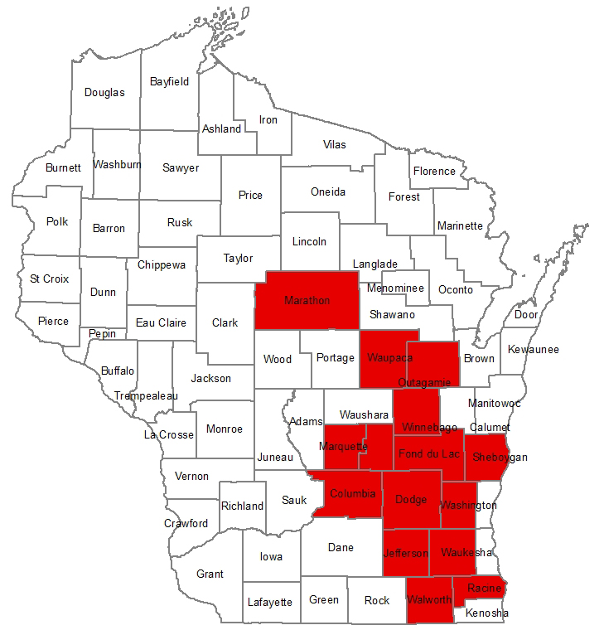
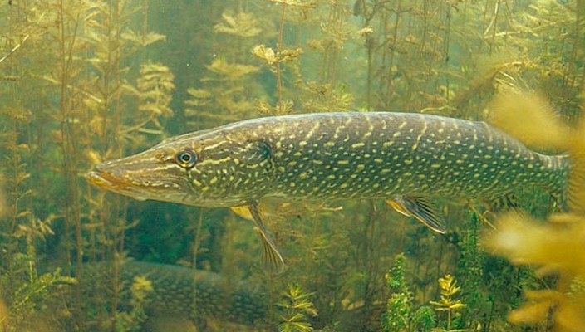
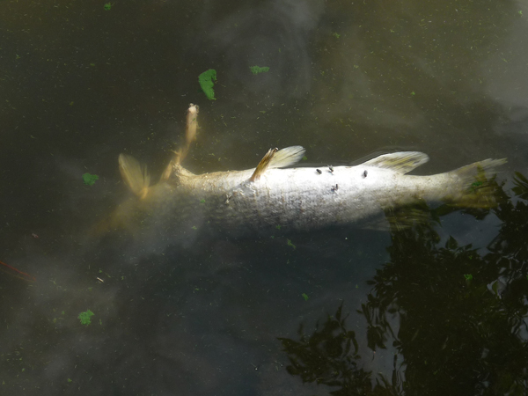
Northern pike
DNR needs to fix this!
Northern pike and walleye are coolwater fish
Runoff from impervious surfaces heats up lakes and rivers
Coolwater fish cannot survive high temperature waters
Can the DNR fix it? What makes the water hot?
Northern Pike Kills July 2012
due to high water temperatures
Pike spawning video, 1st minute youtube.com/watch?v=0kVgYpESQ_w&t=93s
Notes:
Northern pike and walleye are coolwater species. Lyons, 2009 at https://onlinelibrary.wiley.com/doi/pdf/10.1577/M08-118.1
I created the speech bubbles next to the dead pike photo because many people did call the DNR about these fish kills. DNR staff went out and collected water samples and analyzed for many contaminants. They found that the only contaminant was heat. The surface temperature on some of these lakes was 90 degrees – too hot for northern pike to survive.
2012 map shows 15 counties with northern pike kills based on this fish kill list http://dnr.wi.gov/topic/fishing/documents/2012FishKillSummaries.pdf
Dead northern photo from July 9, 2012 article “Dead northerns line shores” in MN https://www.albertleatribune.com/2012/07/dead-northerns-line-shores/

Slide 15
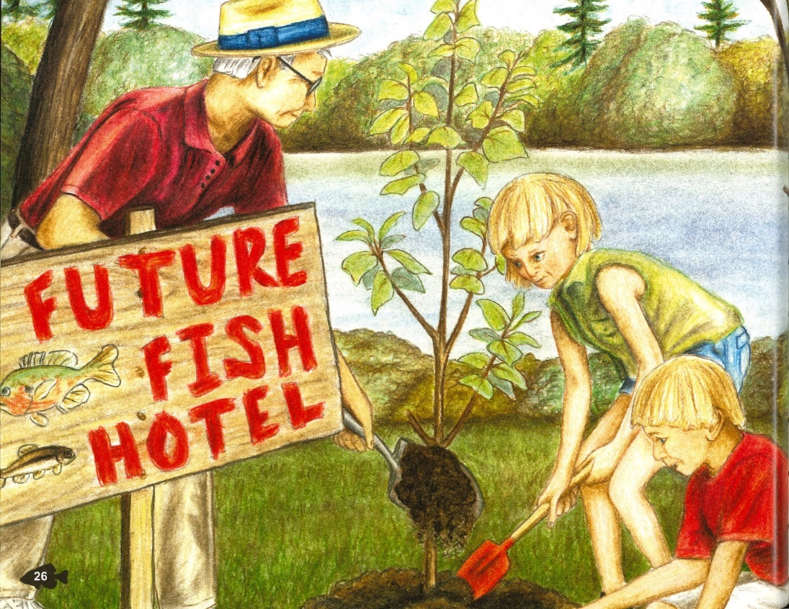
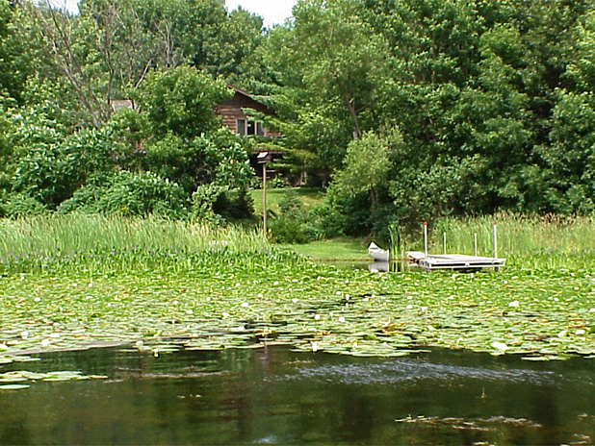
Ways to help fish
Follow shoreland zoning rules
Set buildings and pavement WAY back from shoreline
Minimize impervious surfaces
Leave trees, branches and water plants in the lake
Leave or plant trees and deep rooted plants on waterfront lots
Keep fertilizers & pesticides away from shorelines
Less impervious surface

