Slide 1
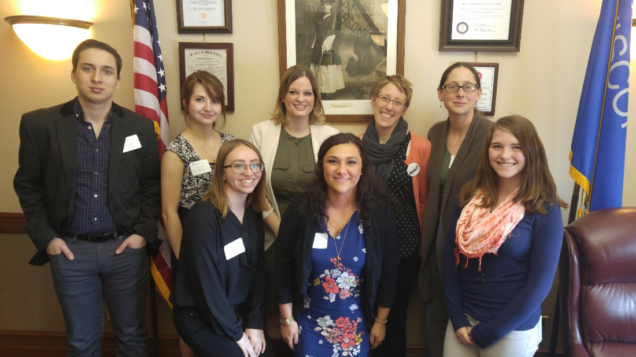
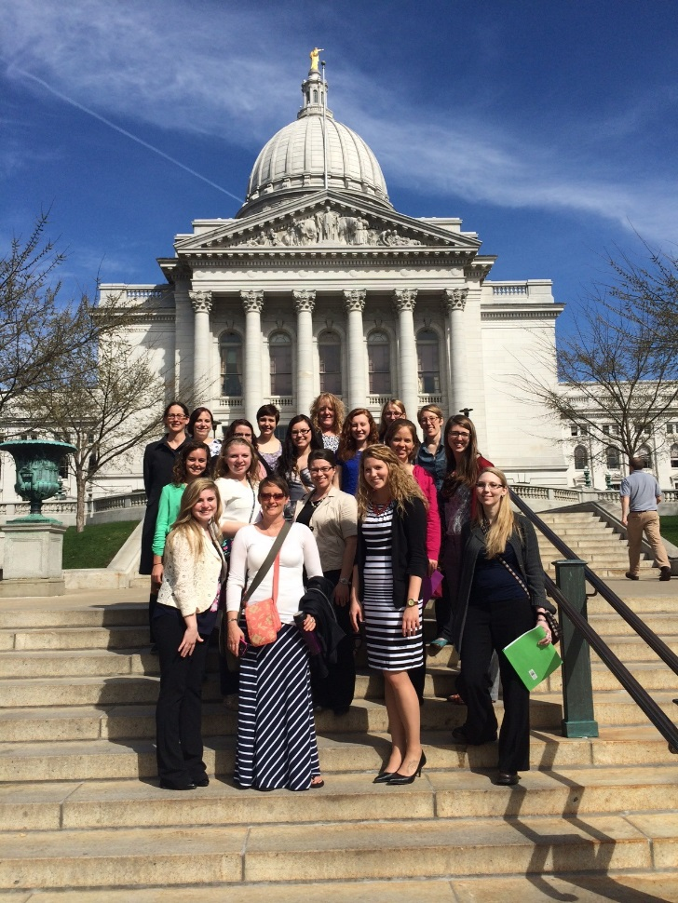

Social Work Program
Department of Sociology and Social Work
University of Wisconsin—Stevens Point (UWSP)
Narrated by: Amy Zlimen Ticho, UWSP Social Work Program Director
Photos: Students and faculty participating in the National Association of Social Workers (NASW) WI Social Work Advocacy Day at the state capitol.
Notes:
Hello. My name is Amy Zlimen Ticho and I am the director of the social work program at the University of Wisconsin—Stevens Point. The purpose of this presentation is to give you an overview of the Social Work Program at UWSP. The aim is to provide you with basic, useful information about the structure, history, faculty, mission, curriculum, and admission process for the social work program. This presentation is intended for current or prospective students, their parents, field supervisors for our internship program, advisors and guidance counselors, other faculty, and any others who have an interest in our program. We hope that you enjoy learning about our program, and we encourage you to contact us if, after completion of the presentation, you have questions.

Slide 2

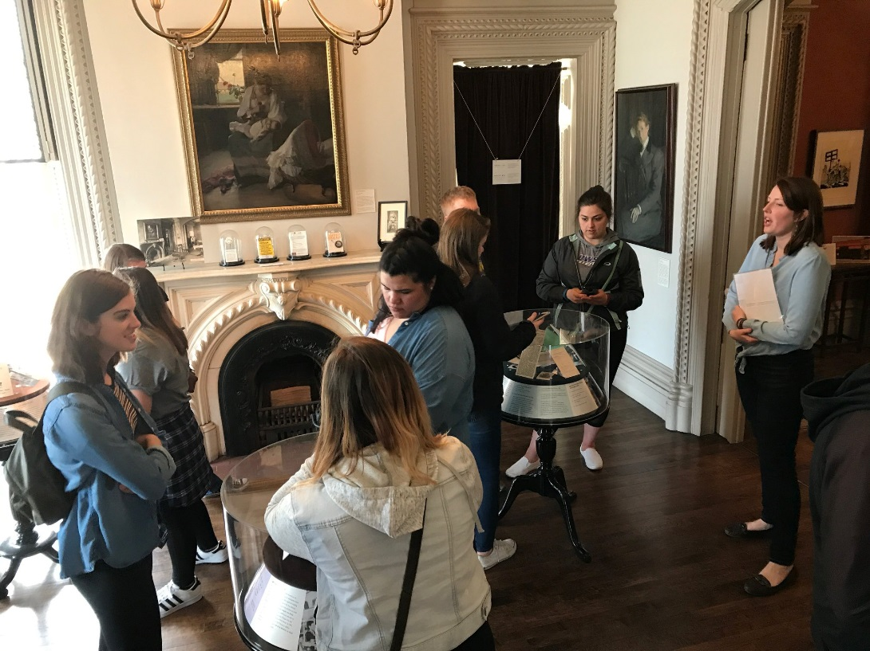
Structure of UWSP
Social Work Program
Department of Sociology and Social Work
Photo: Students and faculty touring Hull House in Chicago.
Notes:
First, let’s briefly discuss the structure of the Social Work Program at UWSP.
The Social Work Program is housed in the Department of Sociology and Social Work. Our Department offers two majors, one in social work and the other in sociology, as well as minors in sociology, criminal justice, and social science in health. Most social work students complete a second major in sociology since the two majors are interconnected. Though not required, many also complement their major in social work with one of our department minors or in other relevant areas such as psychology, child/youth/family studies, religious studies, political science, women/gender studies, or Spanish.
The Department of Sociology and Social Work is part of the College of Letters and Science, the largest of the 5 colleges at UWSP, offering numerous majors, minors, certifications, emphases, and graduate degrees within 13 departments.

Slide 3

History of Social Work at UWSP
Prior to 1992—Department of Sociology offered a 12-credit emphasis in social work for sociology majors
1992—Department of Sociology began offering a 31-credit minor in Native American and Rural Social Work
2009—Department of Sociology began working with the Council on Social Work Education (CSWE) towards accreditation of its newly developed Social Work Major
2010—Department of Sociology became the Department of Sociology and Social Work and the Social Work Major was first offered
June 2014—The Social Work Program was granted initial accreditation by CSWE
Notes:
Next, I will share a brief history of social work at UWSP. Social work at UWSP has really come a long way!
For some time prior to 1992, the Department of Sociology offered a 12 credit emphasis in social work for sociology majors.
Due to student interest in careers in social work, the Department of Sociology added a 31-credit minor in Native American and Rural Social Work in 1992.
With Council on Social Work Education (CSWE) accredited programs becoming the standard and with the emergence of social work certification and licensure in 1994, it became clear the Department of Sociology needed to further develop and structure its social work program to best serve students. As such, the UW System was approached, and authorized approval for the implementation of a social work major in 2008. The Department of Sociology formally began working with CSWE in 2009 to work towards accreditation.
The name of the Department of Sociology was changed to the Department of Sociology and Social Work in 2010 and the social work major was launched and began admitting students into the major.
After working with CSWE over a 4 year period to bring the program into compliance with its standards, initial accreditation was granted in the summer of 2014. Accreditation is a significant achievement for our program, signifying that we provide an experience in keeping with the standards of the social work profession. Students graduating from accredited programs are more marketable for employment, can gain employment in specific areas that require a social work degree, are more easily able to get certified as social workers, and are eligible for advance standing in graduate school.
Once granted initial accreditation, programs go through a reaffirmation process with CSWE after their 4th year as an accredited program and then every 7 years thereafter.

Slide 4
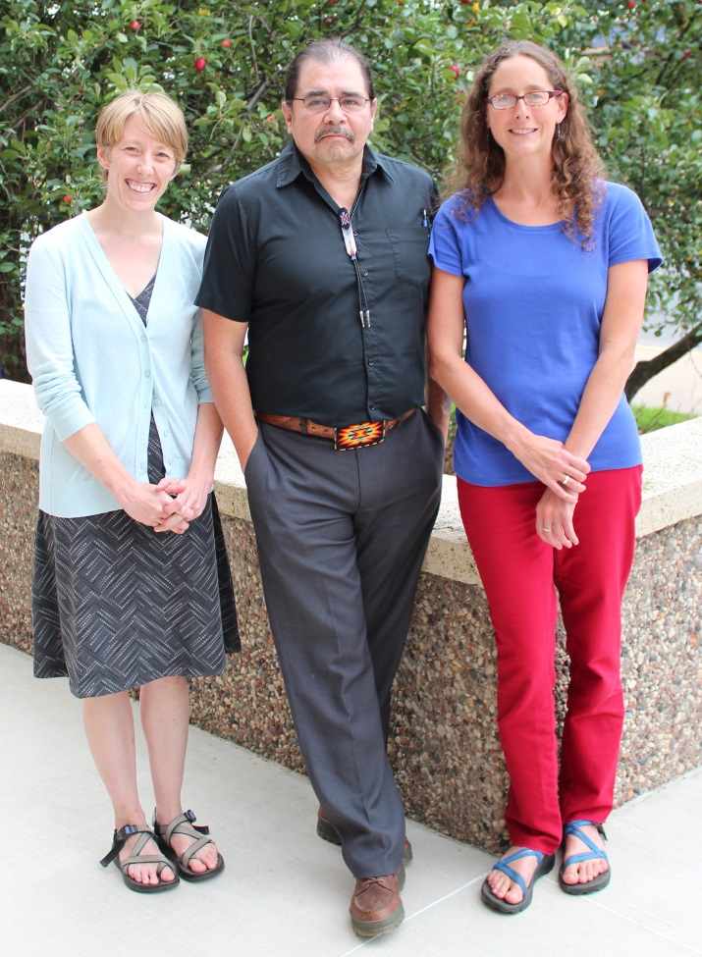
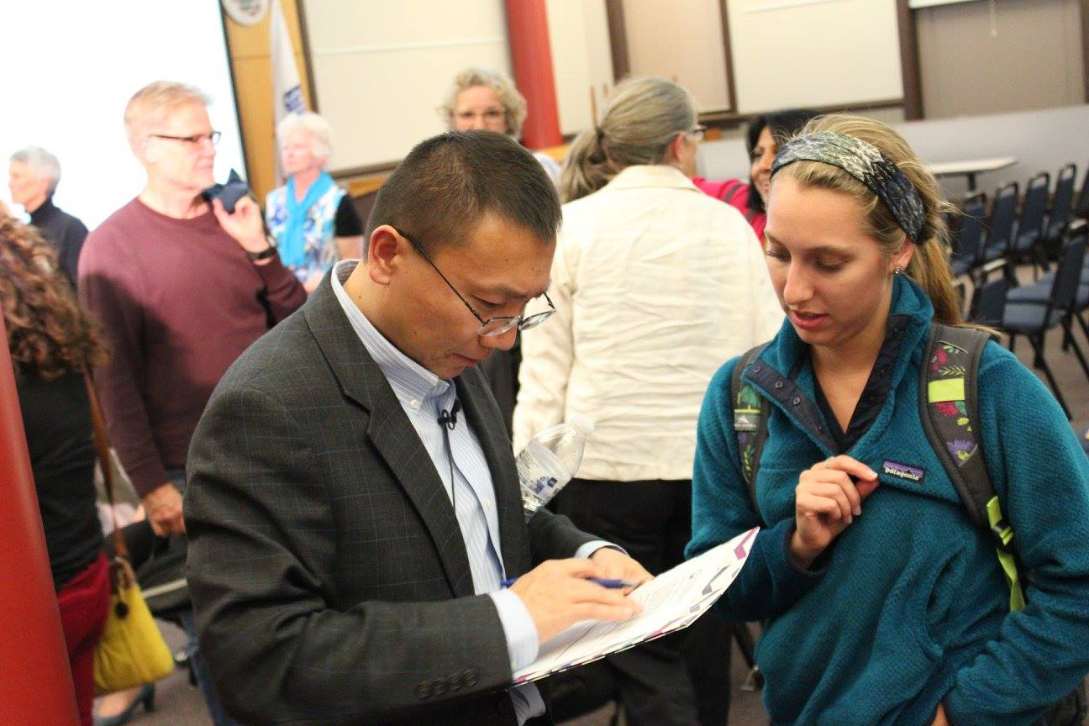
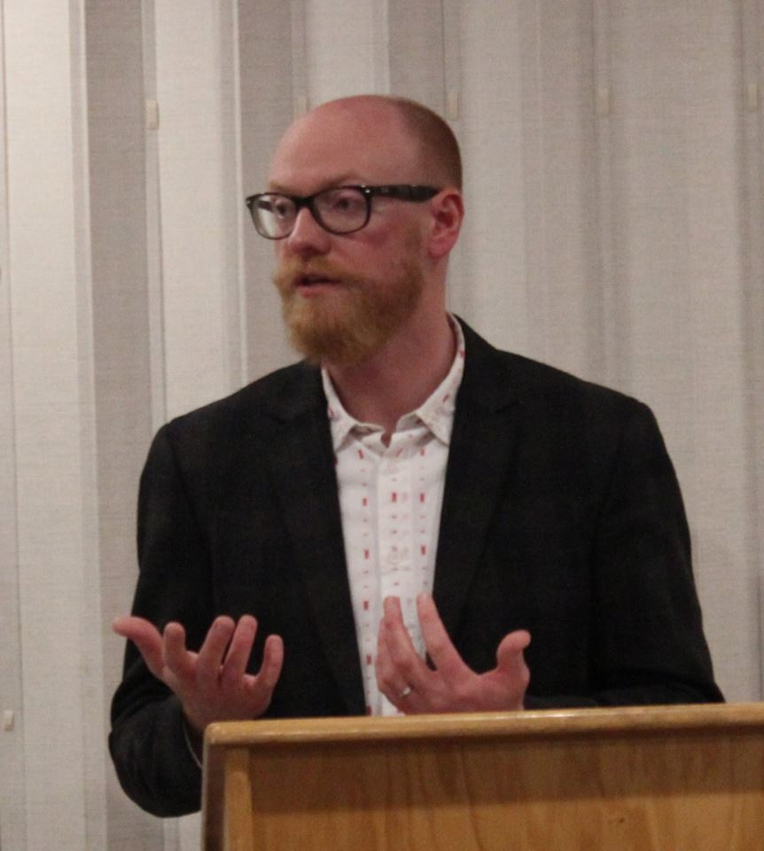
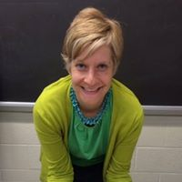
UWSP Social Work Program
Key Faculty
Notes:
Next, let’s discuss the faculty involved with the Social Work Program. While there are four full-time social work specific faculty, the program utilizes sociology faculty and professional social workers from the local community who teach on a part-time basis. This array of faculty allows us to offer a well-rounded, rich curriculum. We will take a moment to profile our full-time social work specific faculty since these are the faculty members that social work students will interact with most.

Slide 5
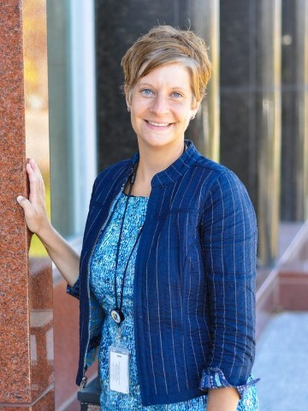
Kate Kipp, MSW, APSW, SAC
Assistant Professor
kkipp@uwsp.edu
715-346-2427
Notes:
First, our most recently hired professor, Kate Kipp. Professor Kipp started as a full-time faculty member in January of 2019. Prior to that, she was a part-time instructor for the program for a number of semesters while working full-time as a social worker in the community. Her practice experience includes coordinating a victim-witness program, directing a justice program for adult offenders involved in the criminal justice system, and working as a child protective services worker. Professor Kipp teaches Introduction to Social Work, Social Work Methods: Groups & Families, Social work Methods: Community Organization and Social Service Administration, and Substance Use Disorders: Assessment and Intervention. Professor Kipp earned her master’s degree in social work from UW-Madison. She is a certified advance practice social worker and a credentialed substance abuse counselor.

Slide 6
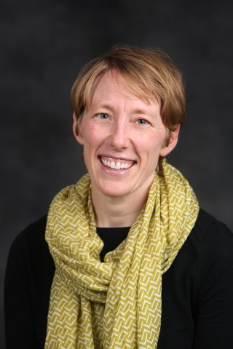
Jess Bowers, MSW, APSW
Assistant Professor & Field Coordinator
jbowers@uwsp.edu
715-346-2444
Notes:
Next, Professor Jess Bowers. Professor Bowers started as a faculty member in the summer of 2014. She coordinates the social work field education (internship) program and primarily teaches our social welfare policy course and a course on social work ethics and professionalism. Professor Bowers has practice and research experience in the field of child welfare, and she also has expertise in school social work. She earned her master’s in social work through the University of Wisconsin—Oshkosh, and she is a certified advance practice social worker.

Slide 7
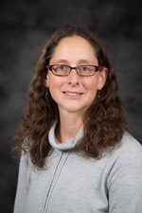
Amy Zlimen Ticho, MSW, Ph.D., APSW Professor & Director of Social Work
azlimen@uwsp.edu
715-346-3603
Notes:
Next is myself. I have been a faculty member in the Department since 2001. I have taught a variety of courses during my time at UWSP, but I most regularly teach Introduction to SW, Social work methods: Casework, and a specialty course on death and dying. Prior to being hired at UWSP, I was a hospice social worker, and since coming to UWSP, my research has focused on various aspects of end of life care. I earned my masters in social work at UW-Madison and my Ph.D. in social work through UT, Austin. I am also a certified advance practice social worker.

Slide 8
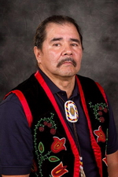
Alton “Sonny” Smart, MSW
Professor
ssmart@uwsp.edu
715-346-3748
Notes:
Finally, our most senior faculty member, who has been in the Department since 1990. Professor Smart, a member of the Bad River Band of Chippewa, is the first Native American faculty person to be tenured at UWSP. He has strong connections to the tribes in Wisconsin through his roles as a social worker, researcher, educator, consultant, and advocate. He has received training in clinical social work and family therapy. He is a tribal judge and has experience in Indian child welfare. Professor Smart has taught a variety of courses during his time at UWSP, but currently focuses on child welfare, social services in Native American Communities, social work with culturally diverse groups, and human behavior and the social environment. Professor Smart earned his masters in social work at the University of Minnesota—Duluth.

Slide 9

Mission/Focus
The mission of the Social Work Program at UWSP is to:
Prepare students for entry level generalist social work practice, attending to the needs and resources of diverse populations and the understanding of global issues (such as oppression) that affect the human condition. The program prepares students to be competent and professional community leaders who implement humane social policies, services, and programs that seek social and economic justice for individuals, families, groups, communities, and the broader global society. A unique emphasis of the program is a commitment to the well being of those living in Rural Central Wisconsin communities as well as to the sovereign cultural integrity of Native American communities within this region.
Notes:
Now let’s talk a bit about our mission. The mission of the social work program at UWSP is to…
In working towards this mission, we also seek to help students uphold the core values of the social work profession, which include service, social justice, the dignity and worth of the person, the importance of human relationships, and competence.

Slide 10

Mission/Focus
Generalist Practice is discussed by CSWE as follows:
“Generalist practice is grounded in the liberal arts and the person and environment construct. To promote human and social well-being generalist practitioners use a range of prevention and intervention methods in their practice with individuals, families, groups, organizations, and communities. The generalist practitioner identifies with the social work profession and applies ethical principles and critical thinking in practice. Generalist practitioners incorporate diversity in their practice and advocate for human rights and social and economic justice. They recognize, support, and build on the strengths and resiliency of all human beings. They engage in research-informed practice and are proactive in responding to the impact of context on professional practice.”
Notes:
As indicated in our mission, we strive to prepare students to engage in generalist social work practice, a focus of all undergraduate social work programs. To clarify what is meant by generalist practice, we have included this definition offered by the Council on Social Work Education. Generalist practice is…

Slide 11

Mission/Focus
The program strives to help students develop competency in the following areas:
Demonstrate Ethical and Professional Behavior
Engage Diversity and Difference in Practice
Advance Human Rights and Social, Economic, and Environmental Justice
Engage in Practice-Informed Research and Research-Informed Practice
Engage in Policy Practice
Engage with Individuals, Families, Groups, Organizations, Communities
Assess Individuals, Families, Groups, Organizations, Communities
Intervene with Individuals, Families, Groups, Organizations, Communities
Evaluate Practice with Individuals, Families, Groups, Organizations, Communities
Notes:
In congruence with this definition, CSWE has developed 9 competencies on which BSW and MSW programs base their curricula and evaluate students. These competencies are an important part of every accredited social work program, with the goal of helping students to develop in these key areas. The competencies are as follows…

Slide 12

Social Work Curriculum
BA or BS in Social Work
Supporting courses
  Political Science 101 (American Politics)
  Psychology 110 (Introduction to Psychology)
  Sociology 101 (Introduction to Sociology)
  Sociology 270 (Race and Ethnicity) OR Sociology 327 (Social Inequality)
  Sociology 350 (Sociological Theory)
  Sociology 351 (Social Statistics)
  Sociology 352 (Research Methods)
Notes:
Next, we will review the social work curriculum.
Overall, students must fulfill the UWSP General Education Requirements for the Bachelor of Science or the Bachelor of Arts and the UW-Stevens Point requirement of 120 credits for graduation.
The social work major itself consists of a number of required supporting courses, specific social work courses, electives, and a capstone experience for a total of 67 credits.
Regarding the supporting courses, social workers need a solid understanding of American government, behavior and mind, the structures and theories of society, human diversity, and issues of inequality. Further, they need to engage in research-informed practice as well as conduct program evaluations and other research studies as part of their practice. The supporting courses listed here provide an essential foundation and supplement to the social work specific courses we will discuss next.

Slide 13

Social Work Curriculum
BA or BS in Social Work
Core courses
  Social Work/Sociology 261 (Introduction to Social Work and the Social Services Field)
  Social Work /Sociology 262 (Social Welfare Policies and Programs)
  Social Work/Sociology 263 (Ethical Practice in the Helping Professions)
  Social Work 359 (Social Work Methods: Casework)
  Social Work 361 (Social Work Methods: Groups and Families)
  Social Work 362 (Social Work Methods: Community Organization and Social Service Administration)
  Social Work/Sociology 364 (Social Services in Native American Communities)
  Social Work 365 (Social Work with Native American and Other Culturally Diverse Families)
  Social Work/Sociology 376 (Human Behavior and the Social Environment)
Notes:
The following courses serve as the core of our professional social work program. They are…
If you reflect on the mission of the social work program, the definition of generalist practice, and the CSWE competencies, you will see how the curriculum is linked to these statements.

Slide 14

Social Work Curriculum
BA or BS in Social Work
Electives
  SW 316 (Child Welfare Practice)
  SW 381 (Death, Dying, Loss and Grief)
  SW 383 (Substance Use Disorders: Assessment and Intervention)
Notes:
Though the aim of any undergraduate social work program is to prepare students for generalist practice, not specialty work, it is important and useful for students to begin developing their knowledge and expertise in key areas of social work practice. As such, students are required to take at least two social work-specific elective courses from the list on this slide. Additional elective courses will be added as the program continues to grow.

Slide 15
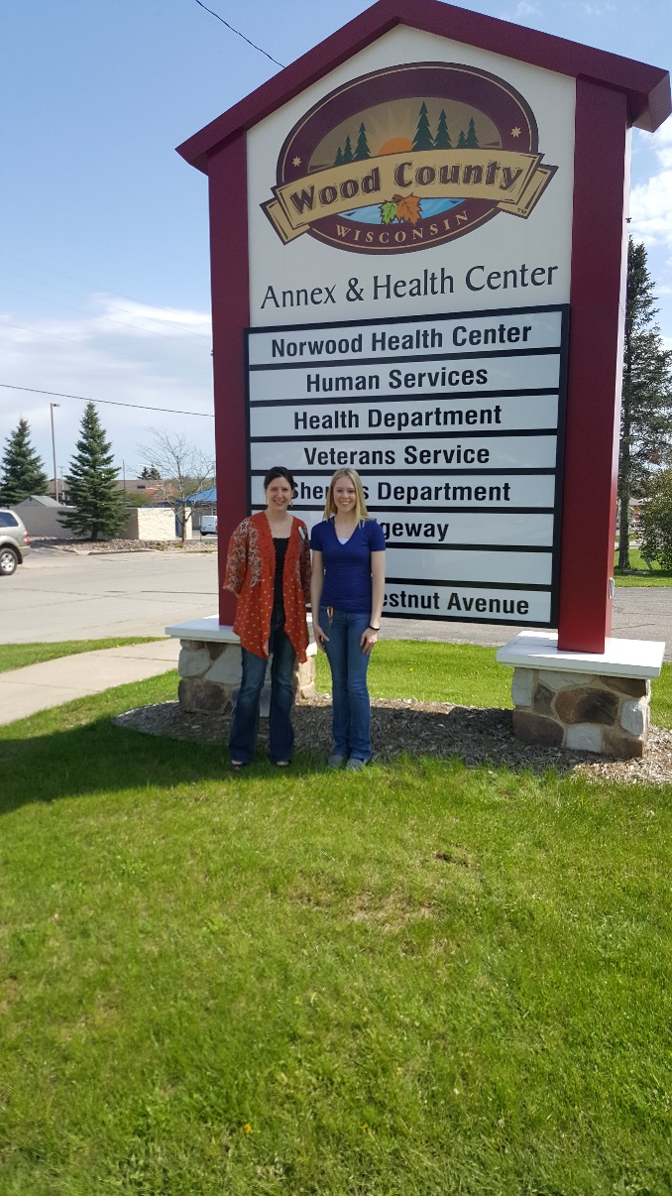
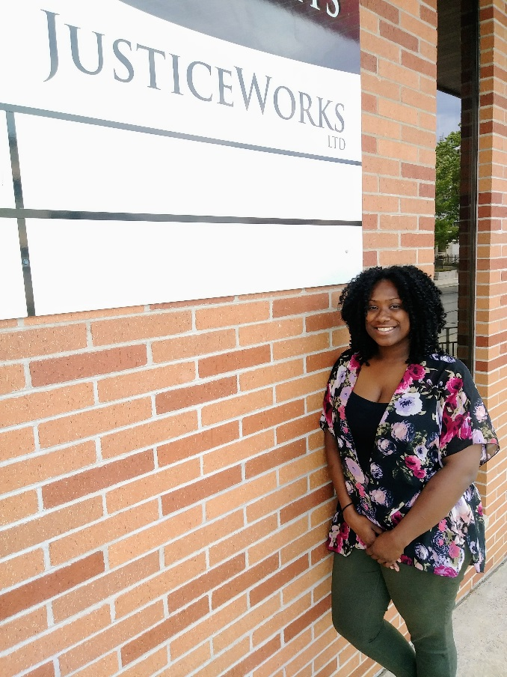
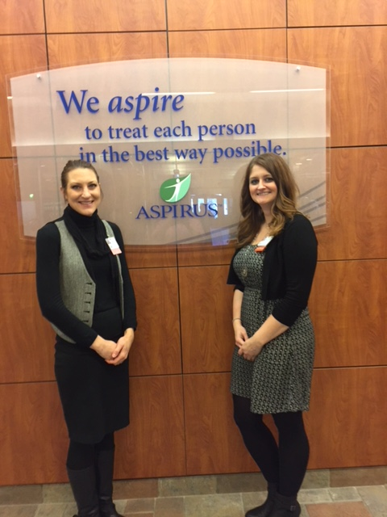
Social Work Curriculum
BA or BS in Social Work
Capstone Experience
  Social Work 494 (Social Work Practicum)
  Social Work 495 (Social Work Practicum Seminar)
Photos: Students at their internship sites
Notes:
Finally, the “signature pedagogy” or “capstone” experience in social work education is the practicum (494 and 495), sometimes referred to as field experience or internship. Another slide show presentation discusses the details of this component of our program. In short, though, students are required to complete at least 400 hours of work in an approved agency over the course of one or two semesters. Students are placed in a wide variety of practice settings including but not limited to child welfare, youth justice, family violence, criminal justice, aging, disability, medical, end-of-life care, schools, mental health, and substance abuse. Students are required to work towards the CSWE competencies under supervision to develop their knowledge and skill as emerging social workers. In the process, they contribute much to their host organizations and communities as a whole. We are fortunate to have partnerships with such an array of organizations.
While students are completing their internships, they are required to also participate in the practicum seminar. This class meets for two hours every other week and allows interns to connect with the field coordinator and one another, process and build off of their internship experiences, and further prepare for professional practice and certification.

Slide 16

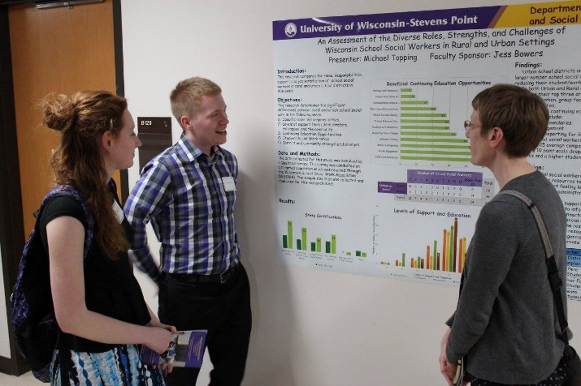
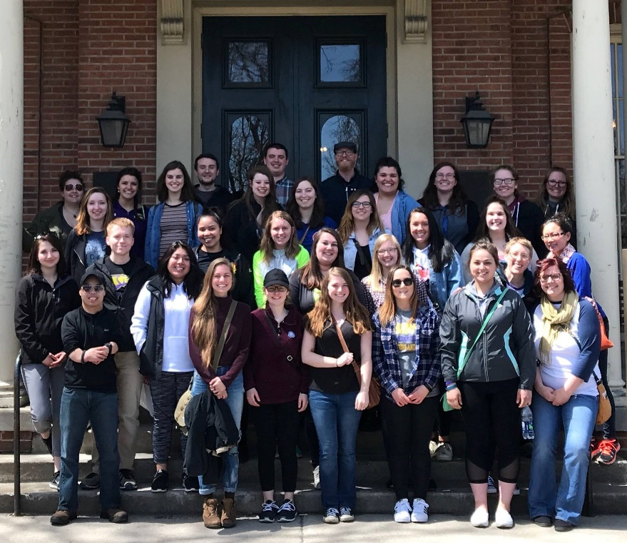
Additional Learning Opportunities
Student Organizations
Field Trips
Volunteerism
Community Engagement
Cultural Events
Speakers/Presentations
Film Screenings
Conferences
Research Symposia
Notes:
It is important that students participate in additional learning opportunities beyond their required coursework. Doing so will make their education more meaningful, help them develop their knowledge and skills, allow them opportunities to collaborate and network, and build experience to advance their careers. Our program is dedicated to helping students identify and gain additional experience in the ways listed on this slide. Our student organizations also help to facilitate many of these additional learning opportunities.

Slide 17

Applying for Admission into the
Social Work Program
***Prior to Admission—Declare an Intended Major ***
Admission Standards
Complete at least 45 credits of undergraduate coursework
Earn minimum GPA of 2.5 from all accredited institutions attended
Earn minimum GPA of 2.5 in the required pre-admission coursework (Sociology 101 and Social Work/Sociology 261)
Earn minimum grade of C- in Social Work/Sociology 261
Be in good academic standing during semester of application
Notes:
Next, we will discuss the admission standards and process for getting accepted into the social work program.
Students who wish to major in social work but have not yet been officially accepted into the major are titled intended majors. To declare an intended major in social work, students should visit the Department of Sociology and Social Work office to complete the form necessary to do this. Once a student is officially accepted into the social work major, his or her status will be changed to accepted social work major by the Department of Sociology and Social Work Academic Program Associate.
The Social Work Program Admissions Committee is pleased to accept applications from interested and qualified students for the social work program. Seats in the major are limited to ensure an acceptable faculty-to-student ratio, with a commitment to providing quality classroom, advising, and internship experiences. The Social Work Admissions Committee reserves the right to admit a limited number of students each semester.
This slide depicts our admission standards. Students seeking admission must…
Meeting the minimum standards does not guarantee that a student will be admitted into the major. Only students who meet the admission guidelines and show strong potential to succeed in social work practice by demonstrating interest, commitment, interpersonal skills, relevant experiences and academic ability will be considered for the program.

Slide 18
Applying for Admission into the
Social Work Program
Admission process
Complete Online Social Work Application (available on Department website)
  UWSP Degree Progress Report
  Two letters of recommendation
  Narrative statement
Submit to website by October 10 or March 1 of chosen semester
Notes:
A formal application for admission is the first step in meeting the requirements for graduation with a social work major. The application materials needed are described in the application, which can be found on the Department website. These materials include a UWSP Degree Progress Report (or report of courses taken if at another institution), two letters of recommendation and a narrative statement describing background, interests, motivations for social work, and experience.
Ideally, students apply for admission at the end of their sophomore year. The Social Work Program reviews applications once per semester, with an October 10 deadline for fall and a March 1 deadline for spring.
Applications are reviewed and decisions are made by the Social Work Admissions Committee. The Committee is comprised of the four full-time social work faculty and one additional faculty member within the Department.

Slide 19

For more information…
Department of Sociology & Social Work
Collins Classroom Center, 488 A
1801 Fourth Avenue
(715) 346-3060
http://www.uwsp.edu/sociology/
Notes:
Thank you for taking the time to learn about the Social Work Program at UWSP. We sincerely hope that this presentation has provided you with a basic understanding of our structure, faculty, mission, curriculum, and admission requirements.
For more information, please visit the Department of Sociology and Social Work website where you can find a description of our program, a sample four year graduation plan, our student manual, internship resources, the application to our program and more. Also feel free to contact me with any questions or concerns that you have. I will be happy to talk with you. You can also visit our main office, which is located on the 4th floor of the Collins Classroom Center on the UWSP Campus.
Thank you for taking the time to learn more about our program!

