Slide 1
Moving Student Applicant(s) through the Candidate Pipeline of a Job Requisition as the Search Committee Chair

Slide 2
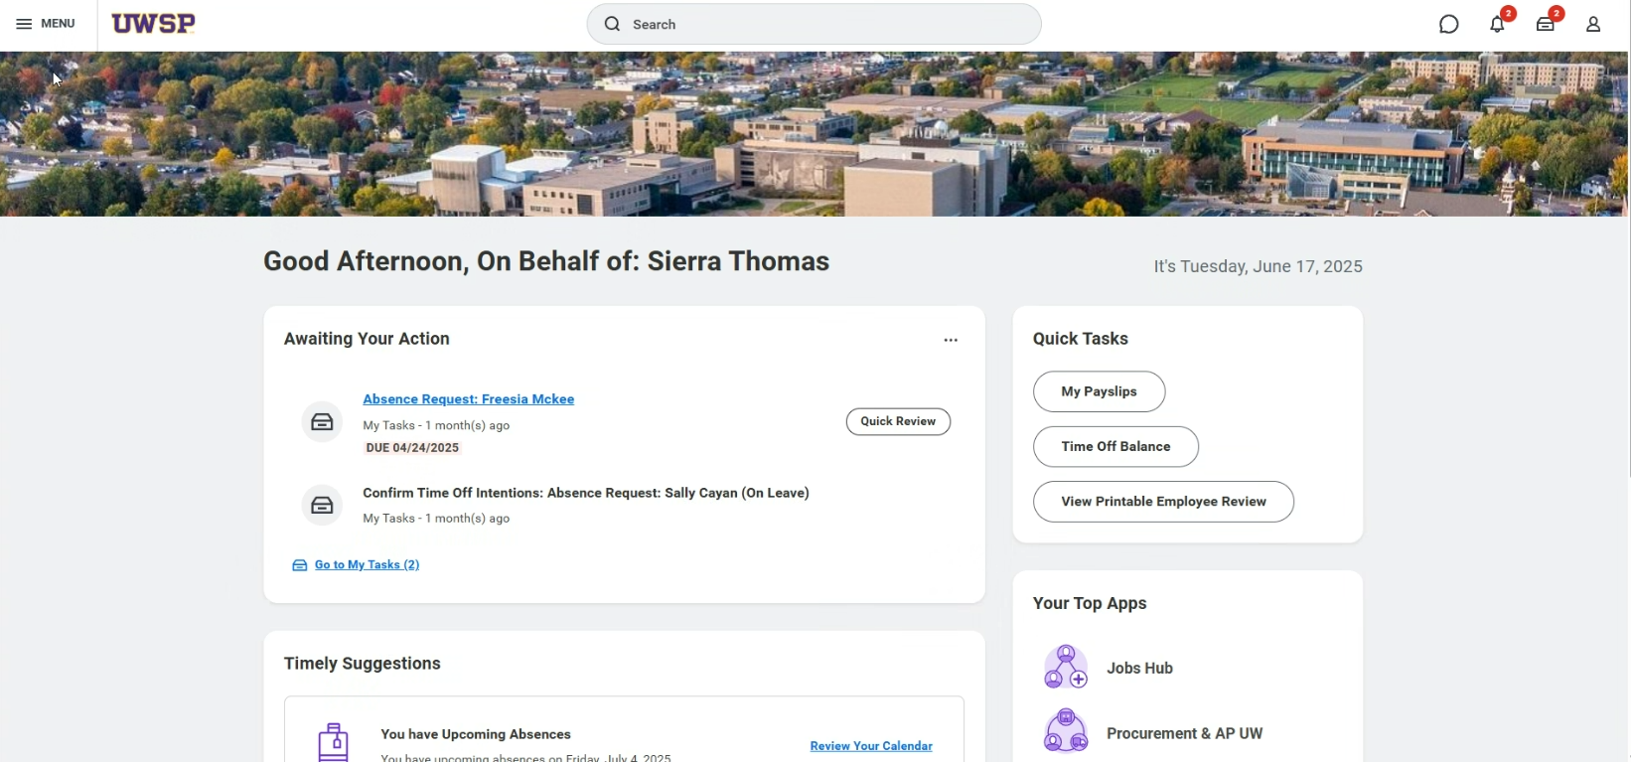
Click “Menu”
This is the Search Committee Chair

Slide 3
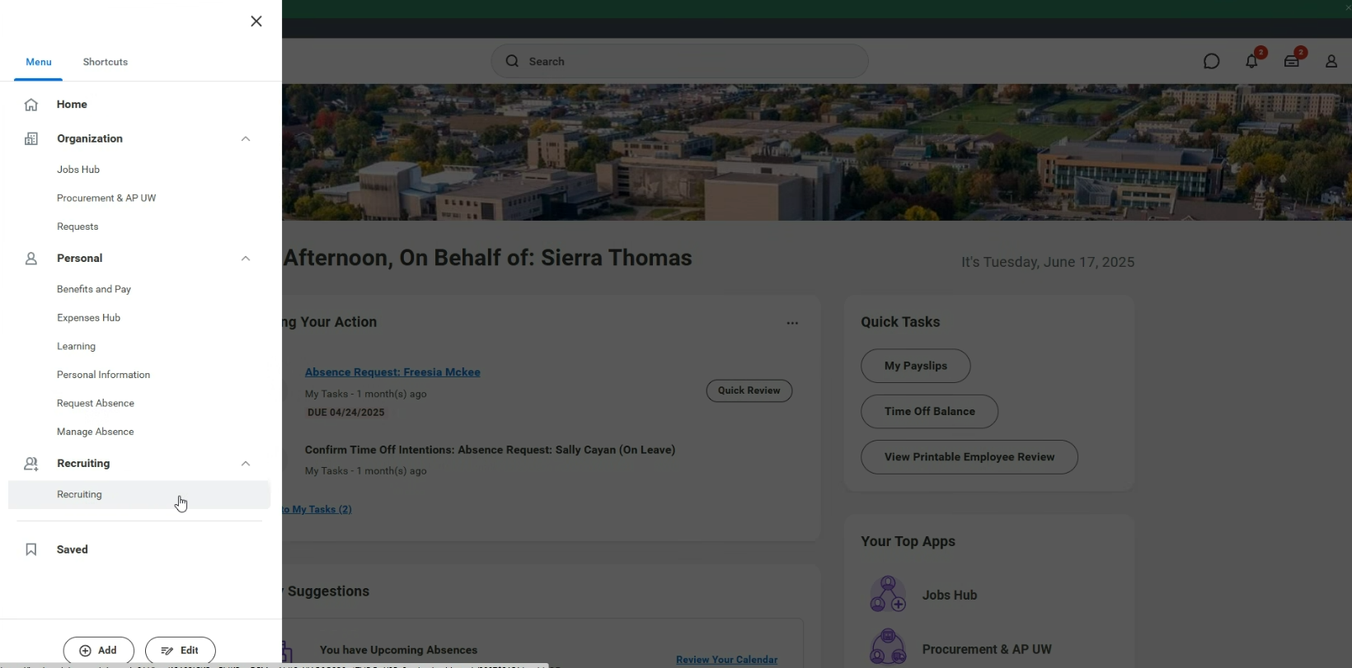
Click “Recruiting”

Slide 4
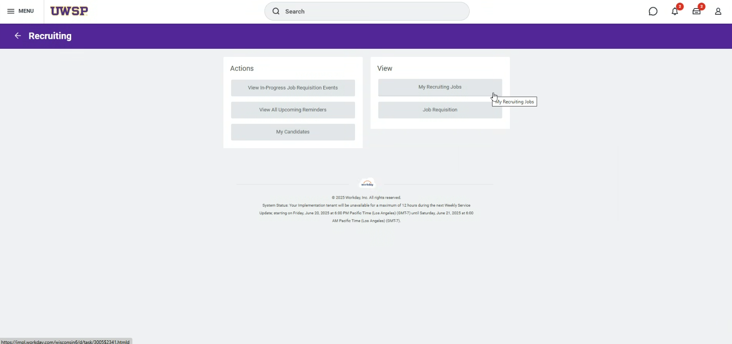
Click “My Recruiting Jobs”

Slide 5
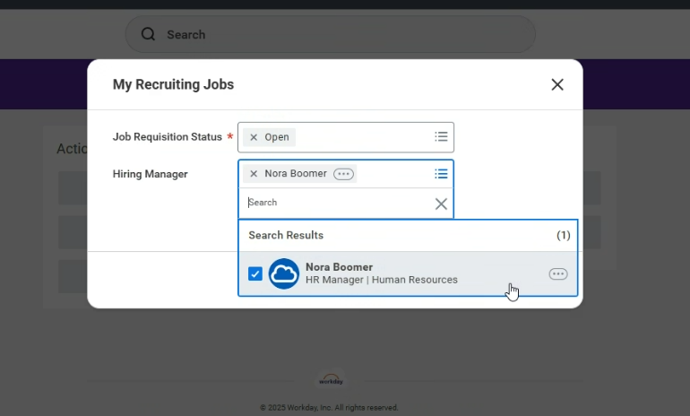
Delete the “Frozen” option so that only “Open” remains
Choose the correct Hiring Manager.
Notes:
The Hiring Manager and the Search Committee Chair should have had a prior conversation about this job requisition. The Search Committee Chair should have been informed by the Hiring Manager that they were serving on the committee.

Slide 6
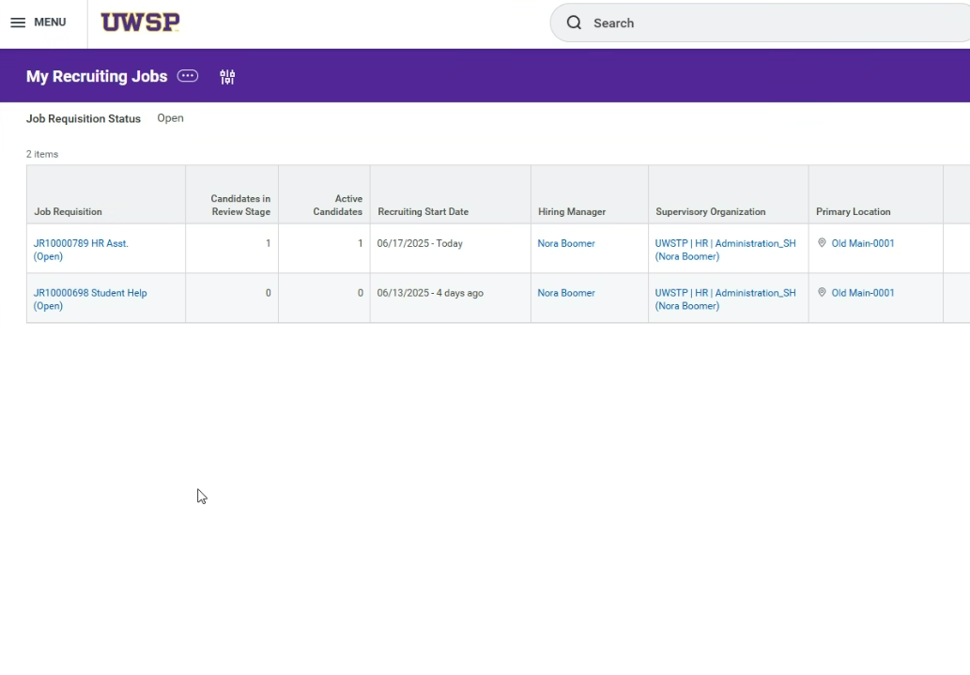
Click the Job Requisition title

Slide 7
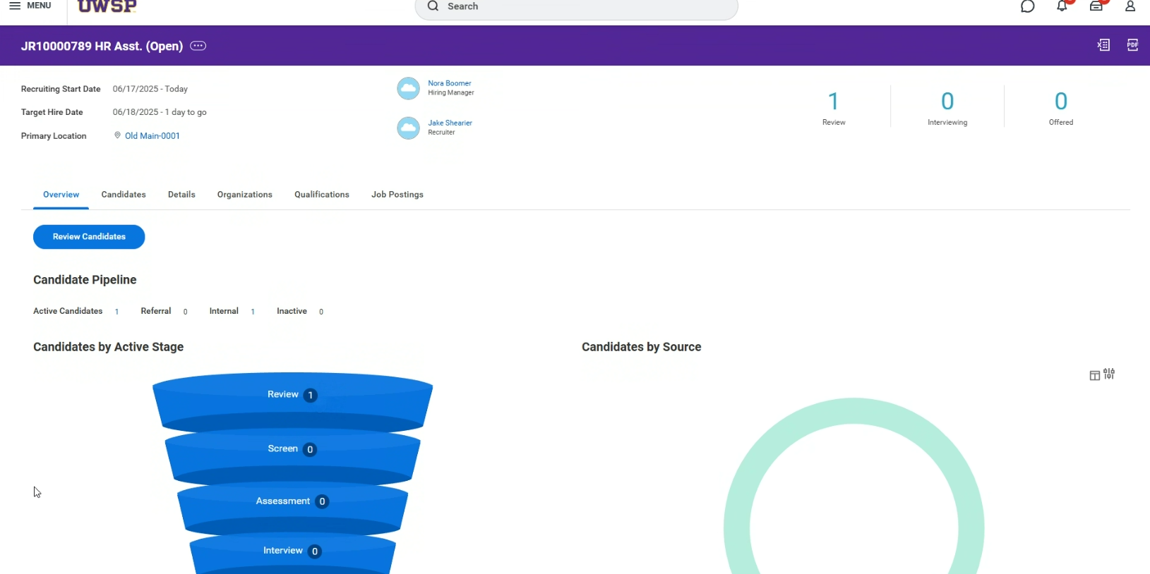

Slide 8
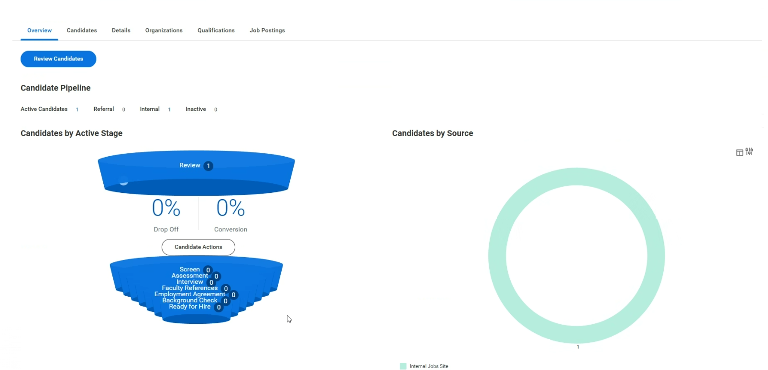

Slide 9
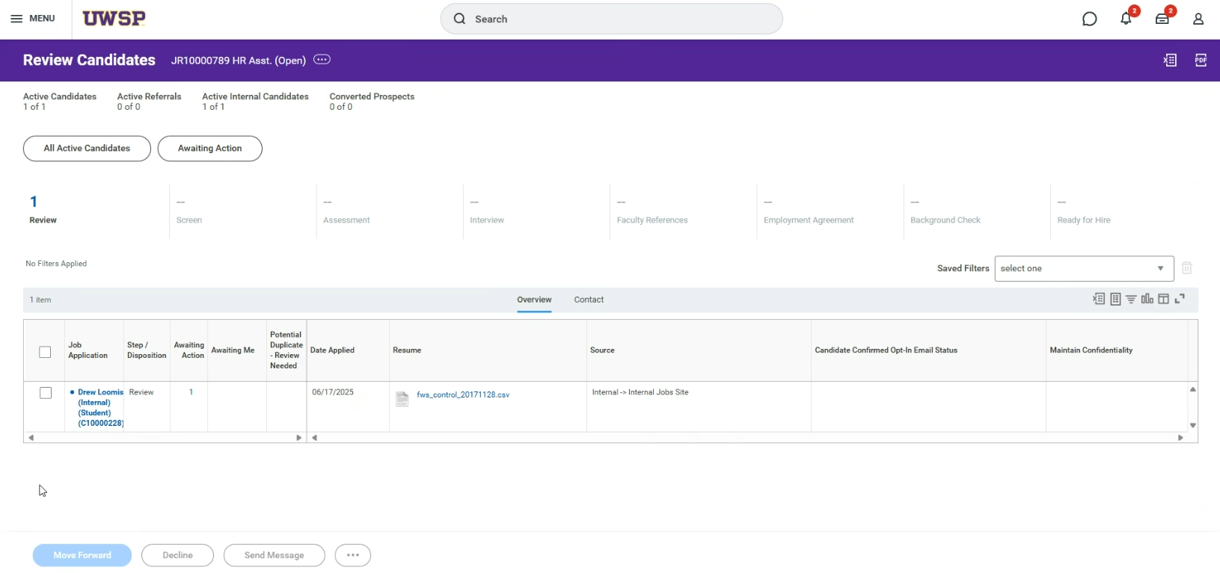

Slide 10
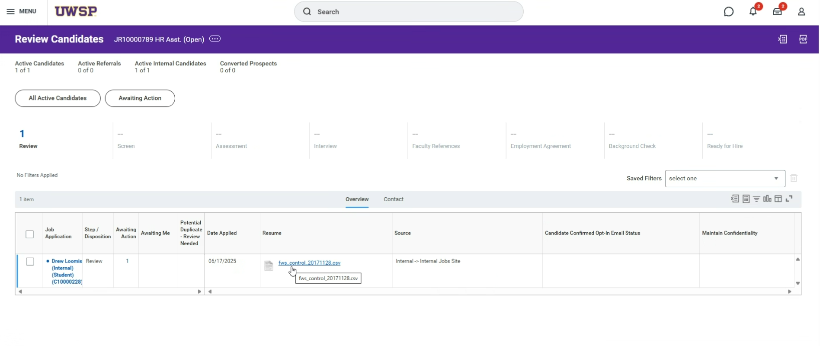
Review attached resume or other documents uploaded by applicant

Slide 11
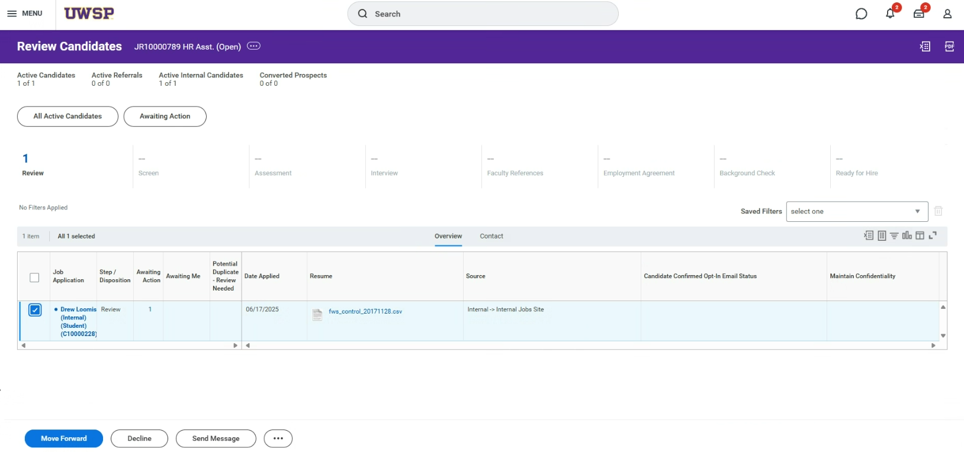
Select any applicant(s) that you would like to move forward in the candidate pipeline
Click “Move Forward”

Slide 12
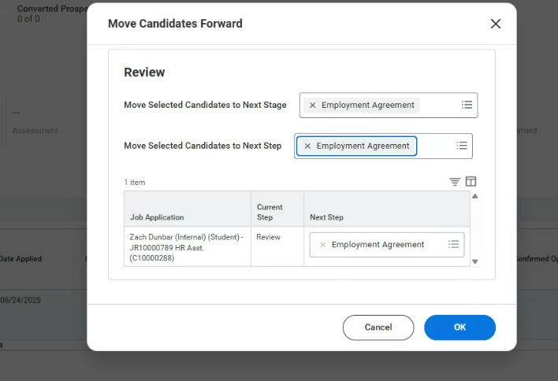
Then choose Employment Agreement for the Next Stage and Step, and it will populate Employment Agreement here.

Slide 13
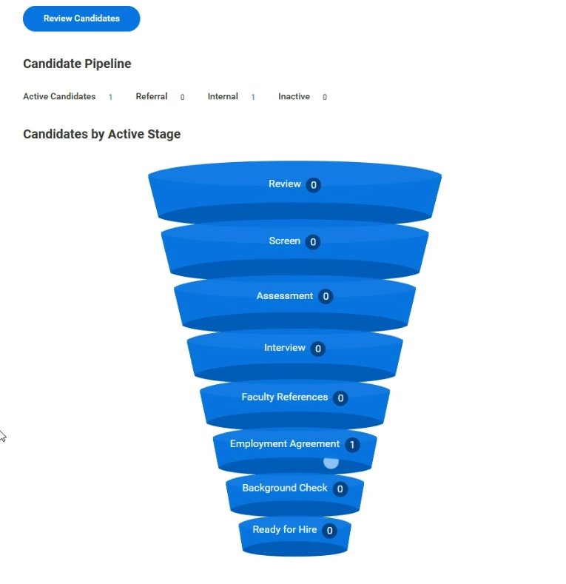
You’ll notice the candidate has now moved on to the “Employment Agreement” stage of the pipeline. These functions are completed by both HR and the successful candidate(s).

Slide 14
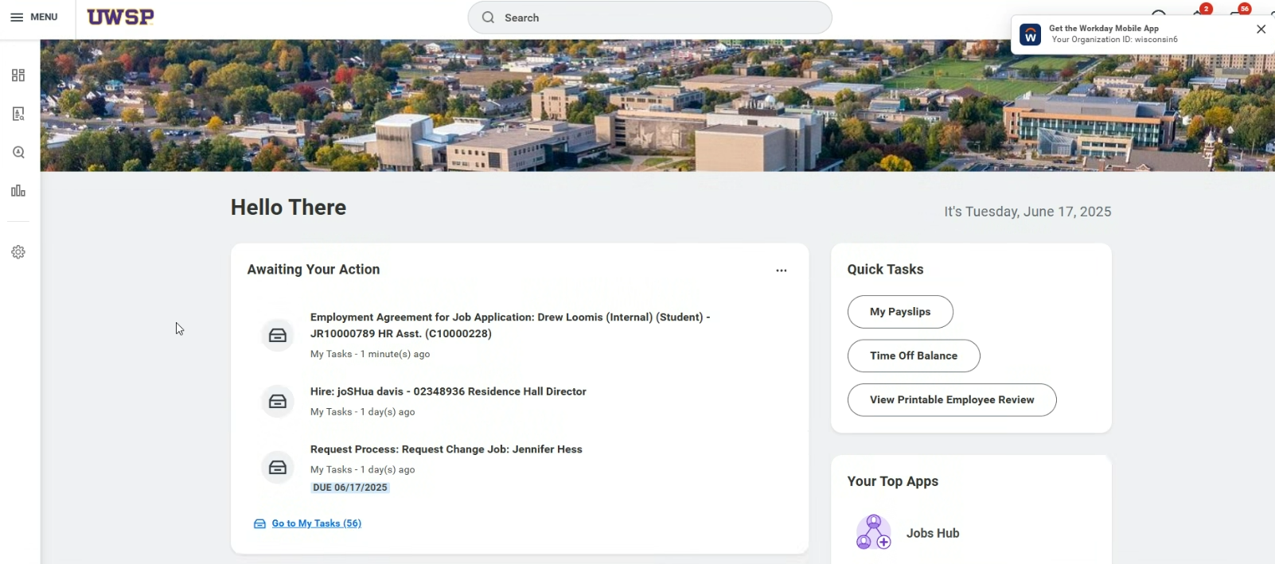
Notes:
HR now receives a task to create an Employment Agreement for the Universities of Wisconsin for the student employee to complete. If a background check is needed, HR will initiate that after an accepted agreement is signed/acknowledged. You’ll note if a CBC is needed during the creation of the req.

