Slide 1
The Maltese Falcon and Literary Criticism: Talking about the Black Bird
Professor Matthew Davis

Slide 2
Samuel Dashiell Hammett
1894-1961
Notes:
Hammett was born on a farm called "Hopewell and Aim" off Great Mills Road, St. Mary's County, in southern Maryland, United States.[3] His parents were Richard Thomas Hammett and Anne Bond Dashiell. (The Dashiells are an old Maryland family, the name being an Anglicization of the French De Chiel) He grew up in Philadelphia and Baltimore. "Sam", as he was known before he began writing, left school when he was 13 years old and held several jobs before working for the Pinkerton National Detective Agency (this later became his influence for most his books[citation needed]). He served as an operative for the Pinkerton Agency from 1915 to 1921, with time off to serve in World War I. However, the agency's role in union strike-breaking eventually disillusioned him.[4]During World War I, Hammett enlisted in the United States Army and served in the Motor Ambulance Corps. However, he became ill with the Spanish flu and later contracted tuberculosis. He spent the war as a patient in Cushman Hospital, Tacoma, Washington. While hospitalized he met and married a nurse, Josephine Dolan, and had two daughters, Mary Jane (1921-10-15) and Josephine (1926).[5] Shortly after the birth of their second child, Health Services nurses informed Josephine that due to Hammett's tuberculosis, she and the children should not live with him. So they rented a place in San Francisco. Hammett would visit on weekends, but the marriage soon fell apart. Hammett still supported his wife and daughters financially with the income he made from his writing.[citation needed]Hammett turned to drinking, advertising, and, eventually, writing. His work at the detective agency provided him the inspiration for his writings.

Slide 3
Novels
Red Harvest (1929)
The Dain Curse (1929)
The Maltese Falcon (1930)
The Glass Key (1931)
Woman in the Dark (1933)
The Thin Man (1934)
Notes:
The Maltese Falcon was written between 1928 and 1929, before the stock market crash.
Was originally serialized in five parts in The Black Mask between October, November, and December of 1929 and January and February of 1930.

Slide 4
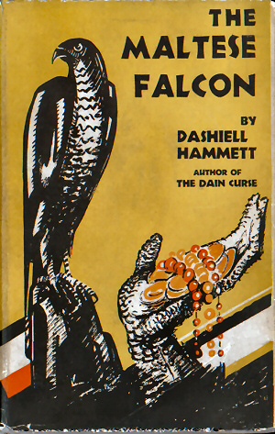
Notes:
Alfred A. Knopf published the novel on February 14, 1930.

Slide 5
1934 Modern Library Edition
Notes:
Selected as first hard-boiled detective story in its series.

Slide 6
Critical Response
David T. Bazelon, “Dashiell Hammett’s Private Eye: No Loyalty Beyond the Job” (1949)

Slide 7
Critical Response
David T. Bazelon, “Dashiell Hammett’s Private Eye: No Loyalty Beyond the Job” (1949)
Edmund Wilson in The New Yorker (October 1940):
Still fearing that I might be unjust to a department of literature that seemed to be found so absorbing by many, I went back and read The Maltese Falcon [. . .] it was difficult for me to understand what they had thought—in 1930—they were toasting. The Maltese Falcon today seems not much above those newspaper picture-strips in which you follow from day to day the ups and downs of a strong jawed hero and a hardboiled but beautiful adventuress.
Notes:
First essay on The Maltese Falcon did not appear until 1969.
Raymond Chandler, writing in The Atlantic Monthly “The Simple Art of Murder” (1944) attempted to correct Wilson’s denunciations of Hammett.

Slide 8
1950s
Critical silence and misunderstanding of Hammett’s work.

Slide 9
1950s
Critical silence and misunderstanding of Hammett’s work.
Largely due to:
Politics: Hammett’s association with the Communist Party hurt his critical reputation in the academy

Slide 10
1950s
Critical silence and misunderstanding of Hammett’s work.
Largely due to:
Politics: Hammett’s association with the Communist Party hurt his critical reputation in the academy
Aesthetics: Genre fiction was widely dismissed in critical assessments of American literature

Slide 11
1960s
Change in reception of Hammett’s work.
Largely due to:

Slide 12
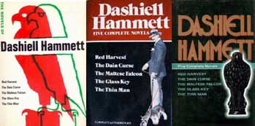
1960s
Change in reception of Hammett’s work.
Largely due to:
Knopf’s resetting of The Complete Dashiell Hammett and its republication in 1865 as The Novels of Dashiell Hammett.

Slide 13
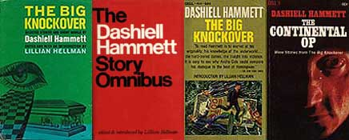
1960s
and
Random House’s 1966 publication of The Big Knockover, a collection of ten tales, including his unfinished Tulip.

Slide 14
1960s
Critical renaissance in Hammett studies
1968: David Madden’s Tough Guy Writers of the Thirties
Irving Malin’s “Focus on The Maltese Falcon: The Metaphysical Falcon”
Robert Edenbaum’s “The Poetics of the Private Eye: The Novels of Dashiell Hammett”
Notes:
A third essay, Philip Durham’s “The Black Mask School” made considerable use of Hammett.
Edenbaum’s essay focused on Sam Spade as a “A new kind of hero—a man who was “free of sentiment, of the fear of death”—[who] still managed to ‘present a critique of the tough guy’s freedom as well’” Also first work to focus on importance of Flitcraft parable to understanding the novel.

Slide 15
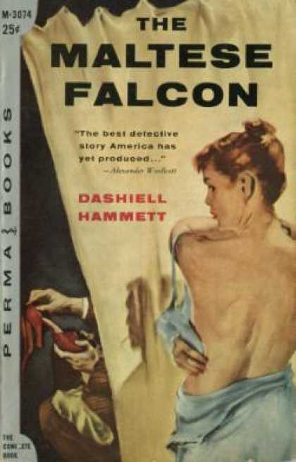

Slide 16
1970s
George J. Thompson’s “The Problem of Moral Vision in Dashiell Hammett’s Detective Novels” serially in The Armchair Detective.

Slide 17
1970s
George J. Thompson’s “The Problem of Moral Vision in Dashiell Hammett’s Detective Novels” serially in The Armchair Detective.
Appeared between 1972 and 1974

Slide 18
1970s
George J. Thompson’s “The Problem of Moral Vision in Dashiell Hammett’s Detective Novels” serially in The Armchair Detective.
Appeared between 1972 and 1974
Traced Hammett’s artistic vision from Red Harvest to The Thin Man

Slide 19
1970s
George J. Thompson’s “The Problem of Moral Vision in Dashiell Hammett’s Detective Novels” serially in The Armchair Detective.
Appeared between 1972 and 1974
Traced Hammett’s artistic vision from Red Harvest to The Thin Man
Engaged the work of other critics

Slide 20
1970s
George J. Thompson’s “The Problem of Moral Vision in Dashiell Hammett’s Detective Novels” serially in The Armchair Detective.
Appeared between 1972 and 1974
Traced Hammett’s artistic vision from Red Harvest to The Thin Man
Engaged the work of other critics
Addressed both the text and critical discourse about the text

Slide 21
1970s
George J. Thompson’s “The Problem of Moral Vision in Dashiell Hammett’s Detective Novels” serially in The Armchair Detective.
Appeared between 1972 and 1974
Traced Hammett’s artistic vision from Red Harvest to The Thin Man
Engaged the work of other critics
Addressed both the text and critical discourse about the text
Saw “no ambiguity” in Spade’s final confrontation with Brigid

Slide 22
1970s
George J. Thompson’s “The Problem of Moral Vision in Dashiell Hammett’s Detective Novels” serially in The Armchair Detective.
Appeared between 1972 and 1974
Traced Hammett’s artistic vision from Red Harvest to The Thin Man
Engaged the work of other critics
Addressed both the text and critical discourse about the text
Saw “no ambiguity” in Spade’s final confrontation with Brigid
Made the case for seeing Spade in heroic terms

Slide 23
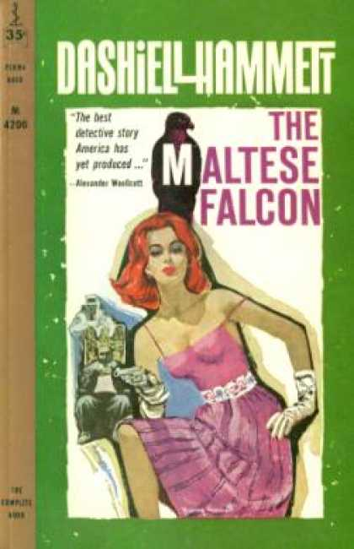

Slide 24
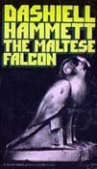
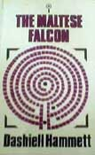
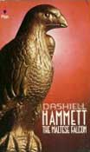
1970s
George Grella’s “The Wings of the Falcon and the Maltese Dove” (1976)
Frederick Burelbach’s “Symbolic Naming in The Maltese Falcon” (1979)
Notes:
Grella explores influence of Henry James’s The Wings of the Dove on Hammett
Burelbach looks at symbolic possibilities of names in the novel

Slide 25
1970s
Steven Marcus’s “Dashiell Hammett and the Continental Op” in Partisan Review (1974)

Slide 26
1970s
Steven Marcus’s “Dashiell Hammett and the Continental Op” in Partisan Review (1974)
Emphasized significance of Flitcraft parable to understanding Hammett’s work:

Slide 27
1970s
Steven Marcus’s “Dashiell Hammett and the Continental Op” in Partisan Review (1974)
Emphasized significance of Flitcraft parable to understanding Hammett’s work:
Scene as “the most important or central moment in the entire novel” but also as “one of the central moments in all of Hammett’s writing”

Slide 28
1970s
Steven Marcus’s “Dashiell Hammett and the Continental Op” in Partisan Review (1974)
Emphasized significance of Flitcraft parable to understanding Hammett’s work:
Scene as “the most important or central moment in the entire novel” but also as “one of the central moments in all of Hammett’s writing”
Saw it as an existential drama about “the ethical unintelligibility of the world” and in doing so enabled a transformation from genre in “the direction of literature”

Slide 29
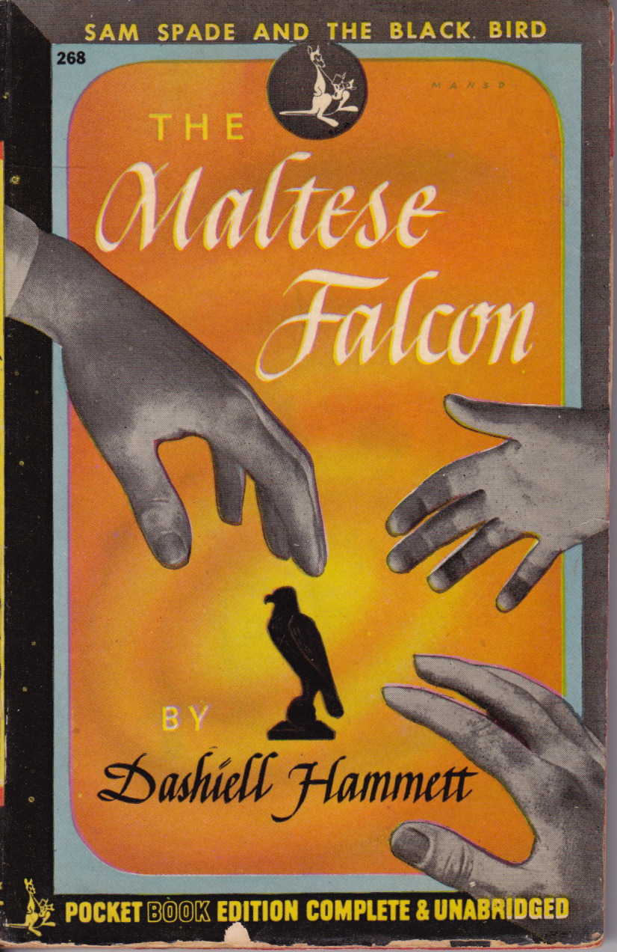

Slide 30
1980s
Three major biographies:

Slide 31
1980s
Three major biographies:
Richard Layman’s Shadow Man: The Life of Dashiell Hammett (1981)
William F. Nolan’s Hammett: A Life at the Edge (1983)
Diane Johnson’s Dashiell Hammett, a Life (1983)

Slide 32
1980s
Three major biographies:
Richard Layman’s Shadow Man: The Life of Dashiell Hammett (1981)
William F. Nolan’s Hammett: A Life at the Edge (1983)
Diane Johnson’s Dashiell Hammett, a Life (1983)
Five book-length studies:

Slide 33
1980s
Three major biographies:
Richard Layman’s Shadow Man: The Life of Dashiell Hammett (1981)
William F. Nolan’s Hammett: A Life at the Edge (1983)
Diane Johnson’s Dashiell Hammett, a Life (1983)
Five book-length studies:
Peter Wolfe’s Wood Beams Falling: The Art of Dashiell Hammett (1980)
Willaim Marling’s Dashiell Hammett (1983)
Dennis Dooley’s Dashiell Hammett (1984)
Julian Symon’s Dashiell Hammett (1985)
Sinda Gregory’s Private Investigations: The Novels of Dashiell Hammett (1985)

Slide 34
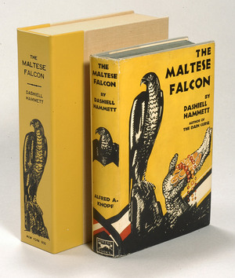

Slide 35
1980s
Critical Foci:
Ambiguity

Slide 36
1980s
Critical Foci:
Ambiguity
Gregory reads Hammett’s work as “declaration of the omnipresence of mystery and the failure of human effort (on the part of both the reader and the detective) to ever dispel it” and examines his distanced third-person point of view as an attempt to “underscore the mystery surrounding the detective”

Slide 37
1980s
Critical Foci:
Politics
Notes:
Shulman claims that during the Cold War Hammett’s politics were dangerous and the most promising approach to his fiction was in disrepute and that we now need to develop detailed political and social criticism that intelligent evaluation of Hammett’s work must be based upon.

Slide 38
1980s
Critical Foci:
Politics
Robert Shulman in “Dashiell Hammett’s Social Vision” (1985) insists that Hammett’s work “carries a concealed social message” that “brings alive the conflicting versions of individualism that society emphasizes”
Notes:
Shulman claims that during the Cold War Hammett’s politics were dangerous and the most promising approach to his fiction was in disrepute and that we now need to develop detailed political and social criticism that intelligent evaluation of Hammett’s work must be based upon.

Slide 39
1980s
Critical Foci:
Economics
Notes:
Shulman claims that during the Cold War Hammett’s politics were dangerous and the most promising approach to his fiction was in disrepute and that we now need to develop detailed political and social criticism that intelligent evaluation of Hammett’s work must be based upon.

Slide 40
1980s
Critical Foci:
Economics
William Marling in “The Style and Ideology of The Maltese Falcon” (1989) argues that a more informed evaluation of the novel would try to recover a “cluster of emerging design values and economic forms” that permeate the text and would allow us to see Sam Spade as “an art nouveau detective” and “a new hero for new readers in a new era”
Notes:
Marling insists that the final scene represents an endorsement of the economic policy of “instrumentality” that was popular in the 1920s and 1930s and that itself insisted on the truth of ideas or forms is determined by their success in solving actual problems.

Slide 41
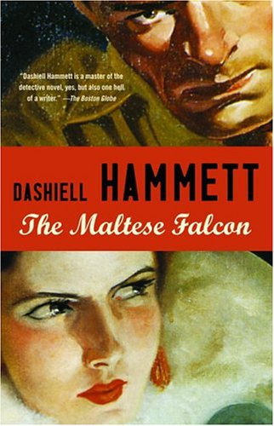

Slide 42
1990s
Increasingly sophisticated analyses of the novel:

Slide 43
1990s
Increasingly sophisticated analyses of the novel:
Jasmine Young Hall’s “Jameson, Genre, and Gumshoes: The Maltese Falcon as inverted Romance” (1990)

Slide 44
1990s
Increasingly sophisticated analyses of the novel:
Jasmine Young Hall’s “Jameson, Genre, and Gumshoes: The Maltese Falcon as inverted Romance” (1990)
Peter J. Rabinowitz’s “‘How Did You Know He Licked His Lips’: Second Person Knowledge and First Person Power in The Maltese Falcon” (1994)

Slide 45
1990s
Increasingly sophisticated analyses of the novel:
Jasmine Young Hall’s “Jameson, Genre, and Gumshoes: The Maltese Falcon as inverted Romance” (1990)
Peter J. Rabinowitz’s “‘How Did You Know He Licked His Lips’: Second Person Knowledge and First Person Power in The Maltese Falcon” (1994)
Mark McGurl’s “Making ‘Literature’ of It: Hammett and High Culture” (1997)

Slide 46
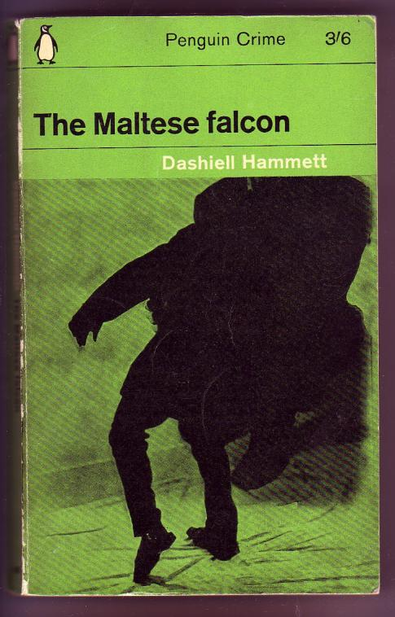

Slide 47
Twenty-First Century
Two important books by Richard Layman make the case for The Maltese Falcon as a great American novel:

Slide 48
Twenty-First Century
Two important books by Richard Layman make the case for The Maltese Falcon as a great American novel:
The Maltese Falcon (2000), volume 3 of the Literary Masterpieces series

Slide 49
Twenty-First Century
Two important books by Richard Layman make the case for The Maltese Falcon as a great American novel:
The Maltese Falcon (2000), volume 3 of the Literary Masterpieces series
Dashiell Hammett’s The Maltese Falcon: A Documentary Volume (2003), an extensive collection of hard-to-find material including previously unknown reviews, correspondence, sales figures, book covers, news articles, and critical essays

Slide 50
Further Avenues of Inquiry

Slide 51
Further Avenues of Inquiry
Genre Studies: The Maltese Falcon and Hard-Boiled Detective Fiction

Slide 52
Further Avenues of Inquiry
Genre Studies: The Maltese Falcon and Hard-Boiled Detective Fiction
Historical Approaches: The Maltese Falcon and the American 1930s

Slide 53
Further Avenues of Inquiry
Genre Studies: The Maltese Falcon and Hard-Boiled Detective Fiction
Historical Approaches: The Maltese Falcon and the American 1930s
Philosophical Approaches: The Flitcraft Parable and Moral Responsibility

Slide 54
Further Avenues of Inquiry
Genre Studies: The Maltese Falcon and Hard-Boiled Detective Fiction
Historical Approaches: The Maltese Falcon and the American 1930s
Philosophical Approaches: The Flitcraft Parable and Moral Responsibility
Gender Studies: Sam Spade and the Hard Boiled Masculine

Slide 55
Further Avenues of Inquiry
Genre Studies: The Maltese Falcon and Hard-Boiled Detective Fiction
Historical Approaches: The Maltese Falcon and the American 1930s
Philosophical Approaches: The Flitcraft Parable and Moral Responsibility
Gender Studies: Sam Spade and the Hard Boiled Masculine
Economic Concerns: The Maltese Falcon and the Gold Standard

