Slide 1
Yoga for Teaching Professionals
Sallie M. Scovill, PhD
Health Promotion and Human Development
sscovill@uwsp.edu

Slide 2
Objectives
Learn simple, workplace yoga techniques to support self-awareness, self-regulation, social and emotional health, and resilience
Facilitate work readiness which improves productivity
Become a more effective employee, you can lead and practice these tools with your co-workers, student workers and provide higher level of student services

Slide 3


Importance of Yoga and Mindfulness for Yourself
Studies support the efficacy of yoga to improve physical and mental health outcomes
(Alexander et al., 2015)
  Chronic Back Pain (Patil et al., 2018)
  Improved Quality of Life in the physical, psychological, and social health domains (Patil et al., 2018)
  Reduce Blood Pressure (Cohen, 2013)
  Combat Compassion Fatigue (Figley Institute, 2012)
  Reduce stress and burnout at work (Alexander et al., 2015)
  Improvement in professional’s counseling skills and therapeutic relationships (Schure, Christopher, & Christopher, 2008)
  Other areas include reduction in headaches, insomnia, and nervousness. (Kauts & Sharma, 2009)

Slide 4
Activity and Work
Why Move?
Too much sitting is BAD!!!
Biological link between movement and thinking processes. (Jensen, 2005)
  Oxygen is essential for brain function.
  Movement is an effective cognitive tactic
    increase attention to material processing
    improve memory and retrieval of information
    boost motivation and morale.
Sitting for long periods of time has detrimental health effects. (Levine, 2015)
  Increased risk of diseases such as obesity and metabolic syndrome.
  Fatigue, low attention.
Moving triggers processes that break down fat and sugar in the body instead of stalling these processes.
Notes:
Oxygen is essential for brain function, and with enhanced blood flow created through physical activity, the amount of oxygen transported to the brain increases.

Slide 5

Importance of Yoga and Mindfulness to Student Learning
Students
Learning
Positive effects on a psychophysiological level that leads to decreased levels of stress in college student (Tripathi et al., 2018)
Physiological improvements in strength and perception of menstrual pain in college students. (Tripathi et al., 2018)
lowers the aggressive and maladaptive behavior of students. (Krauts & Sharma, 2009).
Increased self-regulation, stress reduction, greater self-esteem and improved physical conditioning. (Wang & Haggins, 2016)
Practice of yoga improved test scores in Mathematics, Science, and Social Studies. (Kauts & Sharma, 2009)
Low-stress students performed better than high-stress students. (Kauts & Sharma, 2009)
Improves memory and academic performance. (Ferreira-Vorkapic et al., 2015; Wang & Haggins, 2016).

Slide 6
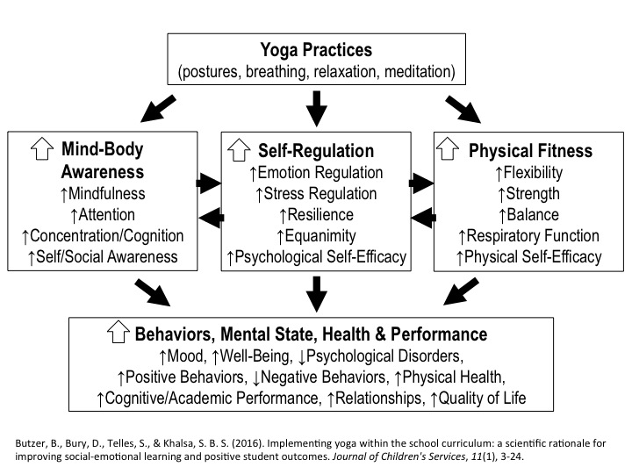

Slide 7
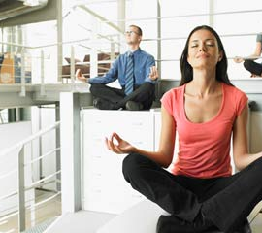
Crafting Activity Breaks
Assignment Description

Slide 8

How to get started
Breathing – Pranayama
  Sit and breathe (mindfulness, awareness)
  Mountain Pose (grounding)
    Extended Mountain
  Crescent Pose (opening ribs)
  Cat and Cow Pose (spine and neck)
  Seated twists (neck pain and stiffness)
  Tree Pose (balance and focus)
  Warrior One (hips)
  Seated Pigeon Pose (hips, low back pain)
  Forward Fold (Hamstring)
  Dancer – seated, kneeling, or standing (balance and hip opener)
  Savasanna (sit and breathe)
    Channel Cleansing Breath (Nadi)
Find reputable links to videos or exercises online. https://www.yogajournal.com/practice/beginners/how-to/office-yoga
Download apps for guided mindfulness.
https://www.youtube.com/watch?v=SEfs5TJZ6Nk
Reminders at your Desk
chrome-extension://kopilngnmfklhhjocdfdlokmodibcbmk/activity_tab.html

Slide 10

Channel Cleansing Breath
Nadi Shodhana Pranayama (Alternate Nostril Breathing Technique)

Slide 11

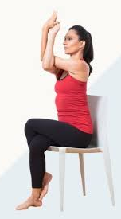

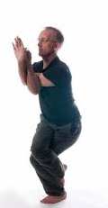
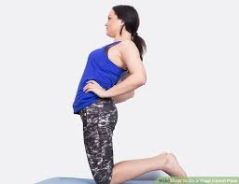
How to get started
Breathing – Pranayama
  Sit and breathe
  Mountain Pose (grounding)
    Extended Mountain
  Crescent Pose (opening ribs)
  Cat and Cow Pose (spine and neck)
  Tree Pose or Eagle (balance and focus)
  Camel Pose (heart opening)
  Seated Pigeon Pose (hips, low back pain)
  Savasanna (sit and breathe)
Use resources from the Well Wisconsin Program.
21 Day Meditation Challenge
Health Library
https://wellwisconsin.staywell.com/Learn.aspx
https://wellwisconsin.staywell.com/Programs/21-Day/All-21-Day.aspx

Slide 12
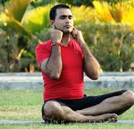
Humming Bee Breath
Instant way to relieve tension, anger and anxiety. It is a very effective breathing technique for people suffering from hypertension as it calms down the agitated mind.
Gives relief if you're feeling hot or have a slight headache
Helps mitigate migraines
Improves concentration and memory
Builds confidence
Helps in reducing blood pressure

Slide 13
Where can I get more resources?
Employee Wellness
  Email
    Empwell@uwsp.edu
  EW Facebook
    https://www.facebook.com/UWSPPAWs/photos/a.10150848588086719/10155859825591719/?type=1&theater
  EW Monday Message for weekly updates on activities on campus and in the community
Apps and poses
  Pocket Yoga
    http://www.pocketyoga.com/Home
  Yoga Journal
    https://www.yogajournal.com/
Read more
  A Case for More Yoga on Campus: Yoga as Self-Care for Higher Education and Student Affairs Professionals
    https://core.ac.uk/download/pdf/51067241.pdf

Slide 14

Questions?

