Slide 1
Making Courses More Transfer-Student Friendly
Dr. Erin D. Speetzen
Dr. Sirin Budak
*Copies of this presentation will be available to attendees after the conference.

Slide 2
Session Goals:
Provide attendees with some context for transfer enrollment at UWSP.
Provide attendees with small changes they can make to their courses to help transfer students succeed.
Provide attendees with some medium-term changes that they could consider for the future.

Slide 3
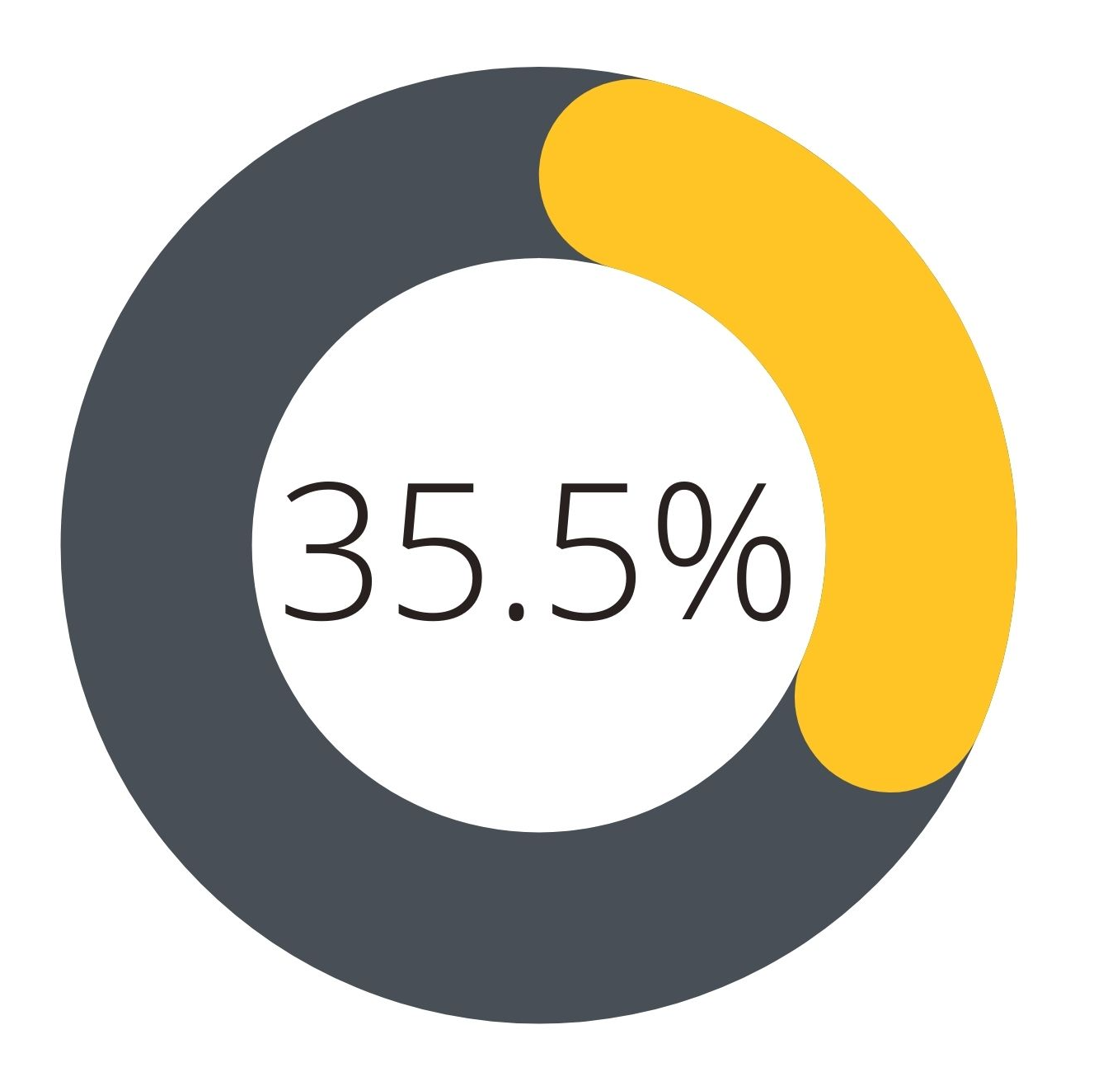
During the 2019 – 2020 academic year, UWSP welcomed a total of 1,932 new students to our campuses. Of these:
685 (35.5%) were new transfer students
1247 (64.5%) were new first-year students

Slide 4
Notes:
UW System no longer breaks UW-System into 2-year vs 4-year schools
Historic data
2018 - 2019 2017-2018 2016-2017
% Collleges 26% 29% 23%
% 4 year 22% 19% 16%

Slide 5
Small Change #1
Send a welcome email before the first day of class with a link to the UWSP Canvas login page, and to the self-paced Canvas student training.
Sample welcome emails from Taft College.

Slide 6
Bonus recommendation: For emails like this, that will stay largely the same from course to course, or semester to semester, consider creating an email signature that contains the content so that its in an easy to find location. All you’ll have to do is insert the signature, update the year/course name, and hit send!

Slide 7
Small Change #2
List prerequisite skills, not just prerequisite courses in your syllabus.
Particularly important for non-content skills (accessing library resources, using course-specific software, etc.)
Example from my Biophysical Chemistry Course:
Old Syllabus Language
Prerequisites: Chem 365, Math 225, Phys 204 OR Phys 250

Slide 8
New Syllabus Language:
This course has several prerequisites: Chem 365 (Biochemistry I), Math 225 (Calculus I), and Phys 204 (College Physics II) OR Phys 250 (University Physics II). The skills from these courses that will be important for your success in this course include your ability to:
Identify types of protein secondary structure from ribbon diagrams.
Distinguish between different types of protein-ligand binding (i.e., competitive, non-competitive, etc.).
Interpret signs and magnitudes of thermodynamics quantities (i.e. what does it mean if $ΔG$ is negative, or if $K$ is large?).
Use Excel (or another program) to make graphs and fit trendlines.
Take derivatives and integrals of functions such as polynomials, trig functions, and natural logarithms.
Relate the value of an integral to the area under a curve, conceptually and using numerical methods (i.e., the trapezoid method or Simpson’s rule)
Use mathematical models to describe the behavior of a system and calculate related quantities.

Slide 9
Bonus recommendation: If there are non-content related skills that students may not have, do you have resources prepared to help get them up to speed such as:
Handouts from previous courses.
Links to YouTube tutorials.
Links to UWSP webpages.

Slide 10
Small Change #3
Facilitate student-student interaction in your course early and often.
Icebreakers
Content review activities
Syllabus scavenger hunts
Canvas group assignments/discussions/peer review etc.

Slide 11
Bonus recommendation: You can set up groups in Canvas to provide small groups of students the opportunity to interact regularly over the course of the semester.

Slide 12
Small Change #4
Include information on campus resources and policies in your Canvas site.
Tutoring services
Academic and Career Advising
Counseling center
Technology help
The Dean of Student’s Office has a great catch-all website that lists campus resources and contact information for a variety of situations.

Slide 13
Bonus recommendation: CITL has put together a student resources module and has shared it to Canvas Commons. You can search UWSP Student Support to access it and import it into your course. Feel free to reach out to any CITL staff member for help.

Slide 14
Medium-Term Strategies
Knowing your students’ socio-economic status
Picking course materials not just for instructor’s convenience but also students’ economic level
Providing alternative free resources for the students who wants to have more practice or fill the gap in their academic journey.

Slide 15
Medium-Term Strategies
Knowing your students’ channel of communication
Be aware of what communication tools your students are using these days.
Give your students a chance to use the same type of tools in your classwork.
Search how those tools can be effectively used in your class.
How would you use social media effectively to increase the motivation in your classroom?

Slide 16
Final Note: CITL will be releasing a self-paced Canvas training on Promoting Transfer Student Success that builds on this presentation and goes beyond just changes we can make in the classroom. Keep your eye out for an email announcement with enrollment information.

Slide 17
Topic for discussion: What strategies have you used to help transfer students succeed?

