Slide 1
Embedding External Certifications into University Coursework:
A Collection of Natural Resource Case Studies

Slide 2
Generally, my students fall under several categories, which can be characterized by their response to these photos.

Slide 3
Generally, my students fall under several categories, which can be characterized by their response to these photos.

Slide 4
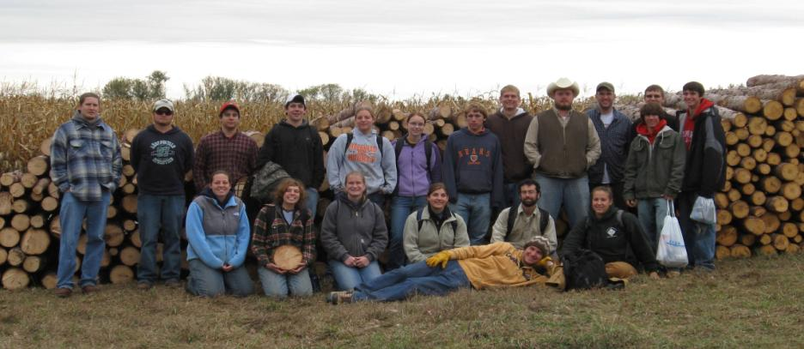

Slide 6
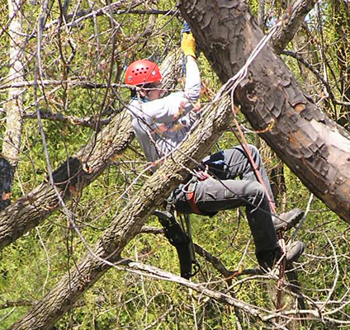
Photo Les Werner

Slide 7
For that reason, there is an emphasis on…
Career preparation
Field laboratories
Use of flipped classes
Leaving the program as “field ready”

Slide 8
Within Natural Resources, skills-based certifications backed by a professional entity are a significant driving influence in the field

Slide 9
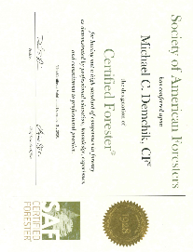
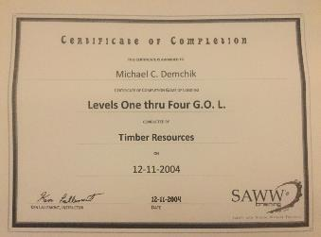
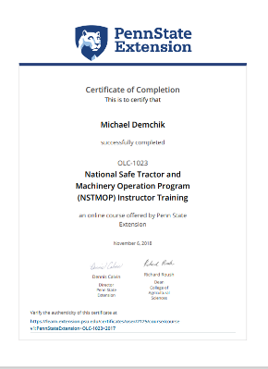
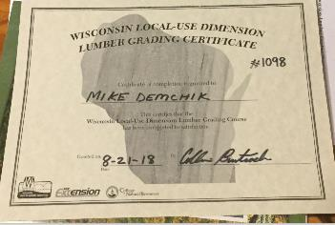
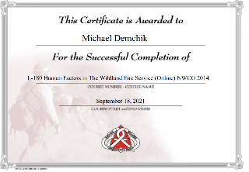
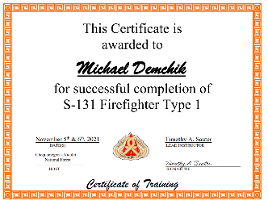
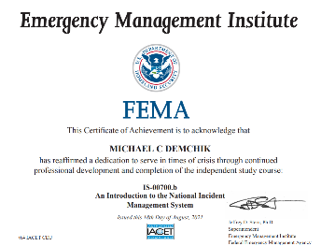
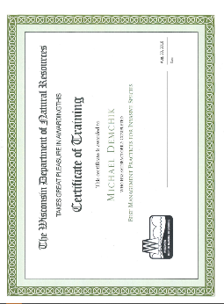
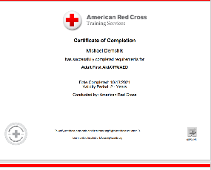
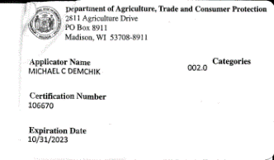

Slide 10
For a later career forester like me, that means attaining and/or maintenance of 48 different certifications

Slide 11
For forestry students, the potential employment impacts of this cannot be overstated

Slide 12
Steps
A few examples
Packaging them into a UWSP Certificate
Embedding them within a major

Slide 13
WI Pesticide Applicators Cert (external certifier DATCP)

Slide 14
For 336 Pesticides in Natural Resource Management
One credit class- For 336
Class is divided into two parts:
The safe use (directed at passing the certification exam)
The science of the chemicals and prescriptions (the hardcore part of the class)
Pass the exam, certified for 5 years in WI

Slide 15
WI BMP Cert for Water Quality and Forest Health (external certifier WDNR)

Slide 16
For 337 Best Management Practices Certification
One credit course
Two-day workshop on WI BMP cert for Water Quality and Forest Health
During semester, develop an access plan for a property following all applicable BMP’s complete with map and detailed description

Slide 17
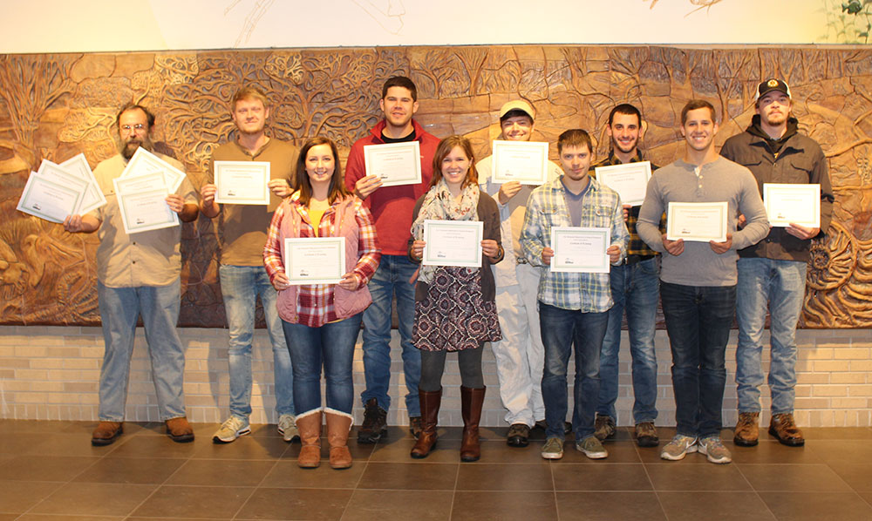

Slide 18
For 434 Sec 3 Restoration Field Techniques: AKA an entire class of certs

Slide 25
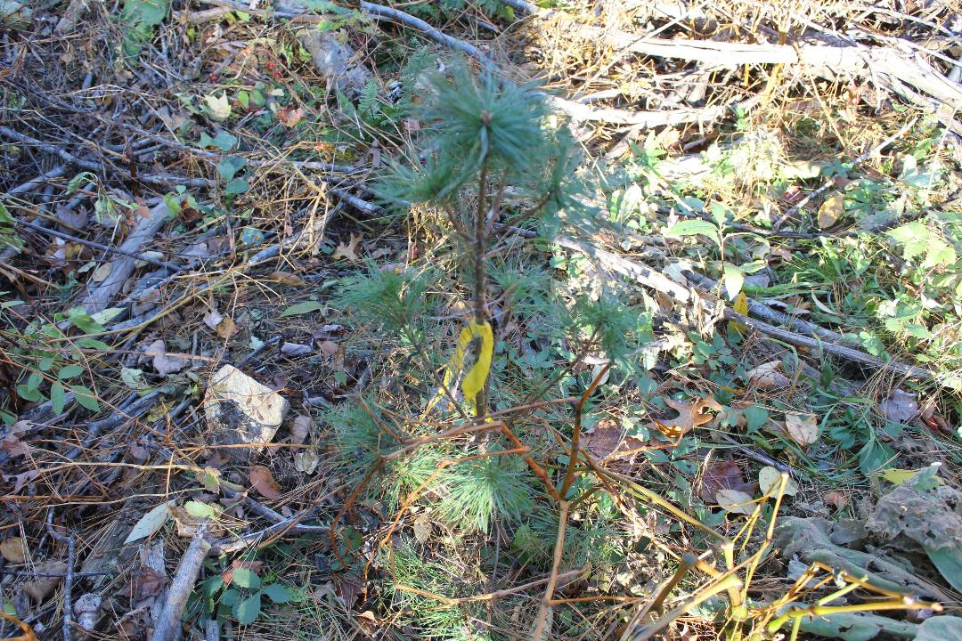

Slide 26
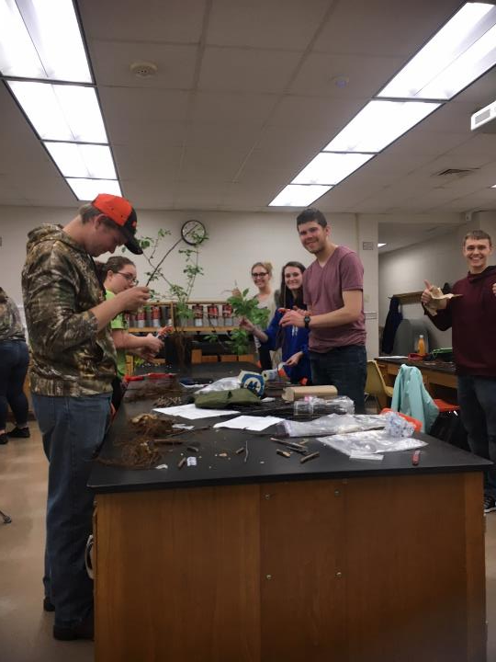

Slide 28
Fire Science

Slide 29
Fire Science
While these have been offered in the past, we just signed an MOU with the USFS regarding future offerings
Basic impacts
Intermediate certification trainings
Red Cards
Field experience in prescribed burns

Slide 30
Fire Science
S-212- Wildland Fire Chainsaw- Annual
S-211- Portable Pumps and Water Use- Biennial
S-219- Firing Operations- Biennial
S-131- Fire Fighter Type 1- Biennial
S-270- Basic Air Operations- Biennial
S-290- Intermediate Wildland Fire Behavior- Biennial
L-280- Followership to Leadership- Biennial
RT-130, Wildland Fire Safety Training Annual Refresher- Annual

Slide 31
Steps
A few examples
Packaging them into a UWSP Certificate
Embedding them within a major

Slide 32
Example 1: Fire Science Certificate

Slide 33
Classes
FOR 224 - Fire Operations (1 credit)
Online required certs- IS100 (I will require IS700 in the future)
In-person Certs
S190, L180, S130
FOR 324 - Fire Management and Ecology (2 credits)
FOR 326 - Wildfire Prevention and Management (1 credit)
For 381 Internship (3 credits) or NRES 454 - Fire Behavior and Fuels (3 credits)

Slide 34
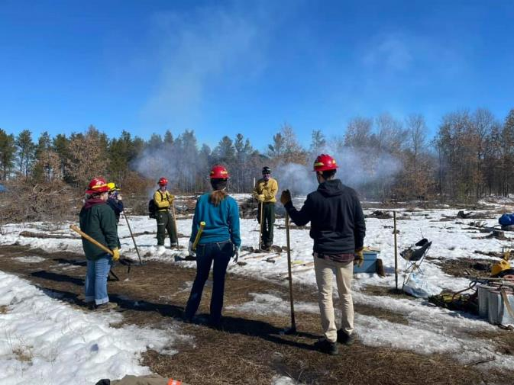

Slide 35
Certifications
S-130, S-190, L-180, IS100, (in future IS 700)
USFS CERTS (at least two of these)
S-212 – Wildland Fire Chainsaw
S-211 - Portable Pumps
S-219 - Firing Operations
S-131 - Fire Fighter Type 1

Slide 36
Example of this Year’s Offerings
Fall 2021
S-131, Firefighter Type 1
S-290, Intermediate Wildland Fire Behavior
Spring 2022
S-212 – Wildland Fire Chainsaw
S-219, Firing Operations

Slide 37
Experience
Experience…. Cook County or Florida
Fire summer job
Fire internship

Slide 38
Example 2: Timber Marking Cert

Slide 39
Required Courses
FOR 432 | Silviculture | 3 cr.
FOR 436 | Managing Non-Industrial Private Lands | 2 cr.
FOR 370 | Forest Products | 2 cr.
FOR 434 Sec 1 | Northern hardwood timber marking | 2 cr.
FOR 434 Sec 2 | Timber Marking for Wildlife Habitat | 1 cr.
FOR 434 Sec 3 | Restoration Techniques | 1 cr.
 | Total Required Credits | 10 cr.

Slide 40
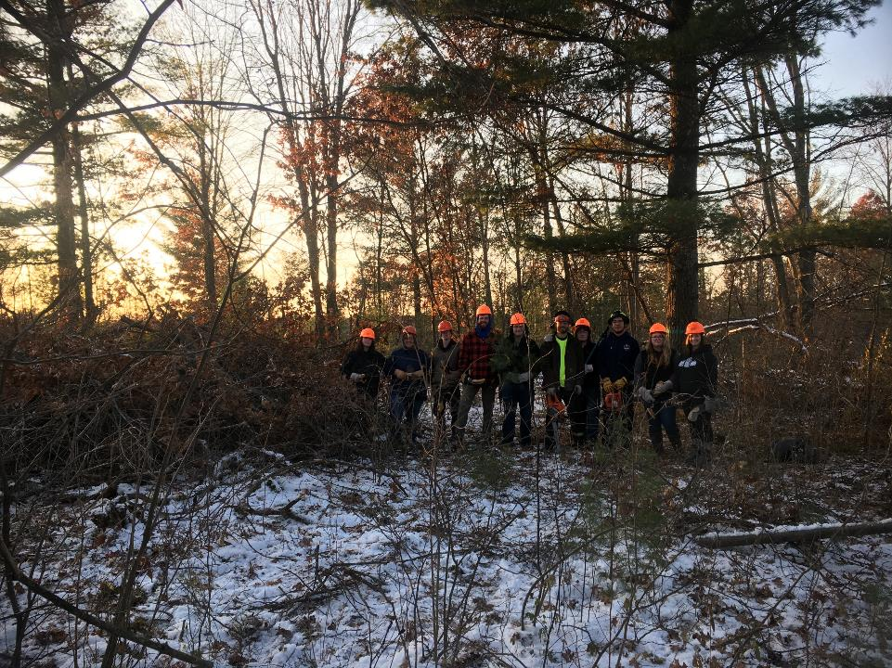

Slide 43
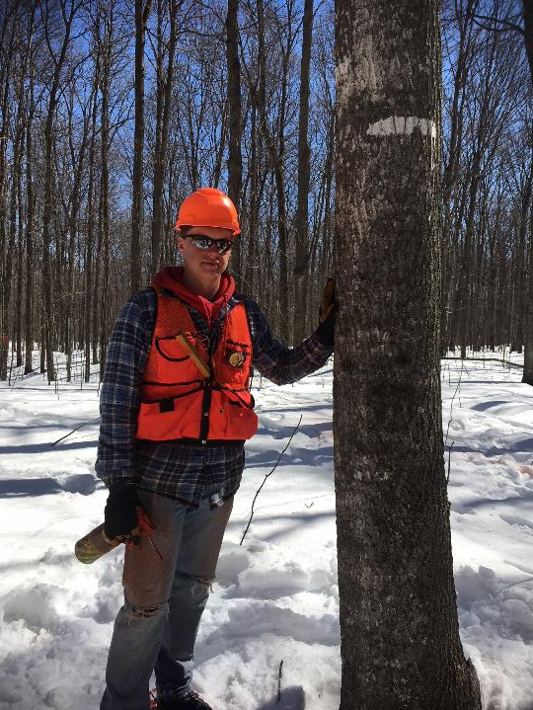

Slide 44
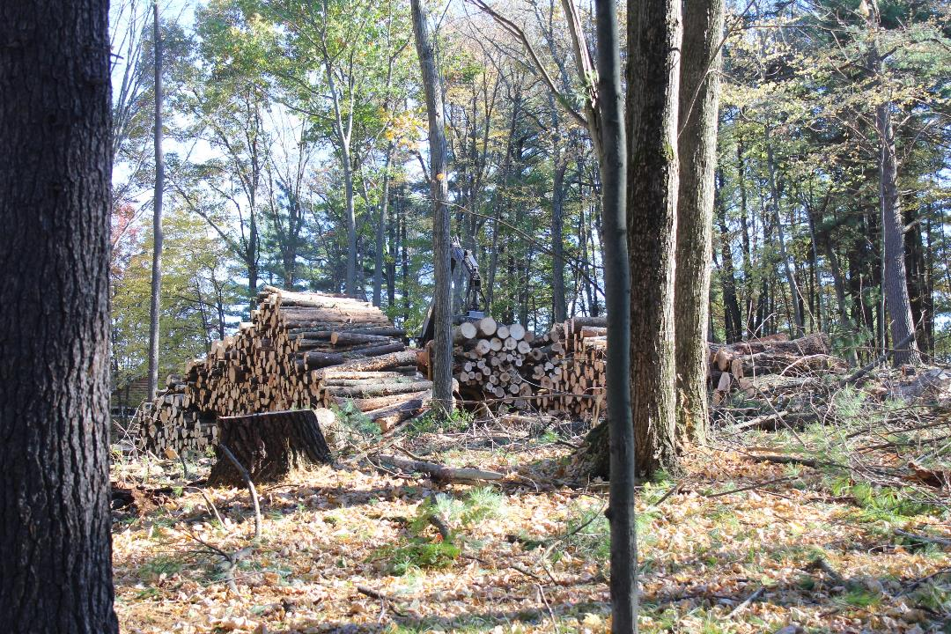

Slide 45
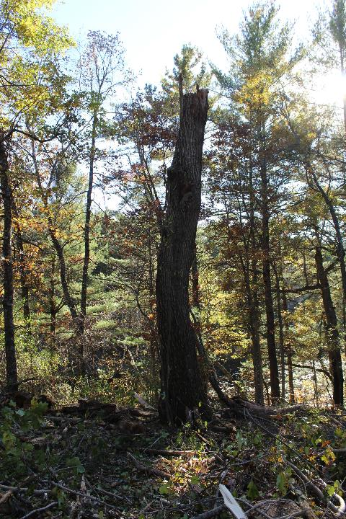

Slide 46
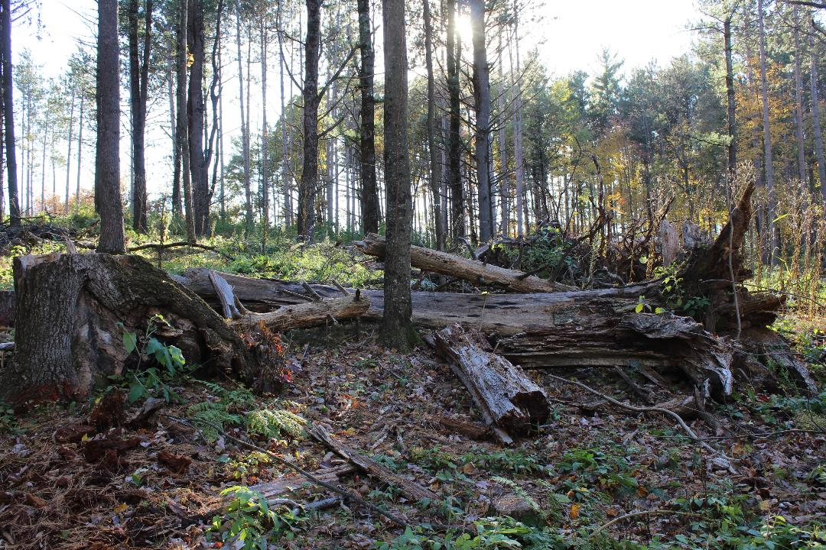

Slide 47
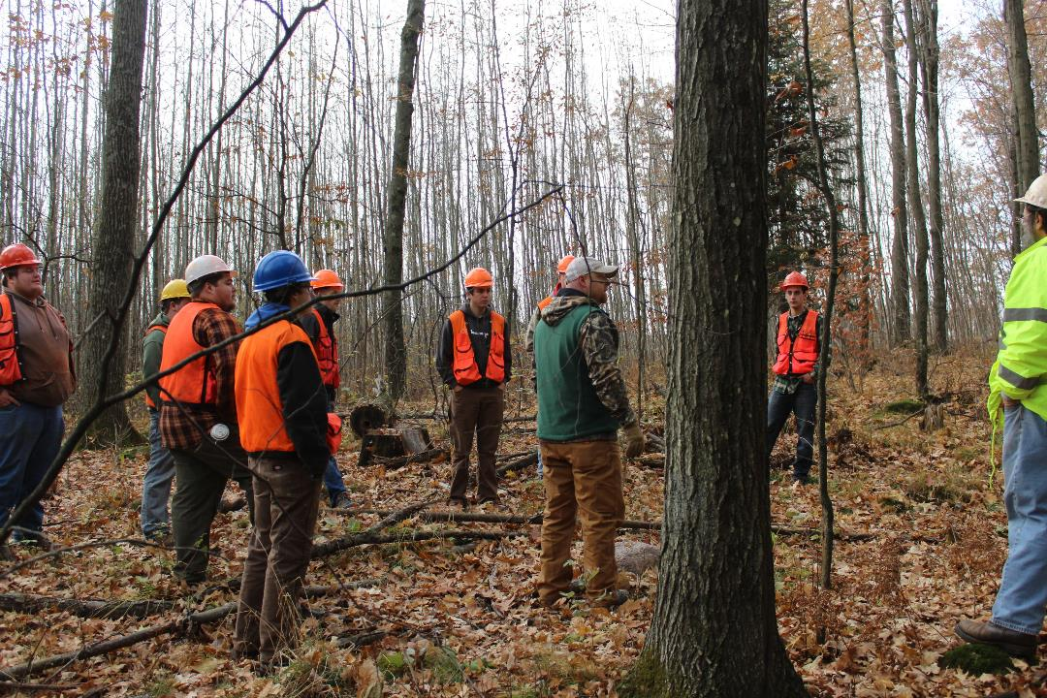

Slide 48
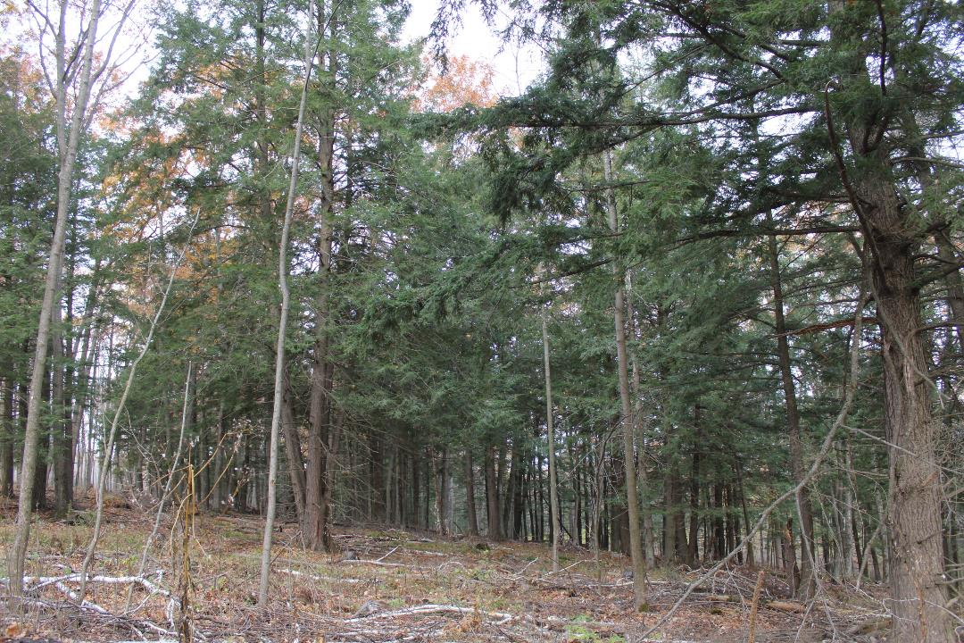

Slide 49
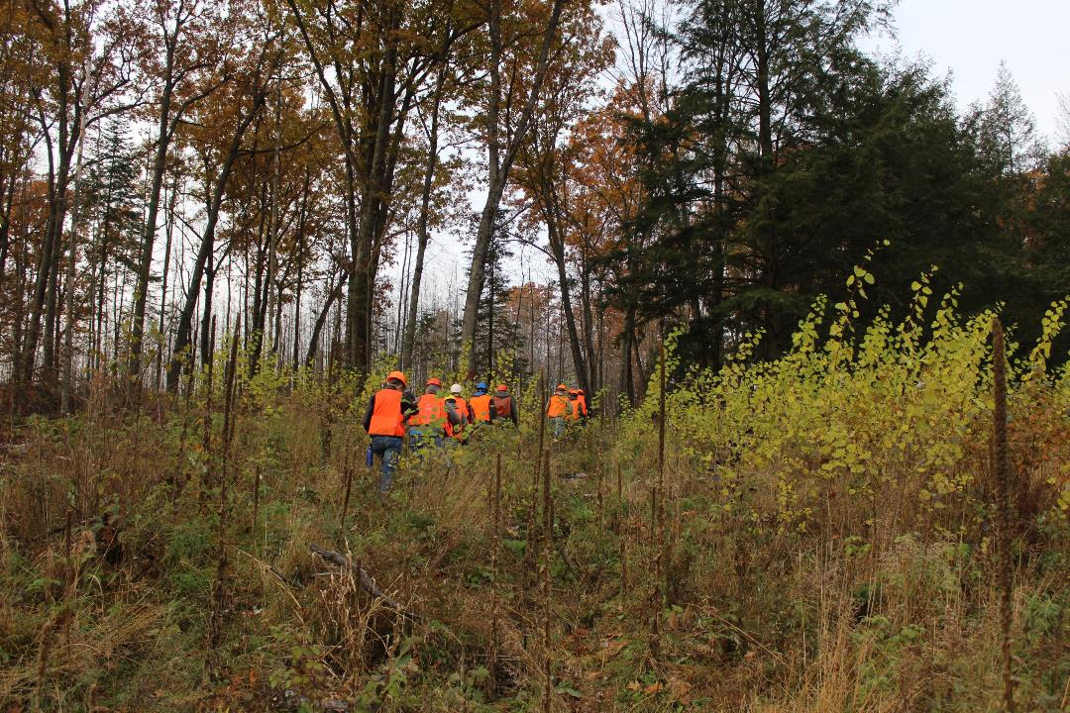

Slide 50
Steps
A few examples
Packaging them into a UWSP Certificate
Embedding them within a major

Slide 51
Forestry: Ecosystem Restoration and Management
This is in-process
With updates, will be submitted for review by SER to automatically qualify students as CERP-IT
For 224: Fire Operations Credits: All will have Fire Fighter Type 2 qualifications
For 336: Pesticides in Natural Resource Management Credits: All will have had the chance to get certified
Fire Track (one of the following certificate based classes)
FOR 337 - Wisconsin Forestry Best Management Practices Credits: 1 or
FOR 395 - Tree Care Techniques Credits: 1 or
FOR 434 - Field Practices in Silviculture Credits: 1-3 (Take 1-2 credits.)
Will have at least 2 additional Federal Fire Certs

Slide 52
Student Evaluation Comments
“Really liked that we were able to receive a best management certification that I can use in my future jobs. Learned a lot about real life forestry and how to address problems and fix them. Very happy with the course”
“Very informative and loved being able to take cert exams in class”

Slide 53
Student Evaluation Comments
“…his classes really help to gain the fundamental skills and practices that are needed by students who are trying to become some of the best in the field and will help them to surpass their counterparts that are going to be their competition when they graduate.”
“I wish all my classes were like this, I realize that this is a university, but having the hands on experience really helps to drive home the things that I am learning and helps me to better grasp the concepts that are being taught.”

