Slide 1
Finding Joy in Academic Community
Using a SoTL FLC as
Community-Building Praxis
James Berry, Jess Bowers, Lauren Gantz,
Amanda Jonsson, Katja Marquart,
Erica Ringelspaugh, Krista Slemmons
30th Annual UWSP Teaching Conference
January 14, 2026

Slide 2
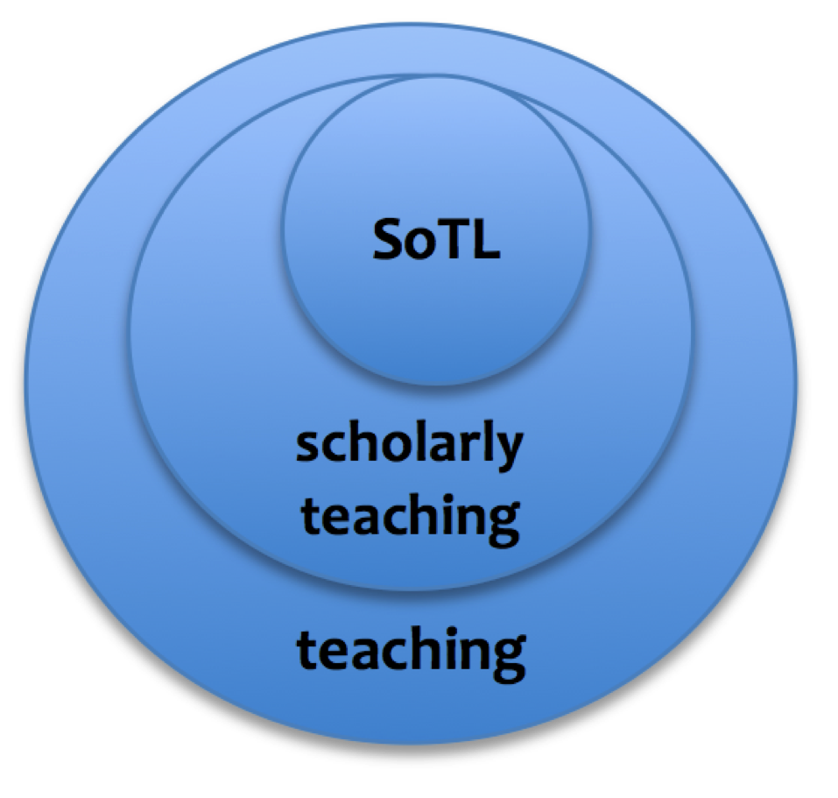
What, exactly, is a SoTL FLC?
SoTL is an acronym for the Scholarship of Teaching and Learning, often understood as systematic inquiry into student learning, and advancing the practice of teaching by making the inquiry public.
FLC is an initialism which stands for a Faculty Learning Community. These short-term communities are focused on bringing together academic staff from a variety of backgrounds for specific purposes related to teaching and learning.
At UWSP, FLCs are administered by the Center for Inclusive Teaching and Learning.

Slide 3
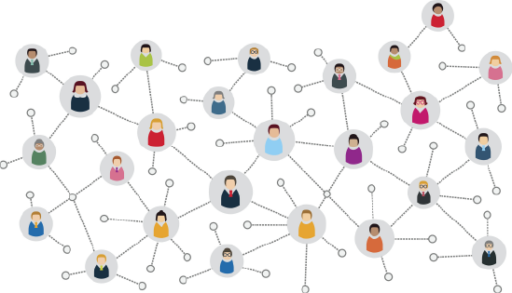
Cool things we've noticed
INNOVATION
Early-career instructors can learn more about their role at a teaching-focused university
RENEWAL
Mid-career instructors can maintain professional wellbeing and fend off burnout
In what ways could SoTL fit into your professional goals?
Notes:
Krista will talk about Innovation; Lauren Renewal.
Jess will add a bit; ask discussion question

Slide 4
Meeting topics: Fun stuff!
Discussion of a shared text
Presentations from experienced SoTL scholars at UWSP
Sharing of works in progress
Collaboration opportunities
Ways to make research public
  UWSP Teaching Conference
  OPID Spring Conference
  National Conferences (e.g. SoTL Commons)
  International Conferences (e.g. ISSOTL)
  Publications (disciplinary and SoTL journals)
Notes:
James and Jess

Slide 5
More topics: Some concerns
IRB is scary—how do I do it?
How do we distinguish between quantitative, qualitative, and mixed-method approaches?
What are ways to get funding for my SoTL project?
How do I overcome large-scale challenges (exhaustion, low bandwidth, overwork, generative AI, other constant threats) when trying to accomplish professional goals like a SoTL project?
SoTL seems intimidating. Would I really fit in?
Notes:
Erica transitions from previous slide and facilitates the popcorn. Back up: Katja

Slide 6
Overall, the experience of building this SoTL FLC has been exciting and fulfilling.
We would like to create a more permanent Community of Practice.
Notes:
People will share the ways this has been meaningful and impactful.

Slide 7

Let's kick off a discussion! We're going to start off with some spiral journaling.
First, draw a spiral in the middle of the page. Take about a minute to do this. Let your mind clear while drawing the spiral. Don't make it too huge.
Next, divide the page into quadrants. Ask yourself the following questions:
How important is it to me to focus on teaching and learning? Why does it matter to me? | What are some advantages that I might take away from becoming involved in a longer-term SoTL Community of Practice?
How would investigating SoTL as a secondary discipline be useful for me? Are there issues in my classroom that I could address using SoTL practices? | What are some challenges I might face if I joined a SoTL Community of Practice?
Notes:
James will introduce and then we will take turns asking questions in quadrant. 1. Amanda 2. Erika 3. Krista 4. Jess

Slide 8
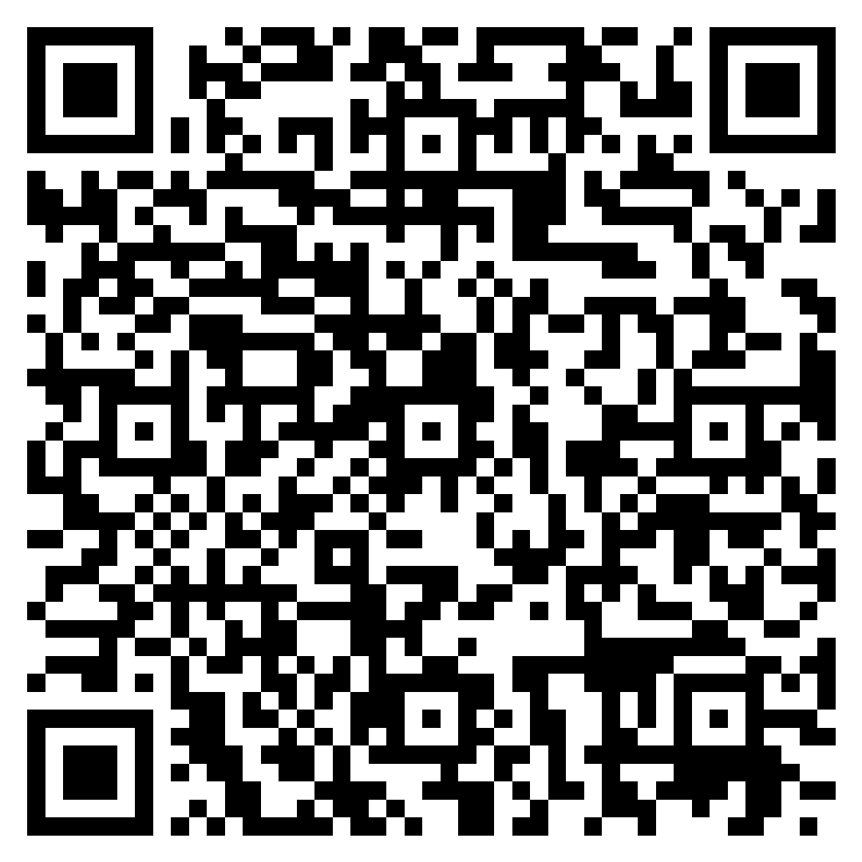
Discussion
Prompts for discussion:
Takeaways from spiral activity
Interest in participating in a Community of Practice
What do you need to be able to participate?
Are there any barriers to your participation?
Are there any other questions we can answer?
SIGN-UP SHEET COMING AROUND!
OR USE THIS HANDY QR CODE:
SoTL Community of Practice.whiteboard

