Slide 1
Open Access, High Impact:
Leveraging OERs to Transform Student Engagement
LIBRARIES CITL

Slide 2
The Problem: Textbook Accessibility
Traditional textbooks are expensive for students.
Text rental programs don’t work well for online students.
Increasingly difficult to access the textbook of choice.
Classroom inclusion: traditional materials can exclude diverse voices.
LIBRARIES CITL

Slide 3
The Solution: Open Textbooks
OER (Open Educational Resources): teaching, learning, and research materials that are available under an open license that permits no-cost access, use, adaptation and redistribution by others.
AER (Affordable Educational Resources): may also include library-licensed materials, offering additional options.
LIBRARIES CITL

Slide 4
Student Engagement
Because OER are openly licensed instructors can modify them to
meet the education needs and background knowledge of their students
include examples that are local and/or more relevant to students' daily lives
increase the representation of underrepresented or marginalized groups
These modifications can increase student efficacy, interest, and belonging and lead to higher engagement.
LIBRARIES CITL

Slide 5
Open Pedagogy
Open pedagogy = involving students in the creation, adaption, or updating of OER materials.
Textbook contributions
Test bank questions
Case studies
Wikipedia articles
Open pedagogy is a type of experiential learning where students demonstrate their understanding through content creation and can make a great high-impact practice!
LIBRARIES CITL

Slide 6
What Textbooks Make Good Candidates?
High-cost textbooks
Textbooks nearing their 3-year update window
Print version no longer available
Courses with high enrollment
Online courses
General Education courses
LIBRARIES CITL

Slide 7
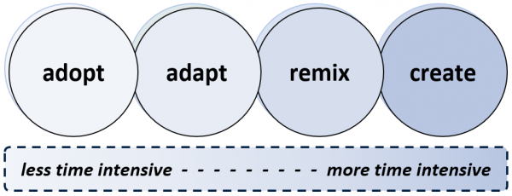
How Can You Use OER?
LIBRARIES CITL
https://library.unimelb.edu.au/open-scholarship/adopt-adapt-share

Slide 8
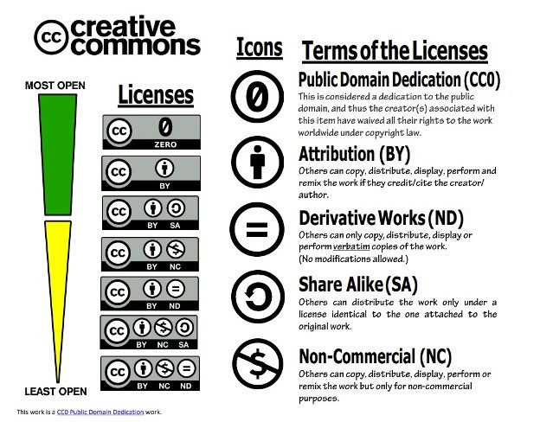
Creative Commons Licensing
Openly licensed materials can be used and reused legally in more ways than traditionally copyrighted materials.
LIBRARIES CITL
https://teaching.resources.osu.edu/teaching-topics/simple-guide-creative-commons

Slide 9
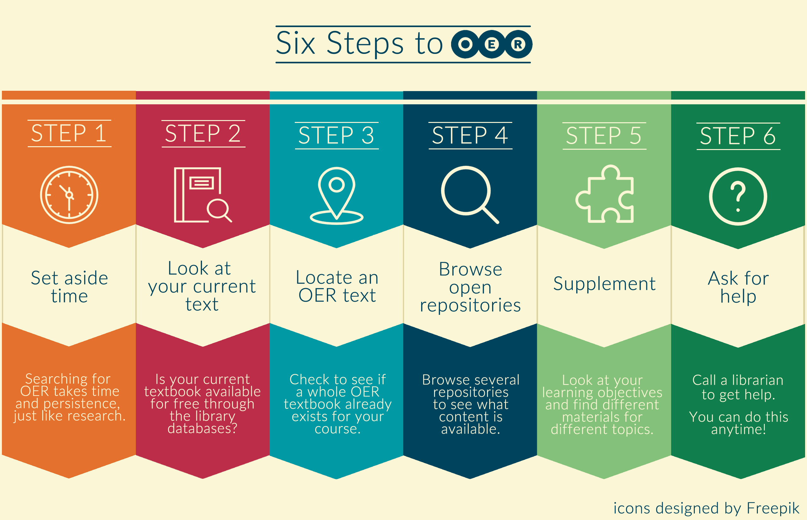
Finding OER: Resources and Tools
Library Guide: https://libraryguides.uwsp.edu/OER
LIBRARIES CITL

Slide 10
Considerations
Is there an existing OER that can be adapted?
Are additional (ancillary) materials needed such as text banks, quizzes, homework platforms, slides, and lesson plans?
Is it accessible?
Accessibility of Web Content Requirement: The Web Content Accessibility Guidelines (WCAG) Version 2.1, Level AA is the technical standard for state and local governments’ web content and mobile apps
How will course materials be shared?
Do students still need a print copy?
LIBRARIES CITL

Slide 11
UWSP Support
Library
Library Guide: https://libraryguides.uwsp.edu/OER
CITL
UW System Support
Pressbooks: https://wisconsin.pressbooks.pub/
LIBRARIES CITL

Slide 12
Questions?
LIBRARIES CITL

