Slide 1
Negotiating Academic Authority and Centering Marginalized Perspectives
Presenters: James Berry, Lauren Gantz, Lara Garrido
Notes:
Introduction – who am I, what are my roles at UWSP, what do I teach. In addition to my position within the English Dept., I also coordinate the WGS minor and serve on the EDIPC. Nearly all of the courses I teach (aside from composition) carry U.S. diversity or global awareness designations.

Slide 2
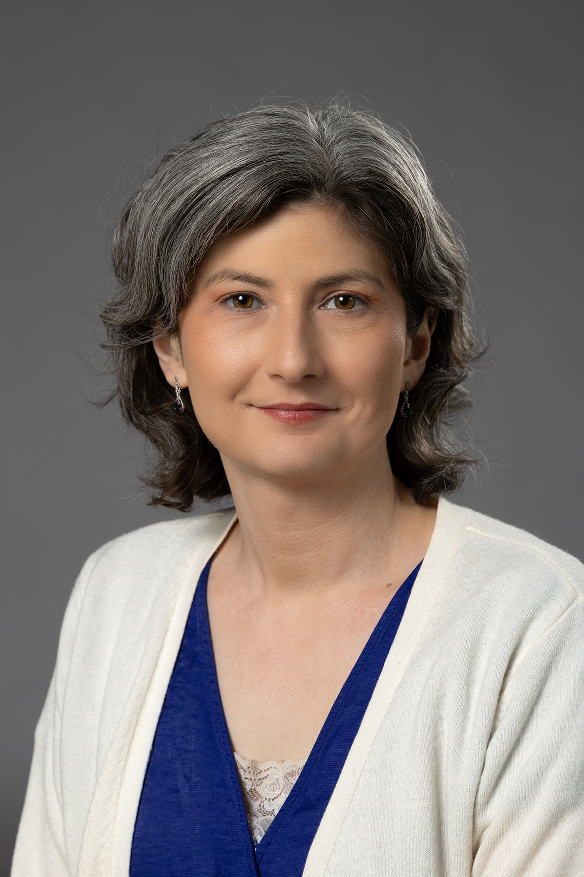
Challenges of Implementing Diversity as a High Impact Practice
Lauren Gantz
Associate Professor of English
Women's and Gender Studies Coordinator
Lgantz@uwsp.edu

Slide 3
What are our goals for diversity?
Diversity as HIP
Explore "'difficult differences'" (AACU)
Experiential learning (AACU)
Equitable access (Oxford Review)
Diversity LO's at UWSP
Describe construction of "diverse identities"
Explain how various groups have responded to oppression
Empathy/understanding of diverse perspectives
Global Awareness LO's at UWSP
Identify key differences between cultures
Analyze global interconnectedness
Curiosity about and empathy for other cultural perspectives
Notes:
I think it's beneficial to start by clarifying exactly what we're striving for when we discuss "diversity" in our teaching. In the realm of HIPs, diversity is described in terms of examining "difficult differences"--racial, ethnic, and gender inequality, as well as global struggles for human rights and freedom. The American Association of Colleges and Universities recommends linking these explorations with experiential learning, such as service learning and study abroad. I also like the Oxford Review's emphasis on equitable access, ensuring that students from underrepresented groups can participate fully.
UWSP's U.S. Diversity and Global Awareness learning outcomes fall primarily under the umbrella of the first HIP—exploring "difficult differences." Since these learning outcomes shape our curriculum, I want to examine some of the challenges we might face when attempting to implement them.

Slide 4
Challenges of Implementing Diversity as HIP: Institutional Demographics and Instructor Authority
Negotiating the status/meaning of "expert"
Extractivist history of academia
Equitable community partnerships
Source: UWSP Common Data Set, 2020-21
Notes:
Implementing diversity effectively in our teaching is rife with challenges. For the sake of time, today I'm just focusing on a couple of issues I've dealt with in my own classrooms.
The first is simply the fact of our institutional demographics. As most of us know, UWSP is a PWI, both in its instructor make-up and its student body. In 2020, only 10% of our instructors were people of color—30 in total. The reality is that most of our diversity-related curriculum is delivered by white faculty (like myself) to white students.
While we as individual instructors can't control these demographics, we can respond to them mindfully. The three points I'll raise here are all intertwined. First, we must consider how (or if) we present ourselves as "experts," particularly if we're teaching about cultures or communities other than our own. Second, we need to be cognizant that marginalized groups have often been mined for knowledge by academics in pursuit of expert status—in many cases without consent or recompense. We should avoid replicating this tendency in our own research and teaching. Finally, if we plan to implement experiential or service learning as part of diversity-related HIPs, we have to do so ethically and equitably.

Slide 5
Example Approach: Apprenticeship Pedagogy
Model "not knowing" as an ethical standpoint for students
Accept that not all knowledge is meant for all people
Generate BIPOC "citational community" (Robinson 22)
Seek (and compensate!) BIPOC knowledge-holders
"The apprenticeship process is one of embracing not knowing, of risking sometimes getting things wrong . . . . Risk, vulnerability, not getting things right: these are not terms that usually frame learning in Western academic spaces." (Vellino 168-69)
Notes:
Navigating my own authority as a white, cisgender, heterosexual instructor who primarily teaches works by multiply-marginalized authors has been a long process of trial and error. However, as I was redesigning my Native American literature course in the fall of 2023, I stumbled upon Brenda Vellino's work on apprenticeship pedagogy. Vellino, like myself, is a white academic, and she describes apprenticeship pedagogy as a means to decolonize one's teaching and mitigate the extractivist tendencies of academia. She writes [read quotation].
Although Vellino focuses primarily on teaching Indigenous literatures, there are four key principles from her pedagogical framework that I think can be adapted by any instructor who wants to implement HIPS related to diversity.
[Work through the list, offering examples of what I did in 280]
Model "not knowing"-->acknowledging my own settler colonial status, discussing my own limited exposure to Native culture/history/literature while growing up, emphasizing the limitations of my own knowledge, acknowledging debates within Native community which I have no authority to weigh in on (ex: blood quantum, use of sacred knowledge in literature)
Not all knowledge is meant for all people-->accept the Indigenous "right to refusal;" as a settler colonial individual, I do not have a right to sacred or privileged tribal knowledges/practices; openly discussing the ethics of sharing stories without permission; not asking guest speaker to share any privileged information
BIPOC "citational community"-->built the class around Indigenous theoretical frameworks of storywork, resurgence, survivance, etc.; began the course with works by Native thinkers about stories/storytelling
BIPOC knowledge-holders-->worked with NAC, DAC, HGS, and OPID to get funding for guest speaker to do a Telling; students signed a thank you card; credited speaker on my WTFS project and shared it with both him and the NAC coordinator

Slide 6
Challenges of Implementing Diversity as a HIP: Problems of Framing
"Empathy Machines"
Empathy "is not a one-stop destination; it's a practice" (Castillo 30)
"Oppression Studies"
Can generate "anger, resistance, evasion, and passive-aggressiveness" (TuSmith 21-22)
Ethnographic Voyeurism
Allows students "to experience difference passively while avoiding engagement with actual people and pressing issues" (Eils 34)
Notes:
The second challenge I've dealt with while implementing diversity as a HIP in my own courses comes down to framing. Some of this has to do with the way students have been taught to approach diverse subject matter in their K-12 educations, and some of it has to do with the way our own U.S. diversity and global awareness learning outcomes are written.
Both USD and GA outcomes emphasize that students develop "empathetic insight" about "diverse cultural perspectives." Such goals are well-intended, but as Filipino-American author Elaine Castillo points out in How to Read Now, empathy requires "work from us in our daily lives, for our daily lives--not just when confronted with the visibly and legibly Other" (30). Our students are only required to take one USD course and one GA course to graduate, which doesn't exactly constitute a practice.
This "empathy machine" framework often goes hand-in-hand with other problematic approaches to diversity. Those who adhere to the "empathy machine" idea tend to emphasize teaching historical and structural oppression. Our USD outcomes echo that tendency, requiring students to explain "how marginalized groups and individuals have responded to the experience of discrimination and inequality." While teaching these experiences is important, Bonnie TuSmith explains that this approach is often misunderstood by students and the general public as "oppression studies," breeding resentment among white students and reinforcing narratives of BIPOC victimization and powerlessness. [If time, example of student eval saying I hate white people.] Some of this is out of our control—the cultural narratives around CRT, DEI, and "woke," for example. However, there are certain approaches we might take to mitigate the equation of "diversity" with "oppression studies."
The "empathy machine" framing can also operate in tandem with an ethnographic approach to diversity, in which students engage in a form of tourism—gaining a superficial understanding of an "exotic" Other. Our GA outcomes reflect this tendency, requiring students to identify "the key components found within one or more cultures that are distinct from those found in predominantly English-speaking cultures." As with our USD outcomes, this GA outcome is well-intended. However, as Colleen Gleason Eils notes, when students occupy the role of the "innocent" or "curious voyeur," (note that "curiosity" is also included in the GA outcomes) no demands are made upon them; they're not required to consider how their ethnographic gaze is implicated in larger systems of power and privilege. [If time, provide example of student eval about Love Medicine}

Slide 7
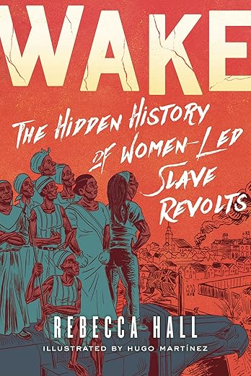
Example Approaches: Resistance Narratives and Metacognitive Inquiry
Include examples of resistance, joy, and humor
Openly interrogate how and why "diversity" is taught
Emphasize that: "[T]hese are stories of human beings living human lives" (TuSmith 25).
Standardize application of analysis and critical thinking
Notes:
I speak of these problematic framings from experience; as a young instructor, I fell into many of these traps myself. It took serious self-reflection, research, and planning to develop courses that can push students out of the "empathy machine," "oppression studies," and "ethnographic voyeur" approaches to diversity. I'm constantly learning and second-guessing myself. That said, there are a few core strategies I've found useful.
Talk through examples of each bullet point:
Resistance/joy/humor-->USD outcome specifies "responses" to discrimination and inequality; responses have taken many forms. Example texts include Wake by Rebecca Hall, Native Poem by Tommy Pico, The Thirty Names of Night by Zeyn Joukhadar, select poems by Gwendolyn Brooks, stories of the No-No Boys, David Henry Hwang's M. Butterfly, etc.
Metacognition-->have students discuss their previous experiences with "diversity" courses or topics; example of my own conversations from Intro to Ethnic Literature; using texts that encourage this kind of interrogation, such as Castillo's book, Nam Le's short story "Love and Honor and Pity and Pride and Compassion and Sacrifice," authors of color who resist or critique the label of "ethnic literature"
Emphasizing the humanity of diverse subjects-->move away from viewing folks as the "objects" of study and toward thinking about relationality. Share example of student who kept responding that he "couldn't relate" to any of our readings.
Critical thinking/analysis-->basically, don't allow students to treat diverse content any differently than your usual course content. For example, I push students in Intro to Ethnic Lit. to engage in close reading/analysis to think about the craft of each author's writing versus simply the content.

Slide 8
Bibliography
American Association of Colleges and Universities. "Trending Topics: High-Impact Practices." https://www.aacu.org/trending-topics/high-impact.
Castillo, Elaine. How to Read Now. Viking, 2022.
Eils, Colleen Gleason. "Narrative Privacy: Evading Ethnographic Surveillance in Fiction by Sherman Alexie, Rigoberto González, and Nam Le." MELUS, vol. 42, no.2, 2017, pp. 30-52. https://doi.org/10.1093/melus/mlx026.
The Oxford Review. "High-Impact Practices: Definition and Explanation." https://oxford-review.com/the-oxford-review-dei-diversity-equity-and-inclusion-dictionary/high-impact-practices-definition-and-explanation/.
Robinson, Dylan. Hungry Listening: Resonant Theory for Indigenous Studies. U of Minnesota P, 2020.
TuSmith, Bonnie. "Frontline Teaching: Ruminations, Sober and Hilarious, of an Ethnic Literature Professor." MELUS, vol. 42, no. 4, 2017, pp. 20-36. https://doi.org/10.1093/melus/mlx062.
Vellino, Brenda. "Apprenticeship Pedagogy for Teaching Indigenous Popular Literary and Multi-Media Genres." SAIL, vol. 34, nos. 1-2, pp. 163-182. https://doi.org/10.1353/ail.2022.0012.

Slide 9
Negotiating Authority and Centering Marginalized Voices in Linguistics
James A. Berry
Department of English
UWSP

Slide 10
Linguistics as an academic field
As a discipline, linguistics is closely tied to the global colonial enterprise and its master narratives:
Much data was gathered by colonial governments and missionaries: extractive methods
Disciplinary “language of coloniality,” focuses on binaries of expert/speaker, text/speech, and colonial/decolonial
Linguistic imperialism prioritizes the teaching of English and a few other colonial/politically influential languages
English language is the most studied in the world
English is (mostly) the language of instruction, scholarly writing, and linguistics textbooks
Introductory textbooks generally use English examples, with other languages often positioned as ‘exotic’ – intentionally or otherwise

Slide 11
Many linguists are reckoning with this history, however
Linguistic scholarship too often relies on extractive methodologies and mobilizes theories that privilege Western ways of knowing the world (Kubota, 2020). The disciplinary— and disciplining— structures of our field assume and reproduce white normativity (Leonard, 2021). These colonial epistemologies and practices are grounded in a logic of dispossession that consistently targets both Native and Black communities (Davis & Smalls, 2021).
The pervasive coloniality of our field means that our teaching, too, must be decolonized, and indeed, that doing so can contribute to the decolonization of linguistics and to the academy as a whole. (Arnold, 2024)

Slide 12
Two classes, two approaches
ENGL 240: Introduction to Linguistics
Indigenous Language Project
Students investigate an indigenous language independently
This research is the material for their homework
ENGL 345: English Language for Teachers
Language in the Classroom
Students read scholars on the use of various Englishes in the classroom
Students then reflect on their own experiences

Slide 13
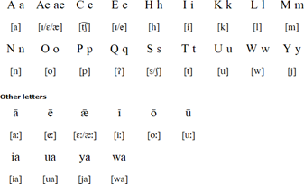
De-exoticizing non-European languages: the Indigenous Language Project
MENOMINEE
Brief Background
Spoken by fewer than 35 first-language users (as of 2007; perhaps only a handful today), primarily on the Menominee Reservation in Wisconsin. Classified as critically endangered by UNESCO. Revitalization efforts (including in-person and online classes) are underway.
Genetically part of the Algonquian language family.
Phonetics/Phonology/
Orthography (Roman alphabet)
Morphology and Syntax
Strongly fusional, to the level of polysynthesis. Roots and affixes fit into highly predictable slots, and what is a full sentence in English is one word in Menominee. Word order varies.

Slide 14
Students learn counternarratives (the resistance and survival of languages)
Focus is on the relationship between the student and the language chosen
Assignments are based on comparative linguistics, involving critical thinking/analysis
Sociolinguistics involved includes the relative safety of the language and efforts to strengthen/revitalize those in danger of going unspoken
Students use scholarly and popular resources to recognize the availability of information and to avoid using a person as an example

Slide 15
Dealing directly with our power/privilege: Reflections on Language in the Classroom
Background
First three weeks of semester: discussion of language ideologies (especially the concept of Standard English) and linguistic power dynamics of the classroom
Readings include “Should Writers Use They Own English?” (Young, 2010), “Students’ Right to Their Own Language” (CCCC, 1974) and “This Ain’t Another Statement! This Is a DEMAND for Black Linguistic Justice!” (CCCC, 2020)
Assignment
Reflection essay
Prompt uses excerpt from Breaking the Rules (Schuster, 2003) about a teacher berating a first-grade student during a lesson
Students are asked to reflect on their own experiences (either as linguistic bully, target of linguistic bullying, or witness to linguistic bullying) in the classrooms they have been in
After reflecting on their own experiences, students are asked to look ahead to their own classrooms or work spaces, creating guidelines for the language ideologies that will shape the behavior they will model

Slide 16
Students consider their own positionalities— past, present, and future
Students enter my class as the “smart” students in English—some even enjoy calling themselves “grammar Nazis”
This reflection and the module leading to it help those students to question their uncritical acceptance of a top-down set of rules to language
Unlearning language ideologies is not simple or straightforward—it is a process, and this reflection helps them see how deeply ingrained ideologies are
The assignment is a justice-based inquiry into power imbalances inherent to the structure of the classroom and how they can be mitigated or intensified by the actions of the instructor
Among our readings, there are several voices from marginalized populations, including but not limited to people of color
The example in the assignment from Schuster (2003), however, is marked by a white lens and white participants—this is acknowledged in the assignment description and students are asked to consider this in their own reflections
Students’ lived experiences are part of the assignment; however, no one’s experience is spotlighted or singled out

Slide 17
Throughout, there is one common denominator
As a white cisgender man, I must share my social identities with students—ignoring them would quietly center them as default lenses
Employing voices that are not white and cisgender in our readings and discussions helps to model the awareness and consciousness I want students to use

Slide 18
Negotiating Authority While Moving Away from the Eurocentric Perspective
Lara Garrido
Department of World Languages & Literatures
Department of Education

Slide 19
What do usually people associate with the word "Spanish"?

Slide 20
My association includes: - Exclusion - Eurocentrism - Possibilities

Slide 21
Negotiating my authority means understanding the reality of the class
My own experience taught me to adapt.
My own privilege: White and European creates conflict.
Heritage language Learners (HLL) are a reality in every state, every school district.
HLL: Heritage language learners have been exposed to the target language at home and in their communities (Bateman & Wilkinson, 2010; Valdés, 2005) but do not necessarily have formal education in the target language.
The education scenery in the U.S. now seems torn into two separate positions: the additive and the subtractive ideology (Randolph, 2017, p. 275).
P1
Exclusion
P2
Eurocentrism
P3
Possibilities
SOLUTION
More linguistic resources

Slide 22
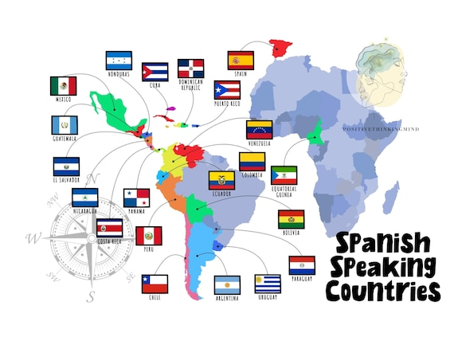
Unique position to create change
Teaching Spanish language and Hispanic culture and education courses to help shape future foreign language teachers and English as a second laguage.
SPAN 315 Proficiency in Reading (Focus on migration) + HLL
SPAN 313 Proficiency in Speaking (Texts and videos from various Spanish-speaking countries) + HLL
FLED 333 Teaching Foreign Languages (The joy and challenge of having HLL in the class)
Why More linguistic resources? Because with more linguistic resources, students can flexibly use their complex linguistic resources to make meaning of their lives and complex communications (Garcia, 2014).

Slide 23
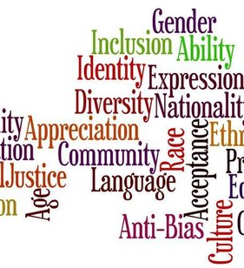
Classroom = Community of learners
HIPs as active learning strategies that promote deep learning and student engagement to broaden their knowledge and share in the experience of learning in community.
STARTING POINT: Ready to leave our comfort zones, challenge our beliefs and accept that we will be learning from each other.
MATERIALS: Carefully selected to present a diverse and accurate representation of Spanish linguistic variations, cultural aspects, historical and political facts embedded within various challenging topics.
WORK: Individual at home or in pairs/groups in class.
DISCUSSION: The work is always discussed in class, first in small groups and then as a whole.
HLL: Unique input that enriches every discussion, challenging perspectives that makes us confront pre-existent narratives that perpetuates dangerous tropes and promotes stereotyping.

Slide 24
Critical thinking and discussion lead to emerging counternarratives
SPAN 315: Proficiency in reading with a focus on migration
Confronting tropes about migration and migrants through Cajas de Cartón (1997), interviewing a migrant, analyzing different migration stories.
SPAN 313 Proficiency in Speaking with different linguistic variations of Spanish
Confronting the notion of "universal Spanish" and "wrong/right Spanish". Acknowledging the indigenous identity and its effect on the Hispanic culture.
FLED 333 Teaching Foreign Languages with HLL in the class with L2 learners
HLLs are an asset to any class because of their unique perspective but language teachers have to address their needs adequately just as much as those of the L2. Subtraction is never the answer.

Slide 25
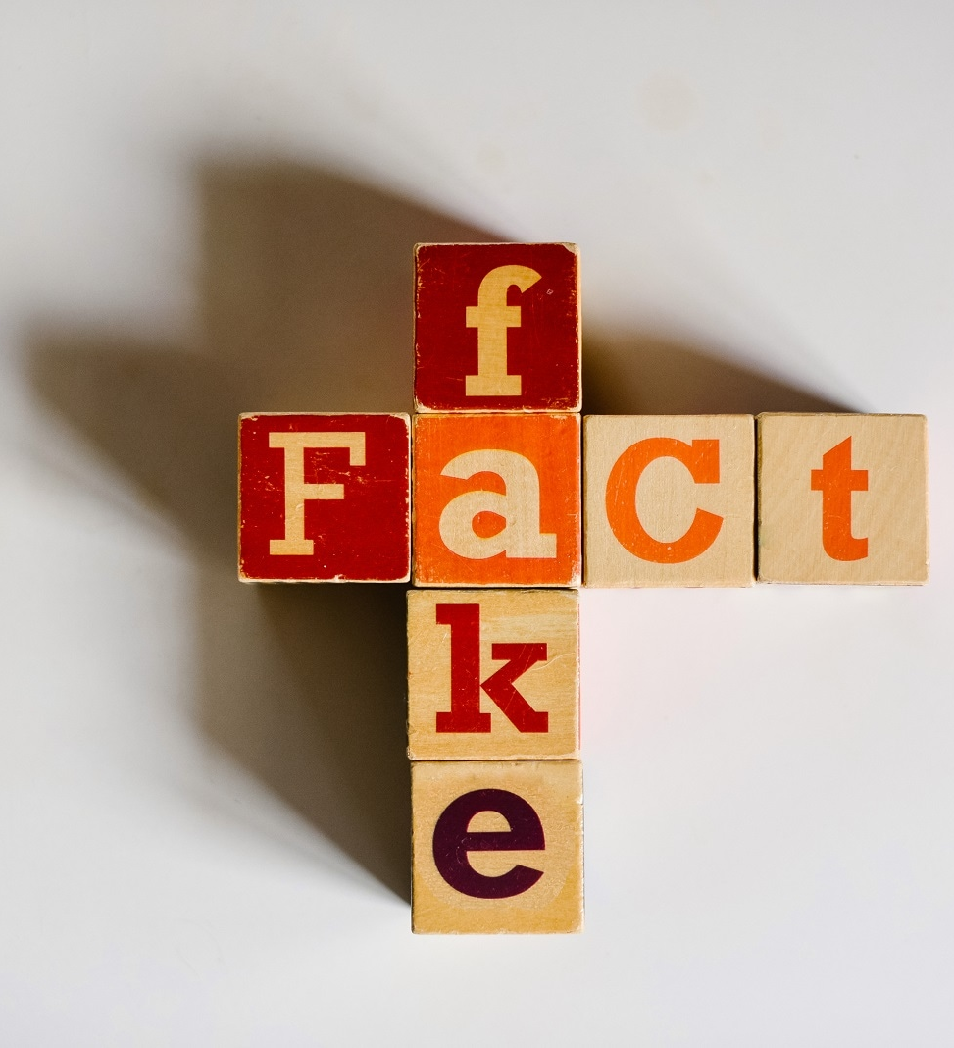
Counternarratives have the power to reframe the discussion
Reading about different stories of migration gives voice to previously silenced groups by describing the diversity of their experiences. “Counter-storytelling is a means of exposing and critiquing normalized dialogues that perpetuate stereotypes” (DeCuir & Dixson, 2004, p. 27)
Being exposed to different Spanish linguistic variations dispels the hierarchy created by the Eurocentric perspective where Spain's variation is correct above any other. "Counternarratives challenge widespread beliefs and discourses" (Solórzano & Yosso, 2001)
Learning about ways in which HLLs are different from L2 students and yet as important emphasizes the need to change a system that neglects them. “Counternarratives as reflection and action directed at the structures to be transformed” (Freire, 2000, p. 126)

