Slide 1
Learning More Than Content: An Interactive Learning Wall & SMART Goals
29th Annual
UWSP Teaching Conference
Dave Barbier, Katherine Bellow, Rachel Krouse, Sergio Romero

Slide 2
Agenda
Quick Overview and Panel Presenters
Dave – Developing Community and Leaders
Rachel – Applying Learning to Life; Personal Autonomy
Sergio – Remote Connection; Virtual Autonomy
Katherine- Community and Learning; Steps to Success
Q&A

Slide 3
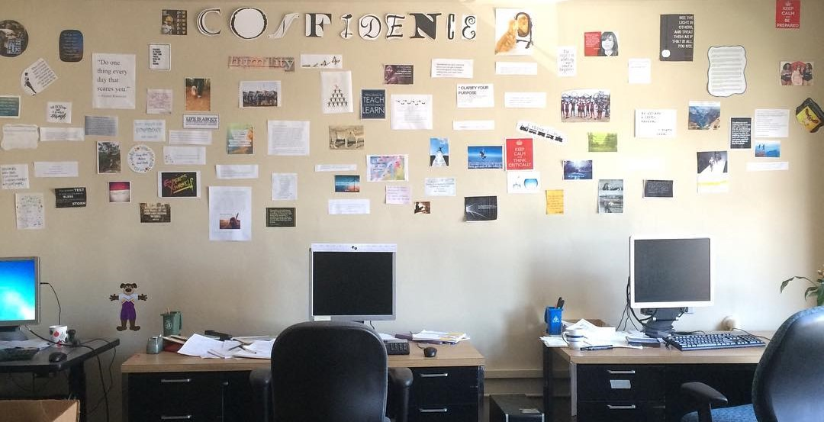
Interactive Learning Wall Origins & Process
Notes:
Wall Prompts First, SMART Goals Second

Slide 4
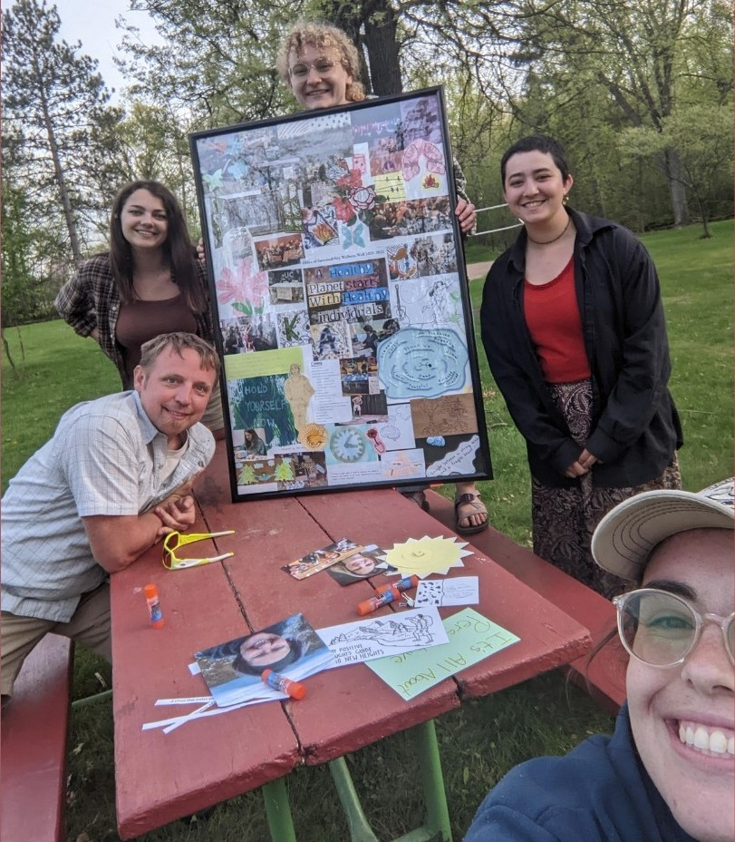
Interactive Wall Benefits
Collective Learning, Creation
Journey not a destination
Takeaway
Adjacent but not specific
Investment in the staff

Slide 5
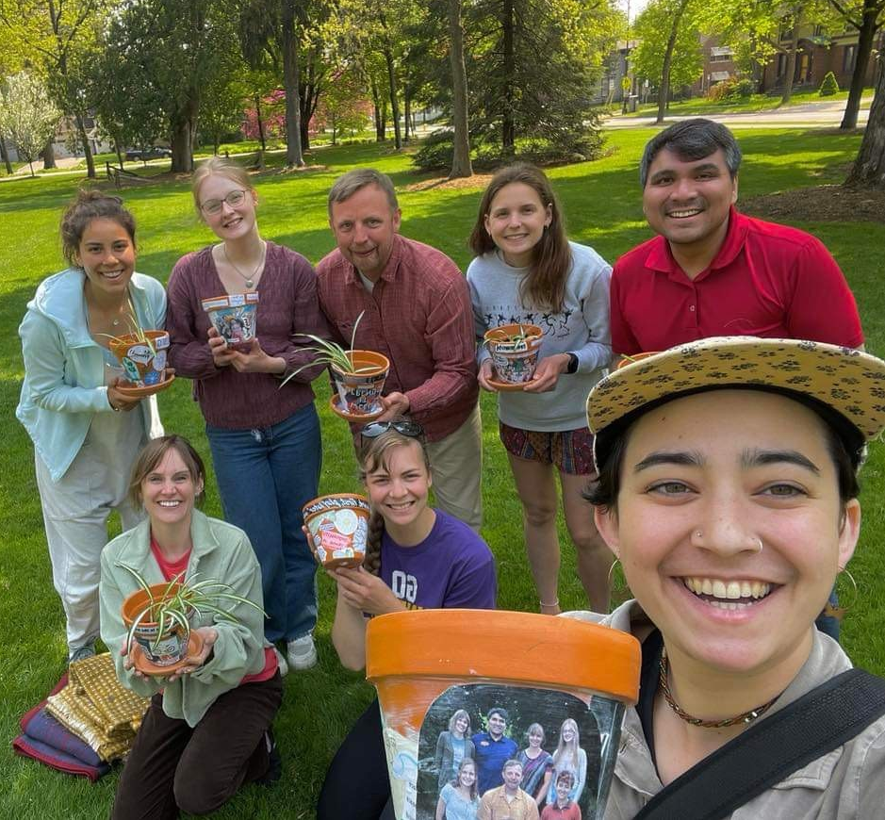
Making Connections through our Interactive Wall
Systems thinking
Connection between learning/work & personal life
Collaboration of multiple outlooks/opinions
"Community" as a mantra

Slide 6
Remote Connection
Remote Disconnect
Virtual Community Building
Collaborative Spaces
Niches v Silos

Slide 7
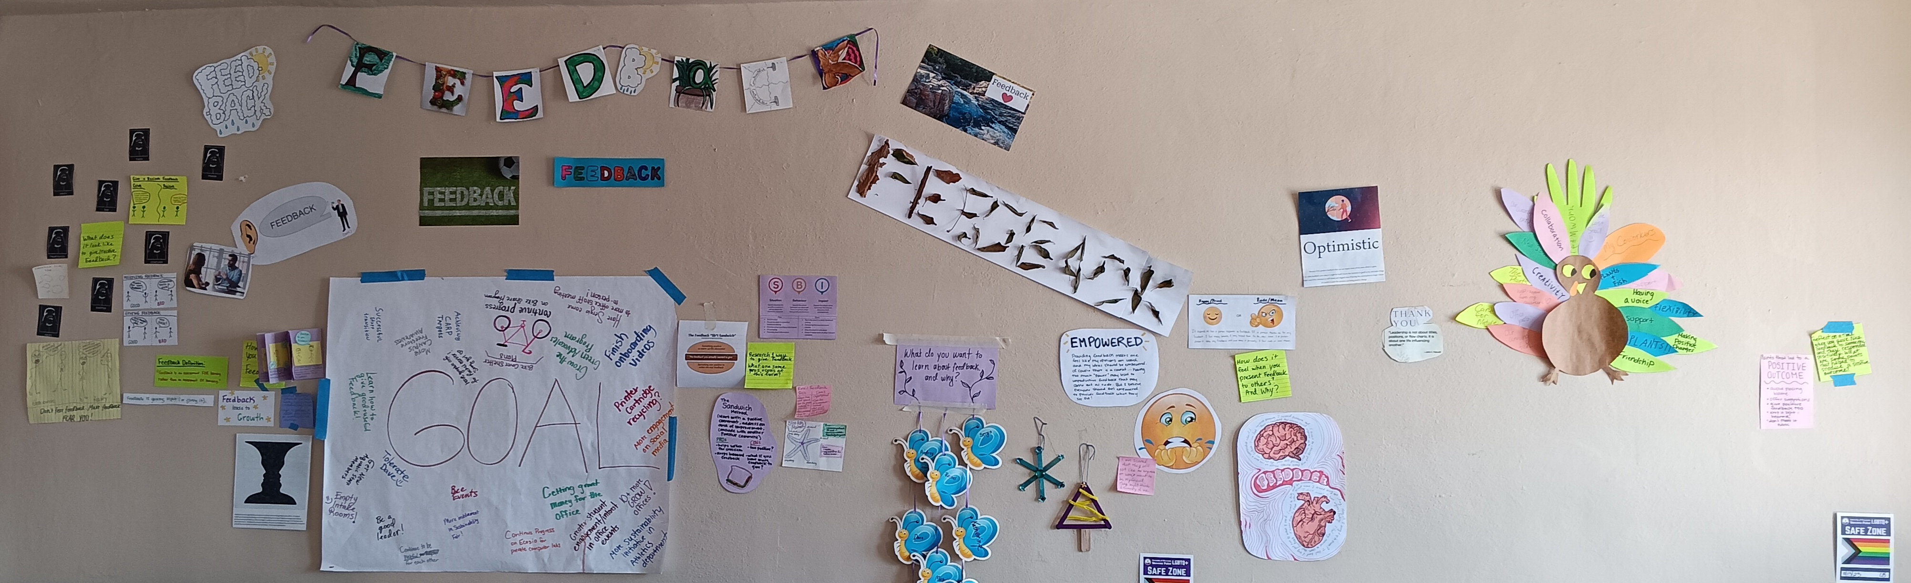
Connecting Community and Learning
From a Participant
To the Leader
Focusing on Feedback​
Connecting to the Community

Slide 8
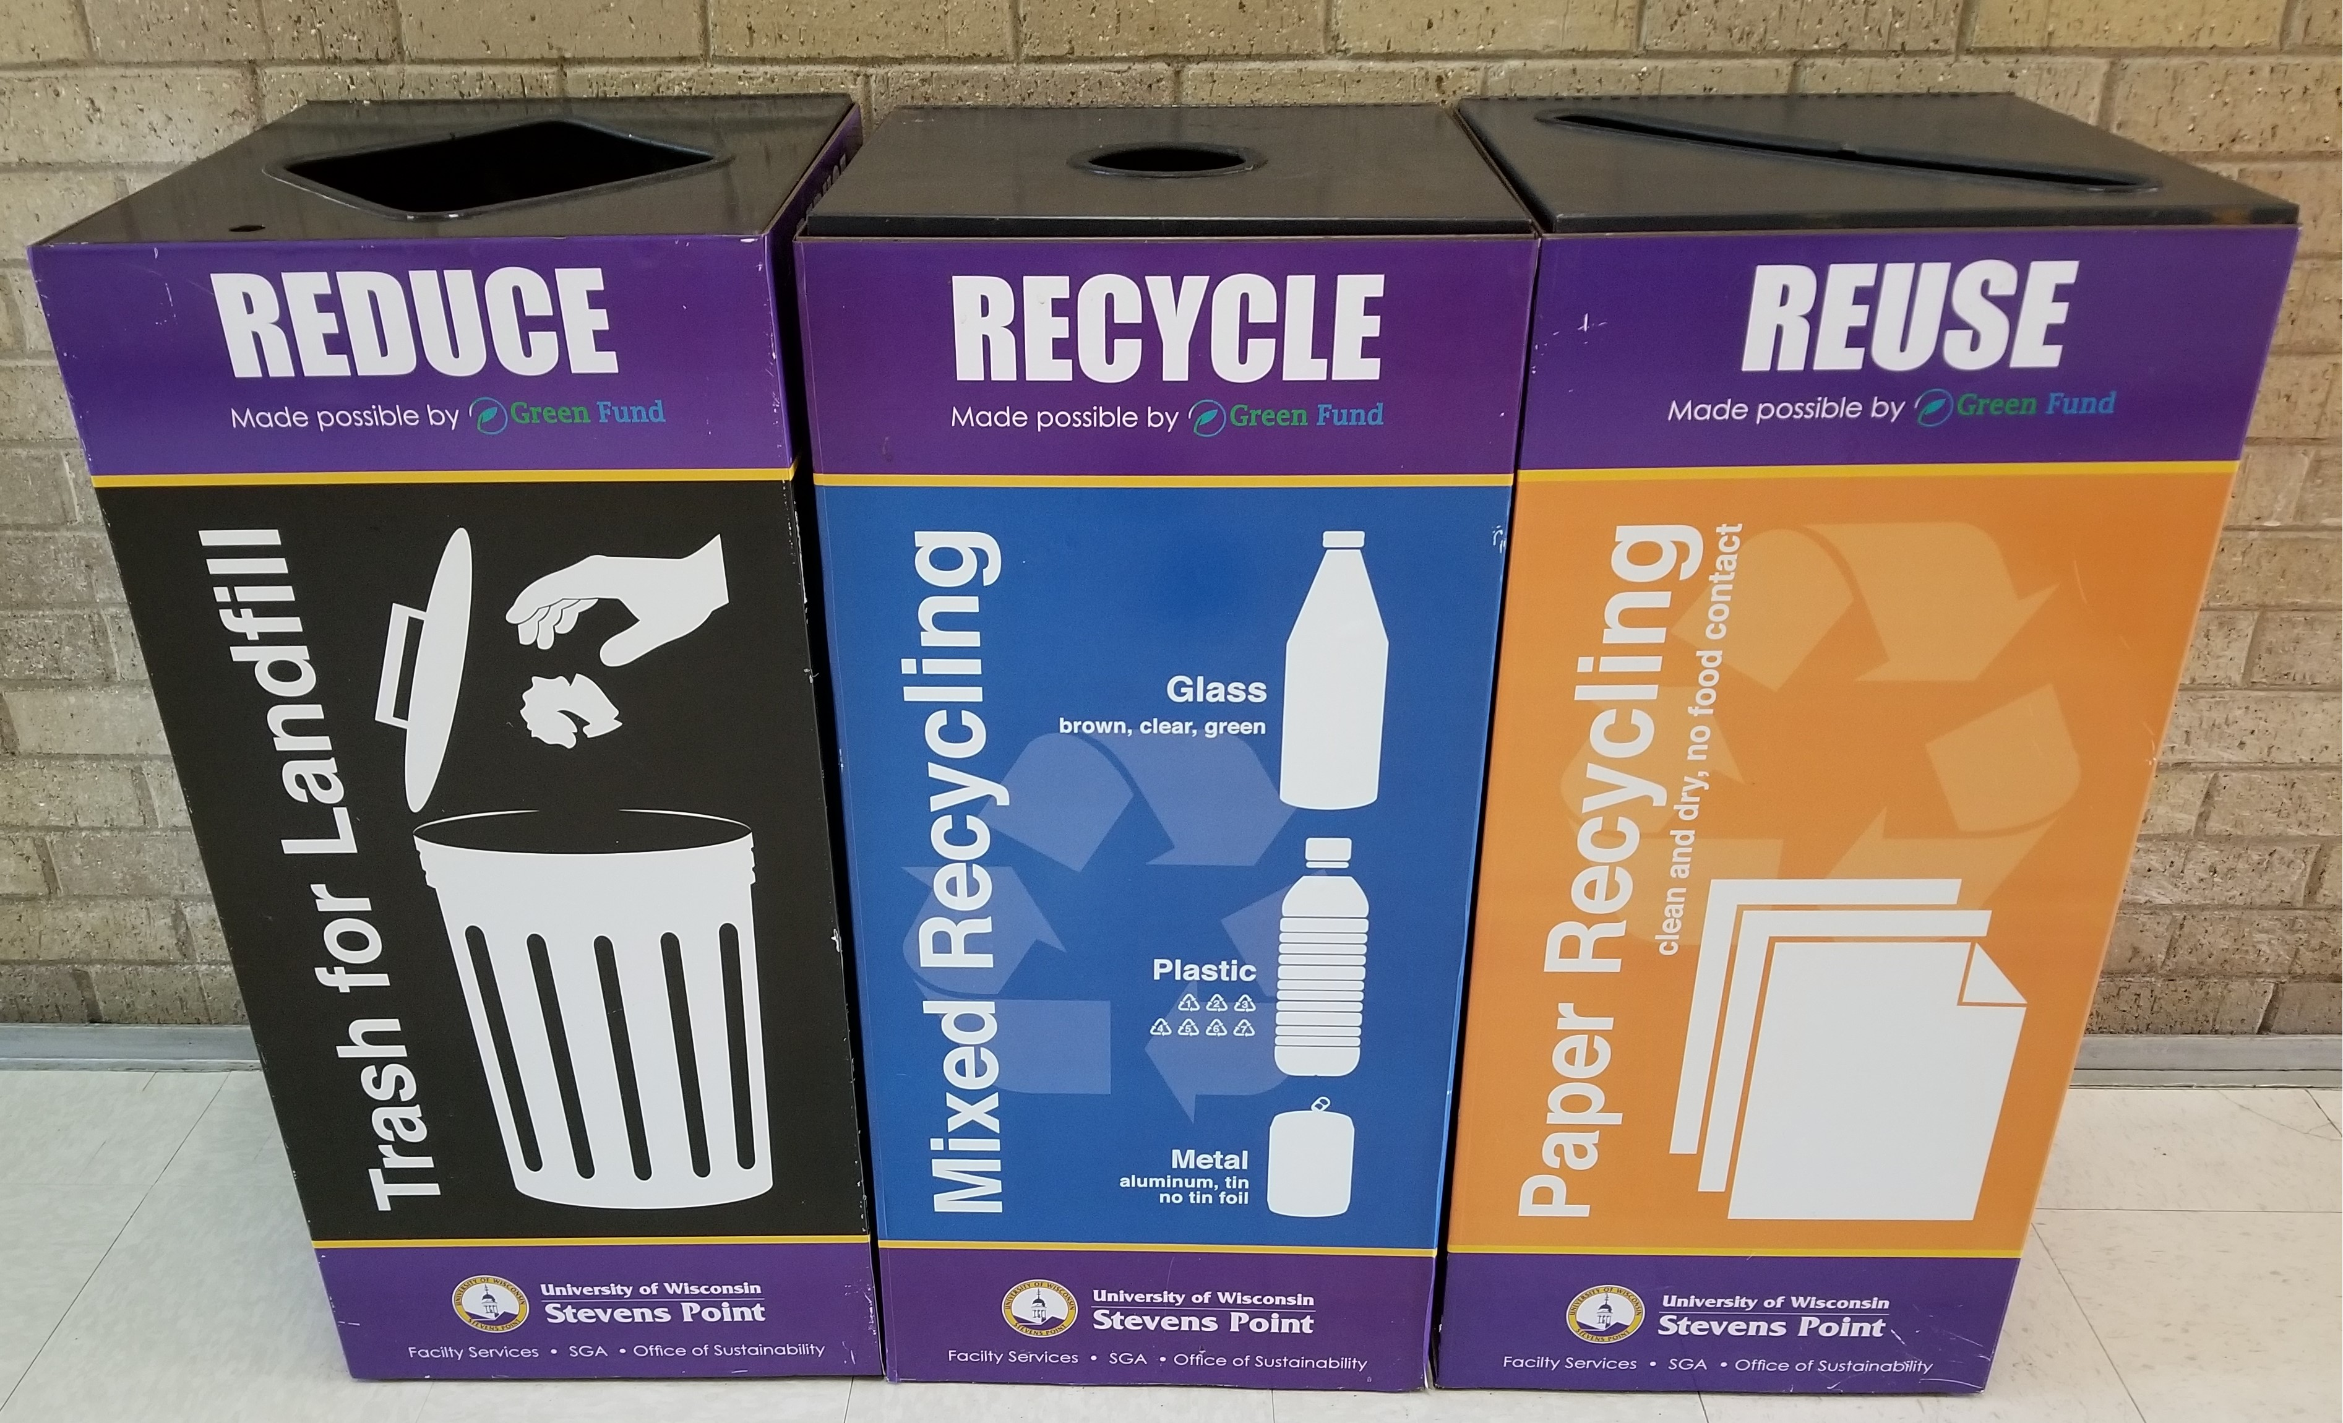
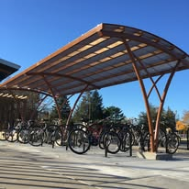
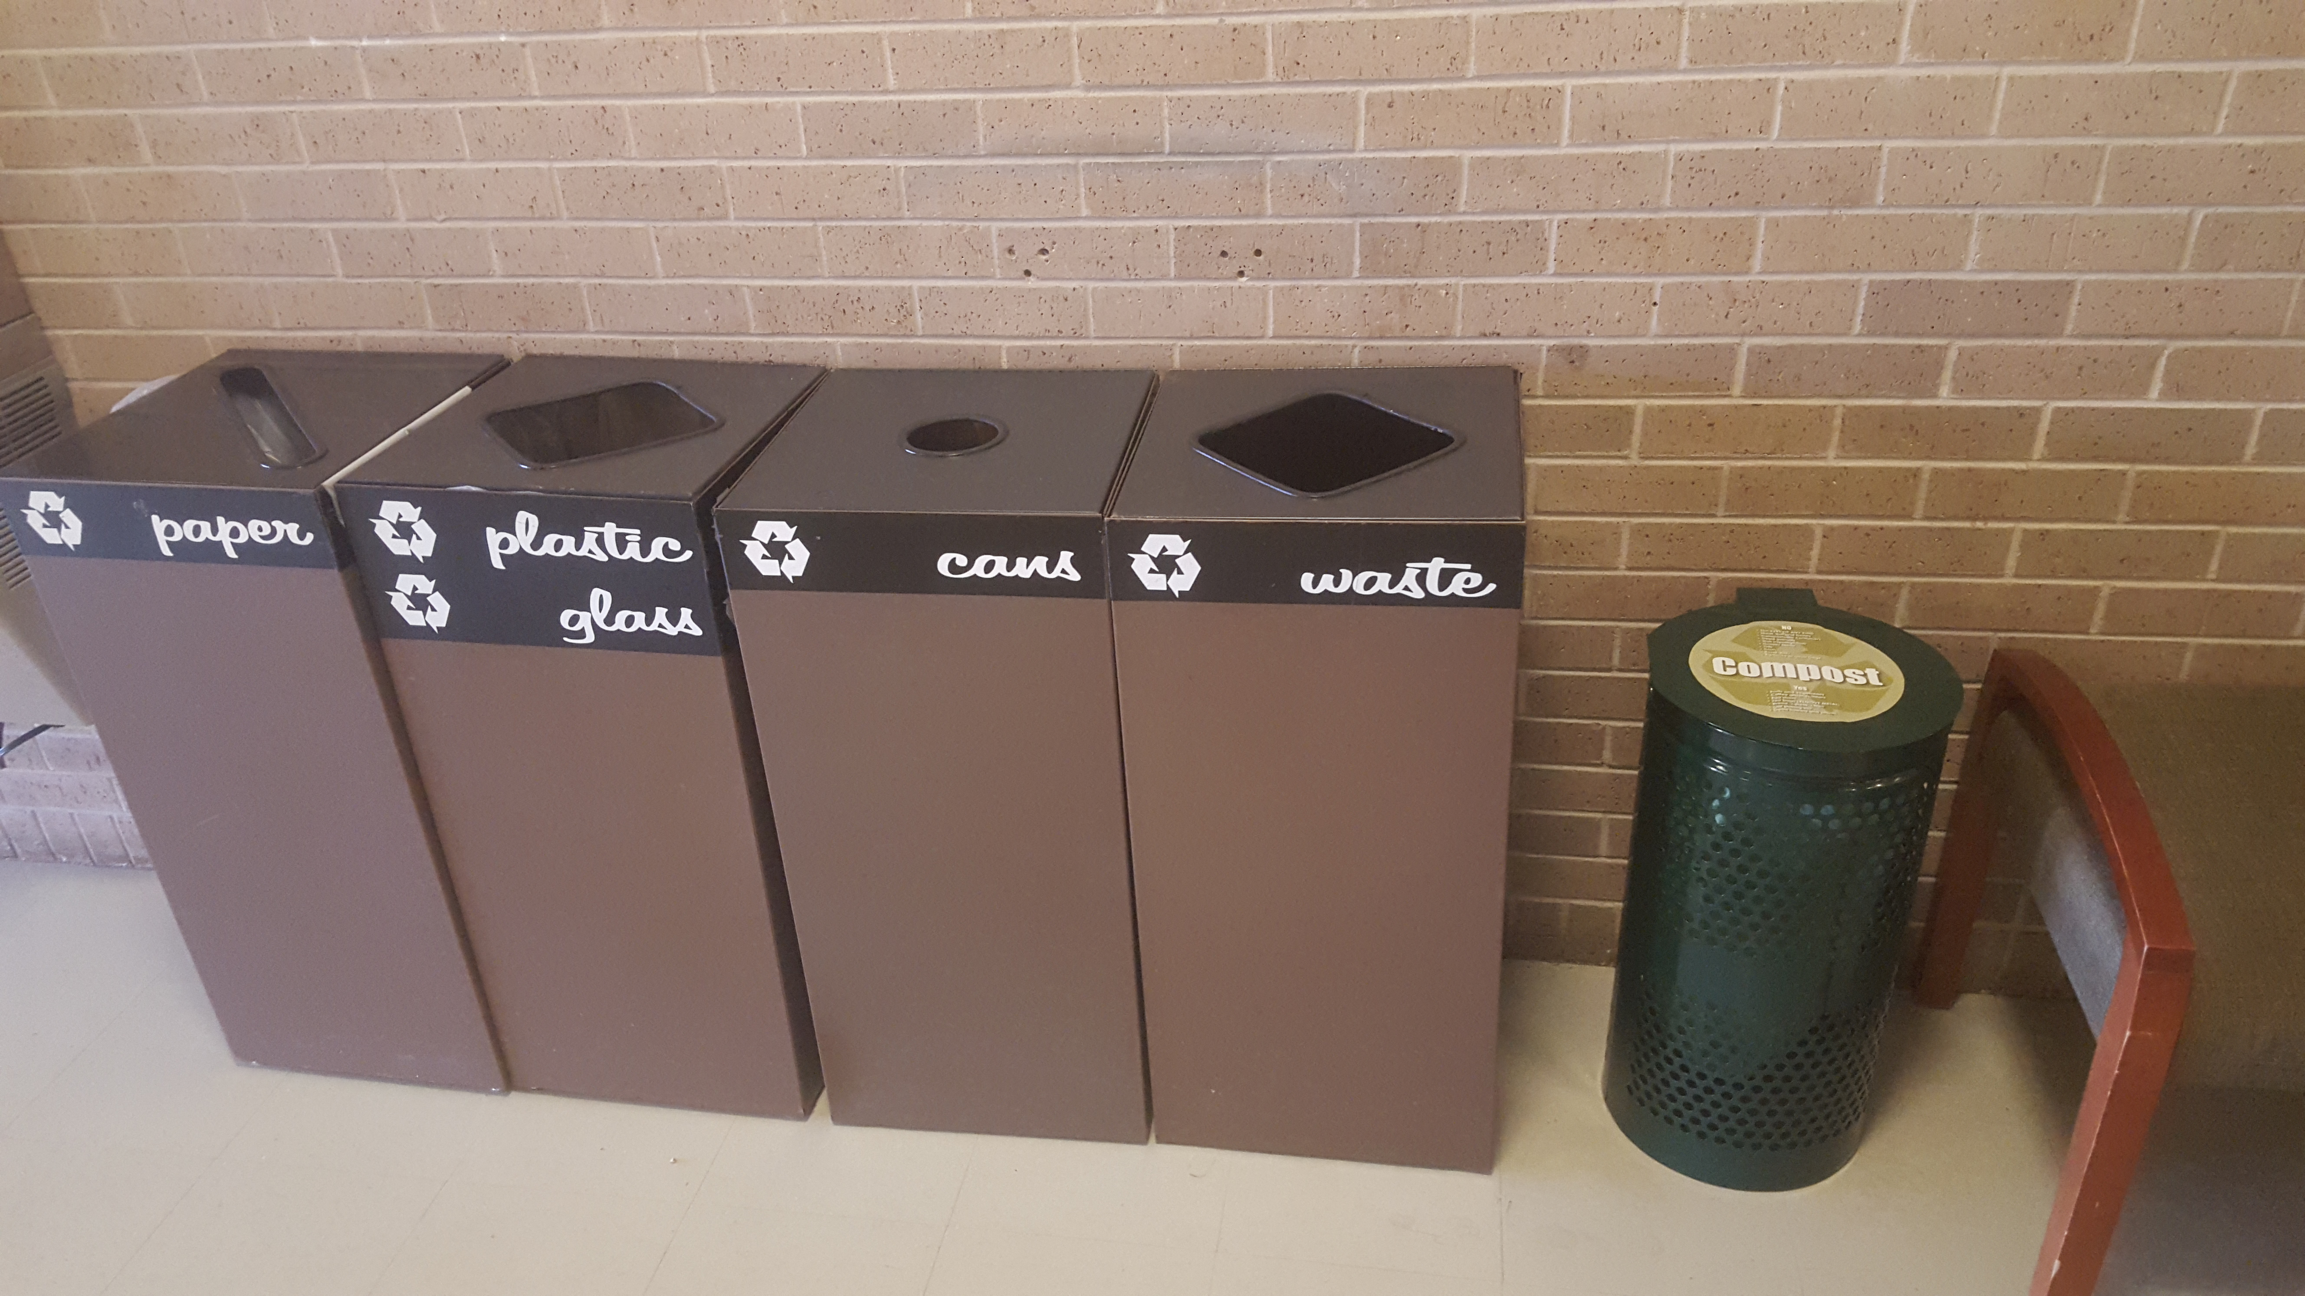
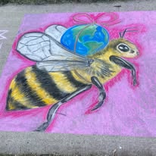
S.M.A.R.T (Specific Measurable Attainable Relevant and Timely) Goals
Critical Thinking
Guide not a measuring stick
Building
Trust
Relationships
Professional Skills

Slide 9
Personal Autonomy & Growth through SMART Goals
"Thrown into the deep end"
Personal connection, ownership, self-awareness
Stretch goals
My growth in confidence
Efficacy in learning & student growth

Slide 10
Virtual Autonomy
High Level of Trust
Personal Ownership
Stretch Goals/Simple Goals
IRB Training v GHGe
Accountability
Notes:
Micromanagement-Lack of Trust-Dissertation Location Based? Relationship with people in the office. Classroom context Canvas/LMS

Slide 11
Steps to Success
First interactions with SMART Goals
Steps in-between
Application to jobs and school

Slide 12
Classroom Use
Wall prompts to connect learning to students' lives
Broader connection and understanding
Wall prompts to foster collaboration
Address issues of loneliness
Help with Retention
SMART goals used in tangent with major assignments
Syllabi
SMART goals used as a professional development tool

Slide 13
What Pointer Alums are saying!
Learning to use SMART goals during my time at the OoS helped to set me up for success in my current job. My employer encourages the use of SMART goals, and I feel that I have an advantage over my coworkers because I am already familiar with the process. - Gabi B
I would say that I have continued to use SMART goals. In the professional world I’ve been fast tracked to project management roles as I have demonstrated my commitment to goals, project planning and monitoring milestones throughout the process. The basis of understanding SMART goals at the OoS for sure helped me get there. - Heidi P-S
SMART goals were extremely helpful in my professional development as it forced me to really think about where I want to be professionally, and the steps I can take to get there. Some of my more challenging goals helped to push me out of my comfort zone and develop leadership skills. - Kenzie L
Participating in (and later coordinating) the interactive learning wall in the OoS served as a physical representation of how community is foundational for a collaborative work environment. It helped me understand my colleagues in ways that likely wouldn't have come up in our normal work tasks. - Abigail K
The confidence wall provided a unique opportunity to really reflect on not just confidence but growth. The feedback we gave each other was especially impactful as it gave us an opportunity to acknowledge each other’s work as we navigated the challenges of balancing our work with student life and other responsibilities. I still have my collage poster and the feedback I got from others is a reminder that we are all sharing in successes and difficulties. It made it possible for me to see my own idea of confidence and sense of confidence grow in a way that few other experiences have. - Justin

Slide 14
Q&A

