Slide 1
College Safety Nets
Improving College Success Skills through Programming and Direct instruction.
Annette Hackbarth Onson, Director of Academic Success
Jennifer White, Assistant Director, Tutoring-Learning Center

Slide 2
AGENDA
Entering Students
Collaboration
Vehicles for Delivering Support
Instructor Toolkit
Campus-Wide Initiatives

Slide 3
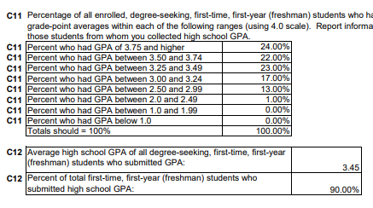
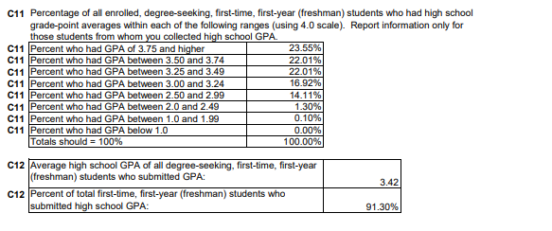
2012-2013
2013-2014

Slide 4
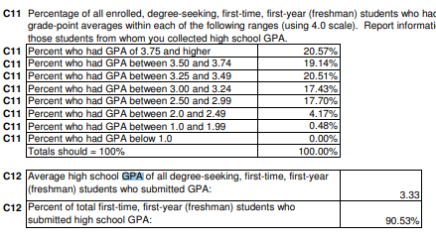
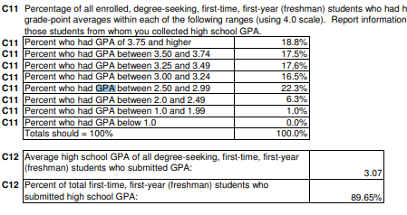
2014-2015
2015-2016

Slide 5
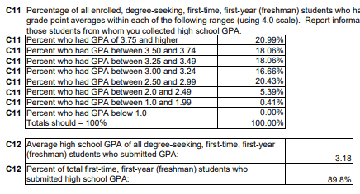
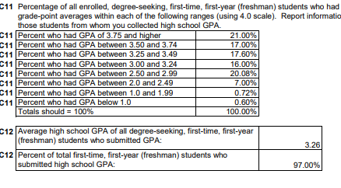
2016-2017
2017-2018

Slide 6
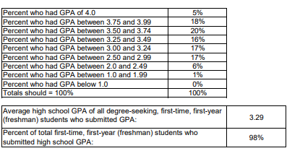
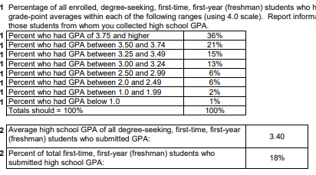
2018-2019
2019-2020

Slide 7
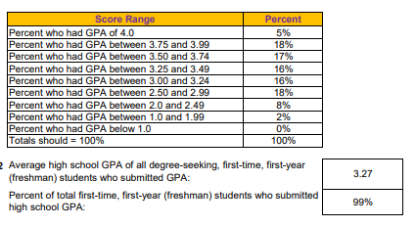
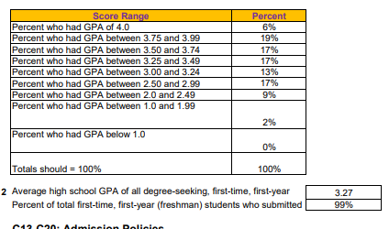
2020--2021
2021-2022

Slide 8
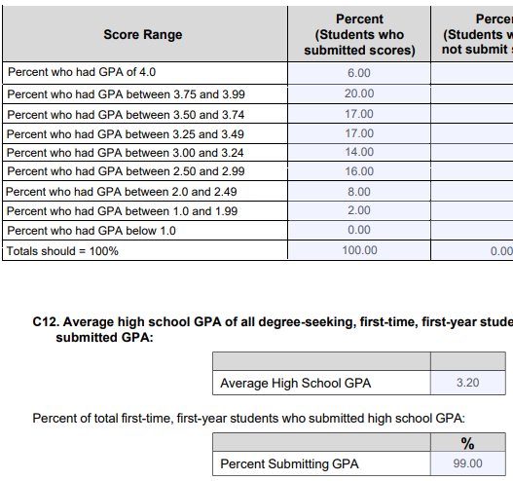
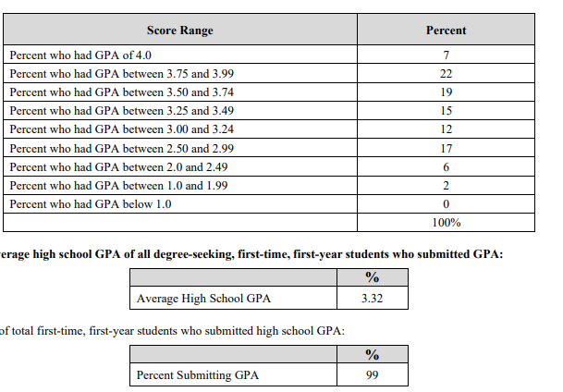
2022-2023
2023-2024

Slide 9
Direct Admit Wisconsin
Slide from UW-System (2023)
Notes:
ANALYSIS: This slide shows that students with lower GPAs will be more likely to attend UW schools. Low GPA is one indicator that some of these students will not be “college ready,” meaning they will need extra support in reading, writing, math, and academic success skills.

Slide 10
Collaboration
New Partnerships

Slide 11
Collaboration

Slide 12
Vehicles for Delivering Support
4

Slide 13
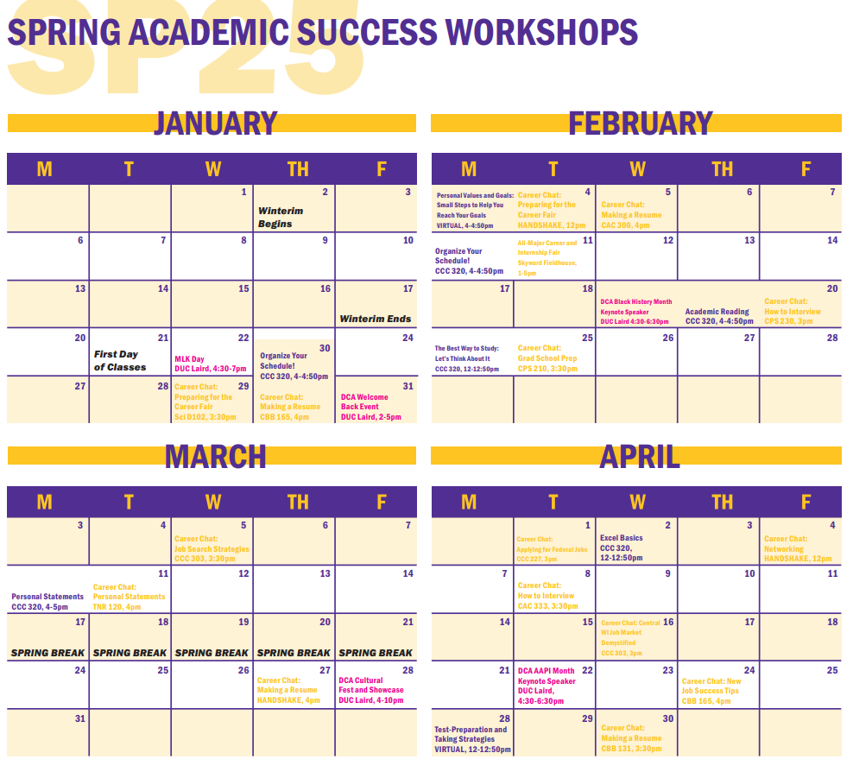
1. Workshops

Slide 14
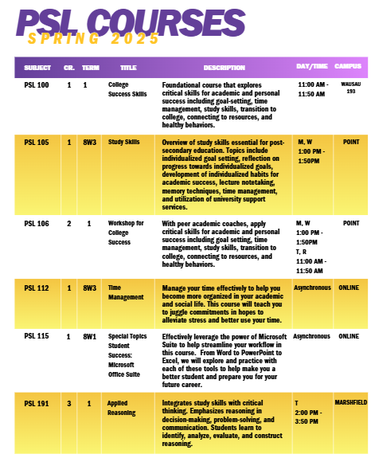
2. Classes
Structured Supports

Slide 15
3. Individual Tutoring Support
Academic Coaching
Tutoring
Academic Skills / Executive Functioning
Professional Staff
Peer Coaches
Content of the Course
Group
Drop In
Individual

Slide 16
4. Specialized Programming (in progress)
Program Title | Audience | Components
Starting Point | entering students lacking entry requirements | 3 credits over the course of the academic year paired with instructor and peer mentor
Focal Point | sophomores & juniors on academic probation or warning | ongoing targeted promotion and communication of workshop and tutoring during the year 3 $1000 schoarlships
Fund for Wisconsin Scholars
Emergency Aid

Slide 17
Embedded Skills
What are some ways you teach academic success skills in your classes?
Notes:
The vehicles we have designed to teach students college success skills resemble those in this study. This explicit teaching of skills does show benefits. If students feel more in control of their learning, they will be more likely to succeed.

Slide 18
Tool #1: Reading a Syllabus
 | Class #1 ___________ | Class #2 ___________ | Class #3 ___________ | Class #4 ___________ | Class 5 ___________
Major Due Dates
Attendance Policy
Plagiarism/AI Policy
Grading (categories, total points, exam weight) What is the most heavily weighted?
Office Hours

Slide 19
Tool #2: Time Management
Insert Time Management lesson plan (Joe)

Slide 20
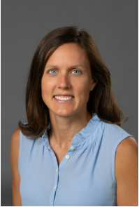
Tool #3: Teaching Reading in 3, 2, 1
How might students interact with a text in a meaningful way where they are retaining information?
3 Connections
2 Questions
1 Main Idea
Jen White: Assistant TLC Director, Writing Center Program Coordinator

Slide 21
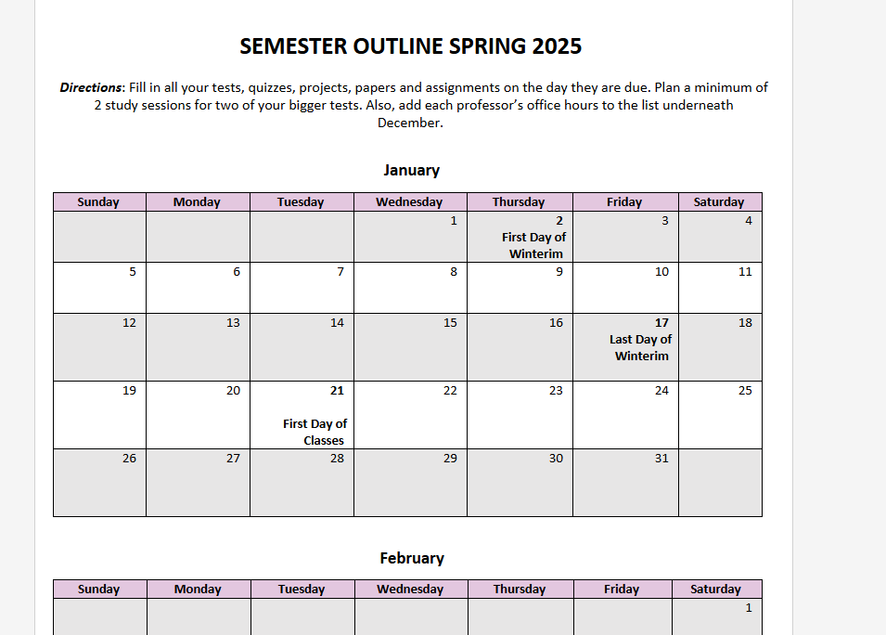
Tool #4: Semester Outline
Tristan: STEM Coordinator,
Study Skills Instructor

Slide 22
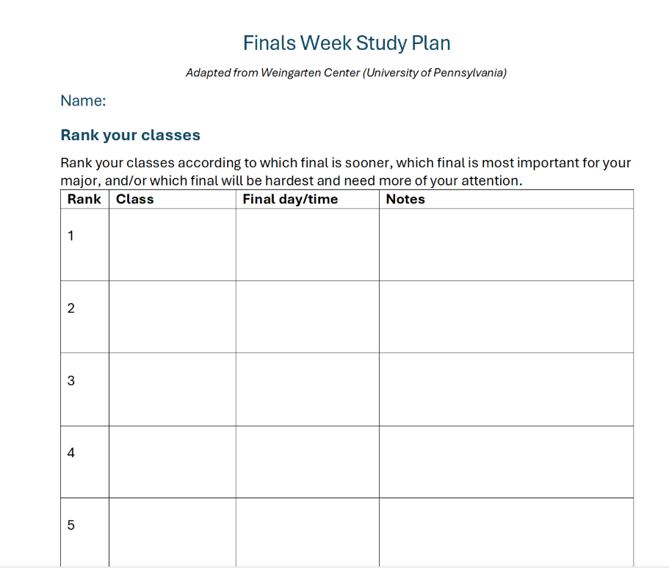
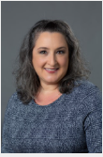
Tool #4: Study Tips
Amanda Meidl: Reading in the Disciplines & Academic coaching Coordinator

