Slide 1
Using Participation to Build Behaviors for Student Success
Amanda Jonsson and Erin Speetzen
UWSP Teaching Conference
Jan 17th, 2024

Slide 2
The problem
Students not knowing how to be a college student.
Thinking success is because of how smart they are, not because of what they do (or don’t do….).
Student need to see the importance of participating in their own learning.

Slide 3
What is participation?
The act of taking part in their own learning.
How do we make sure students know how to do this?
How to motivate students to work to improve at this?

Slide 4
The inspiration
redefines the purpose and goal of assessing participation as a skill-building framework
provides evidence that this framework can be applied successfully in the college classroom
Notes:
Instructor bias in participation grades.
Pre-college opportunities for building participation skills.

Slide 5
The framework
Explicit explanation of each dimension
Initial self-assessment and goal-setting
Midterm self-evaluation
Final reflection
Attendance and tardiness
Preparation for each class meeting
Participation in small group discussions
Participation in full group discussions
Participation in other ways
Participation

Slide 6
Why this?
It’s transparent.
It allows students to examine how their behaviors compare to our expectations.
It builds in elements of choice and autonomy.
Setting goals can help increase motivation and effort.
It allows students to reflect on their progress.
It rewards student growth.
Notes:
Clearly articulates the behaviors, especially out-of-class behaviors, that we expect out of successful students.

Slide 7
The courses
CHEM 105
86 students, mostly new first-year students.
CHEM 106
41 students, mostly second-year students.
Mostly STEM majors, but not chemistry/biochemistry majors.

Slide 8
How we adapted the framework
Attendance and tardiness
Preparation for class
Participation in in-class activities
Out-of-class review
Participation in other ways

Slide 9
Attendance and tardiness
Attendance and tardiness
Preparation for class
Participation in in-class activities
Out-of-class review
Participation in other ways
coming to all lectures, discussions, and labs
being on time
not leaving class early
staying in lab until you’ve completed the lab report or until lab is over

Slide 10
Preparation for class
Reviewing notes while waiting for class to start
Previewing new content and coming to class with questions
Reviewing pre-requisite material
Completing all pre-lab activities (watching videos, taking quizzes, prepping lab notebook)
Attendance and tardiness
Preparation for class
Participation in in-class activities
Out-of-class review
Participation in other ways

Slide 11
Participation in in-class activities
Actively sharing thoughts
Listening to group members and considering their ideas
Being respectful
Staying on task
Helping group members who have questions
Asking questions of your peers/instructors when you’re stuck
Attendance and tardiness
Preparation for class
Participation in in-class activities
Out-of-class review
Participation in other ways

Slide 12
Out-of-class review
Regularly working on suggested problems and ungraded practice quizzes
Completing any in-class activities that you didn’t finish in class
Reviewing your notes shortly after class to make note of questions and add information
Attendance and tardiness
Preparation for class
Participation in in-class activities
Out-of-class review
Participation in other ways

Slide 13
Participation in other ways
A variety of activities including, but not limited to:
Attending office hours
Going to drop-in tutoring
Forming study groups
Discussing course material or comparing notes outside of class with peers or friends
Attendance and tardiness
Preparation for class
Participation in in-class activities
Out-of-class review
Participation in other ways

Slide 14
The assignments
Three Canvas assignments
Initial self-reflection and goal setting (week 2)
complete/incomplete; no points
Midterm reflection (after exam 3)
complete/incomplete; no points
Final reflection (week 15)
100 pts; worth 5% of course grade

Slide 15
Initial Self-Assessment and Goal-Setting
For each dimension, rate your participation in similar courses on a scale of 1 – 5 (1 = needs lots of improvement, 5 = excellent). Include a once sentence justification.
Set three goals for how to improve your participation that are realistic and reasonable. These goals will be the basis of your participation grade.
Write a plan for how you’ll achieve your goals. (minimum of one paragraph)

Slide 16
Midterm self evaluation
For each dimension, rate your participation in this course on a scale of 1 – 5 (1 = needs lots of improvement, 5 = excellent). Include a one sentence justification.
Reflect on your current participation in the course and progress toward each goal. (minimum one paragraph)
Identify steps needed to improve your participation, meet goals, and be on track to get the participation grade that you would like. (minimum one paragraph)
Students could change their goals if they realized they weren’t realistic/reasonable.

Slide 17
Participation Final Reflection
For each dimension, rate your participation in this course on a scale of 1 – 5 (1 = needs lots of improvement, 5 = excellent). Include a one sentence justification.
Reflect on the progress you made towards your goals since midterm. (minimum one paragraph)
Propose and justify what grade you think you deserve for participation this semester taking into account your
Overall course participation
Whether or not you met their goals.

Slide 18
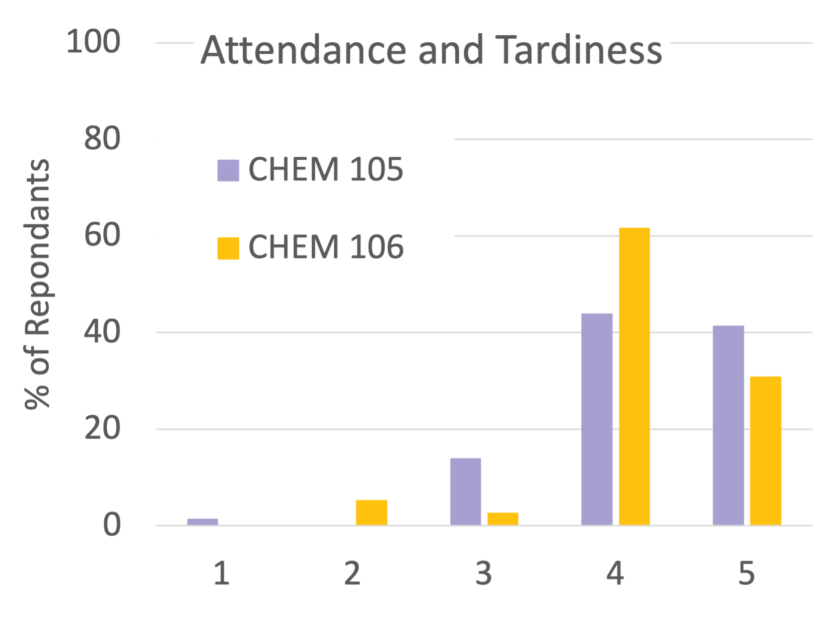
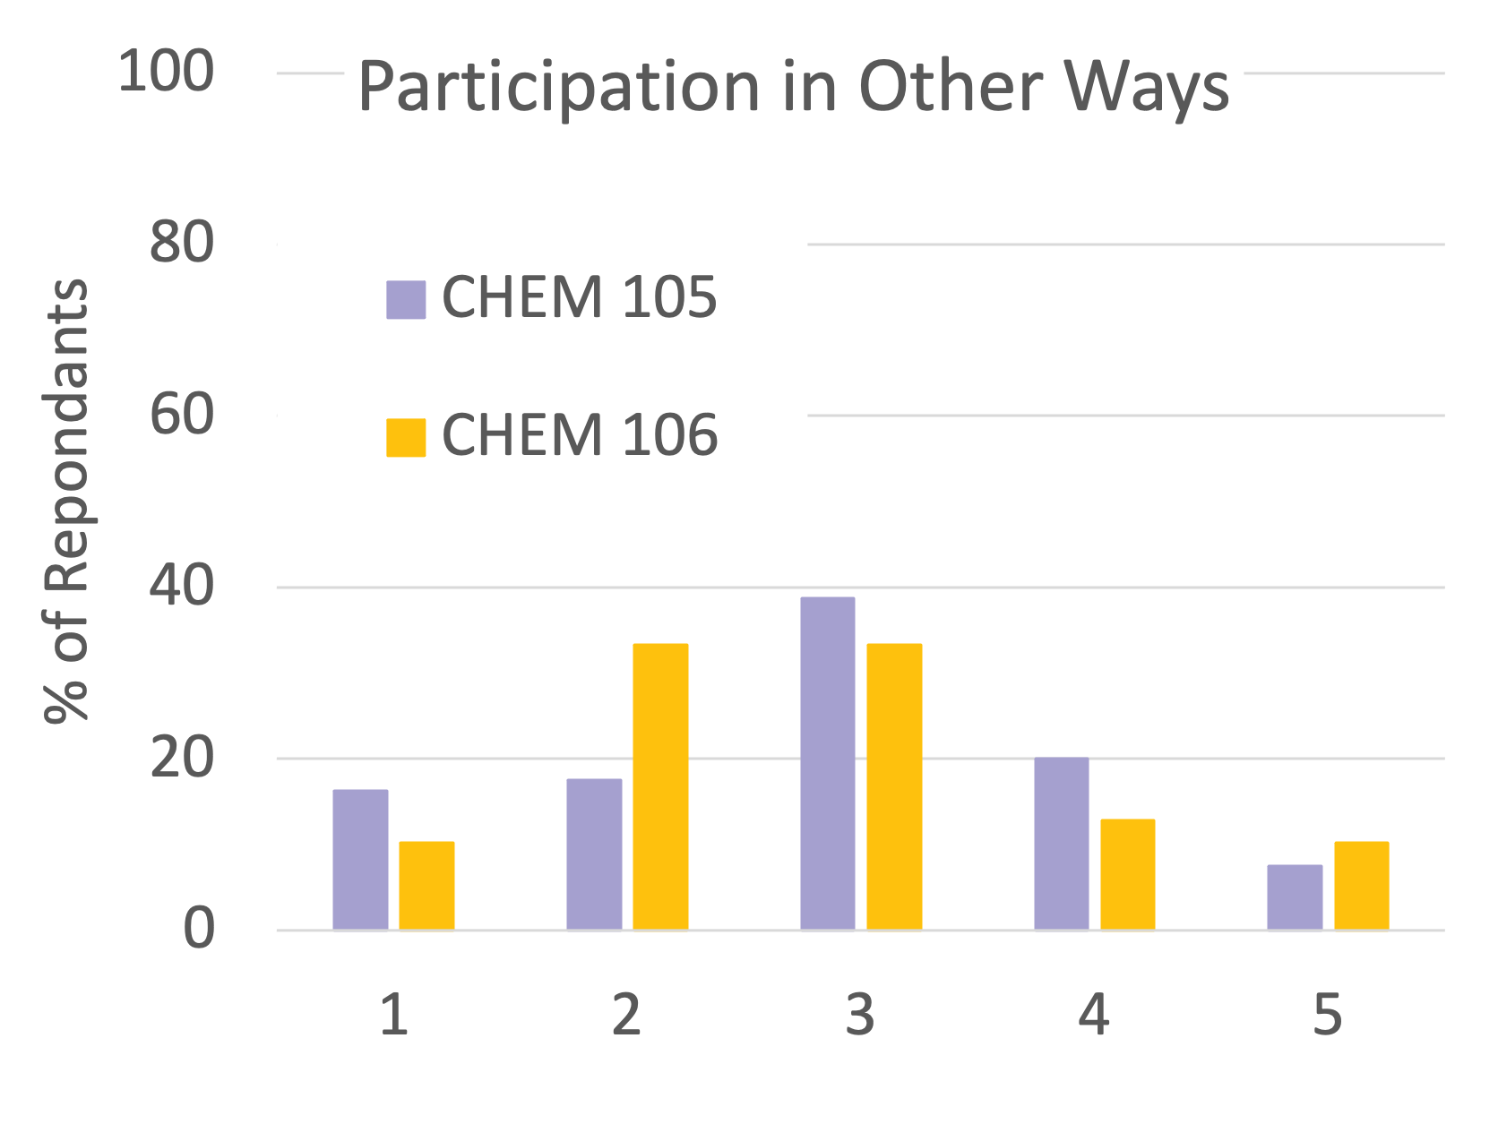
The results
Did students take the self-assessment seriously?

Slide 19
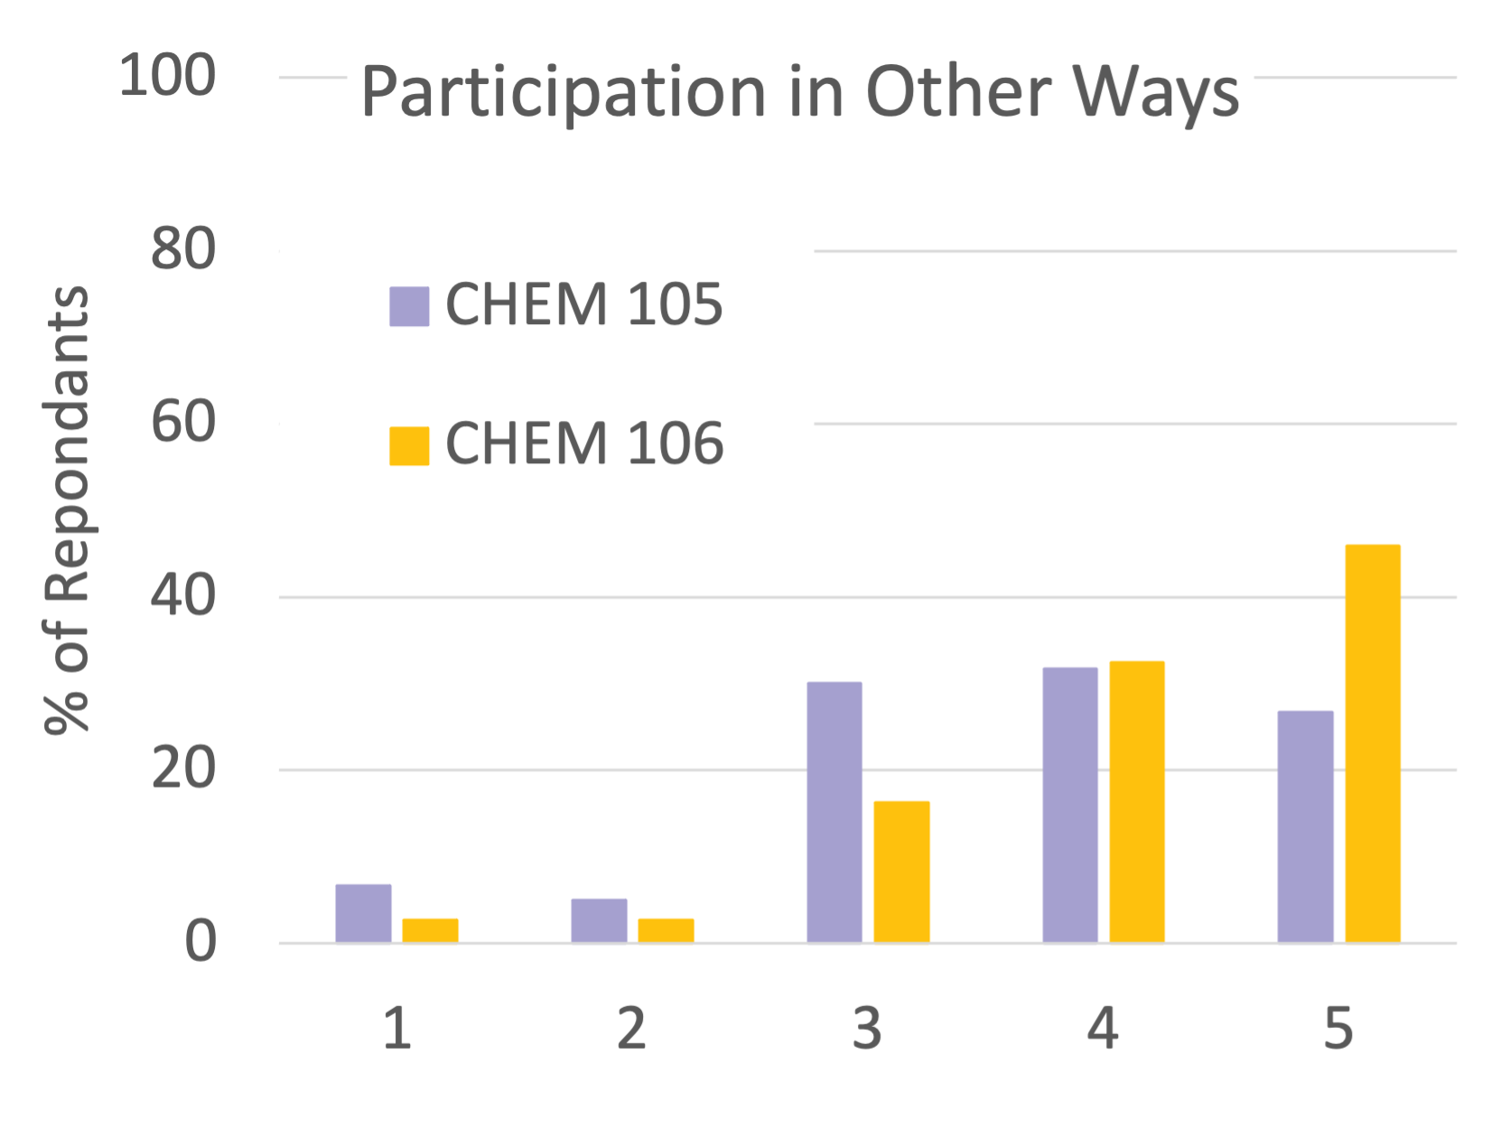
The results
Did the self assessment results change?
Final reflection
Initial reflection

Slide 20
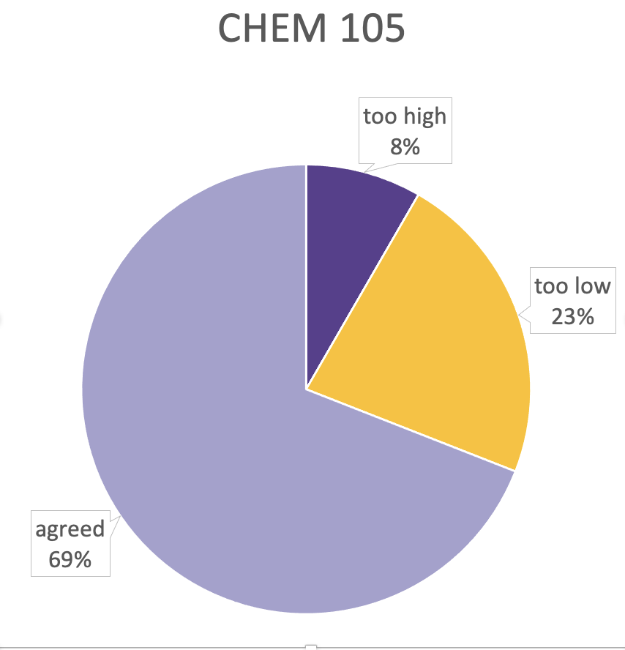
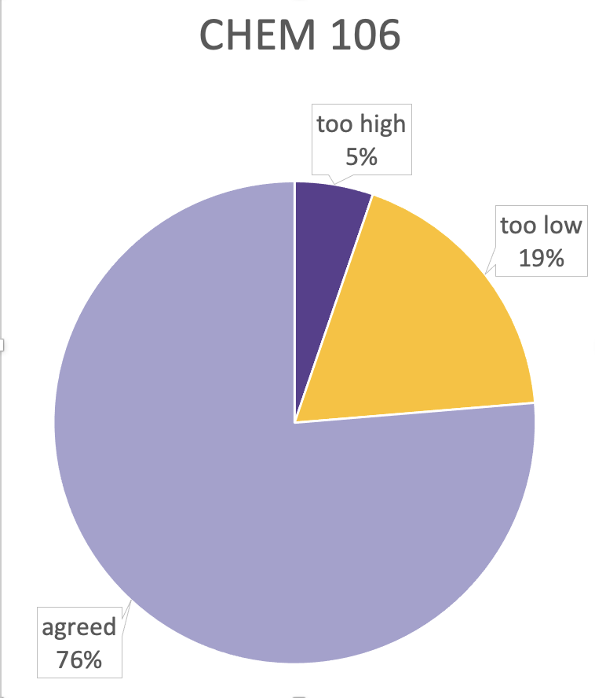
The results
Did the self-reported grades match ours?
Notes:
From
https://sites.stlawu.edu/cita/2022/12/31/guest-post-alanna-gillis-an-evidence-based-way-to-improve-students-participation-and-how-to-grade-it/
About 90% of the time I agree with their grade, another 8% I give a higher grade, and less than 2% of the time I give a lower grade.

Slide 21
The results.
I believe my participation is a 95 percent. I asked many questions throughout the semester and treated this class very seriously. I also went to the TLC once a week ever since my first exam to help me out with the class. The only times where I missed something was the Wednesday lecture before Thanksgiving & a few lectures due to hockey games and then the last lab.
Exam 1 | Exam 2 | Exam 3 | Exam 4
75% | 97.5% | 90.8% | 93.3%
105 student

Slide 22
The results.
I would say I earned an A (92%) in Chem 105 Participation although I did not do the typical participation like raising my hand in class I feel I did everything else at a very high level and continued to improve my goals throughput the semester one of the biggest things was comfortability I was able to become a lot more comfortable with my professor in asking questions and emailing her when I was gonna miss class and etc. But also I became way more comfortable with my peers I was always there to help them with there questions in class and out of class.
Exam 1 | Exam 2 | Exam 3 | Exam 4
87.5% | 88.3% | 86.7% | 85%
105 student

Slide 23
The results.
In terms of a grade percentage, I would say 90%. If you had asked me after the first exam I would have said a 60%....the changes I made now seem so elementary but they were vital to my success in the course. I began to show up to class...doing the work expected of me and asking questions, I even went to two office hours...I also began to stay in the building until my lab report was done, which was huge for my time management and helped me not feel so overwhelmed after class...
Exam 1 | Exam 2 | Exam 3 | Exam 4
63.6% | 80.7% | 90% | 91.4%
106 student

Slide 24
The results.
I believe that I deserve a 90%, the progress that I made in this course is more than I honestly thought that I would be able to do. I have improved in other ways besides my goals too, by creating better study habits and learning how to manage my time and know when to buckle down and get my stuff done.
Exam 1 | Exam 2 | Exam 3 | Exam 4
58.6% | 50% | 83.2% | 72.1%
106 student

Slide 25
The results.
...I believe I deserve a 90 or 95%... This semester I was proactive. Meeting with you multiple times, seeking out help from multiple sources, and cycling through study strategies. Most of the time, I felt like my extra effort was going to waste, that was until I began to watch my exam scores increase rapidly. I mean, going from a 41% to an 81% is incredible. That jump proved to me that I had the potential to be good at chemistry, and that my efforts were paying off. I finally feel confident in a subject that I was so insecure about in the beginning of the semester, and I did the work to make that happen.
Exam 1 | Exam 2 | Exam 3 | Exam 4
41.0% | 81.4% | 92.1% | 80.7%
106 student

Slide 26
The results.
Overall if we're looking at improvement, I think my grade should be 75%. I am nowhere near a great student who studies hard, but I feel I have put much more effort in since the beginning of the semester. reviewing notes is something I would never do unless it was night before the exam. This year I've done it twice a week. Coming into the class I was planning on doing everything by myself, but in lab, I actually enjoyed working with a partner. My homework this semester was not done at 11:00 with an hour left to do it. This semester I actually gave myself time instead of rushing through it at the end.
105 student

Slide 27
The results.
I never used to look over notes before class and I think picking up that habit for this class has really helped me; however, this new habit was hard to pick up and sometimes, especially at the beginning of the semester, it was hard to keep up. Past semester I really struggled on attendance later in the semester, but I feel, with the goal, I did a lot better.
….I believe a grade of 91% is well deserved. The reason why I took off 9% of the grade is because I never really attended office hours or tutoring because I was too afraid. It is hard for me to ask for help because I have always been taught to do it myself and ask questions later. This something I am working on to better myself for my future classes.
106 students

Slide 28
What did we learn?
Even many of our very "good" students said they didn't engage in the suggested behaviors.
Student resistance to office hours and tutoring is strong, but they seem much more like to form study groups.
Many students know they could do better with higher participation but are happy with the grade they have and choose not to.
Many small reminders of the behaviors we wanted to see were helpful.
Having students self-assess before setting their goals was important.
Timing matters
Timing based on exam schedule vs. less structured

Slide 29
What did we learn?
Students are more likely to be too harsh on themselves than too easy.
Many students apologized in their final reflections for not doing more.
Intention conversation about it being okay to change goals that didn’t serve them was important.

