Slide 1
THE GROWTH MINDSET IN STEM
Get out a sheet of paper to write personal reflections on

Slide 2
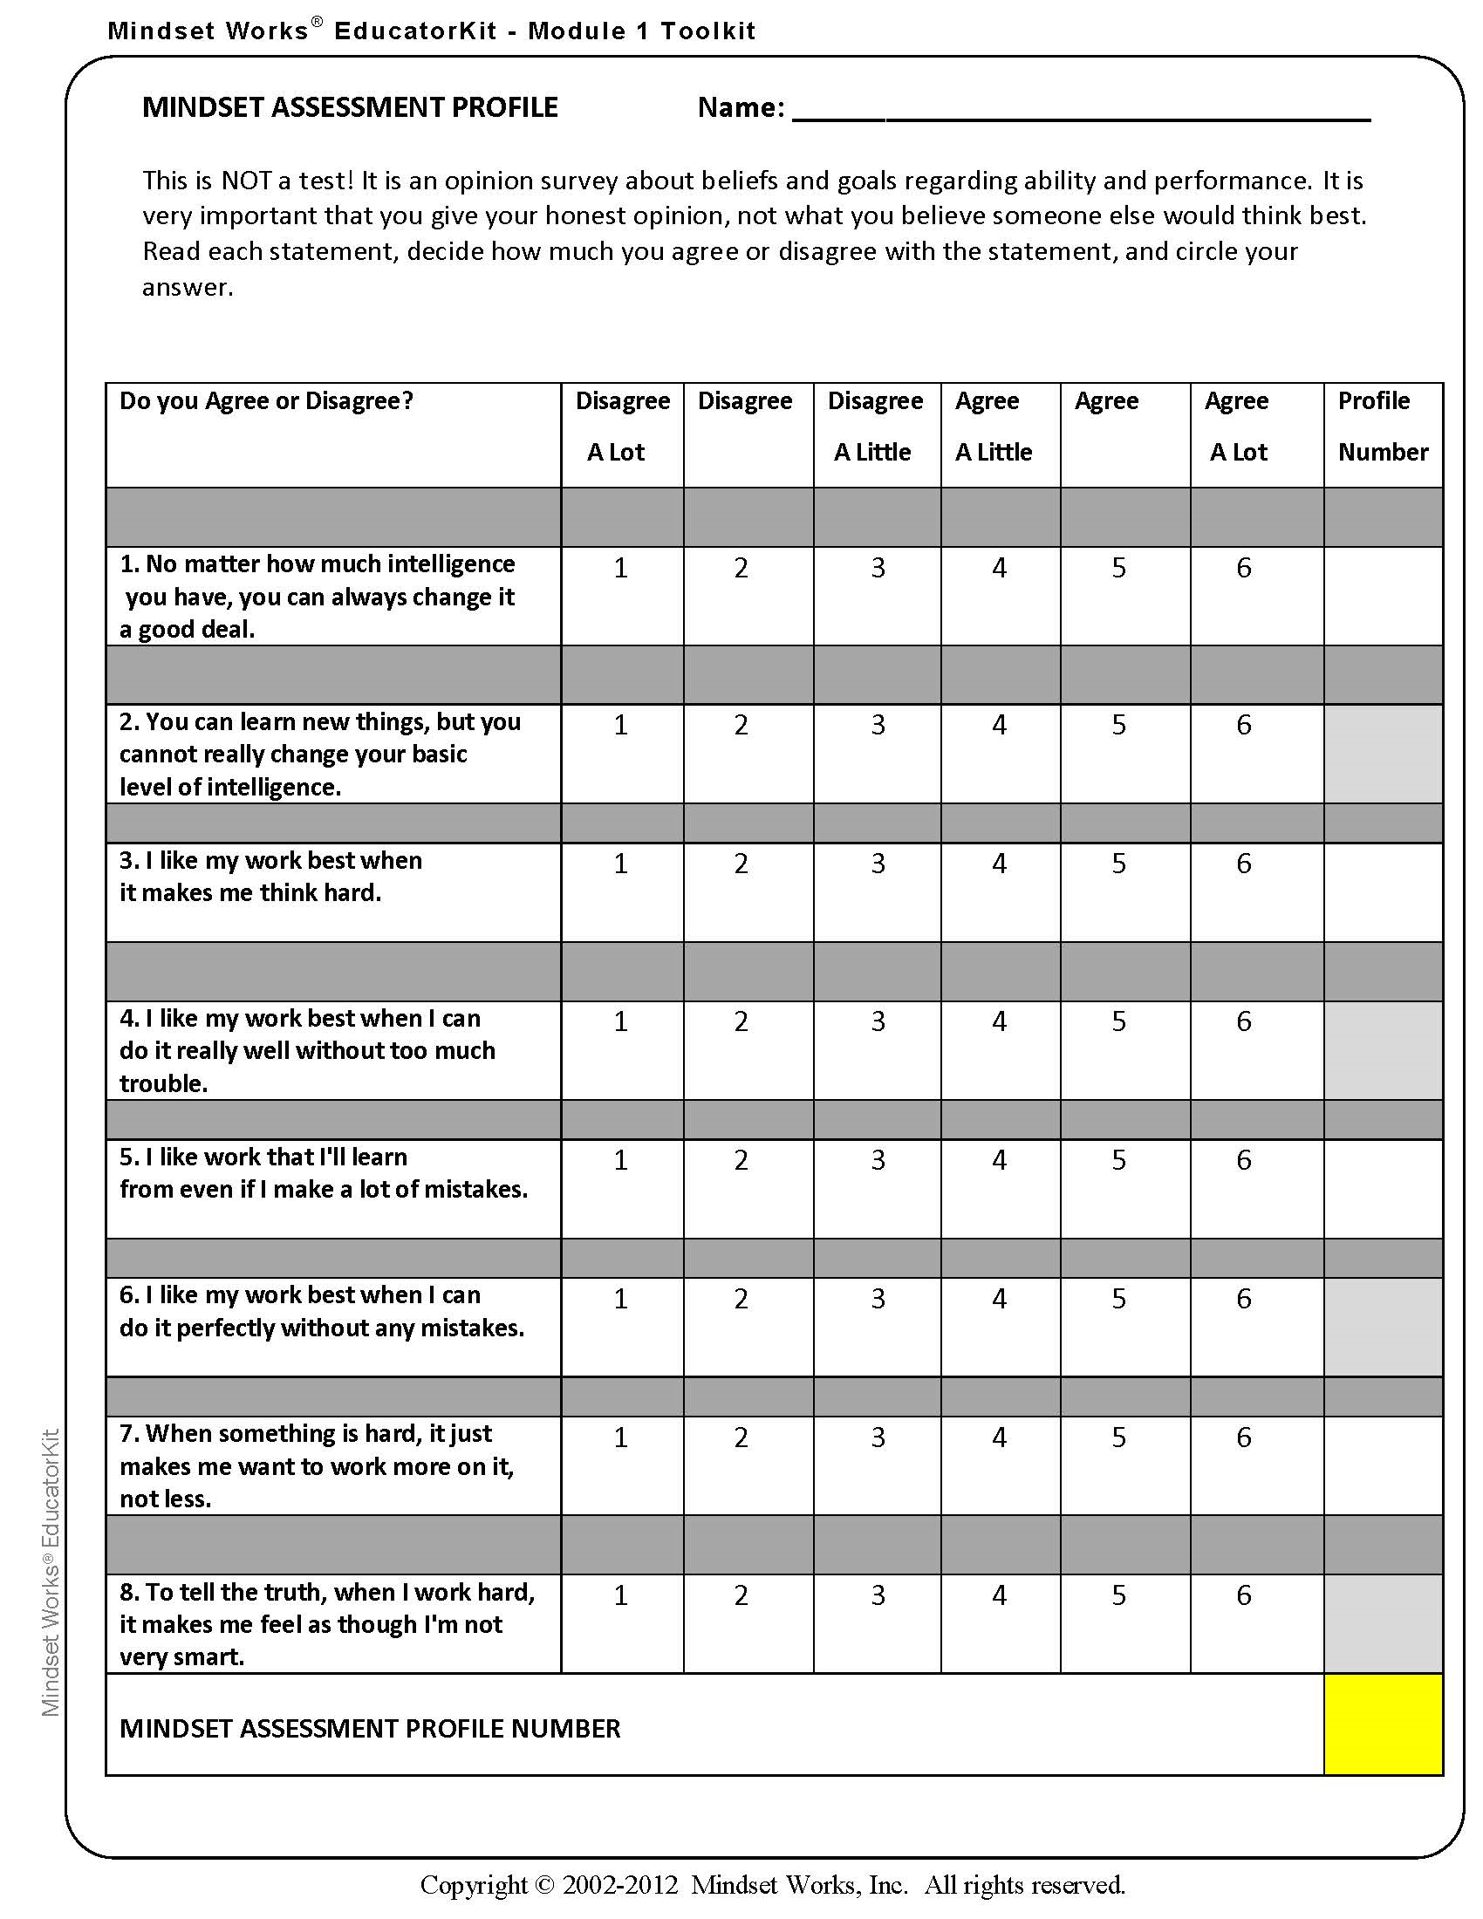
This is NOT a test!
This is an opinion survey and it is important that you give your honest opinion, not what you believe someone else would think best.
Write the numbers 1-8.
Read each statement, decide how much you agree or disagree with the statement, and record the number that corresponds with your answer next to the question number.

Slide 3
WHAT IS A GROWTH MINDSET?
https://www.youtube.com/watch?v=Xv2ar6AKvGc

Slide 4
WHAT IS A GROWTH MINDSET?
 | Fixed Mindset | Growth Mindset
Definition | Belief that ability is a fixed trait that cannot change | Belief that ability is malleable and can be developed
Interpretation of Effort | Effort is bad; if you’re smart, you shouldn’t have to work hard | Effort is good; it’s how you get better
Motivation | What matters is looking smart, so you can prove your ability | What matters is learning, so you can improve your ability
Response to Setbacks | Helplessness; setback is a sign that you don’t have what it takes | Resilience; setback is a sign that you need to work harder or try a new strategy
Interpretation of Failure | Failure is the end of the story: time to give up | Failure is the beginning of the story: time to try again

Slide 5
WHAT IS MY MINDSET?
The Implicit Theories of Intelligence Questionnaire is a tool to assess mindset
The Mindset Assessment Profile is a tool to assess one’s mindset, drive to achieve goals, and enjoyment of thinking

Slide 6
WHAT IS MY MINDSET?
The Implicit Theories of Intelligence Questionnaire is a tool to assess mindset
The Mindset Assessment Profile is a tool to assess one’s mindset, drive to achieve goals, and enjoyment of thinking

Slide 7
WHAT IS MY MINDSET?
For questions with odd numbers, write the numbers of your answers and add them up.

Slide 8
WHAT IS MY MINDSET?
For questions with even numbers, convert your numbers using the table below and add those numbers up.
If you chose this answer: | Then write:
Disagree A Lot (1) | 6
Disagree (2) | 5
Disagree A Little (3) | 4
Agree A Little (4) | 3
Agree (5) | 2
Agree A Lot (6) | 1

Slide 9
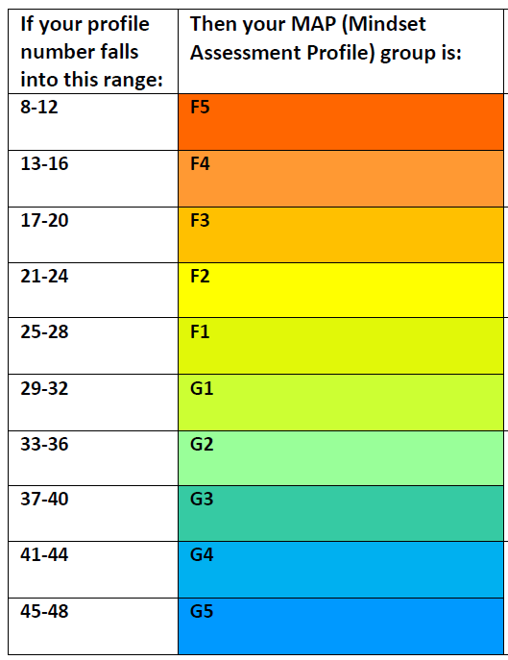
WHAT IS MY MINDSET?
Add your two summed numbers together to get your Mindset Assessment Profile (MAP) number
Use your MAP number to determine your MAP group

Slide 10
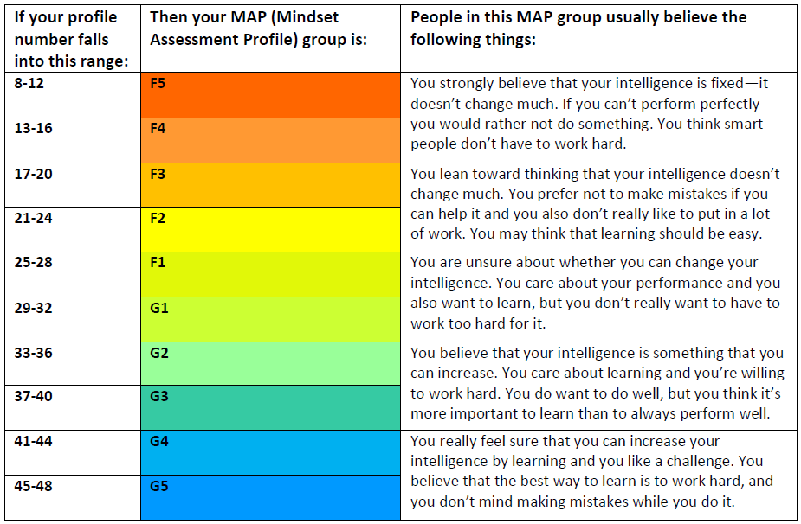
Which parts of the description of your MAP group match how you think and feel and which don’t?

Slide 11
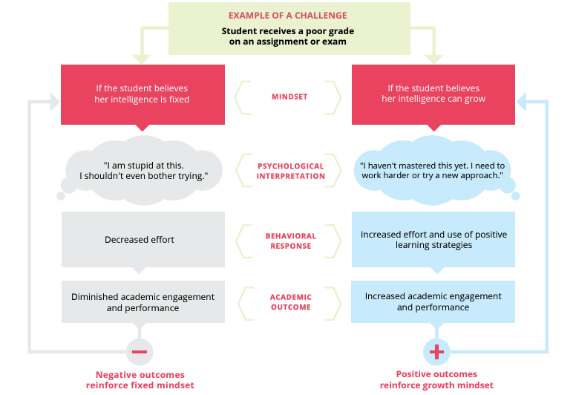
Why is Mindset important in stem?
Mindset can affect:
Growth
Academic outcome
Self esteem
Mental health
Sense of belonging

Slide 12
Why is Mindset important in stem?
Failing is what we scientists do best!

Slide 13
The power of “yet”
I can’t do this.
I’m not good at this.
I don’t understand this.
This doesn’t work.
This doesn’t make sense.

Slide 14
The power of “yet”
I can’t do this yet!
I’m not good at this yet!
I don’t understand this yet!
This doesn’t work yet!
This doesn’t make sense yet!

Slide 15
Our greatest glory is not in never falling, but in rising every time we fall.
Confucius

