Slide 1
Equipping Students to Engage in Productive Dialogue
Dona Warren
Dave Dettman
Rob Manzke
Erin Speetzen
Notes:
3:00 PM - 3:40 PM

Slide 2
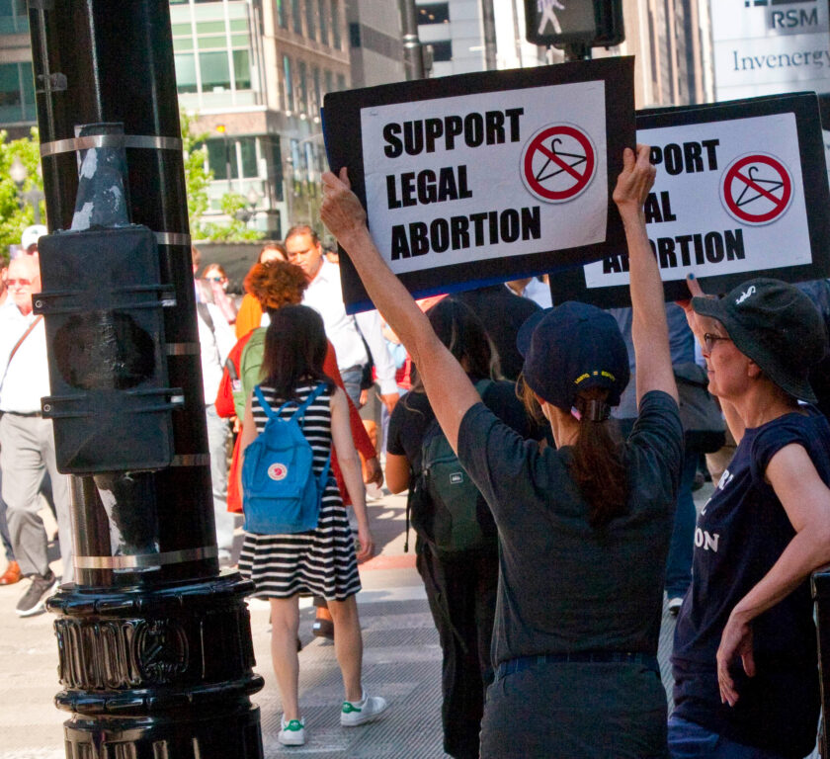
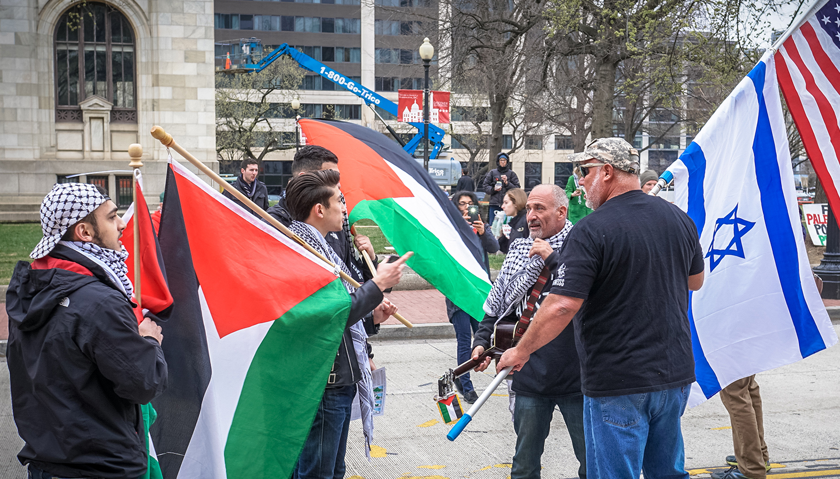
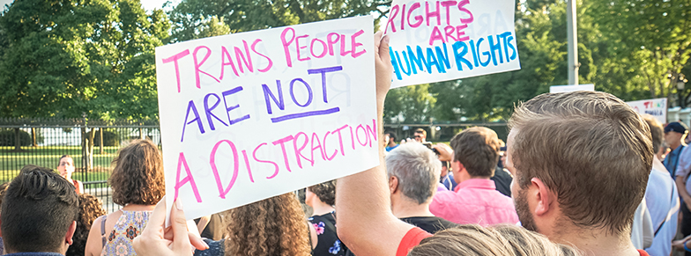
Supporting students includes equipping them with the skills they need to flourish in potentially stressful environments.
One such environment is dialogue about controversial issues.

Slide 3
We will Discuss
The results of a state-wide survey of student views about freedom of expression.
A campus-wide effort to help students hone their ability to communicate productively about divisive topics.
One approach to fostering meaningful discussions in class.
Resources that would be most useful as we work to foster productive dialogue in our courses.
Notes:
1 is Dona
2 is Rob
3 is Dave
4 is Erin

Slide 4
1) The results of a state-wide survey of student views about freedom of expression.
Student Views on Freedom of Expression survey was administered to all UW schools in the Fall of 2022. President Rothman announced the results on February 1, 2023. The full report can be found at https://www.wisconsin.edu/civil-dialogue/download/SurveyReport20230201.pdf
The survey had two broad foci: 1) student attitudes about free expression, and 2) student understanding of the First Amendment.

Slide 5
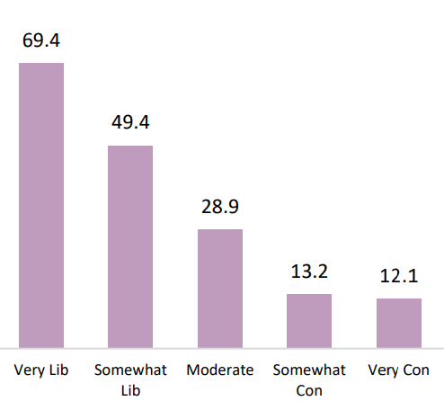
1) The results of a state-wide survey of student views about freedom of expression.
Percent who think quite a bit or a great deal that people who express offensive views are causing harm to those they offend:
https://www.wisconsin.edu/civil-dialogue/download/SurveyReport20230201.pdf - p. 26

Slide 6
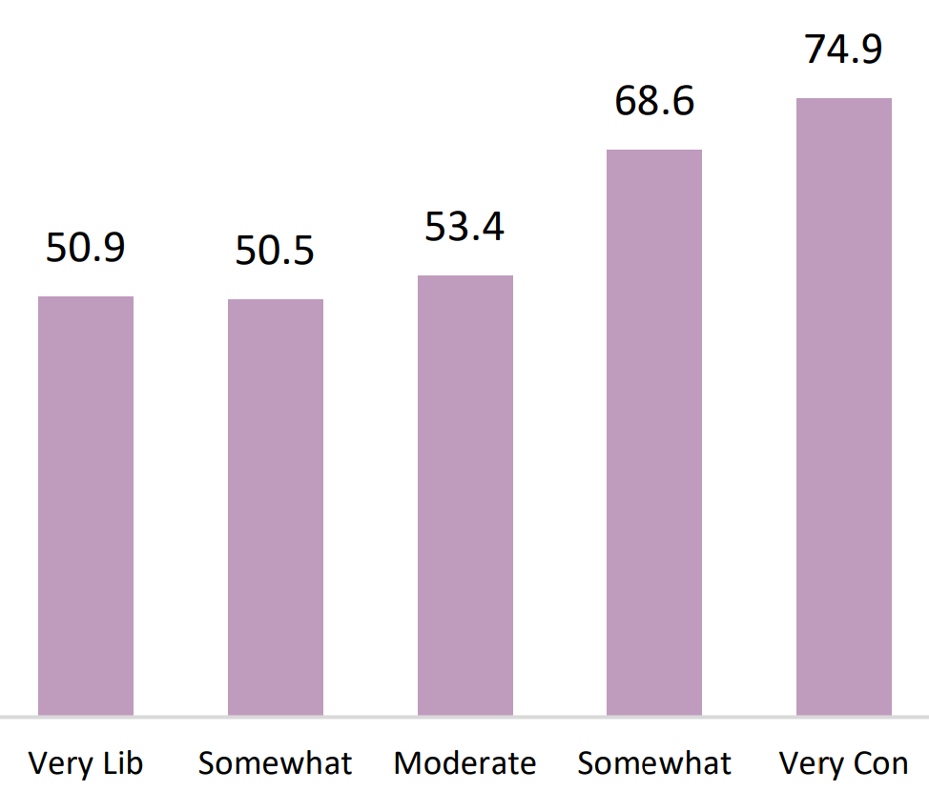
1) The results of a state-wide survey of student views about freedom of expression.
Percent of students who have wanted to express their views on a controversial topic in class, but have decided not to.
https://www.wisconsin.edu/civil-dialogue/download/SurveyReport20230201.pdf - p. 68

Slide 7
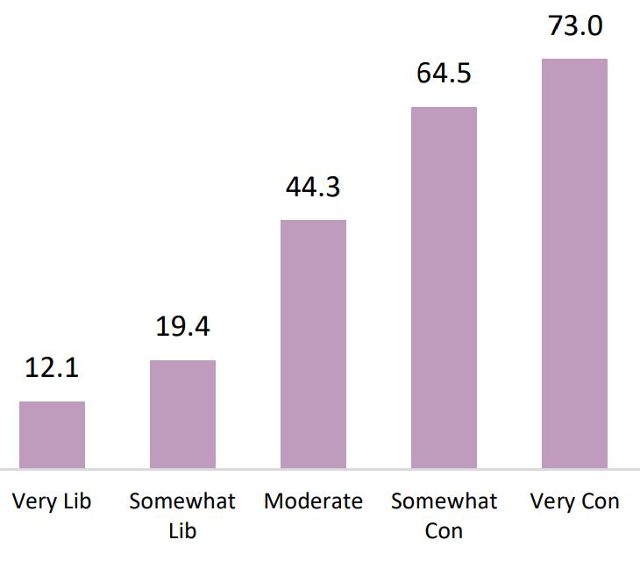
1) The results of a state-wide survey of student views about freedom of expression.
Of those who said they have wanted, but decided not, to express their views, the percent who reported it was because they were worried the instructor would give them a lower grade.
https://www.wisconsin.edu/civil-dialogue/download/SurveyReport20230201.pdf - p. 68

Slide 8
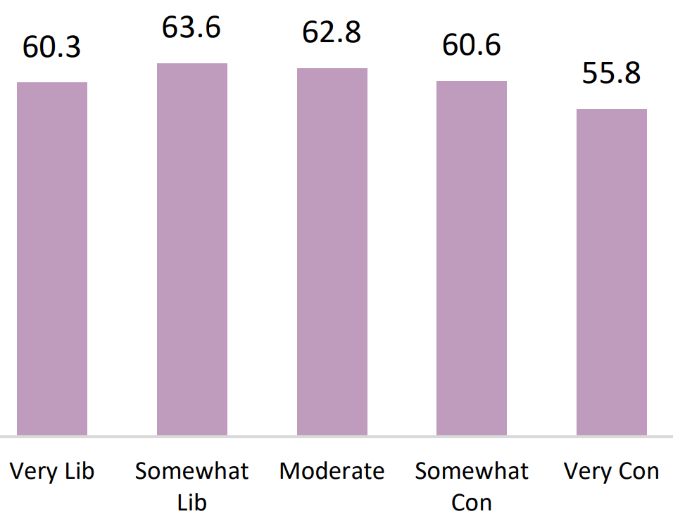
1) The results of a state-wide survey of student views about freedom of expression.
Of those who said they have wanted, but decided not, to express their views, the percent who reported it was because they were worried other students would disagree with them.
https://www.wisconsin.edu/civil-dialogue/download/SurveyReport20230201.pdf - p. 69

Slide 9
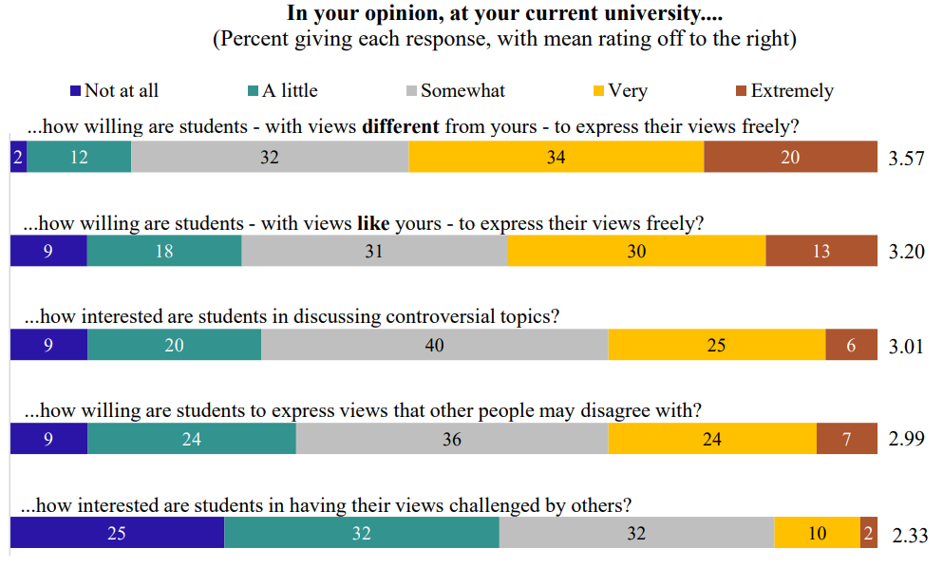
1) The results of a state-wide survey of student views about freedom of expression.
https://www.wisconsin.edu/civil-dialogue/download/SurveyReport20230201.pdf - p. 48

Slide 10
2) A campus-wide effort to help students hone their ability to communicate productively about divisive topics.
Chancellor’s Commission on Freedom of Expression and Civil Discourse
Membership
Hon. Judge Patricia Baker - Circuit Court Branch 3
John Blakeman - Professor, Department of Political Science
Dave Dettman - Library Instruction Program Coordinator / Associate Professor
Rob Manzke - Chief of Staff
Michele Miller - Associate Director for Programming, University Centers
Troy Seppelt - Dean of Students
Erin Speetzen - Director, Center for Inclusive Teaching and Learning
Dona Warren - Professor of Philosophy and Critical Thinking Center Director

Slide 11
2) A campus-wide effort to help students hone their ability to communicate productively about divisive topics.
Chancellor’s Commission on Freedom of Expression and Civil Discourse (November 29, 2023)
The mission and responsibilities of the Commission include:
Promoting awareness of free expression and civil dialogue to the campus community.
Developing and implementing free speech and civil dialogue related educational activities for faculty, staff and students.
Assessing the campus climate in respect to free speech and civil dialogue.
Hosting an event each semester that focusses on free speech or civil dialogue.
Providing input to the chancellor and campus leadership regarding how to improve the university climate for free speech and civil dialogue.
In addition to the standing goals of the Commission, the Chancellor would like the group to focus on the following:
Develop and implement faculty development opportunities in the areas of free expression, civil dialogue, First Amendment, academic freedom and classroom dialogue facilitation.
Ensure the university is in compliance with Regent Policy Document 4‐21, Commitment to Academic Freedom and Freedom of Expression.
Develop and promote online training and resources for faculty, staff and students related to free expression and civil dialogue.
Ensure incorporation of branch campuses education and training activities.
Provide the Chancellor with an end‐of‐year report that describes the accomplishments of the Commission and sets goals for the next academic year

Slide 12
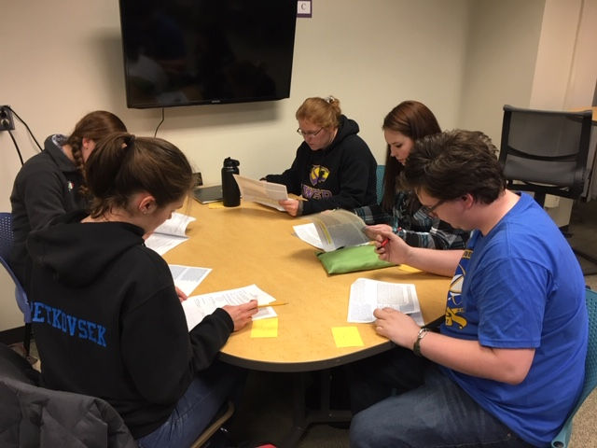
3) One approach to fostering meaningful discussions in class.
Promoting Critical Thinking, Civil Discourse, and Group Consensus via Structured Academic Controversy

Slide 13
Consensus from Controversy? That Seems Counterintuitive
12
Johnson, Johnson and Tjosvold share study results that reveal “Constructive Controversy has been found to promote greater liking among participants than did concurrence seeking, debate, or individualistic efforts (2009).”
Notes:
Within controversy and conflict (characteristics of a debate) there are elements of disagreement, argumentation, and rebuttal that could result in individuals disliking each other and could create difficulties in establishing good relationships. They seem, however to have the opposite effect.

Slide 14
Learning Outcomes for a Structured Academic Controversy
3
As a result of participating in this activity, students can/ will be able to….
Articulate background knowledge related to the controversial issue.
Construct and share reasoning in favor of a position.
Analyze and evaluate reasoning from multiple perspectives.
Collaboratively synthesize multiple perspectives.
Notes:
The learning outcomes are very straightforward and measurable which is another thing that attracted me to the technique. The idea of multiple perspectives was also something I have been wrestling with as an educator for a very long time. In my experiences with one shot library sessions the norm is faculty assigning a research paper where students have to pick a topic, usually one that has multiple perspectives, find sources, read the sources and then either write a paper or create an annotated bibliography. Many students select something they have a firm opinion on and are very reluctant to spend any time at all seeking out and evaluating perspectives and reasoning that runs counter to their own. As a result they never have to wrestle with cognitive conflict, something that some studies have concluded is essential in helping students overcome confirmation bias.

Slide 15
Critical Thinking Dispositions
Truth-Seeking
Healthy Skepticism
Tracking Reasoning
Open-Mindedness
Attentive Listening
Case-Making
2
Structured Academic Controversy (also known as Constructive Controversy) is a carefully constructed and deliberative process that promotes civil discourse and critical thinking.
Johnson, D. W., & Johnson, R. T. (1988). Critical thinking through structured controversy. Educational Leadership, 45(8), 58 – 64.
Notes:
Critical thinking (CT) is commonly defined as a metacognitive process, consisting of a number of cognitive skills (e.g. analysis, evaluation and inference) and a variety of personal dispositions (e.g. open-mindedness, inquisitiveness and skepticism), that, when used appropriately, increases the chances of producing a logical solution to a problem or a valid conclusion to an argument. SAC is a process that strives to help in this case students acquire the above dispositions. Briefly, the technique involves a form of cooperative debate where groups of 4 are assigned or select a controversial topic to discuss. The two pairs take turns advocating for each side of the issue before coming together as a group to reach a consensus on the topic. From this point on I will refer to structured academic controversy as SAC.
SAC has a nearly 40-year history with David W. Johnson and Roger T. Johnson being the most prominent scholars in the field publishing hundreds of articles, and dozens of books and book chapters.

Slide 16
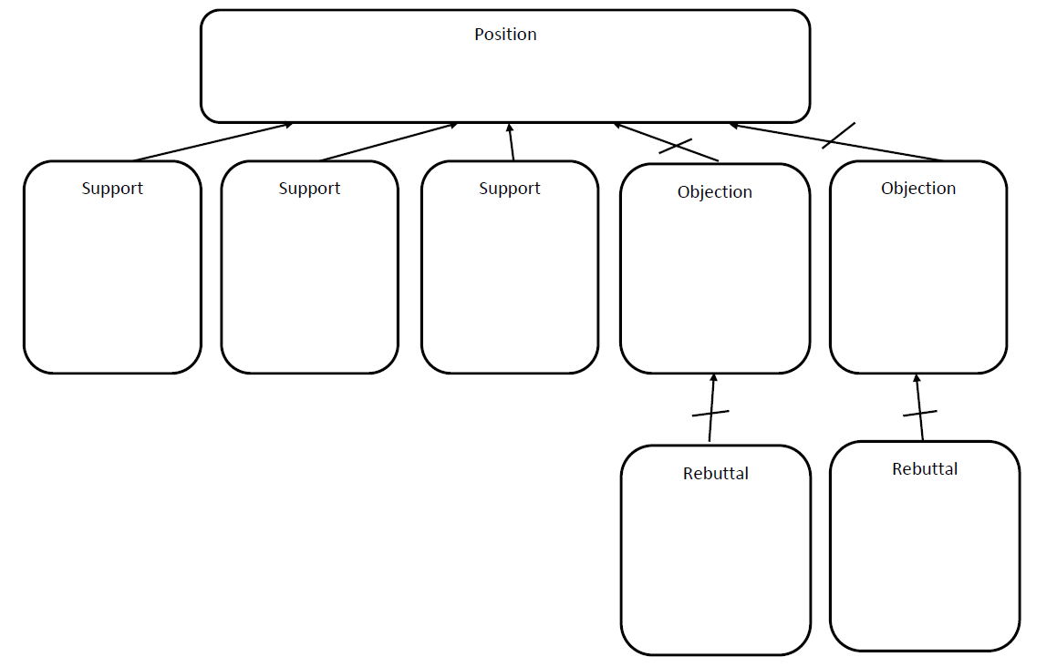
Argument Mapping
4
Notes:
After experimenting informally with SAC in three for credit library courses in the Spring of 2018 I expressed to a college in the philosophy department that students were struggling keeping their reasoning and arguments in order and the exercise very often suffered as a result. She suggested using some for of argument mapping to help them stay on track.
Argument mapping is a way to visually show the logical structure of arguments. You break up an argument into its constituent claims, and use lines, boxes, colors and location to indicate the relationships between the various parts. The resulting map allows us to see exactly how each part of an argument is related to every other part. Argument maps tend to be very philosophical to argue complex ideas like “If you let somebody die is it the same as killing somebody?” I brought the idea into my structured academic controversy experience to serve as an organizing component that students use to help keep track of the various arguments they are encountering as they gather research during the days after the initial SAC activity.

Slide 17
Benefits of
SAC Activity with Argument Mapping
5
Mastery of the argument schema (difference between support, objection, rebuttal, etc.).
Familiarity with a conceptual tool that can be used for deliberation.
Cultivation of a method for weighing reasoning
Acquaintance with a method for collaborative reasoning and decision-making.
Notes:
So, by infusing argument mapping students had a visual representation of multiple perspectives on a controversial issue and arguments for and against them. Even if they do not agree with a perspective they can’t simply dismiss it. As part of the argument map the reasoning behind all of the perspectives must be weighed.
Mastery of the argument schema (difference between support, objection, rebuttal, etc.).
Familiarity with a conceptual tool that can be used for deliberation.
Cultivation of a method for weighing reasoning
Acquaintance with a method for collaborative reasoning and decision-making.

Slide 19
Assessment Results
Gathered data validates previous SAC research studies that correlate participating in the cooperative activity with student motivation and interest in learning more. In this case spending more time outside of class researching, talking about their topic with others, and considering more potential sources.
Also, annotations written by the LR 101 group without the SAC activity contain more of the language from the articles abstracts or summaries than do the annotations of both groups that had the SAC activity. ​

Slide 20
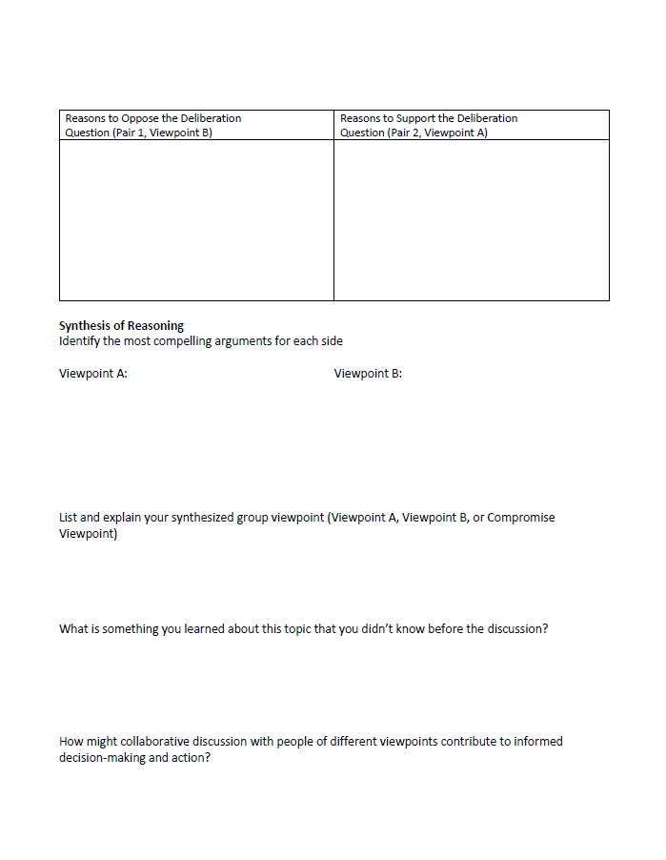
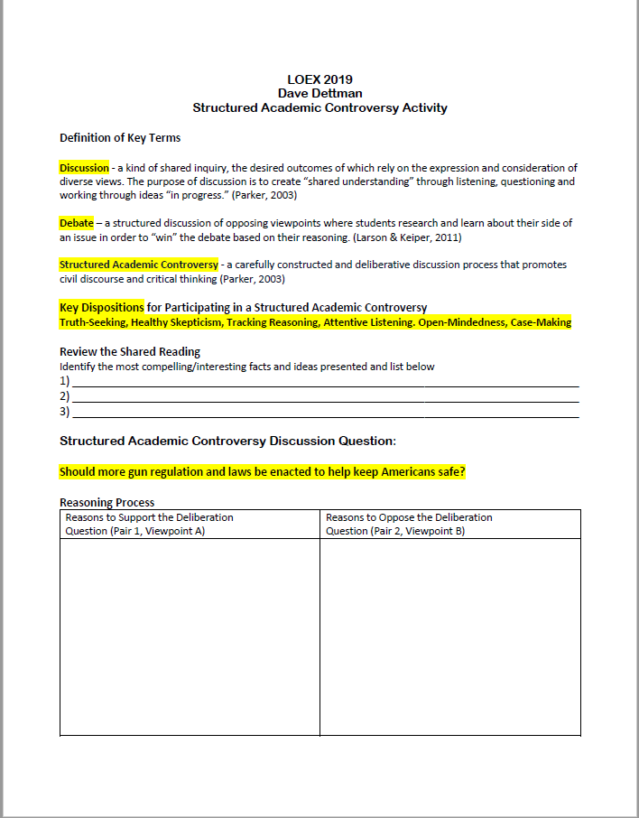

Slide 21
4) Resources that would be most useful as we work to foster productive dialogue in our courses.
Chancellor’s Commission on Freedom of Expression and Civil Discourse (November 29, 2023)
The mission and responsibilities of the Commission include:
Developing and implementing free speech and civil dialogue related educational activities for faculty, staff and students.
Hosting an event each semester that focusses on free speech or civil dialogue.
In addition to the standing goals of the Commission, the Chancellor would like the group to focus on the following:
1. Develop and implement faculty development opportunities in the areas of free expression, civil dialogue, First Amendment, academic freedom and classroom dialogue facilitation.
3. Develop and promote online training and resources for faculty, staff and students related to free expression and civil dialogue.
It’s vital that faculty be involved in this work.
What concerns do you have?
What hopes do you have?
How can you participate?

Slide 22
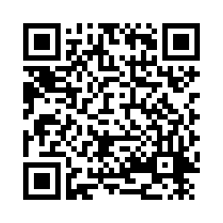
4) Resources that would be most useful as we work to foster productive dialogue in our courses.
Are you interested in using resources to help promote civil discourse / productive dialogue in your classes? If so, what resources would you find most valuable?
Are you interested in helping to develop resources to promote civil discourse / productive dialogue? If so, what resources would be interested in helping to create?

Slide 23
References
The University of Wisconsin Page on Civil Dialogue, including the survey results and other resources https://www.wisconsin.edu/civil-dialogue/
UWSP’s Library Guide for Critical thinking, Productive Dialogue tab https://libraryguides.uwsp.edu/critical_thinking/productive_dialogue
UWSP’s Center for Inclusive Teaching and Learning https://www3.uwsp.edu/citl/Pages/default.aspx
Dettman, David. "Promoting Critical Thinking and Civil Discourse via Structured Academic Controversy." LOEX 2019 Conference Proceedings https://commons.emich.edu/cgi/viewcontent.cgi?article=1035&context=loexconf2019

