Slide 1
CITL Dialogue: Exploring What’s Next and Supporting Your Needs
UWSP Teaching Conference
January 17th, 2024

Slide 2
Goals
Share lessons from last year's conference.
Share what we’ve done and what we plan to do.
Hear from you!

Slide 3
Lessons From Last Year’s Conference
Faculty need opportunities to talk to one another.
Faculty want to feel heard.
Faculty need support.
Mental health
College-readiness

Slide 4
CITL Themes for This Year
Mental health
Student success
Artificial Intelligence

Slide 5
Mental Health
Mind Over Monster’s book clubs
Revised syllabus template
Revised student support resources in Canvas
Spring Teaching Tip Tuesday series
Sallie Scovill – Faculty Fellow

Slide 6
Student Success
Teach Students How to Learn book club (fall)
Saundra McGuire talk (fall)
Work with Director of Academic Success
Revised student support resources in Canvas
Addition of link to Navigate in Canvas

Slide 7
Artificial Intelligence
AI series
Auburn course on Teaching with AI
Workshops on revamping assignments in light of AI.
Yue Li – Faculty Fellow

Slide 8
Other CITL Initiatives
Guidelines around flexibility
Brown bag sessions
CITL website redesign
Free Speech and Civil Discourse/Productive Dialogue (session this afternoon)
High Impact Practices
Sarah Orlofske – faculty fellow
Open Educational Resources

Slide 9
If any of these are particularly interesting to you, or if you’re interested in helping to plan or facilitate programming in any of these areas please let us know using this survey.

Slide 10
Hypothesis
Collaborative, inline markup and discussion of class readings and multimedia content, integrated with Canvas
Discussion
Group note taking
Collaborative study guides

Slide 11
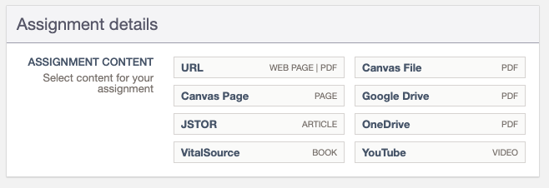

Slide 12
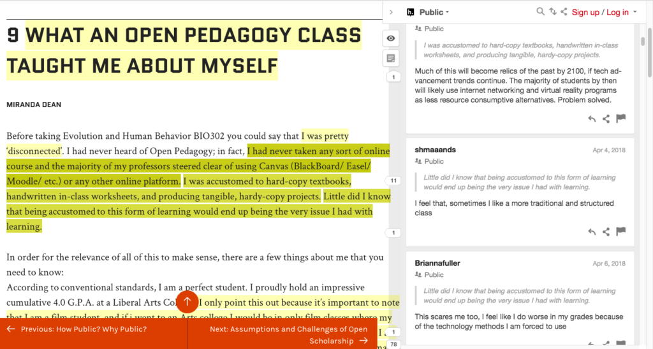

Slide 13
Scan the QR code for an introductory video

Slide 14
Hypothesis
Piloting Spring 2024 with 500 seats (about 100 remaining)
Looking for instructors who wish to try it from any discipline
Training Provided; local and webinar series from Hypothesis
Contact Sean: sruppert@uwsp.edu to be considered for the pilot

Slide 15
What do you need?
Each table has some feedback sheets with some questions for you.
Take this time to talk with those around you and let us know how we can better support you and the work that you do.

