Slide 1
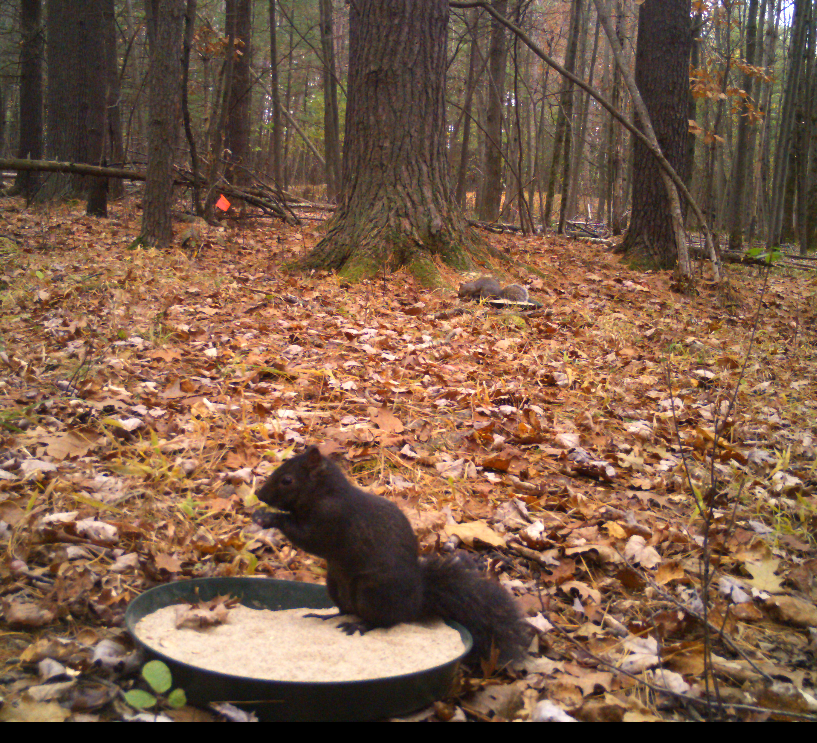
Squirrel-Net: Improving research skills by involving students in a national study of squirrel behavior
Christopher Yahnke, Department of Wildlife Ecology and Brian Barringer, Department of Biology

Slide 2
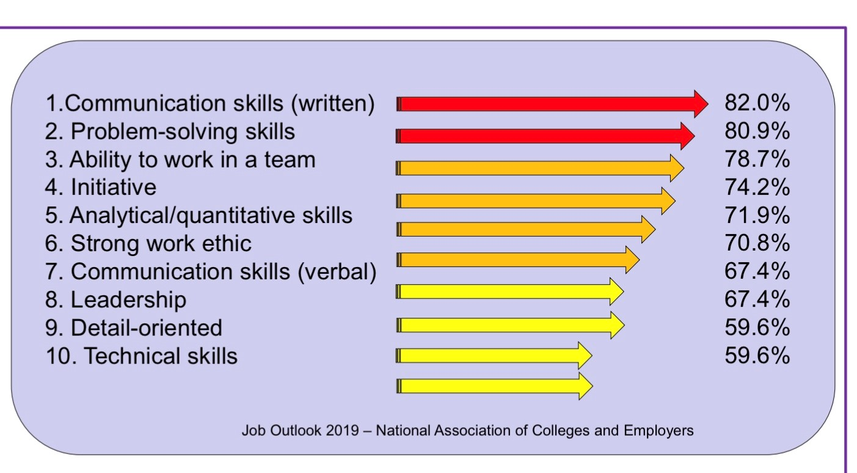
We want our students to get jobs!
Employers were asked which skills – beyond strong GPA – they most want to see on a student’s resume. I include the most current NACE top 10 skills list on all of my course syllabi. While the list does not change much from year to year, Leadership dropped from number one in 2017 to number eight in 2019, and Written Communication increased from number three to number one in 2019.

Slide 3
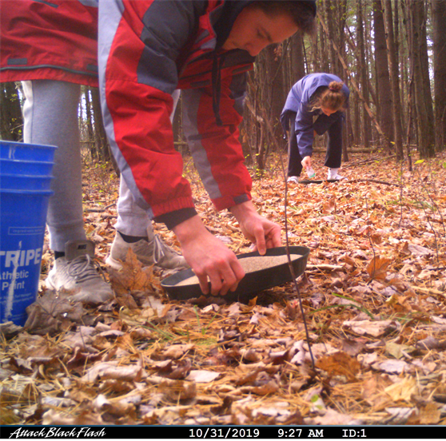
Undergraduate Research
Research experiences are critical elements of undergraduate science education. They provide an opportunity for students to learn about inquiry, gain confidence in overcoming obstacles, and self-identify as scientists¹⁻³. However, gaining extra-curricular research experience is not often feasible for many students either as a result of financial or time limitations⁴, lack of awareness of opportunities, or institutional structure and resource limitations. This is particularly the case for STEM students from under-represented groups⁵. Furthermore, university culture and/or current STEM pedagogy can make these students feel they do not belong in academia, leading to higher dropout rates⁶.

Slide 4
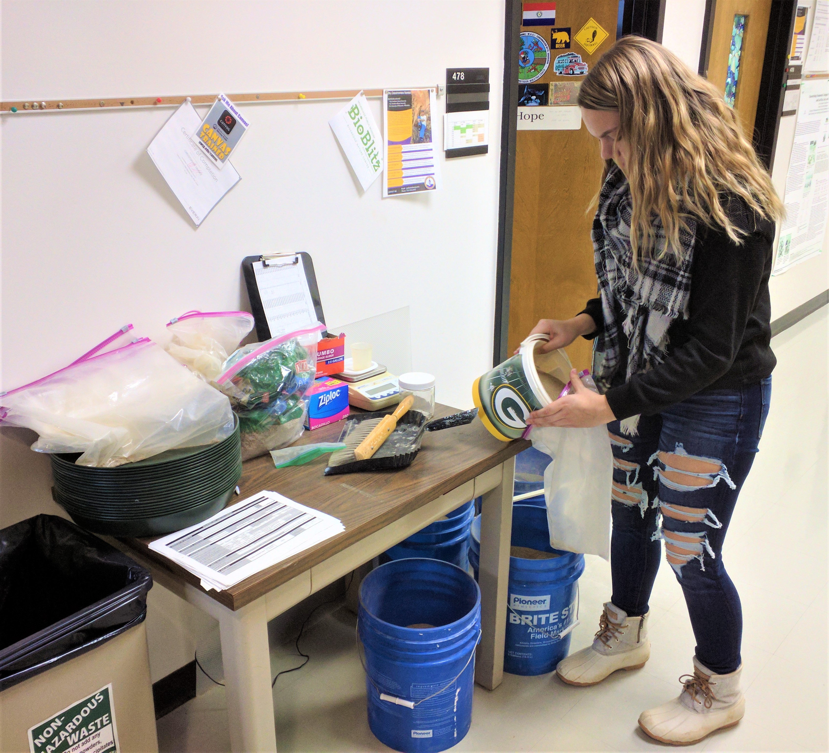
CUREs (Course-based Undergraduate Research Experiences)
Course-based undergraduate research experiences (CUREs) are a strategic way to introduce more students to authentic research⁴; however, many barriers limit their widespread adoption^{7,8}. Development of a CURE can be time consuming⁹ and may seem daunting to faculty that lack pedagogical training. Additionally, it is difficult to collect sufficient data for meaningful analyses in a semester, particularly at smaller institutions or in field-based courses⁸. This restricts student opportunities to engage in research, master data analysis¹⁰, and prepare for graduate school or data-driven careers¹¹. Finally, most CUREs target large-enrollment introductory courses⁹, limiting exposure to mentoring opportunities. Rarely do students return to the same topic within their undergraduate program, even though repeated exposure promotes deeper engagement and long-term gains in skills and content knowledge¹².

Slide 5
Story of Liz Westerberg and Johanna Varner
What is Squirrel-Net?

Slide 6
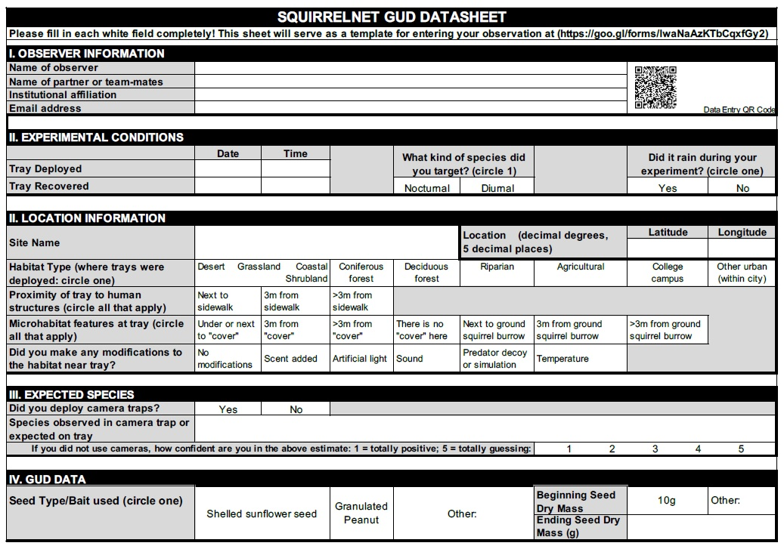
Student datasheet for the Giving Up Density Module. The QR code links to a Google Sheet where students enter this into a national dataset.

Slide 7
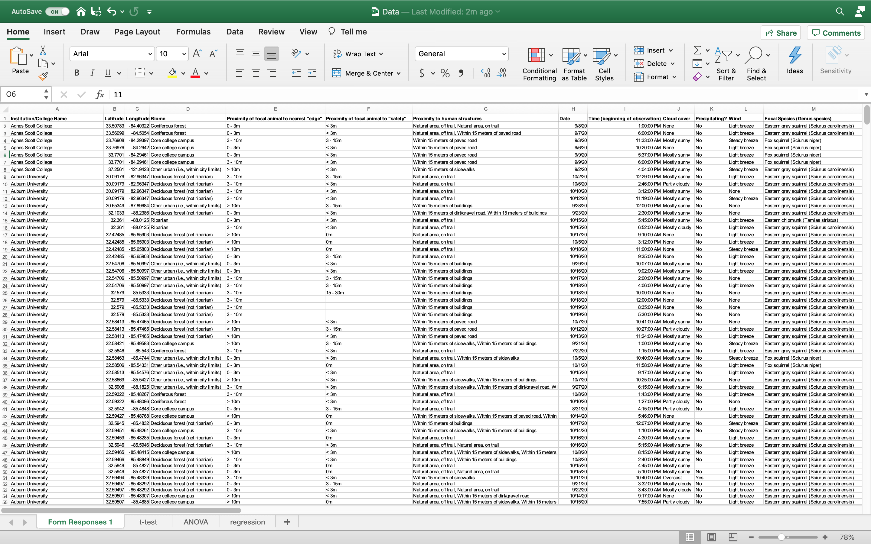

Slide 8
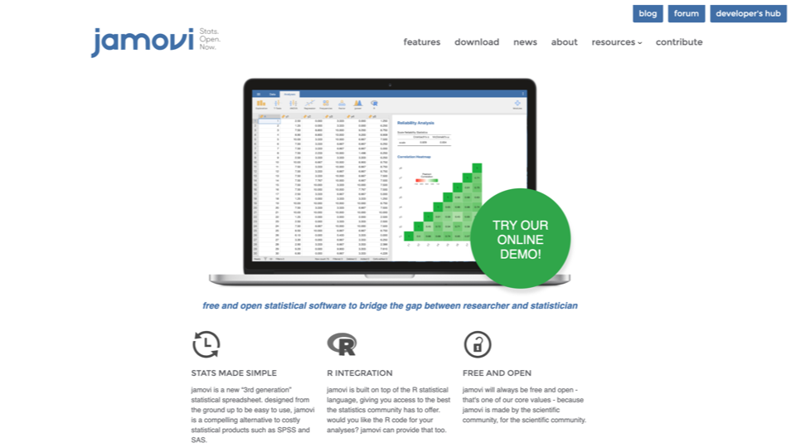

Slide 9
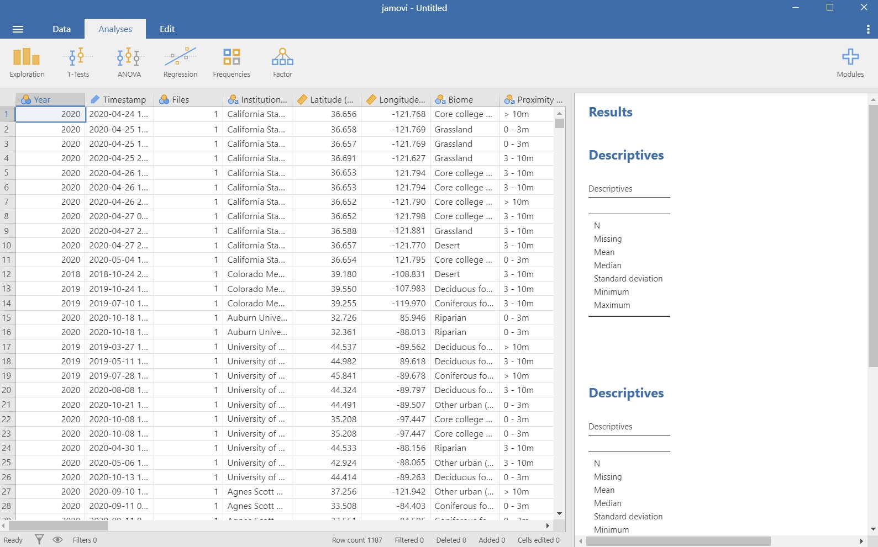

Slide 10
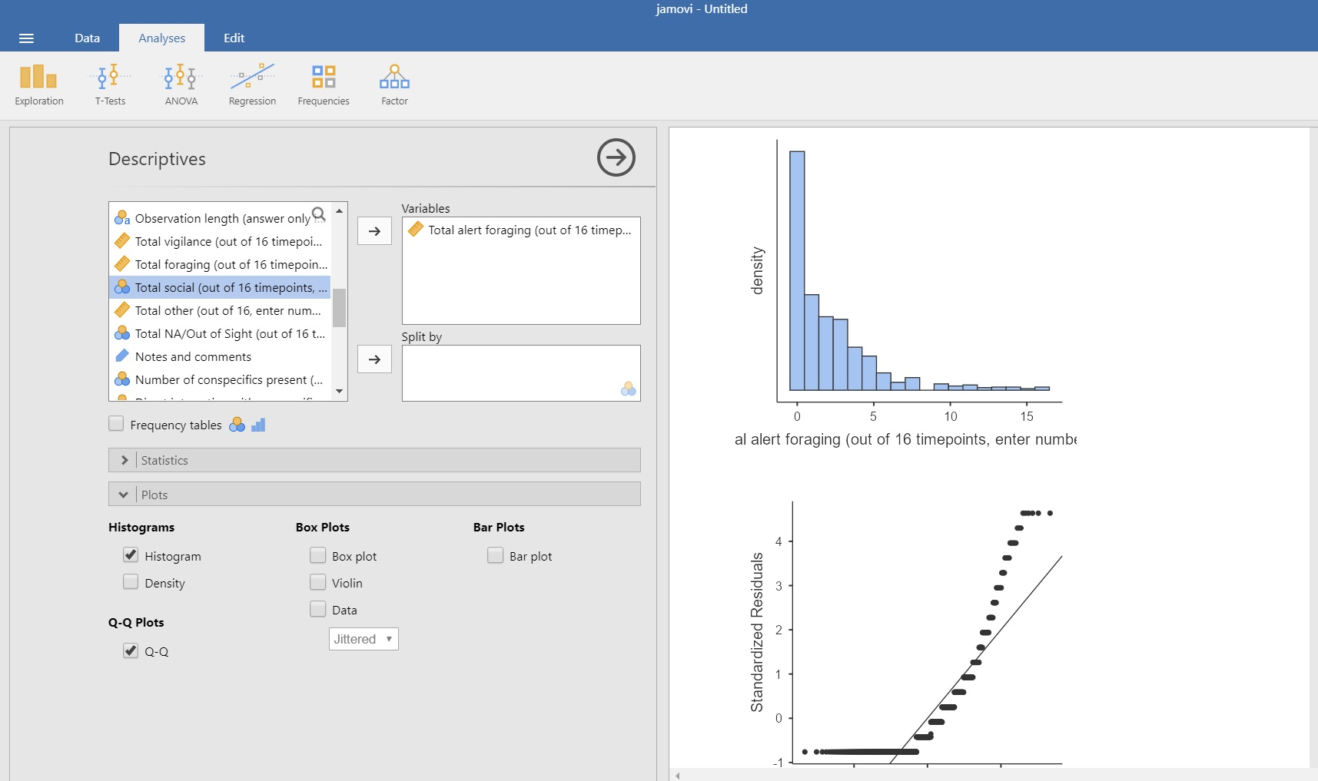
Distribution plots to visualize normal distributions

Slide 11
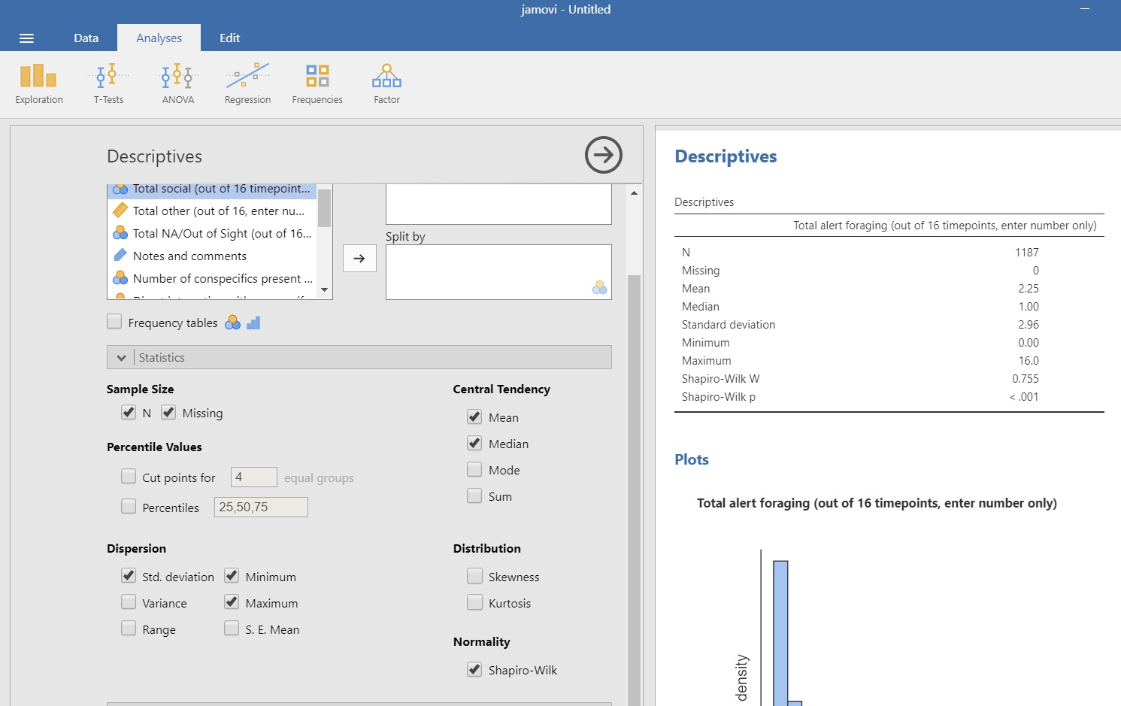
Statistical tests for normality

Slide 12
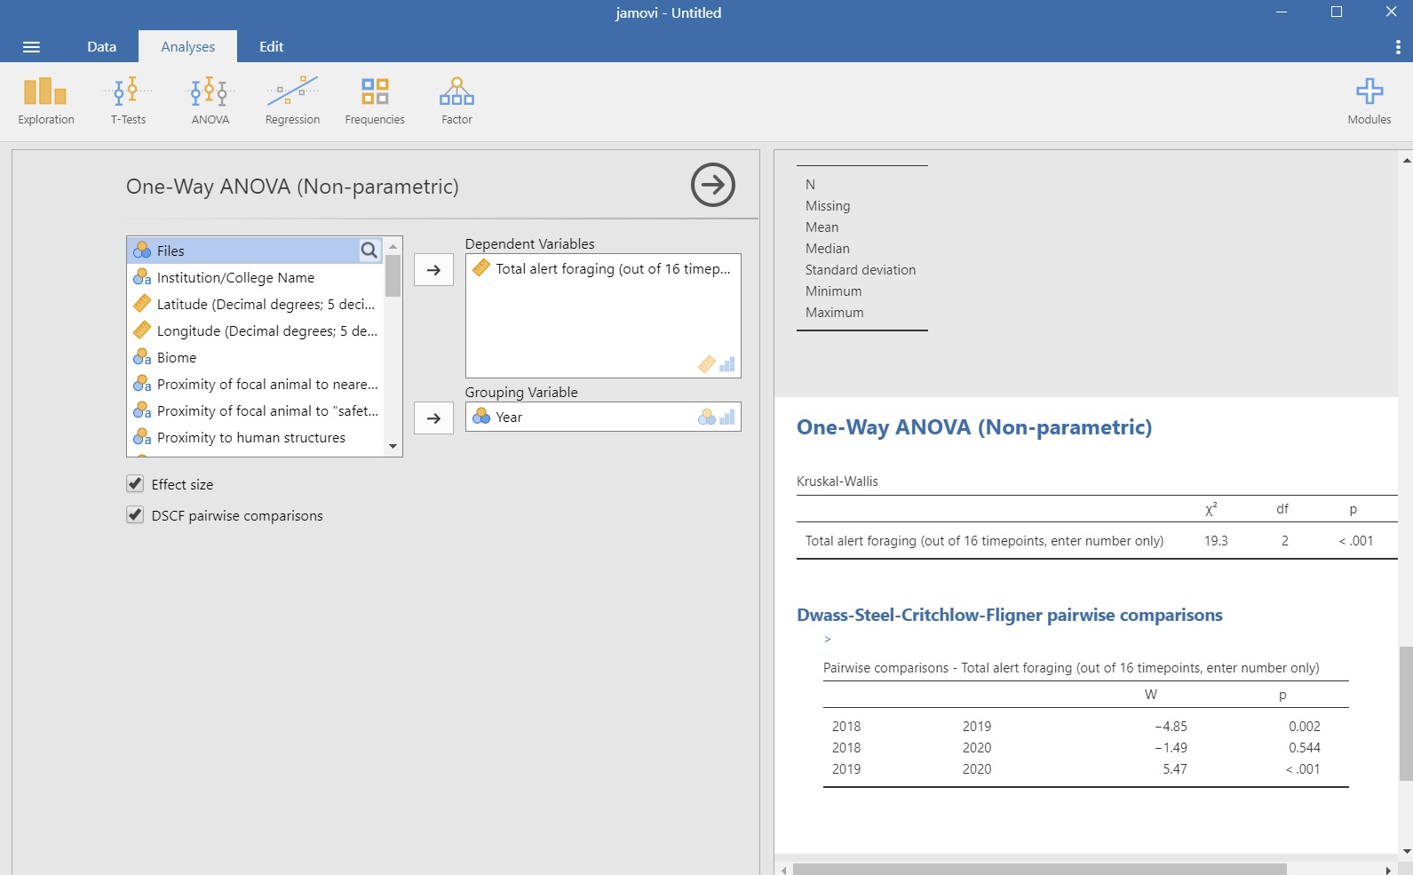
Students can quickly analyze behaviors (Dependent variables) and grouping variables (Independent variables)

Slide 14
Intro C
GUD and Behavior modules C/B
Jamovi and data analysis/handling B
Tangible learning outcomes/ artifacts B/C
Recruiting other institutions C
Thank You

Slide 15
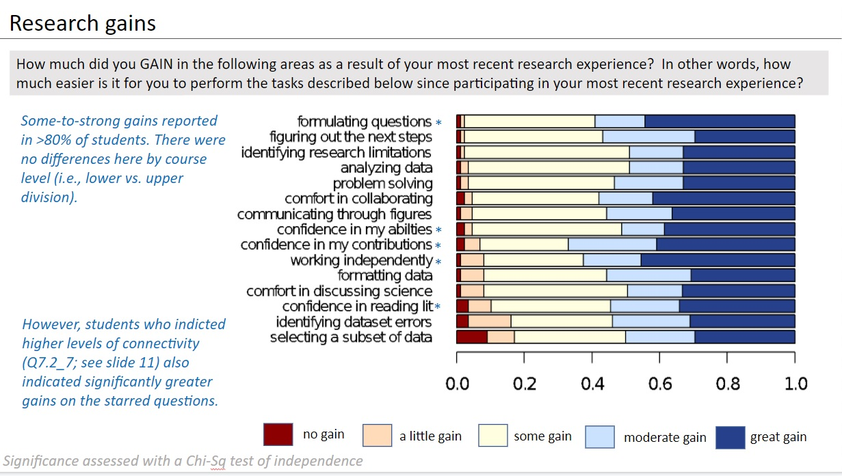

Slide 16
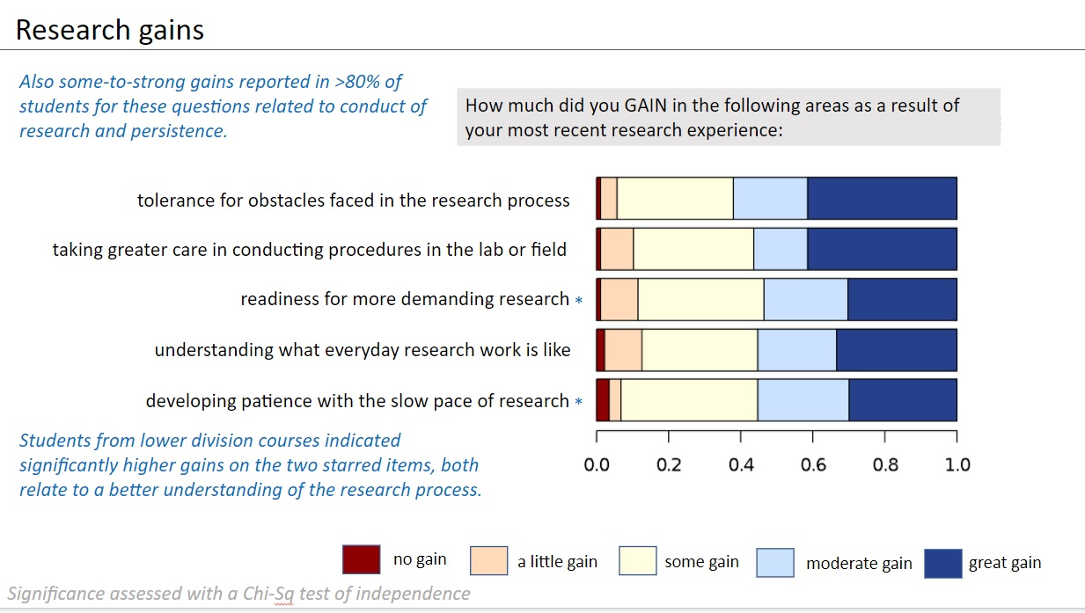

Slide 17
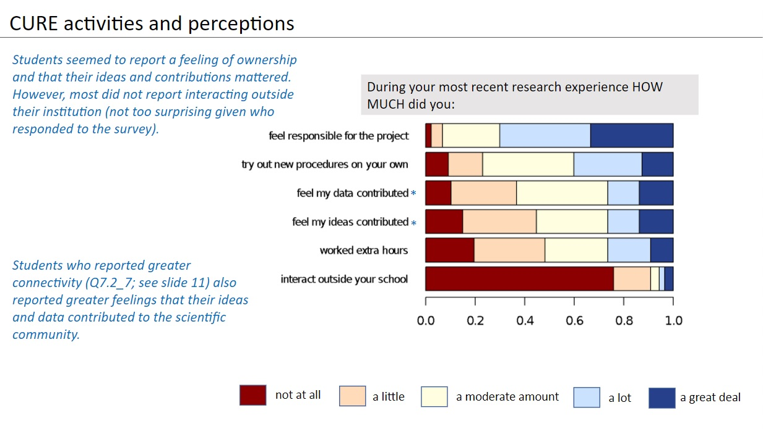

Slide 18
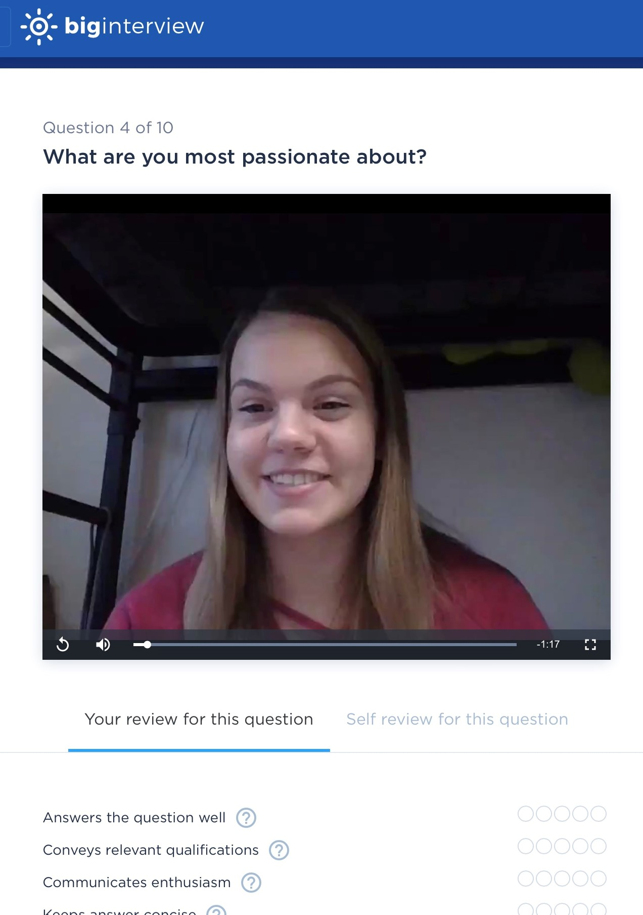
Wisconsin Teaching Fellows and Scholars Project
Can an intervention using a Squirrel-Net Cure improve student responses on job interview questions?
Used Big Interview and had first semester Biology students answer ten mock interview questions.
Pre and Post interviews were conducted using the same 10 questions, one given at the beginning of the semester and one towrds the end.
All students participated in the Squirrel-Net GUD CURE during the semester.
Student interviews were transcribed and coded using QDA Miner.

Slide 19
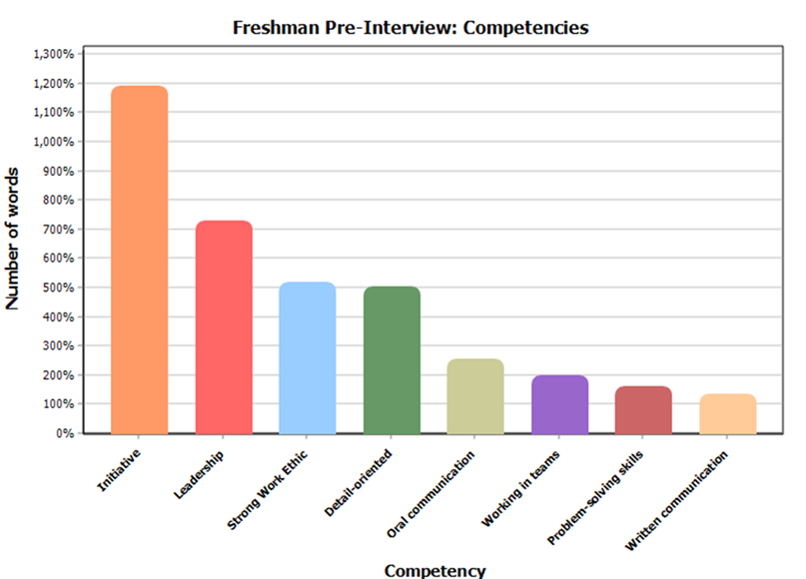
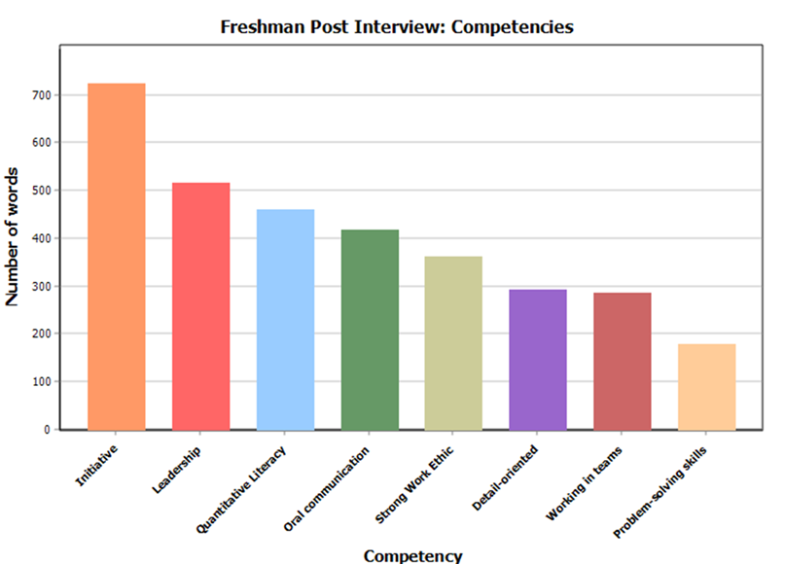
Initiative and Leadership were the two competencies that were highlighted most in first year student responses. After the Squirrel-Net CURE activity more students included examples of quantitative literacy and oral communication in their interview responses.

Slide 20
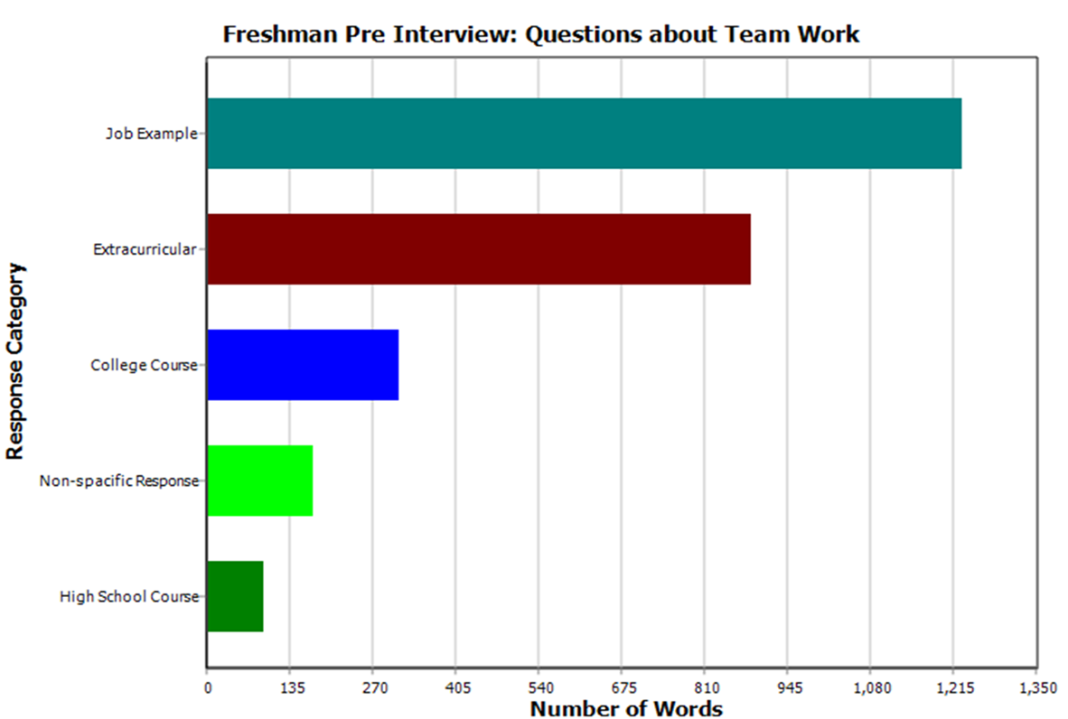
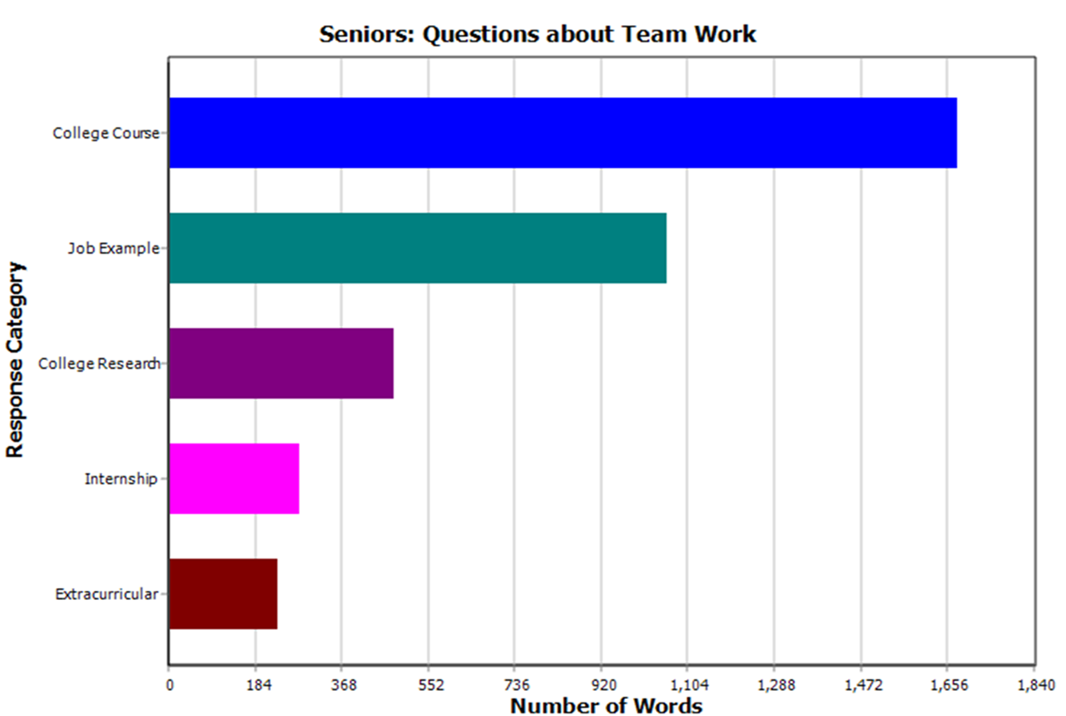
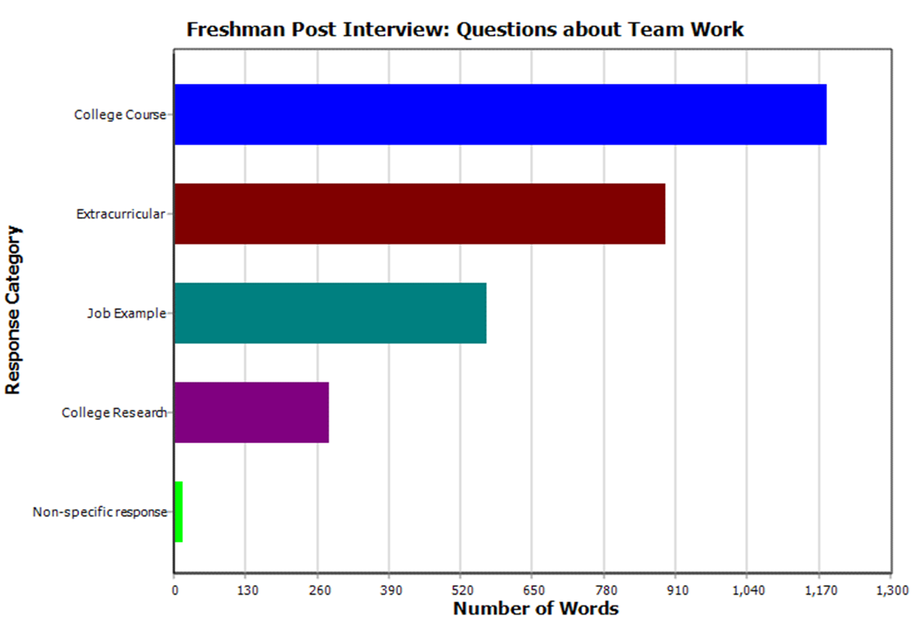
First year students quickly incorporated examples from college courses and college research into their interview responses. There were still many examples from extramural activities, particularly relating to questions about working on teams. Extramural examples declined dramatically in the senior responses. Student mock interviews using Big Interview were transcribed and coded using QDA Miner.

Slide 21
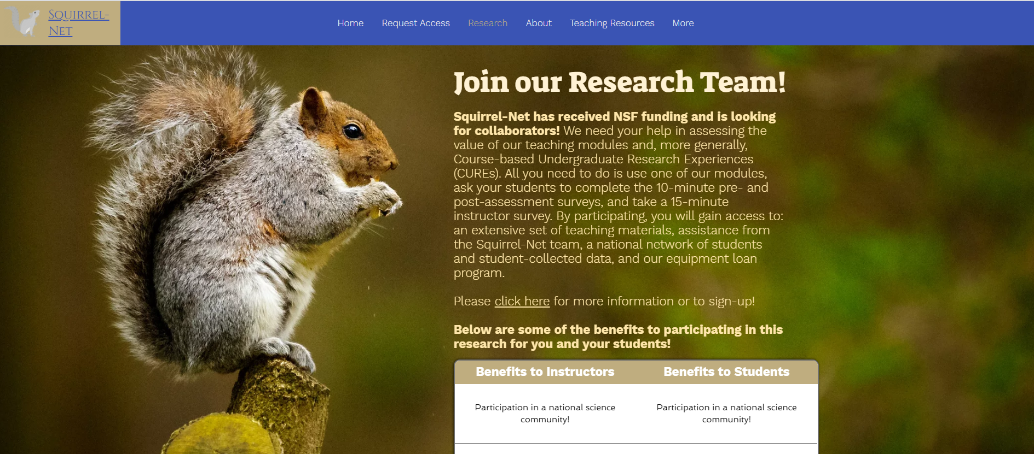
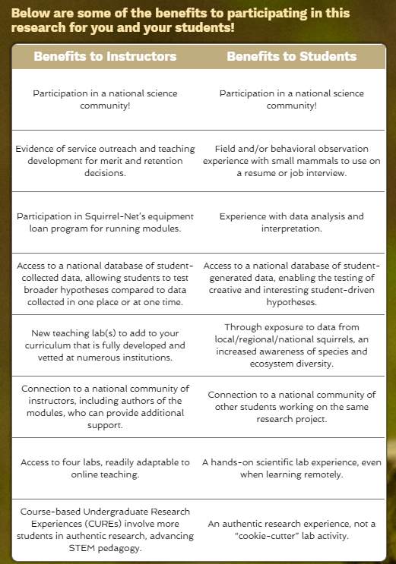
How do we recruit instructors?
Society list-servs (Mammal-L, Ecolog, SABER)
Professional meetings (ASM, SICB, TWS, ESA)
Website and CourseSource Publications
Word of Mouth

