Slide 1
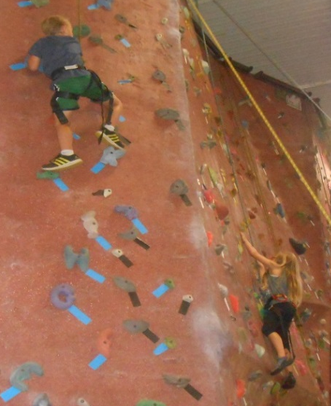
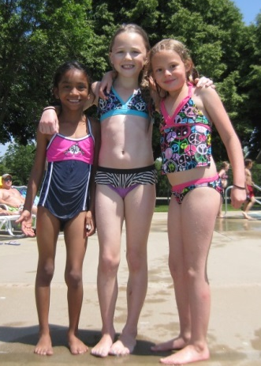
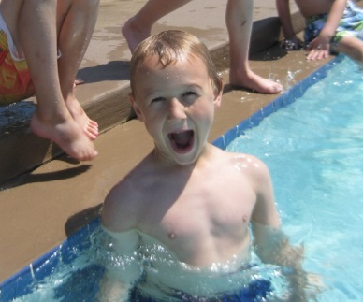
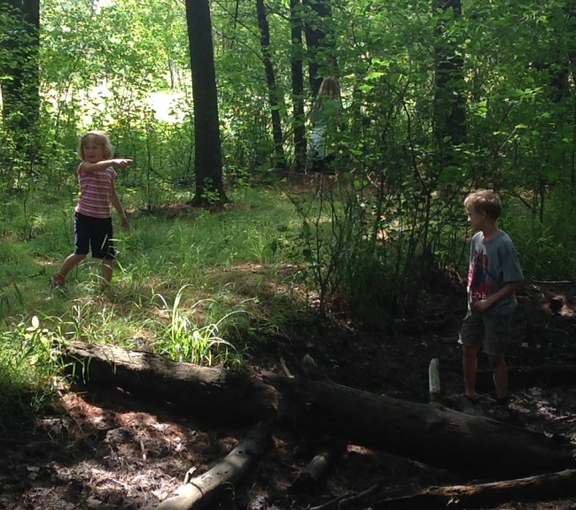
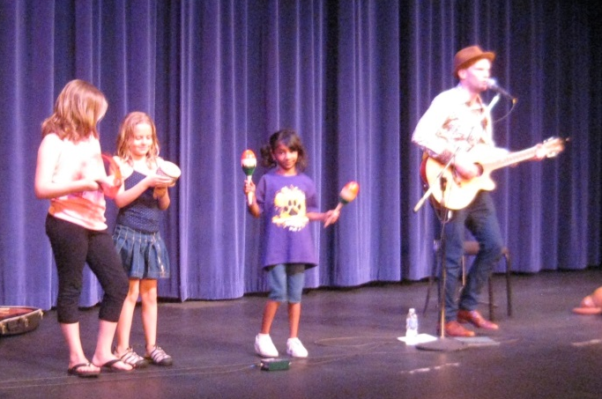
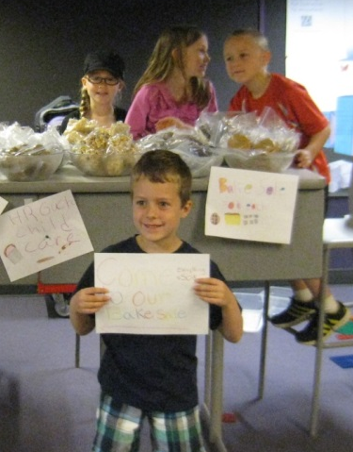
Summer Program
UWSP Child Learning Center (UCLCC)
June – August/September
Ages 5-12
Rock Climbing
Spring has finally sprung and your friends at the UCLCC are gearing up for a fantastic summer! The UCLCC is excited to offer another summer filled with adventures, learning, and friendships!
True to fashion our summer program is going to be the best Stevens Point has to offer. Our Summer adventures will include swimming and plenty of time spent outdoors, as well as creative and stimulating indoor activities and projects.
Swimming
Public Library Programs
KASH
Park
Cray-fishing
Sentry Theater
Gardening
Arts & Crafts
Schmeeckle Reserve
Tour local businesses
Cooking & Bake Sale
Movie Theater

Slide 2
Register Now!!!
Contact Information
Becky Helf, Director
bhelf@uwsp.edu
715-346-4370
Call today to set up a center tour!!
Center Location
910 Fremont St
Lower Level Delzell Hall
Hours of Operation
7:30am – 5:30pm
Who can register their child?
Anyone ☺
www.uwsp.edu/childcare

