Slide 1
Kenya video!
Link to photos

Slide 2
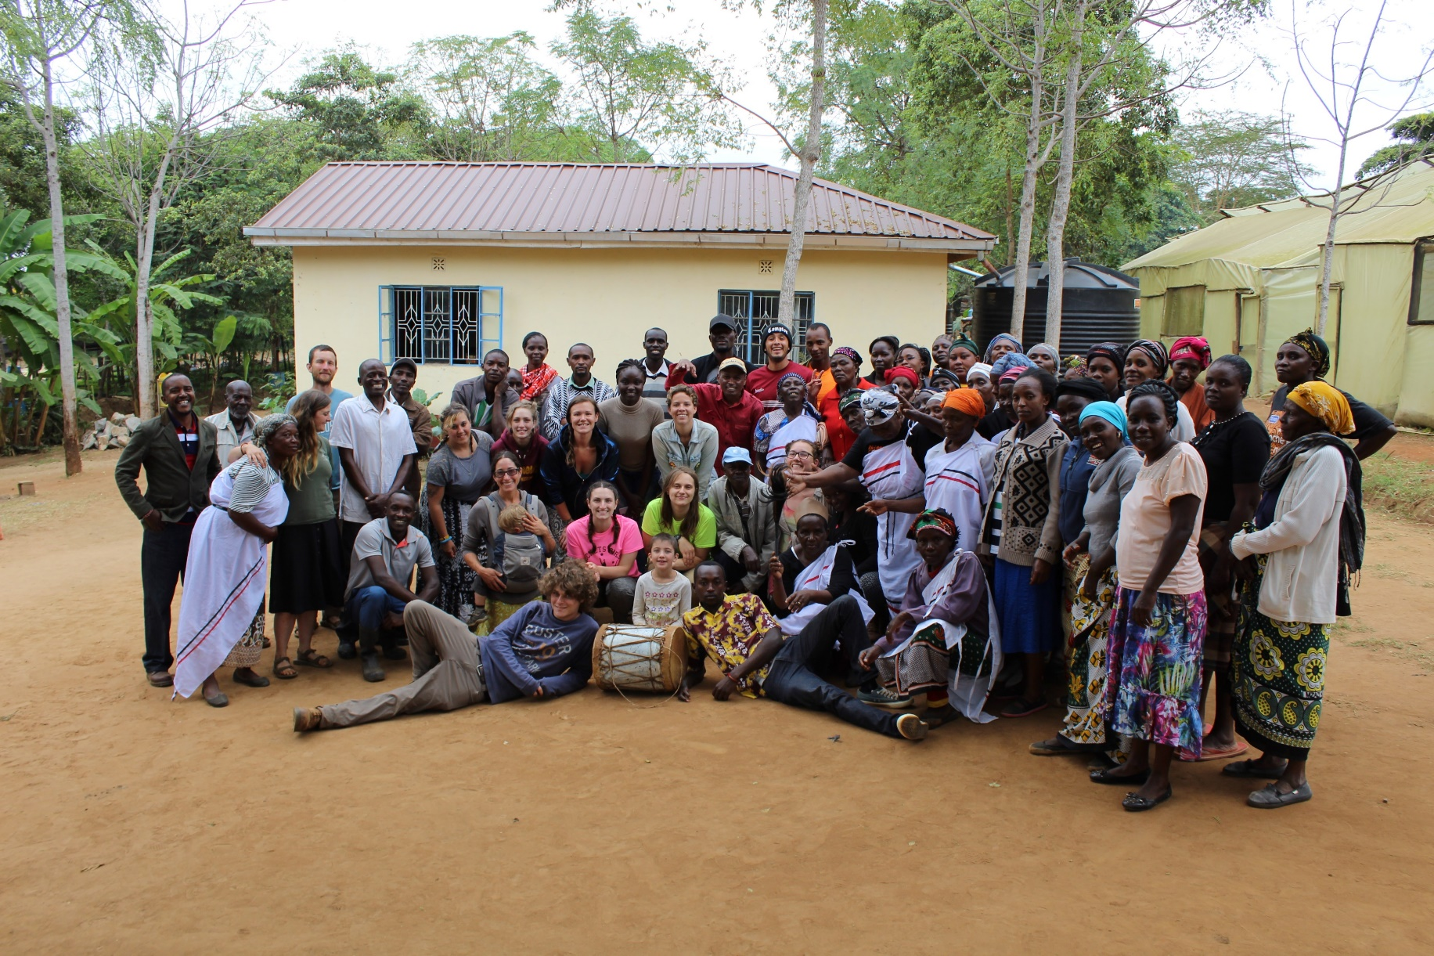
Permaculture training &
Sustainability in Kenya
Notes:
Every summer my husband and I teach a permaculture course in Kenya, since 2010. we take students from UWSP, 15-20, and then also have 15-20 Kenyan students as part of the course. the main goal of the course is to teach participants, and community members in the areas where we take the course, permaculture techniques so they can practice them and teach others.

Slide 3
Kenya course logistics
3 weeks (approx. dates June 4-24, 2023)
3 credits in summer
1-credit Kenya seminar (NRES 479) in spring
2-credit CWES (CNR SFE students only)

Slide 4
Application info
Apply NOW for passport!
Apply to Office of International Education (OIE) by Dec 1 for priority
CNR SFE students only: pre-application (link in CNR Reporter or ask me) by Oct 31 at 11:59pm

Slide 5


Who is part of this course?
UWSP students- all majors welcome!
Students from Kenya, other countries
Many Kenyan community members & instructors!

Slide 6

Where do we go?

Slide 7


Slide 8
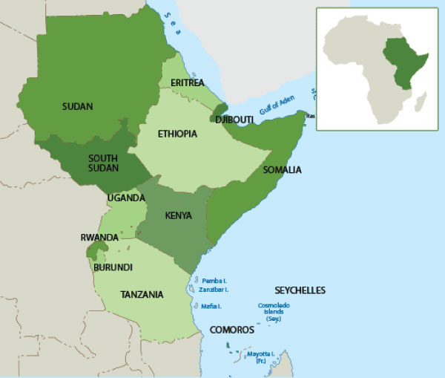

Slide 9
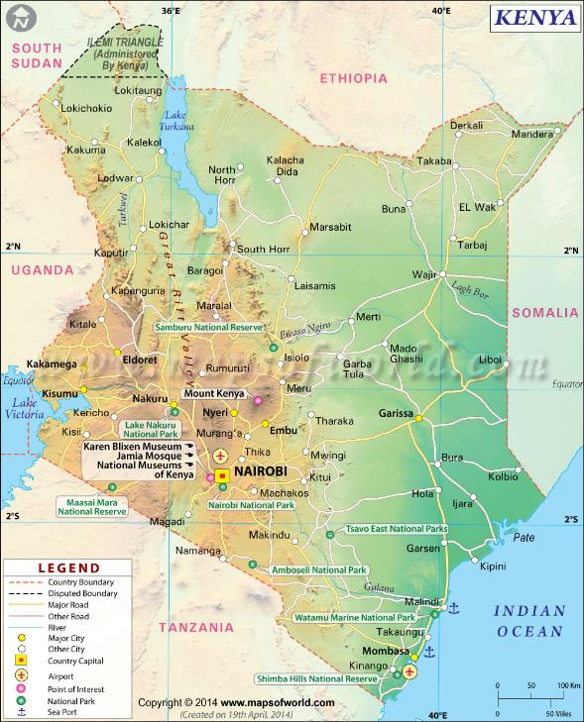

Slide 10
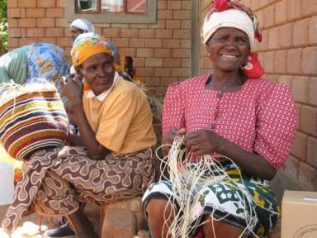
Kenyan languages & cultures

Slide 11
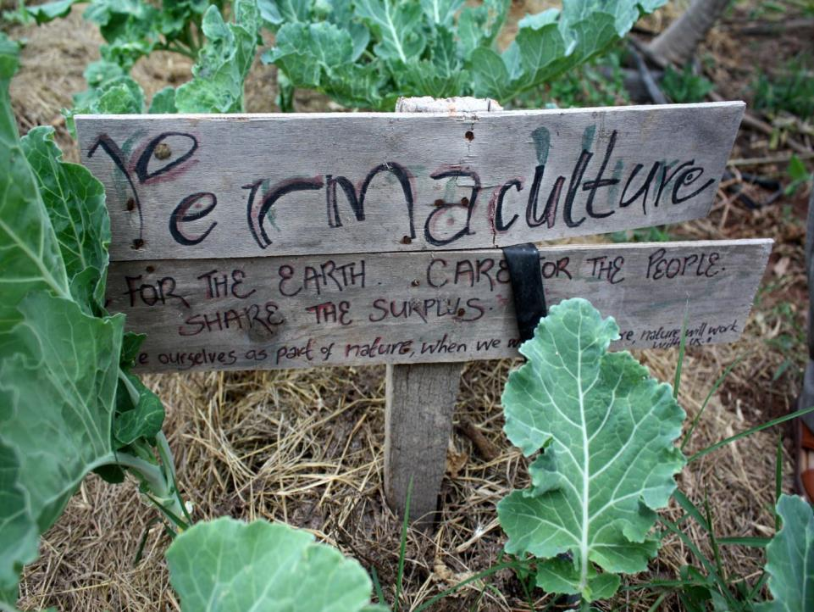
What do we do?
Notes:
Permaculture is a set of ethics and principles related to designing sustainable living systems. It can apply to everyone, everywhere. 3 ethics: earth care, people care, and fair share.

Slide 12
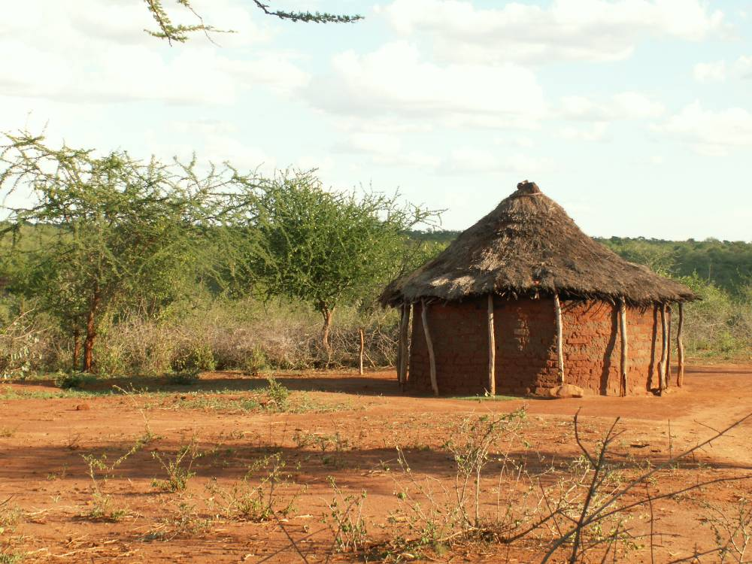
Permaculture strives to sustainably
integrate:
Shelter
Water
Food
Energy
Waste
Community
Notes:
Shelter- appropriate and centered, for people and animals
Water- no waste, storage, use when available, recycling
Food- nutrition, local varieties adapted to climate
Energy- locally available material, renewable
12

Slide 13
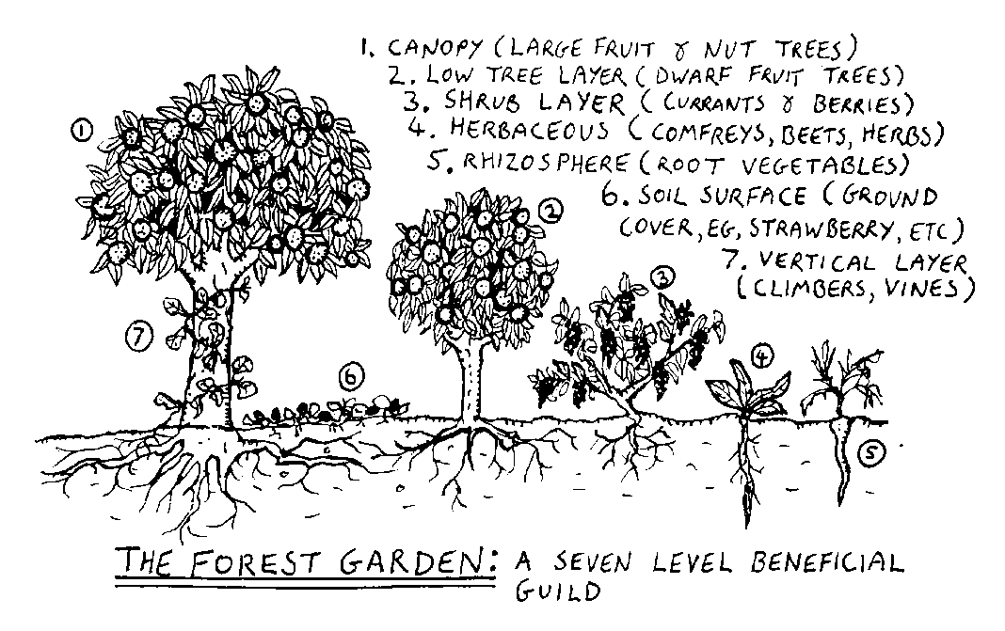

Slide 14
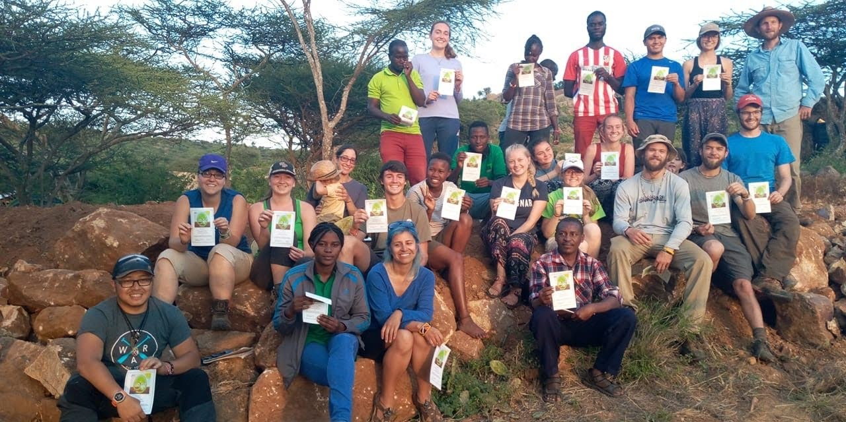

Slide 15
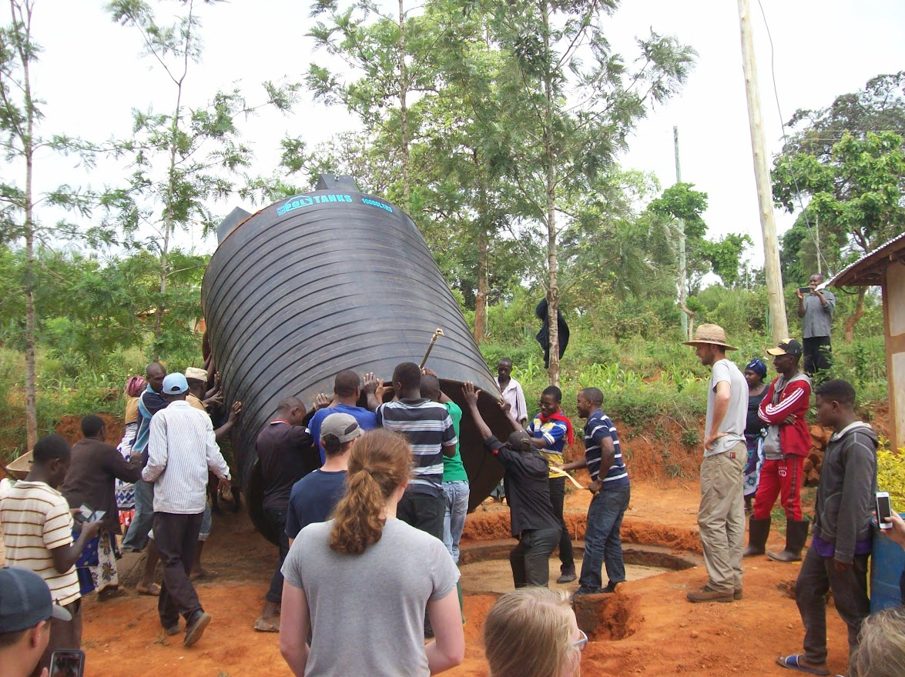

Slide 16
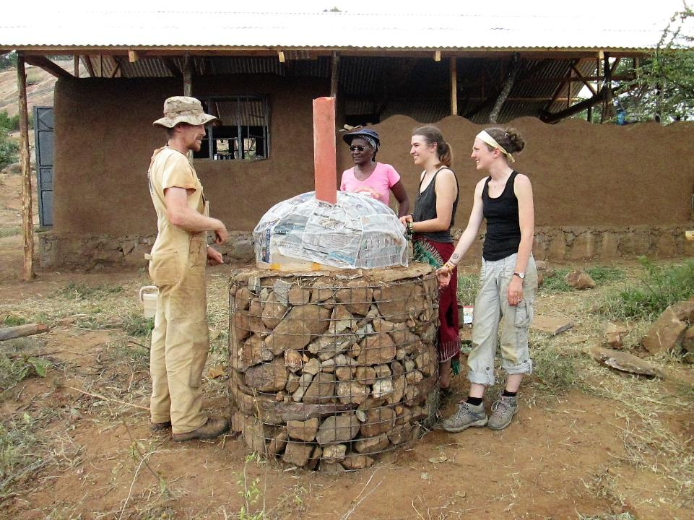

Slide 17
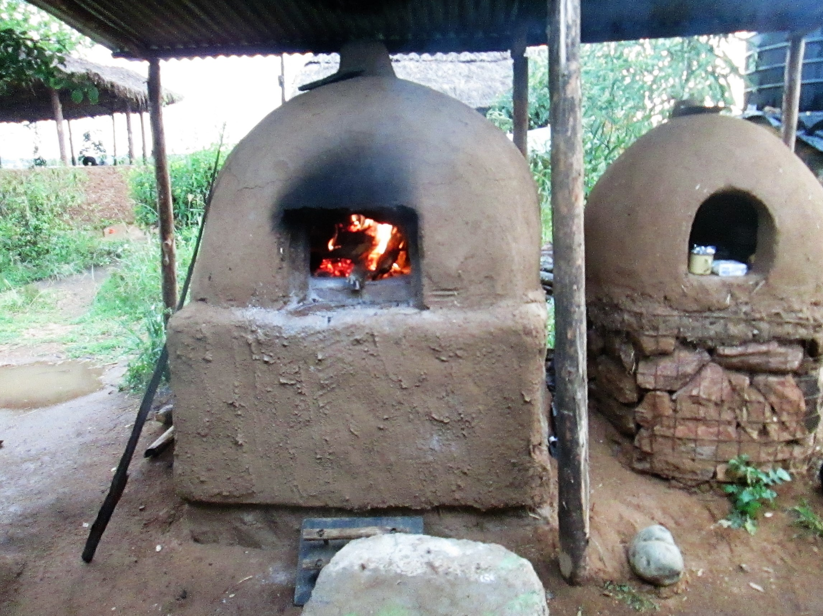

Slide 18
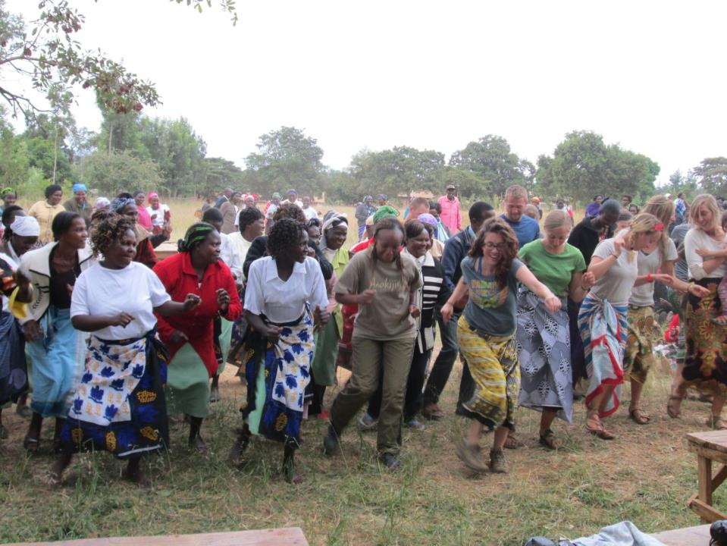

Slide 19
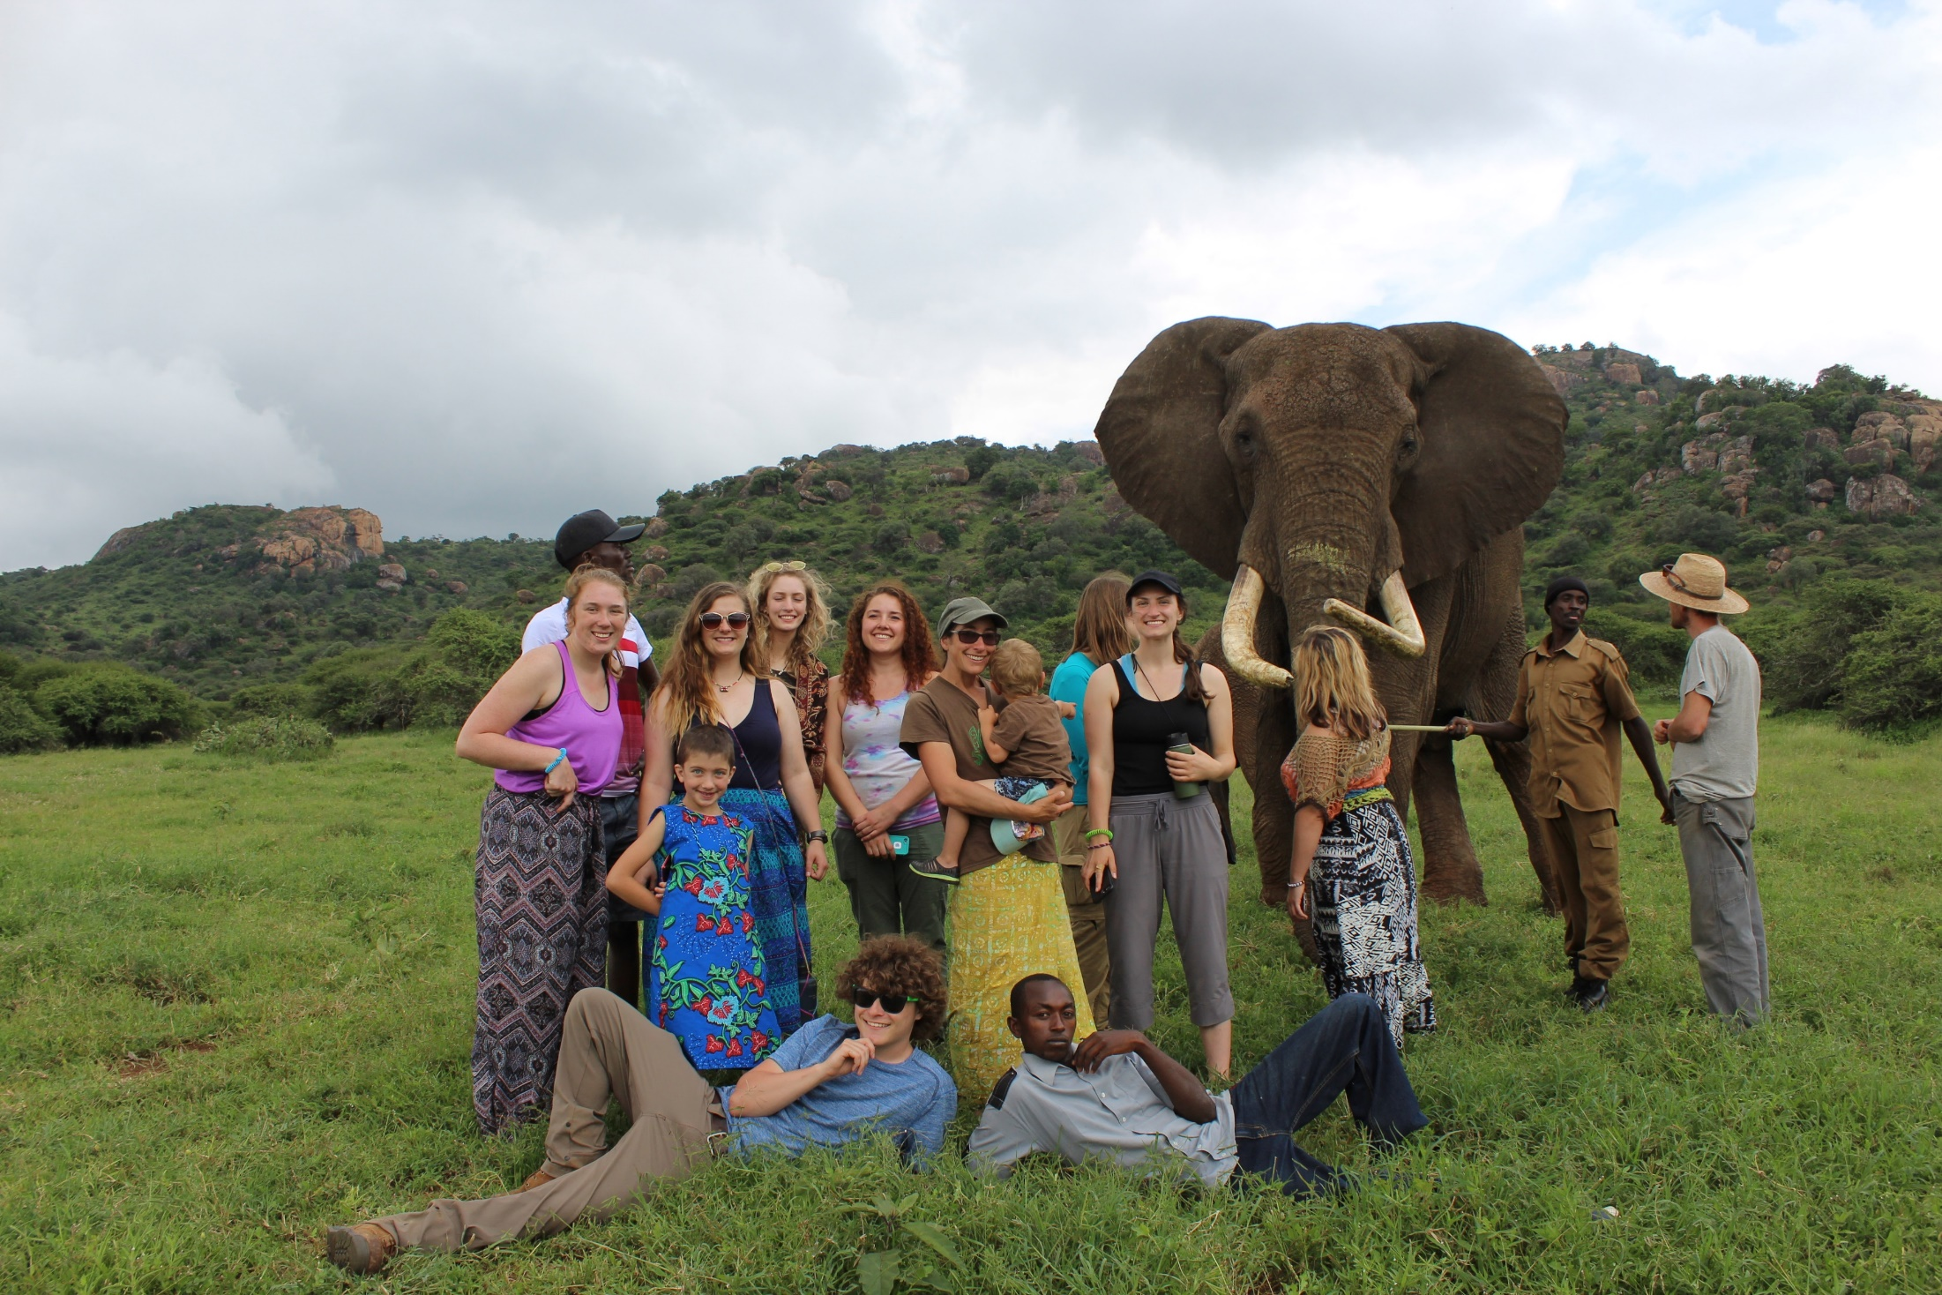

Slide 20
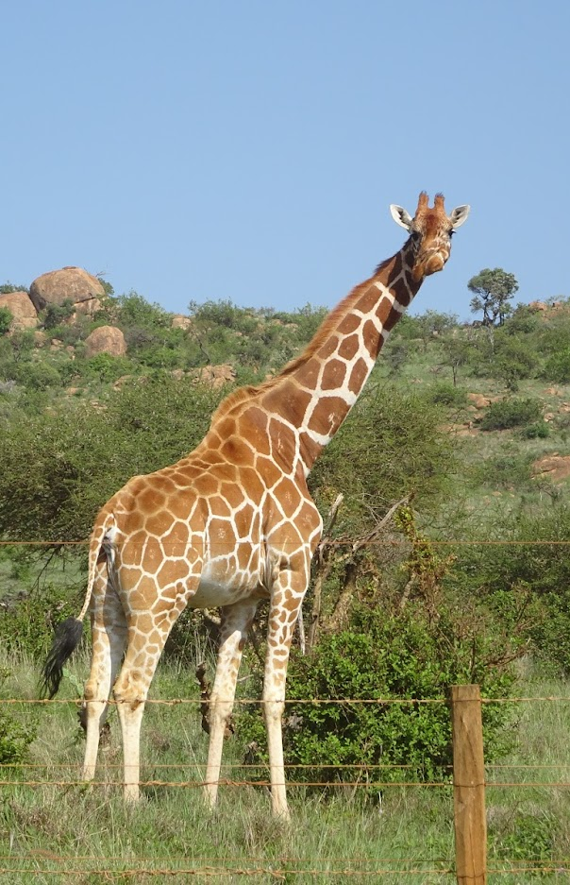


Slide 21
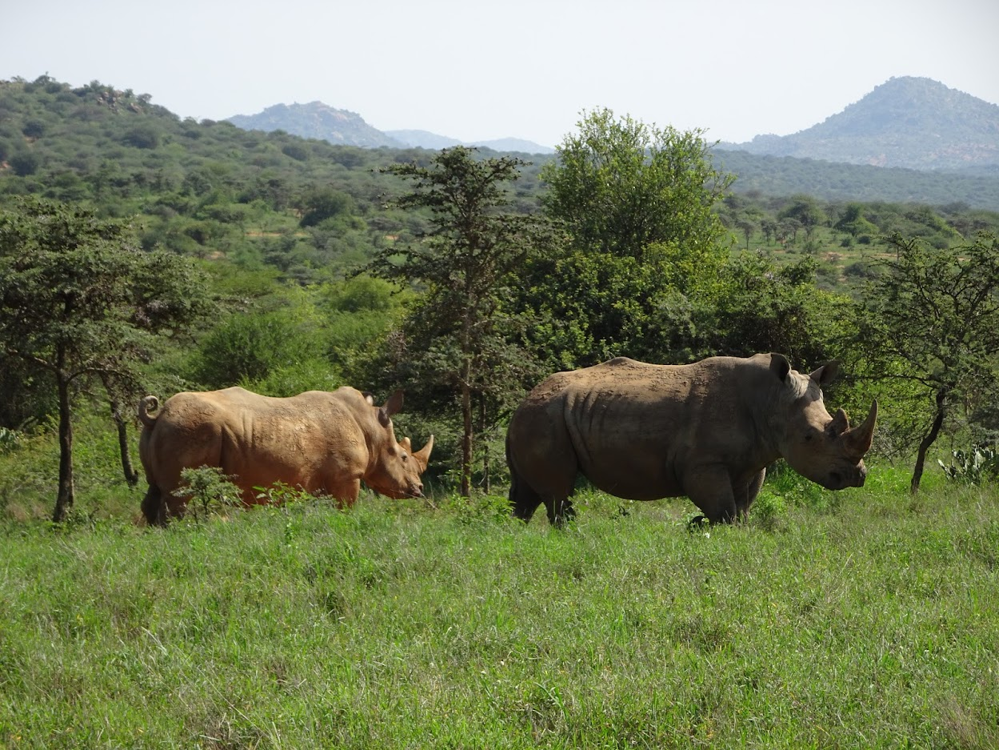

Slide 22
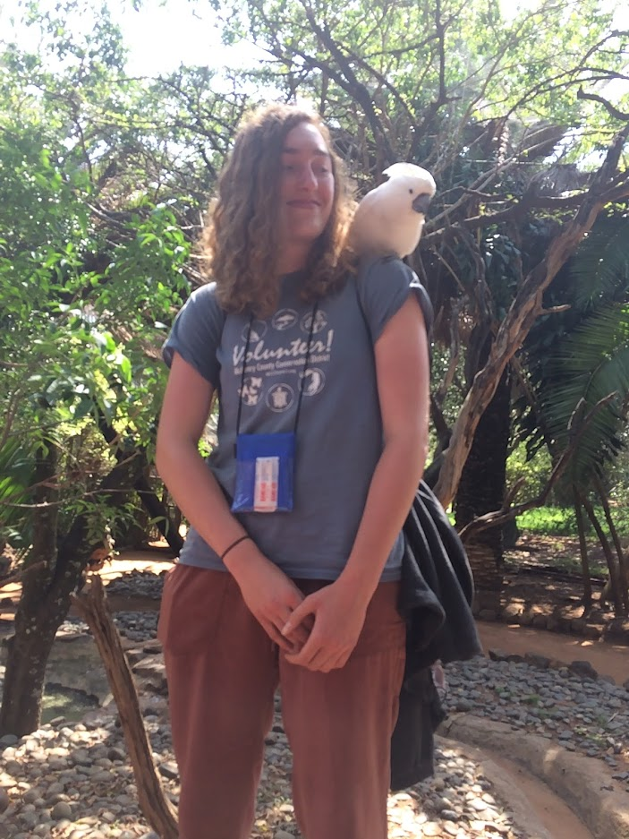

Slide 23
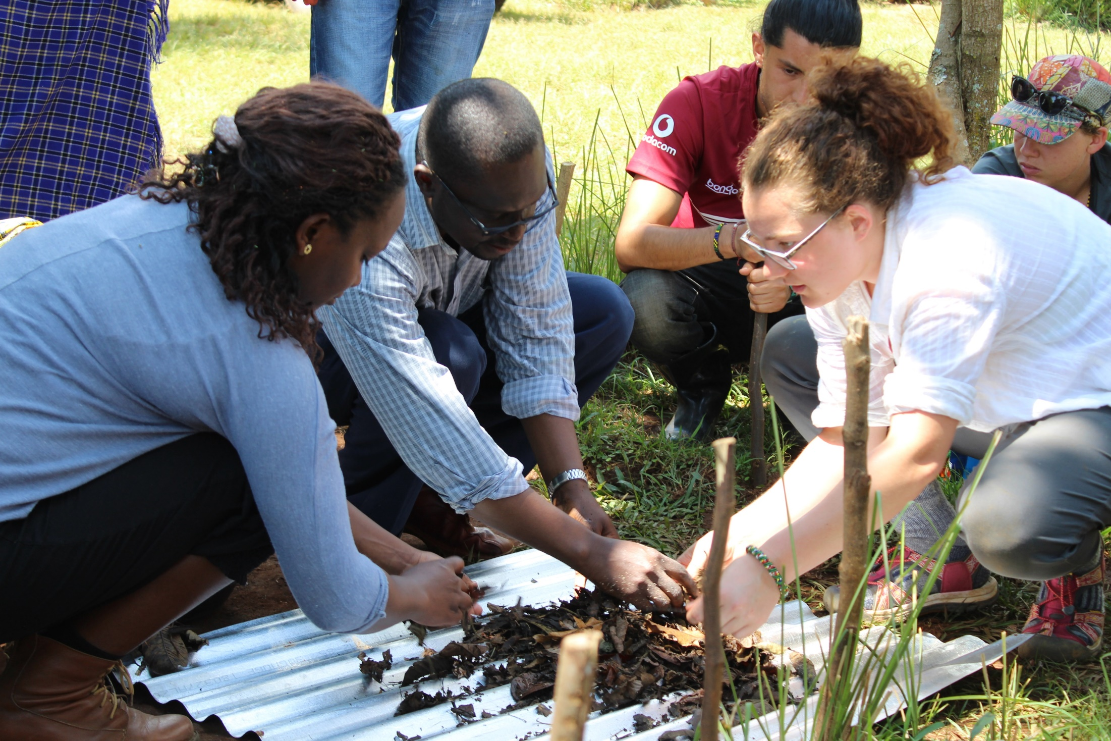

Slide 24
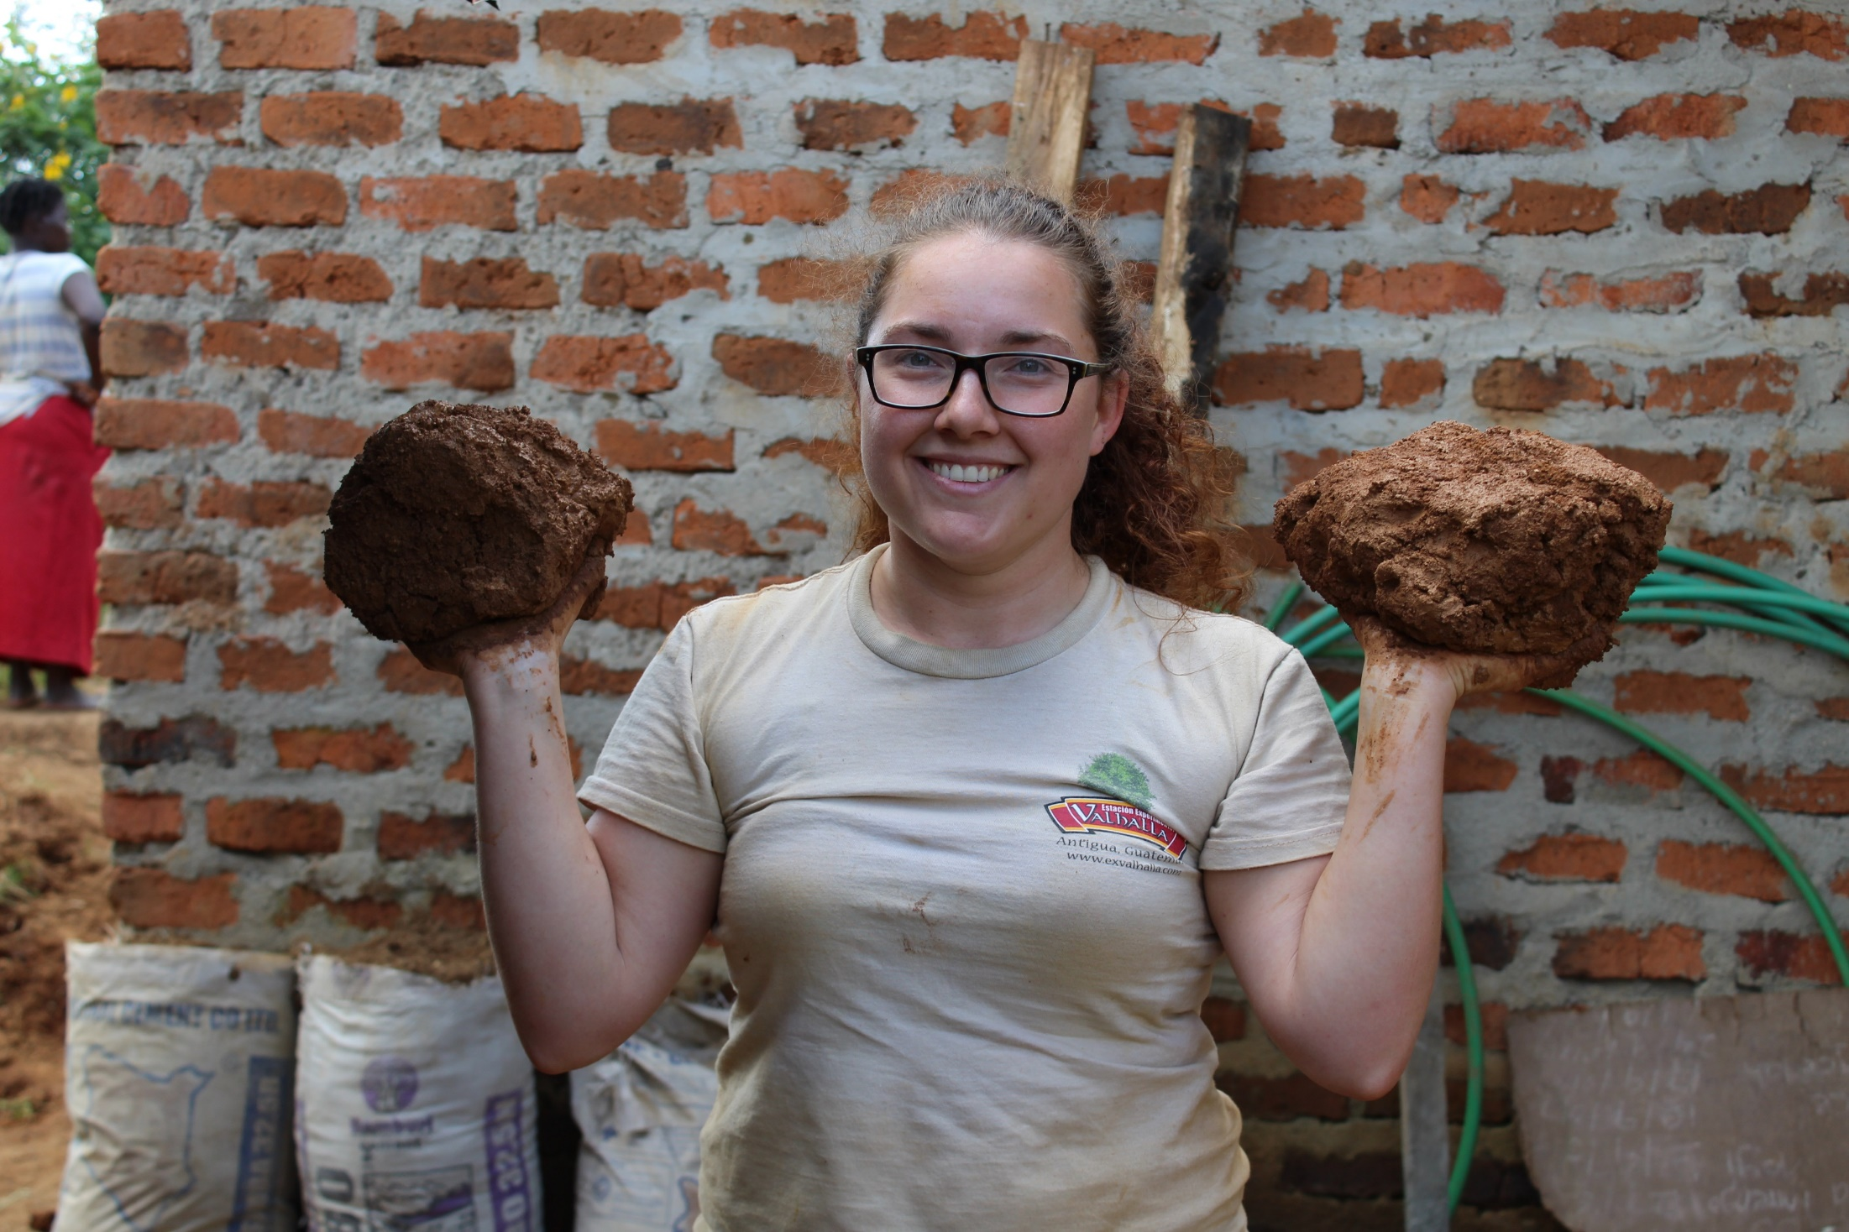

Slide 25
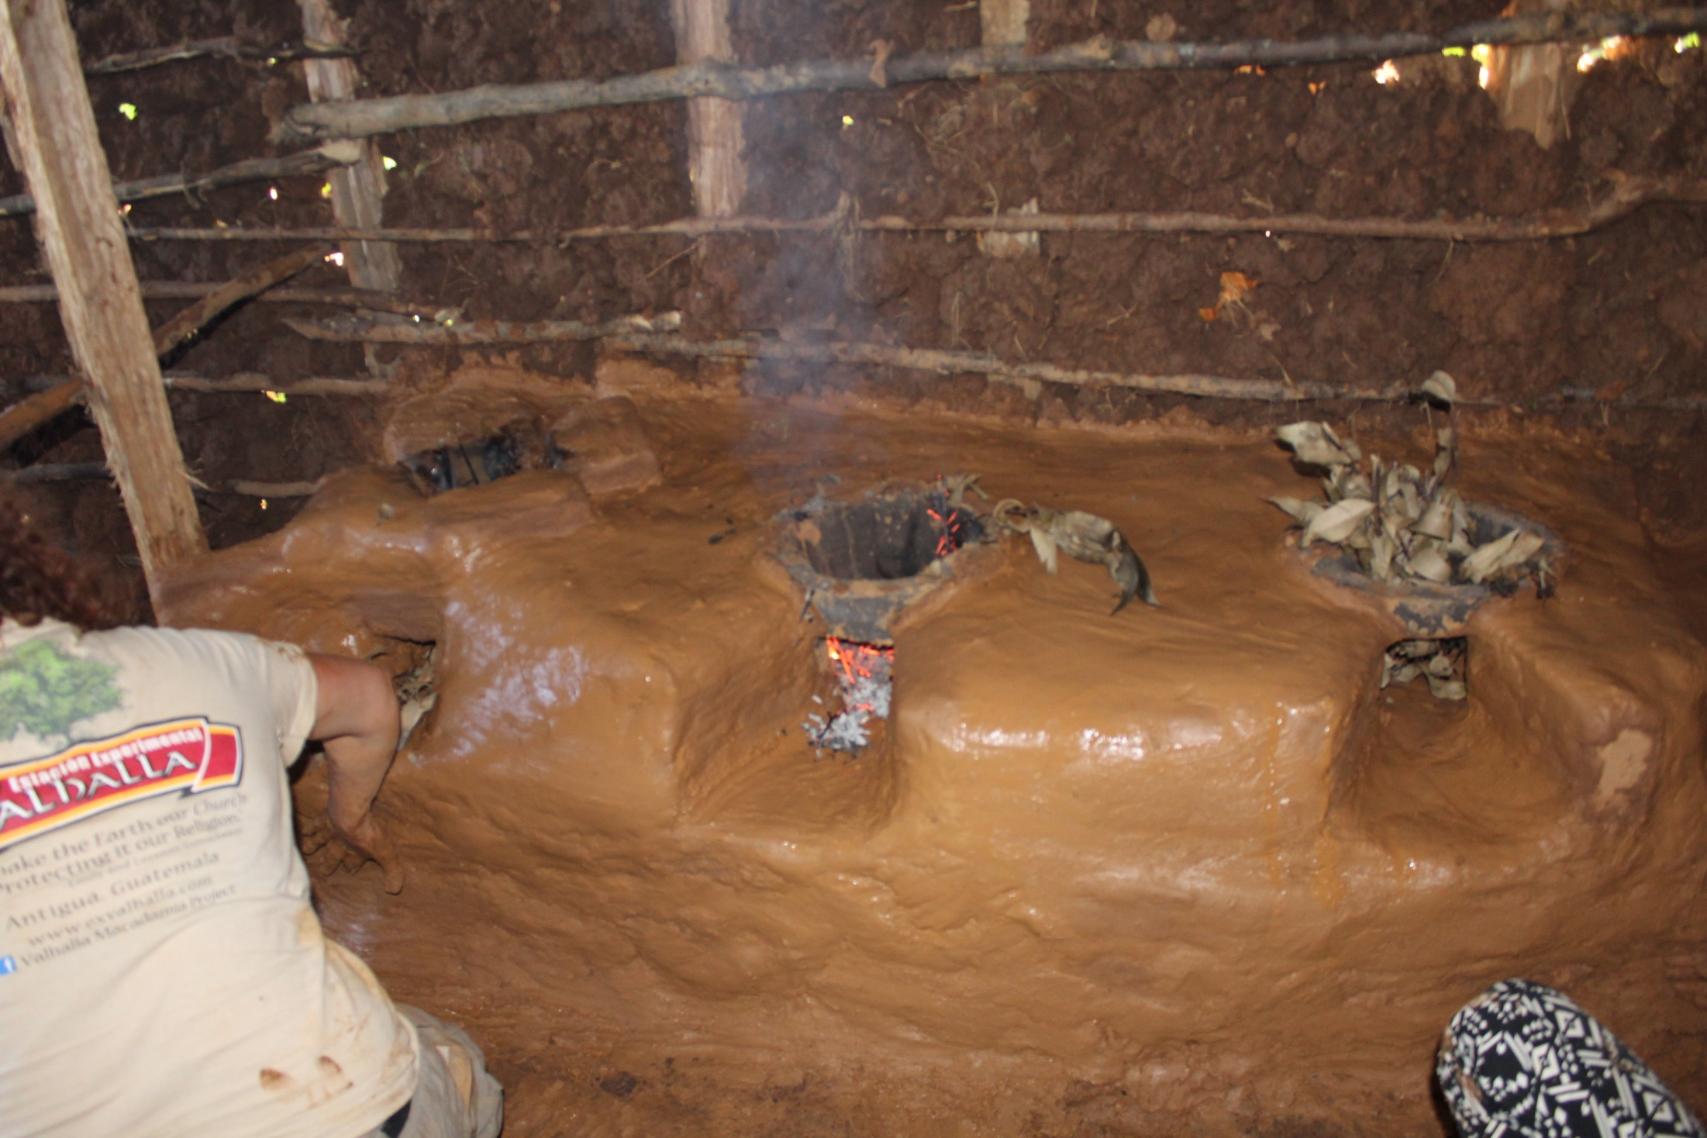

Slide 26
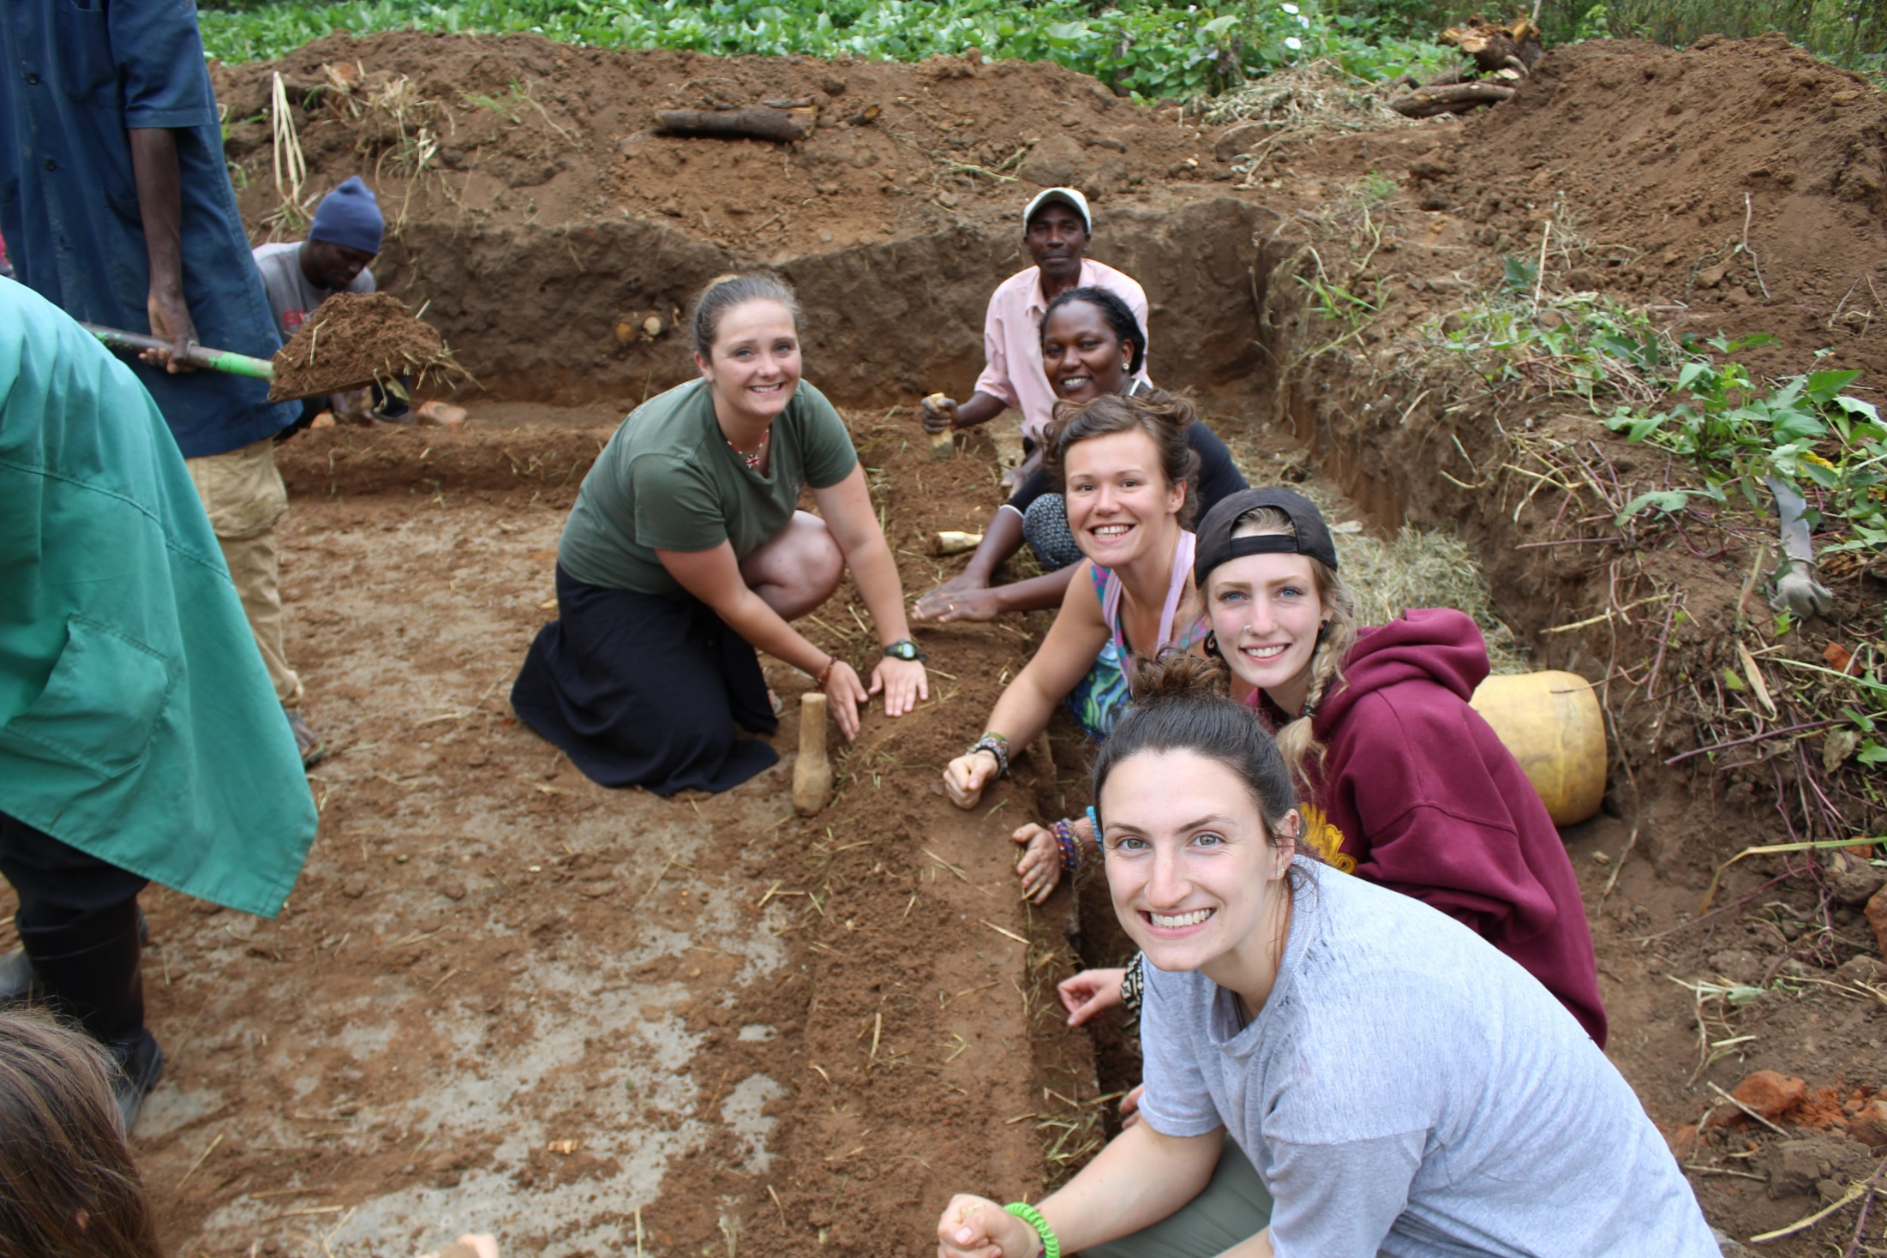

Slide 27
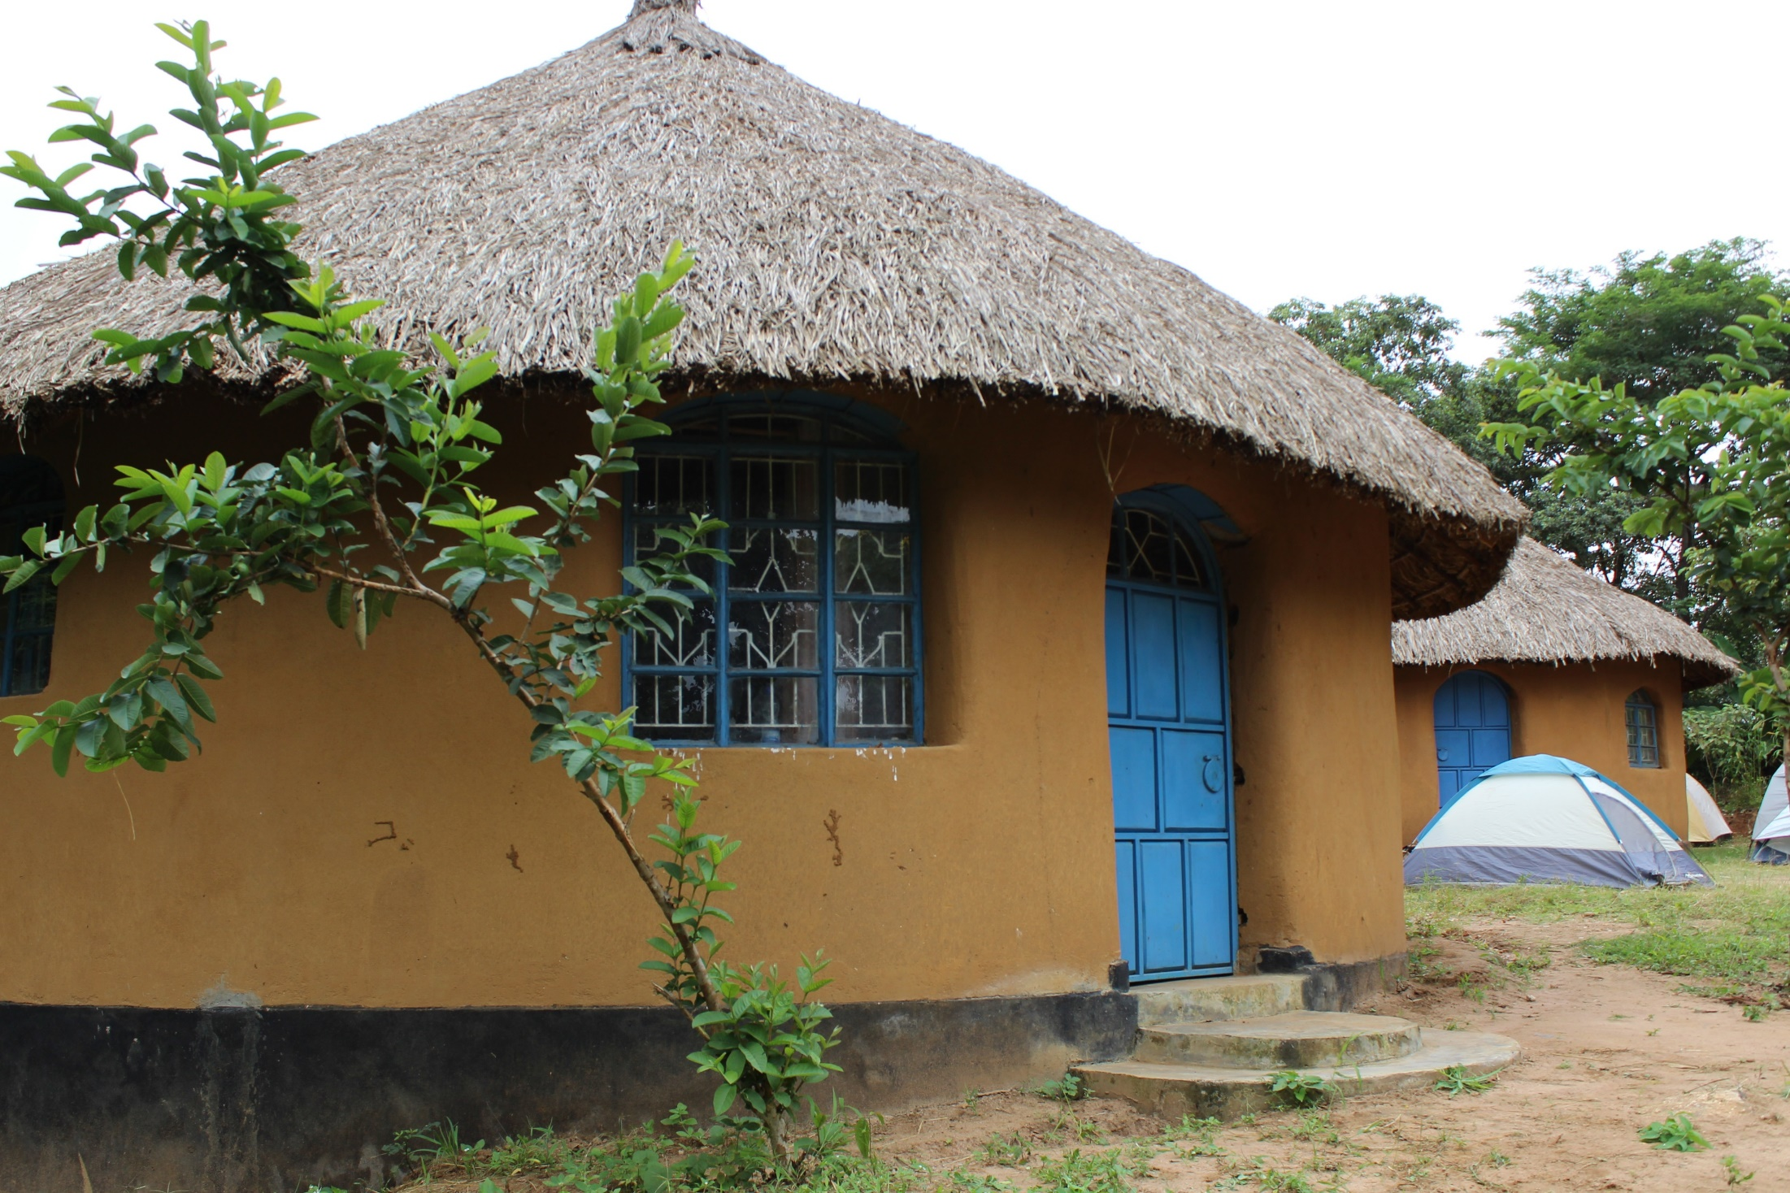

Slide 28
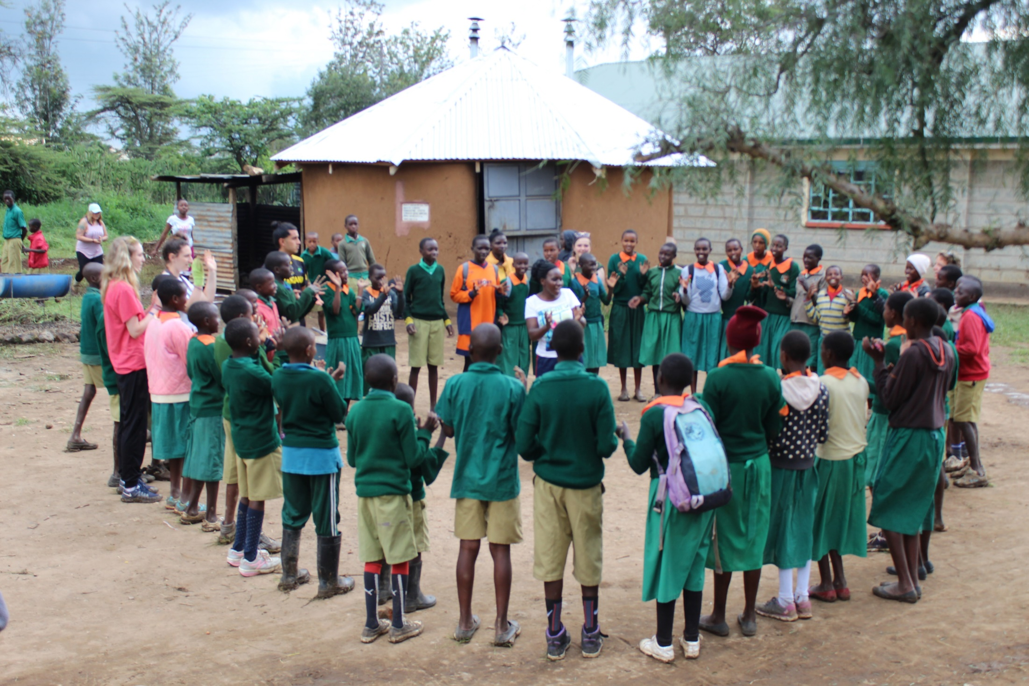

Slide 29
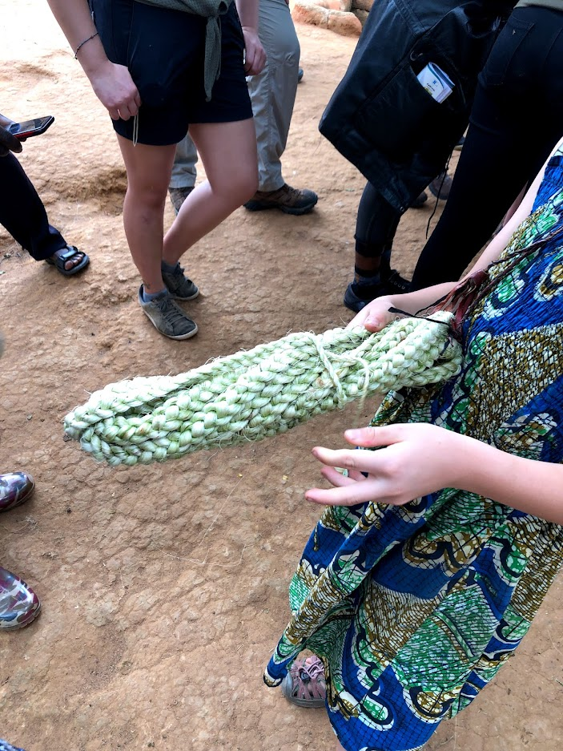
Jess sisal

Slide 30


Slide 31
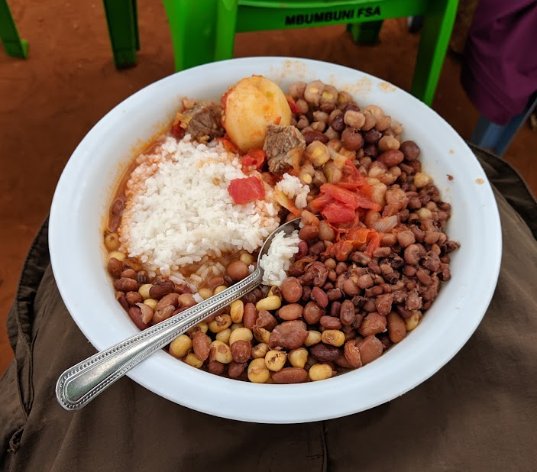
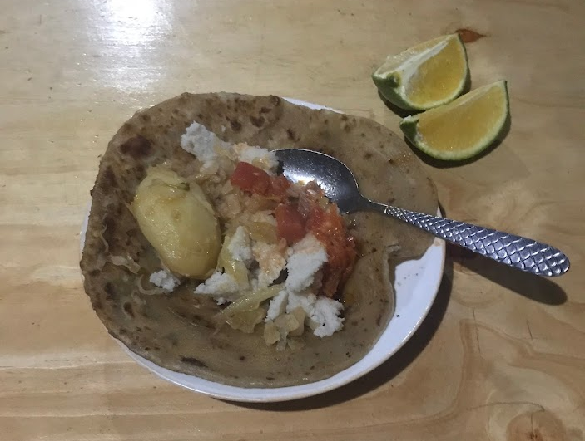
What do we eat?

Slide 32
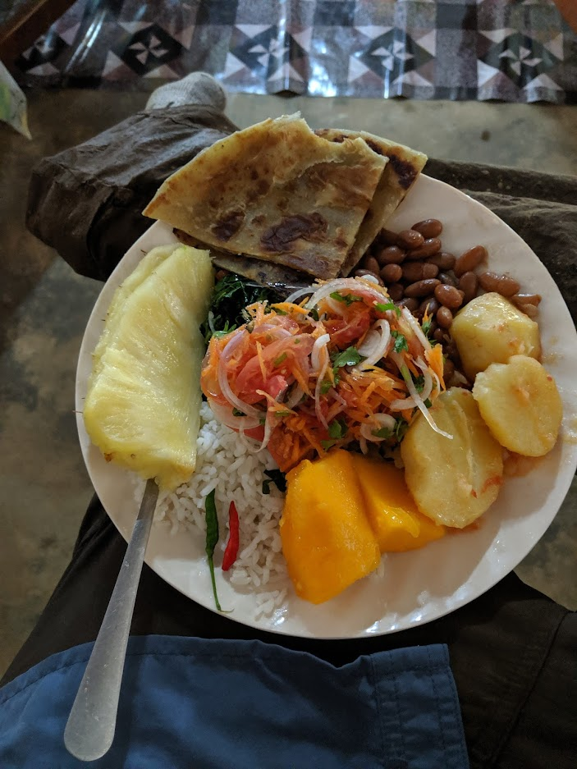

Slide 33
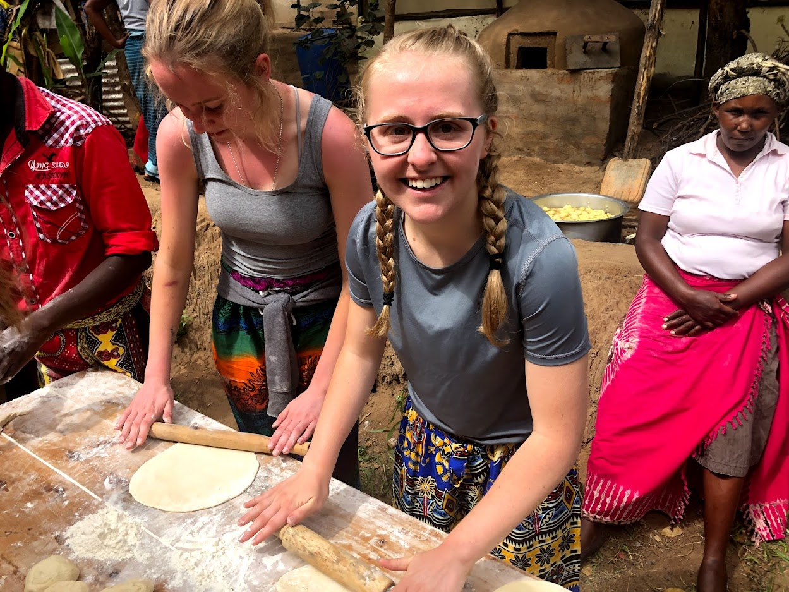

Slide 34
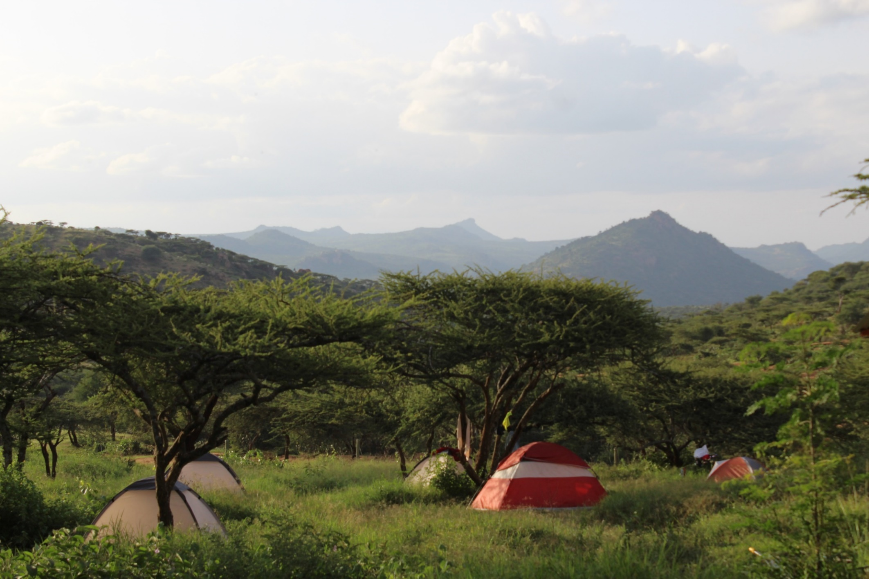
Where do we sleep?

Slide 35
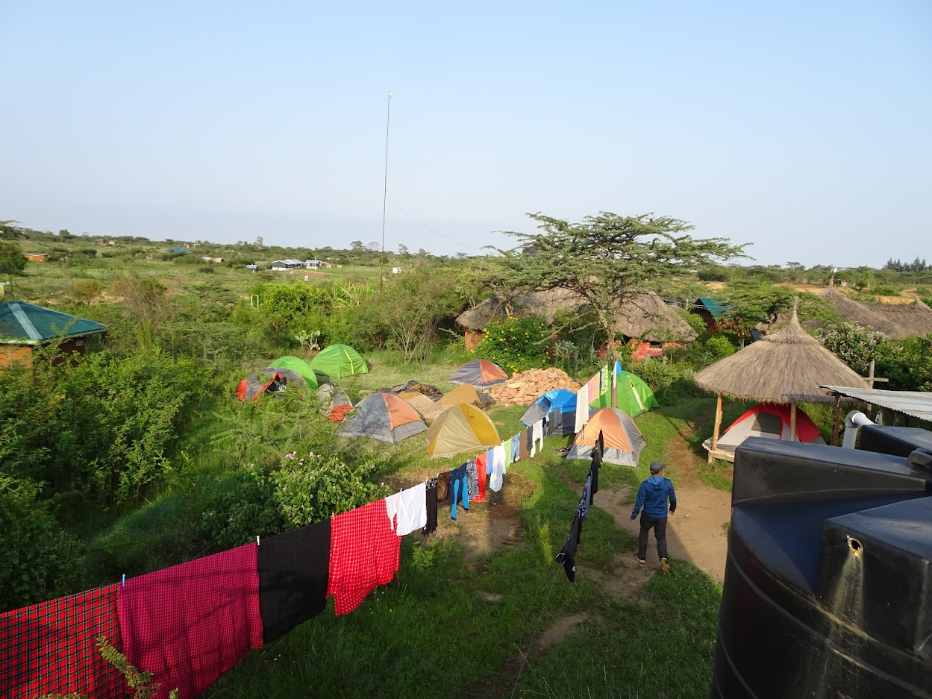

Slide 36
Thank you!
Asante sana!

